Slide 1
NodeRank
Yinghua LI

Slide 2
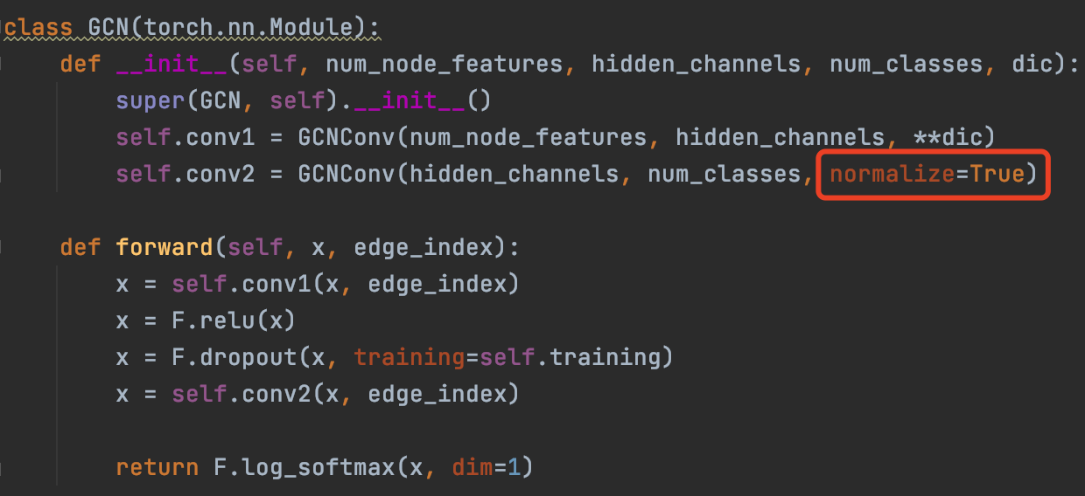
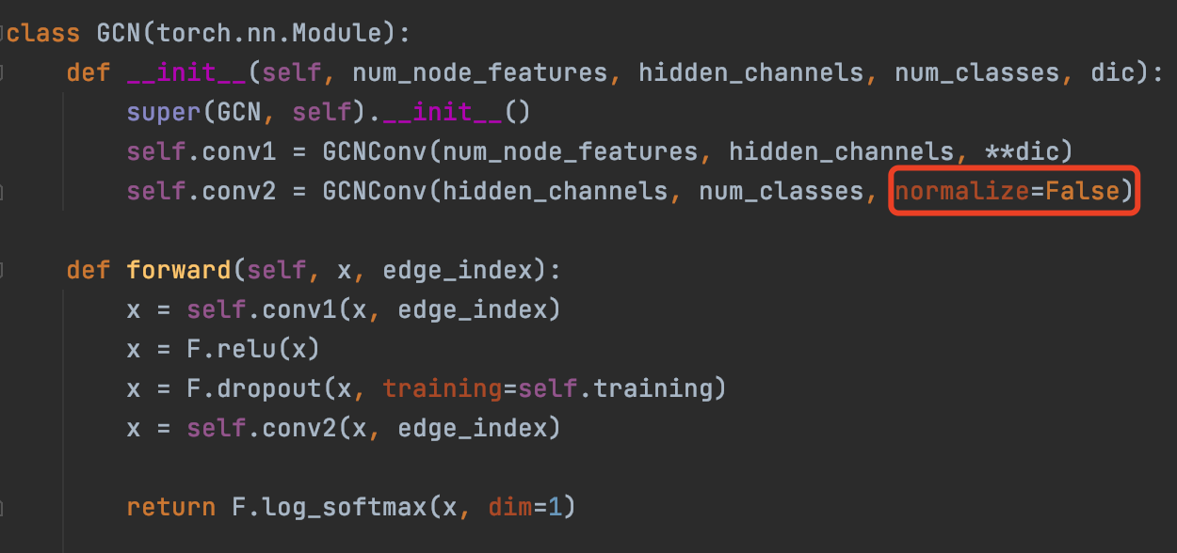
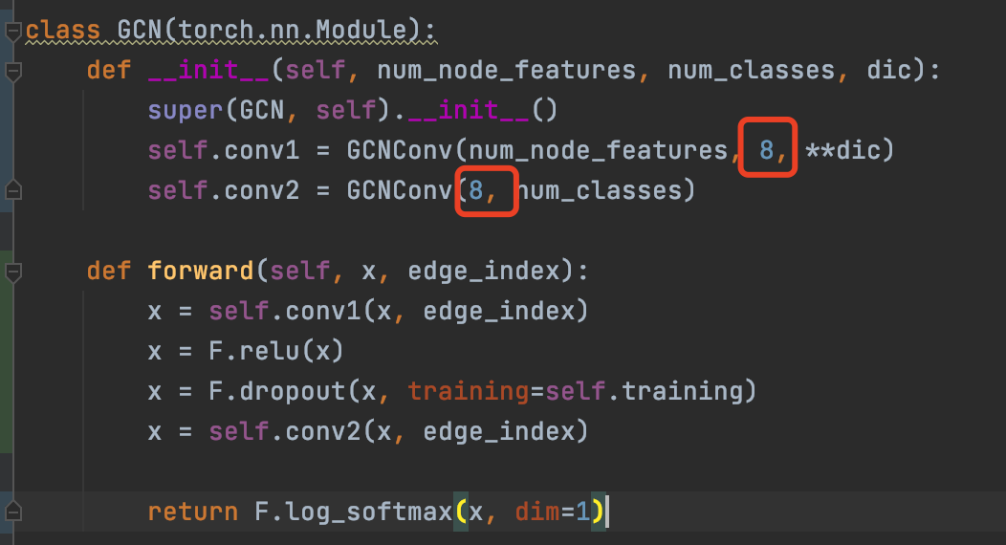
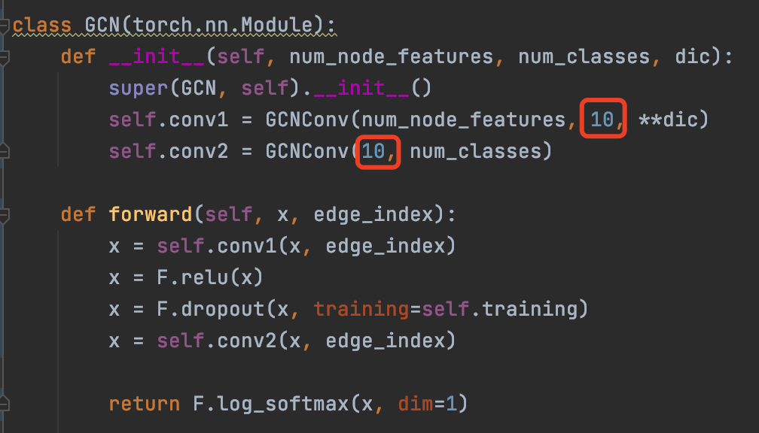
Mutation model
Original model code
mutation model code

Slide 3
class GCN(torch.nn.Module): def __init__(self, num_node_features, hidden_channels, num_classes): super().__init__() self.conv1 = GCNConv(num_node_features, hidden_channels) self.conv2 = GCNConv(hidden_channels, num_classes, normalize=True)
…
class GCN(torch.nn.Module): def __init__(self, num_node_features, hidden_channels, num_classes): super().__init__() self.conv1 = GCNConv(num_node_features, hidden_channels) self.conv2 = GCNConv(hidden_channels, num_classes, normalize=False)
…

Slide 4
GraphPrior
Original model
Mutation model 1
Mutation model 2
Mutation model 3
node1
woman
woman
woman
woman
node1 score = 0
node2
woman
man
woman
man
node2 score = 2
node3
woman
man
woman
woman
node3 score = 1
Original ranking
node1
node2
node3
New ranking
node2
node3
node1
The higher the score, the easier the node is to predict wrong.

Slide 5
GraphPrior
Original model
Mutation model 1
Mutation model 2
Mutation model 3
node1
0
0
0
0
node2
0
1
0
1
node3
0
1
0
0
Node1 vector = [0, 0, 0]
Node2 vector = [1, 0, 1]
Node3 vector = [1, 0, 0]
Node1 = 0.1
Node2 = 0.7
Node3 = 0.3
->
LR/RF/LGBM/DNN
->
Original ranking
node1
node2
node3
New ranking
node2
node3
node1
The higher the value, the easier the node is to predict wrong.

Slide 6







Original GNN model
D
A
C
D
A
B
C
Prioritized
graph test set
Graph test set
to be labeled
B
Feature
extraction
Features
Ranking models
labeling
Mutant GNN models
Original GNN model
Mutation rules
Developers

Slide 7




Training Graph data
with label
Graph structure
mutation
Feature
extraction
Leaning to rank
Ranking model
Ranking
Mutation structure vector
Training Feature
extraction
Graph data
Node attribute
mutation
Feature
extraction
Test ranking node
Mutation attribute vector
Feature combination
Labeling
Node attribute vector
Test Feature
extraction
Graph model
mutation
Feature
extraction
Test feature combination
Developer
Graph model
Mutation model vector
Test Graph data
to be labeled

