Slide 1
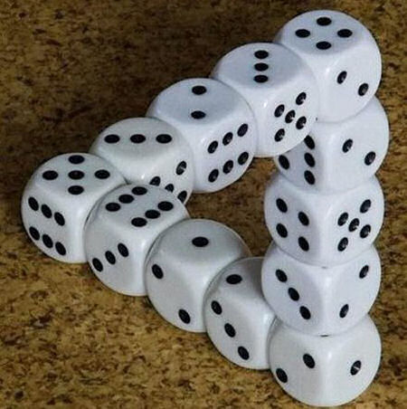
Illustration - Monte Carlo Integration
Wing Kit Leung

Slide 2
Contents
Purpose of Monte Carlo Integration
A Simple Example
Mathematical Expression
Theoretical Error Estimation
A 20-D integration
Conclusions

Slide 3
Purpose of Monte Carlo Integration
The purpose of integration is, for whatever applications, to
find the area under a curve in 2D
find the volume inscribed by a surface in 3D
find the volume in a hyperspace for even higher dimensional problems

Slide 4

Purpose of Monte Carlo Integration
However, analytical solutions are sometimes too complicated/impossible to obtain:
Numerical integration is needed, and one popular choice is Monte Carlo integration, especially when tackling high dimensional problems

Slide 5

A Simple Example
Finding the area of a quadrant with unit radius:
Equation of the quadrant:
Analytical integration:
Suppose we do not know polar coordinates, analytical
integration then become not easy.
Now we will do this integration by Monte Carlo method
step by step.

Slide 6
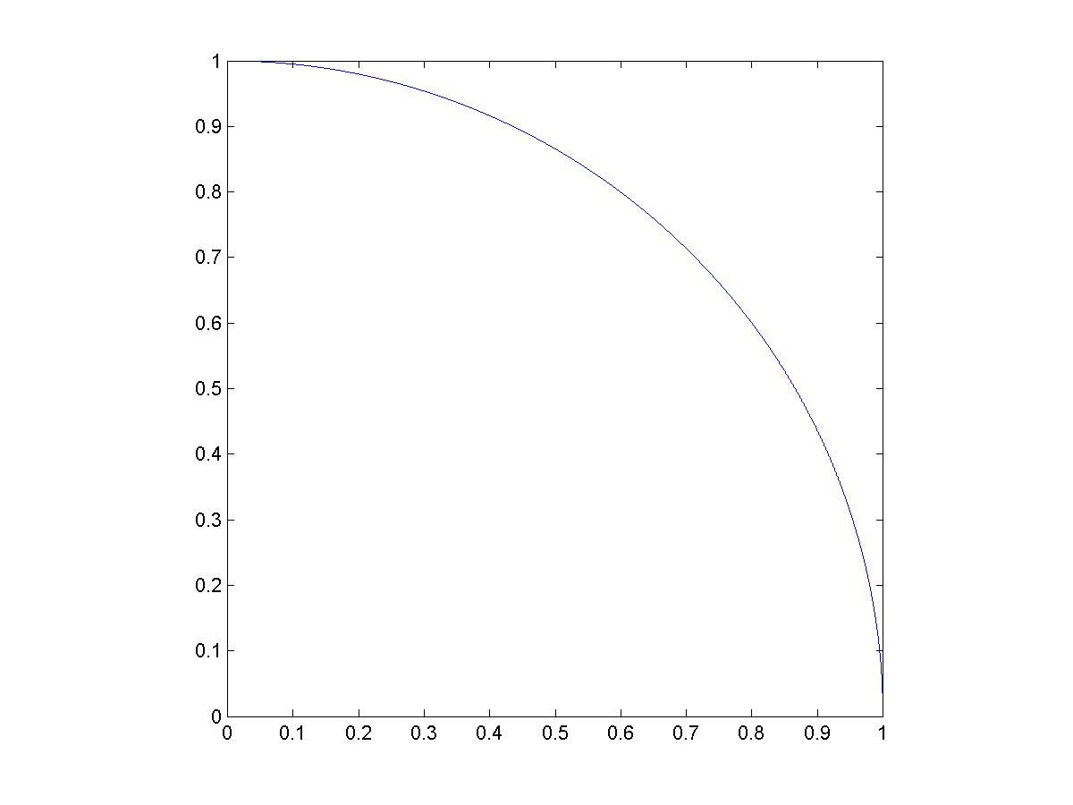
A Simple Example
Step 1 - Make a unit square to inscribe the quadrant:

Slide 7
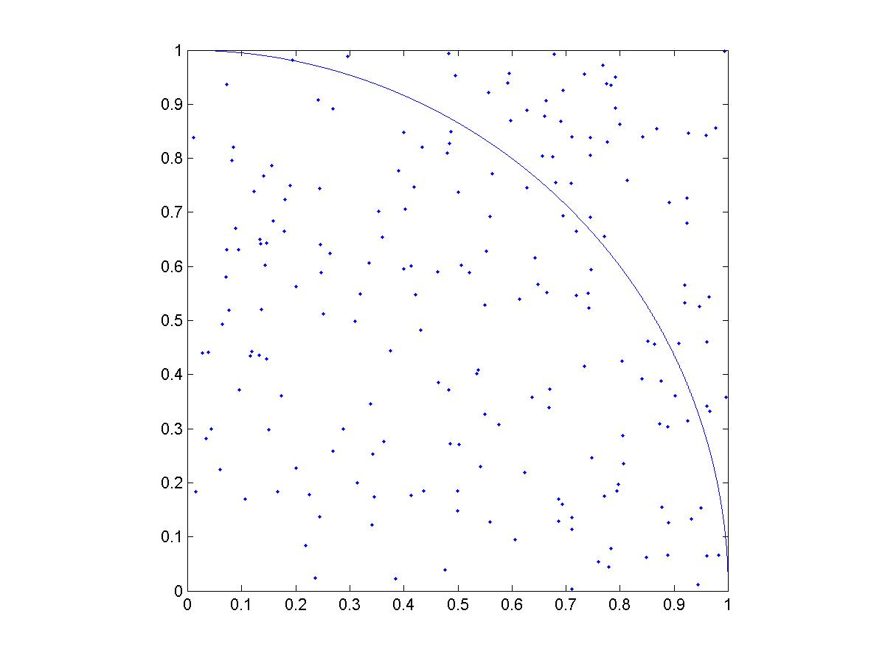
A Simple Example
Step 2 – Uniformly distribute points (200 points in
this case) on the square by plain pseudo random
sampling:

Slide 8
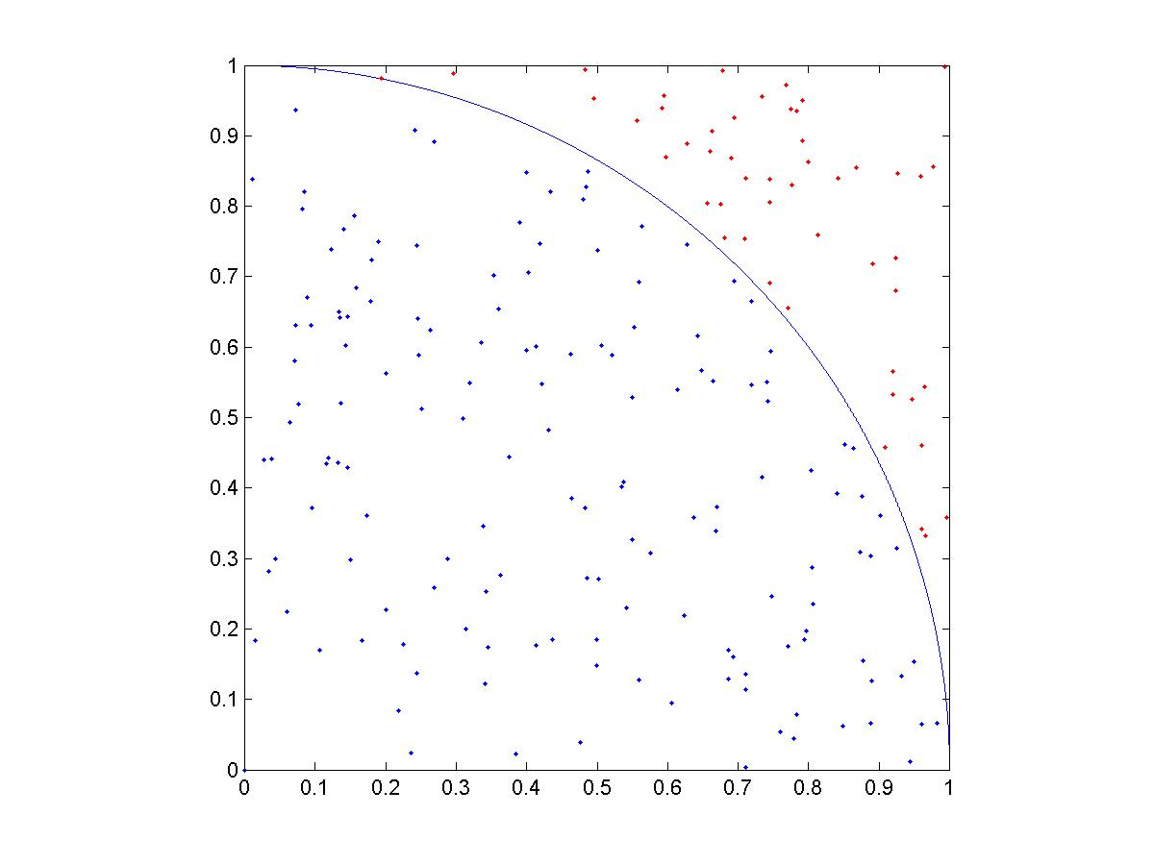
A Simple Example
Step 3 – Distinct the points inside the quadrant
from the others:

Slide 9

A Simple Example
Step 4 – Finally, we can obtain the area of the
quadrant by the no. of points inside the quadrant
and the total no. of points:
In this case, D = 1, N = 200, N_{in} = 155
A = 0.7550 ~ π/4 = 0.7854
The above known as the simplest“hit or miss”
algorithm, which is the basic idea of Monte
Carlo method.

Slide 10
A Simple Example–a more efficient way
Mean value algorithm:
Step 1 - Uniformly distribute points on the domain
of integration by plain pseudo random sampling.
Again, no. of points N = 200 and the domain is
x = 0..1.
Step 2 – Calculate the corresponding y-coordinates
of the points with the function

Slide 11
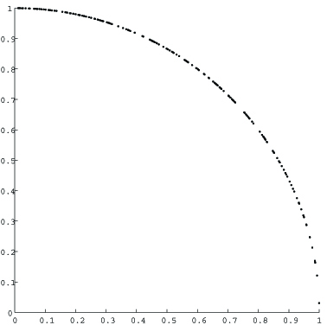
A Simple Example–a more efficient way
Step 3 – Get the average
y value of the points:
<y> = 0.7776
Then multiply <y> by the
domain of integration 0..1.
The area obtained is:
0.7776 X 1 = 0.7776

Slide 12
A Simple Example–a more efficient way
In comparison, the percentage error of the two
approaches with the same sample size are:
2D“hit or miss”:
100%X(0.7750 - 0.7854)/0.7854 = 1.32%
Average value algorithm:
100%X(0.7776 - 0.7854)/0.7854 = 0.993%

Slide 13


Mathematical Expression
The general expression of mean value algorithm
Monte Carlo integration:
First, for 1D cases:
The average value of f(x) =
Thus

Slide 14

Mathematical Expression
In the sense of Monte Carlo integration, if there are
N points x_{1…} x_{n} lying uniformly in the interval [a,b]:
where V is the volume defining the integral limits.

Slide 15


Mathematical Expression
In general, a n dimensional integral can be written as
where p is a n-dimensional point: p = {x_{1…} x_{n}}.
By Monte Carlo integration, if there are N points
distributed in the integral limits defined by
V = x₁x_{2…}x_{n} = (b₁-a₁)(b₂-a₂)…(b_{n}-a_{n}). The integral is

Slide 16



Theoretical Error Estimation
The accuracy of Monte Carlo method depends on
the random sample size N:
variance of the f(x) =
By Central Limit Theorem, the variance & error of the
Integral are
=>

Slide 17
Theoretical Error Estimation
Implications:
The variance is proportional to N⁻¹ & the error is proportional to N^{-1/2}
To decrease the error by a factor of 100, one has to increase the sample size by a factor of 10000. This is a slow convergence

Slide 18
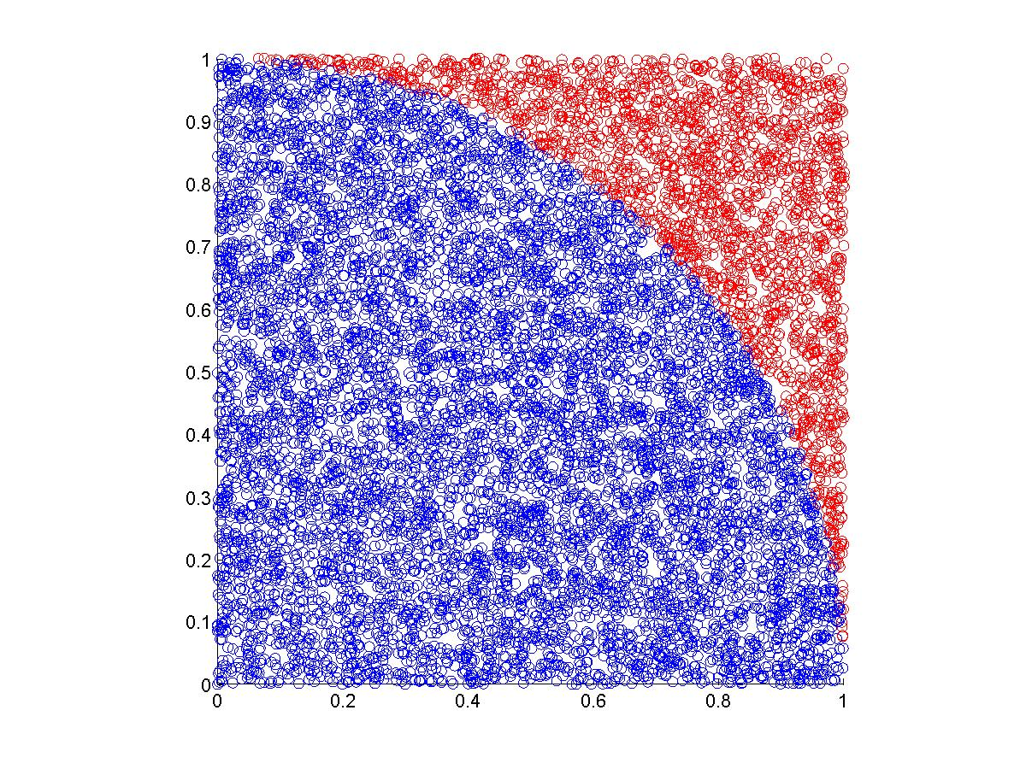
Theoretical Error Estimation
Consider the 1st example, but increase the sample size
from 200 to 10000:
The estimated area is now
7818/10000 = 0.7818
π/4 = 0.7854
A better estimation than the previously obtained 0.7550!!

Slide 19

A 20-D integration
Let us define a function:
Giving the integral:

Slide 20
A 20-D integration
This time:
Sample size N = 10000
Sum of f(p_{i}) = 2.5324X10⁴
<f> = 2.5324X10⁴/10000 = 2.5324
V = 1X2X…X20 = 2.4329X10¹⁸
I = V<f> = 6.1611X10¹⁸
It took me less than 5min to code the program and the program took less than 10s to give me the result!!

Slide 21
Conclusions
The error is proportional to N^{-1/2}, and it is independent on the dimension of integration. In other words, Monte Carlo integration performs just as well in high dimensions as in one dimension.
It can easily handle integration regions with irregular boundaries.
Since the error convergence is rather slow as N^{-1/2}, this method is inefficient for simple and low dimensional problems.

