Slide 1
JetUML diagram layout enhancements
Yingjie Xu
Notes:
I worked on this as a COMP 400 project with Martin throughout this semester

Slide 2
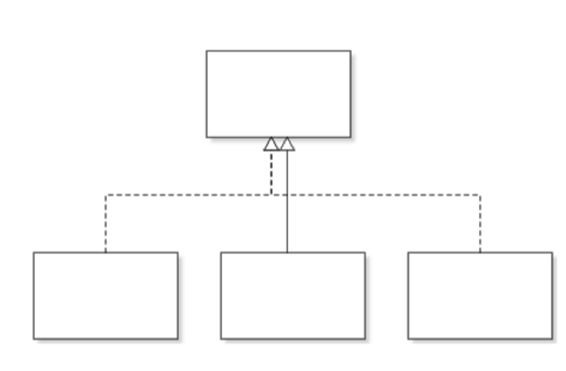
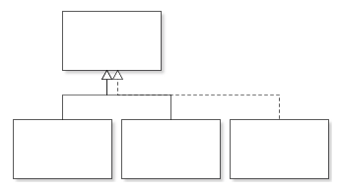
Problems to solve: make connection edges smarter
Edge Crossing
Overlapped Path
Solutions:
Update Edge layout algorithm for class diagram
Move away from the stateless drawing design ➔ Layouter
Notes:
2 ideas:
Editable: used by other UML tools but this would make JetUML really complicated.
Smarter algorithm

Slide 3
Definition of position in class diagram
Node
0
L2
L1
Center
Index = 0
R1
R2
left
Index = 2
left
Index = 1
right
Index = 1
right
Index = 2
•••
•••
The midpoint of a node side would be the central point with an index of 0. Based on the central point, we increment the index separately on both the left and right sides.

Slide 4
Edge layout algorithm for class diagram
The purpose of updating the edge layout algorithm is to make it smarter and avoid as many edge crossings as possible.
1. Edge category: Categorize edges based on their visual appearance
Implementation edges, extension edges
2. Priority rule: Give a priority number to each edge category.
Higher Priority → More centered connection point (drawn first)
Extension edge has higher priority than implementation edge → It takes the central position

Slide 5
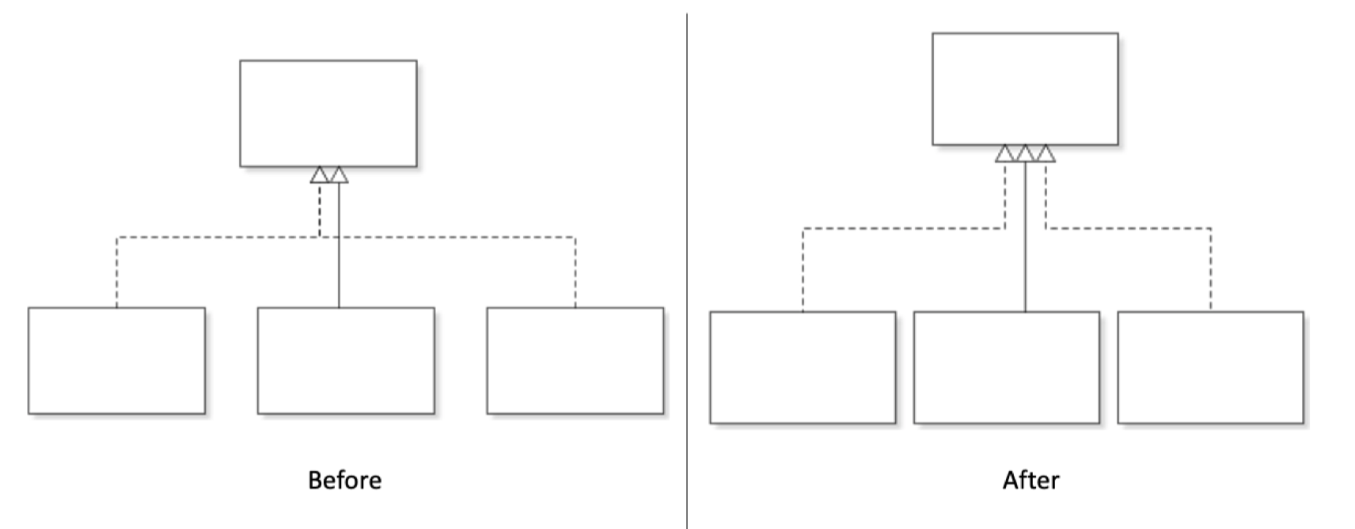
Edge layout algorithm for class diagram
3. Edge aggregation and node position
Notes:
the extension edge has the highest priority so it takes the central position. The other two implementation edges are on diﬀerent sides of the target node, so we do not aggregate those two edges even they are within the same edge category.

Slide 6
Edge layout algorithm for class diagram
Priority list: (high to low)
Extension edges
Implementation edges
Aggregation edges
Let’s apply those rules with an example
0
L1
0
L1
R1
R2
0
R1

Slide 7
Edge layout algorithm for class diagram
Priority list: (high to low)
Extension edges
Implementation edges
Aggregation edges
Edge aggregation happens only when edges belong to the same category are on the same side
L1
0
L1
R1
0
R1
R2
Different side
Same side
Notes:
Let's summarize what we know. The edges with the highest priority among all the edges would always take the central position as the connection point.
In contrast, for those edges that could not take the central position, we would only aggregate those edges within the same category if they are on the same side of the node. Otherwise, we would separate them to avoid edge crossings.

Slide 8
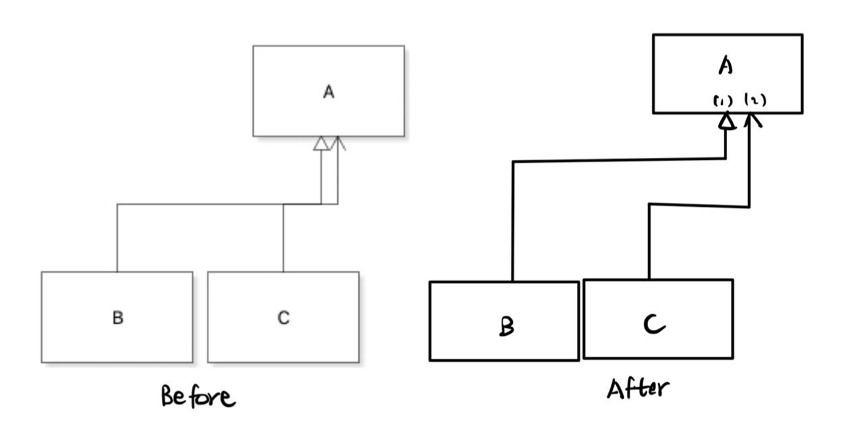
Edge layout algorithm for class diagram
4. Optimize the edge path

Slide 9
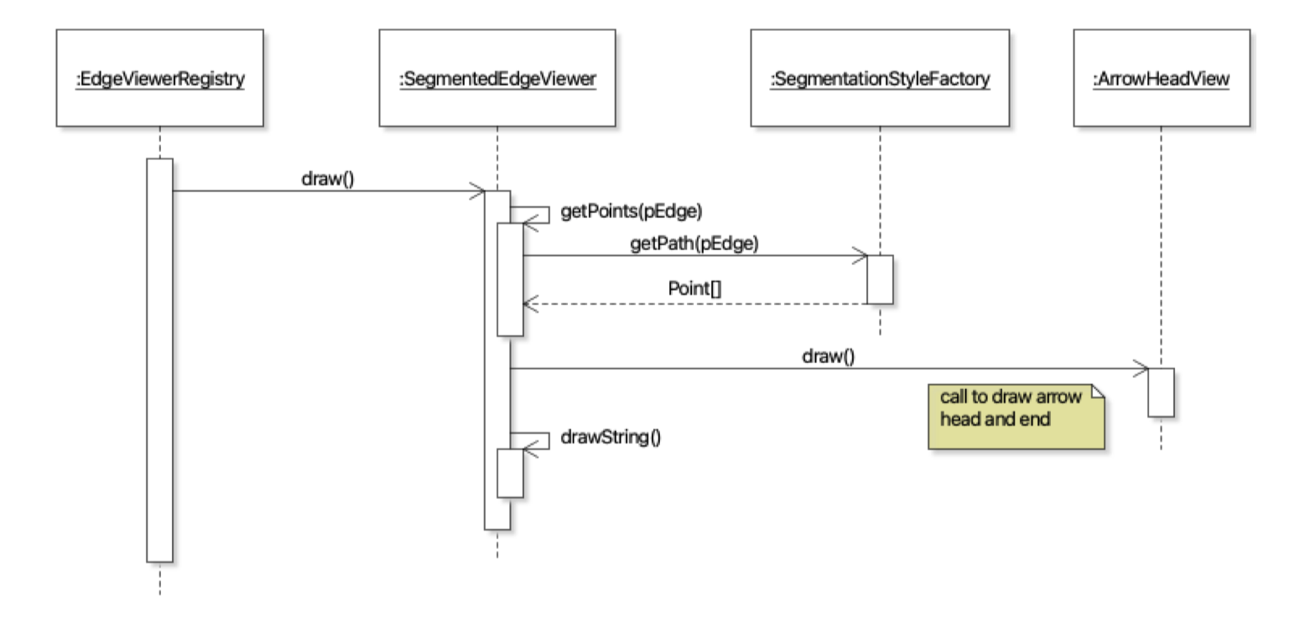
Edge layout algorithm for class diagram
5. Stateful drawing design → Layouter
Sequence diagram for previous stateless drawing design
Notes:
In order to achieve the algorithm previously discussed, moving away from the stateless edge drawing design would be necessary. We could see the sequence diagram for the stateless design, the getPath method is called for each separate edge and they do not share information with each other.

Slide 10
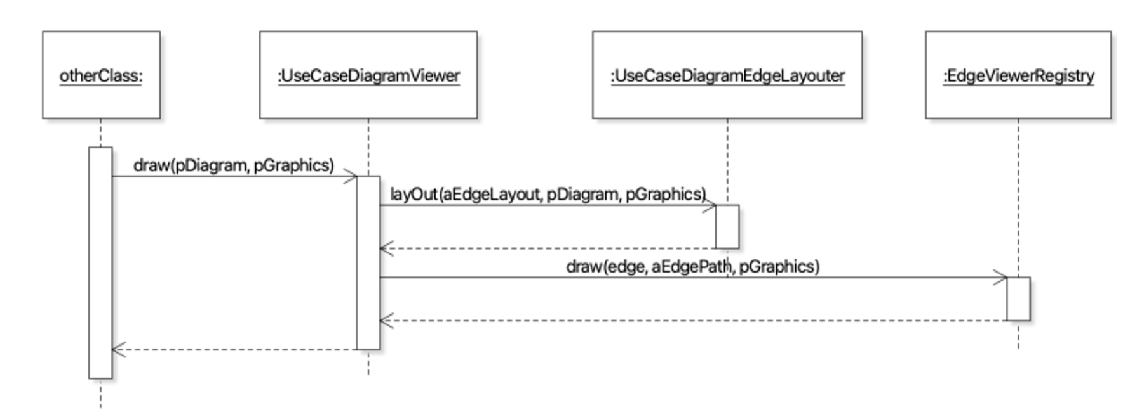
Layouter
Layouter - an additional layer of indirection between the DiagramViewer and the EdgeViewers
Previous design: DiagramViewer → EdgeViewer (calculate path + draw the edges)
Updated design: DiagramViewer → Layouter (calculate path) → EdgeViewer (draw the edges)
Notes:
Layouter is designed to solve this problem. It is an additional layer of indirection between the DiagramViewer and the EdgeViewers. Previously, DiagramViewer would iteratively send each edge to its corresponding EdgeViewer, and EdgeViewers would not only calculate the edge path but also draw the edges. By adding the layouter, we would separate the responsibility of calculating edge paths from EdgeViewers to the layouters. Since the layouter is calculating edge paths for all the edges on the diagram, it is stateful and it allows us to calculate new paths based on previously calculated paths.

Slide 11
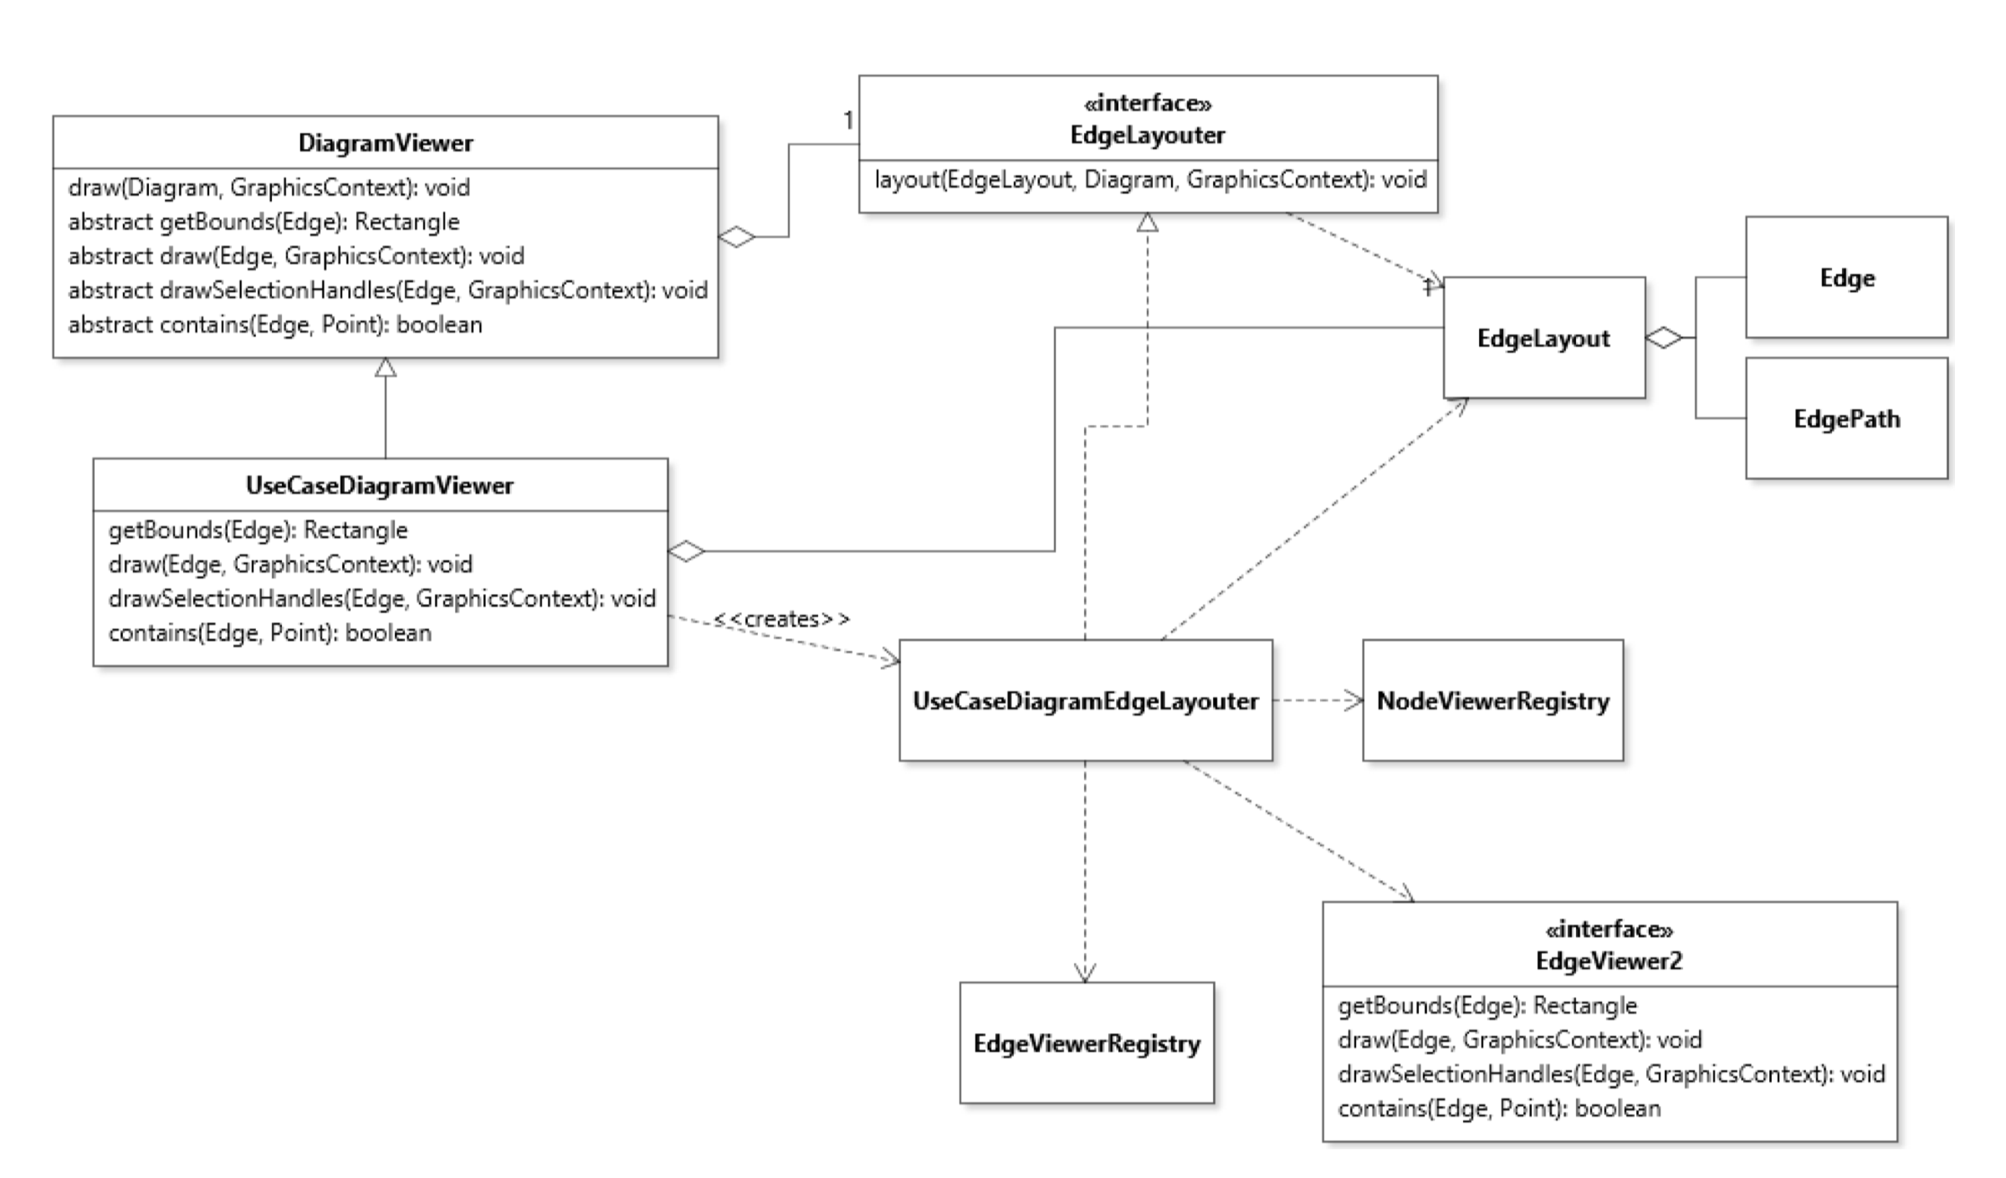
Notes:
Let’s take a look at the class diagram, we added an interface named EdgeLayouter. It has a layout method that would take EdgeLayout as a parameter. EdgeLayout is basically a wrapper for the HashMap which uses Edge as a key and its EdgePath as the value. EdgePath is an array of points that represents the edge path. The goal of calling the layout method is to calculate the EdgeLayout for the corresponding diagram. Inside the DiagramViewer, we would create a single instance of the corresponding Layouter.

Slide 12
Benefits of this design:
Stateful design
DiagramViewer could cache the edge layout for future queries (contains, getBounds etc.)
Layouter could take all the edges into
consideration to avoid edge crossings
Notes:
The stateful layouter design is quite beneﬁcial. It applies the separation of concerns principle. The DiagramViewer could cache the edge layout for future queries. An example of that would be caching the results of the getBounds method in a HashMap. The layouter could take all the edges on the diagram into consideration when planning the new edge paths and avoid as many edge crossings as possible. The EdgeViewer would only need to draw the edges by using the resulting edge paths provided by the layouter.

Slide 13
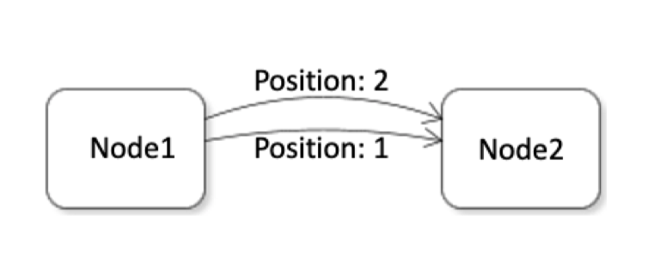
Benefit of Layouter design in State Diagram
The concept of position in state diagram
In Stateless design: for each edge, we need to iterate through all the edges to calculate position value
With layouter: by using a nested hashmap, we could get the position value by simply querying it from the hashmap
Time complexity for calculating the position value for each edge:
O(N) → O(1)
Notes:
Position calculation in state diagram would be an another example that obtains beneﬁts from this design. Here let’s define the concept of position in state diagram. The concept of position is used when two StateTransitionEdges have the same start node and the end node. In order to give them diﬀerent edge paths so that they are not completely overlapped with each other, we give them diﬀerent position values to separate them.
In the stateless design, whenever we want to draw a StateTransitionEdge, we need to recalculate its position value and iterate through all the edges in the current diagram. This would result in a lot of duplicated calculations because we are not able to cache the information anywhere.
With our updated design of layouter, I used a nested HashMap to store the number of edges with the same start node and end node. By doing so, we could simply go to the nested HashMap and get the position value without iterating through all the edges.
Suppose N is the number of StateTransitionEdges in the diagram, the time complexity for calculating the position value for one StateTransitionEdge would decrease from O(N) to O(1).

Slide 14
Questions

