Slide 1
IMDB Movie Review Text Mining
Presenter: Yingjun Guan
Course: STAT578A

Slide 2

About Me
Yingjun Guan
First-year doctoral student from School of Information Sciences (iSchool)
Advisor: Vetle Torvik
Research Interest: data mining, text mining, machine learning, and data visualization, specifically on how DM and TM can help analyze sociotechnical data such as medical data, publication data, or geographical data, etc; and how to better visualize and story tell the data.

Slide 3
Content
1. Introduction
2. Data Preprocessing
3. Algorithm
4. Results
5. Future work

Slide 4
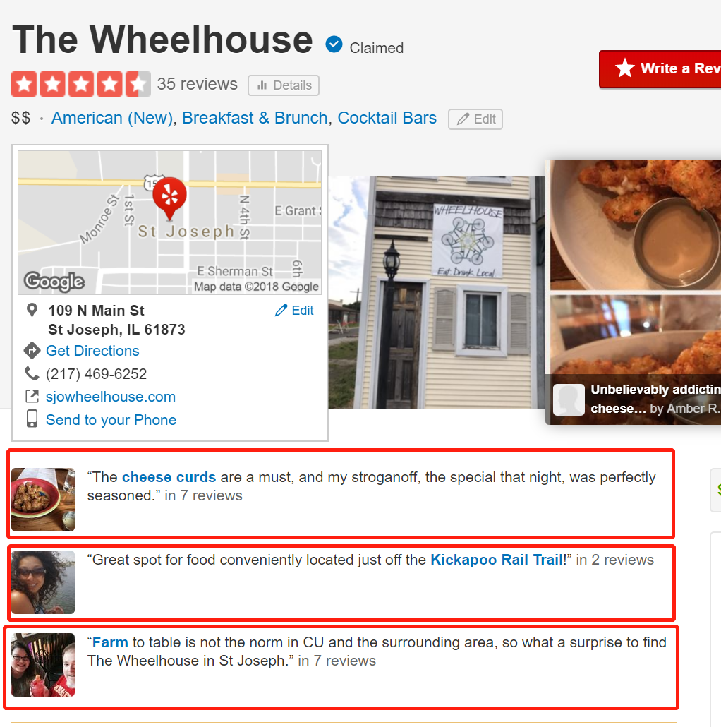
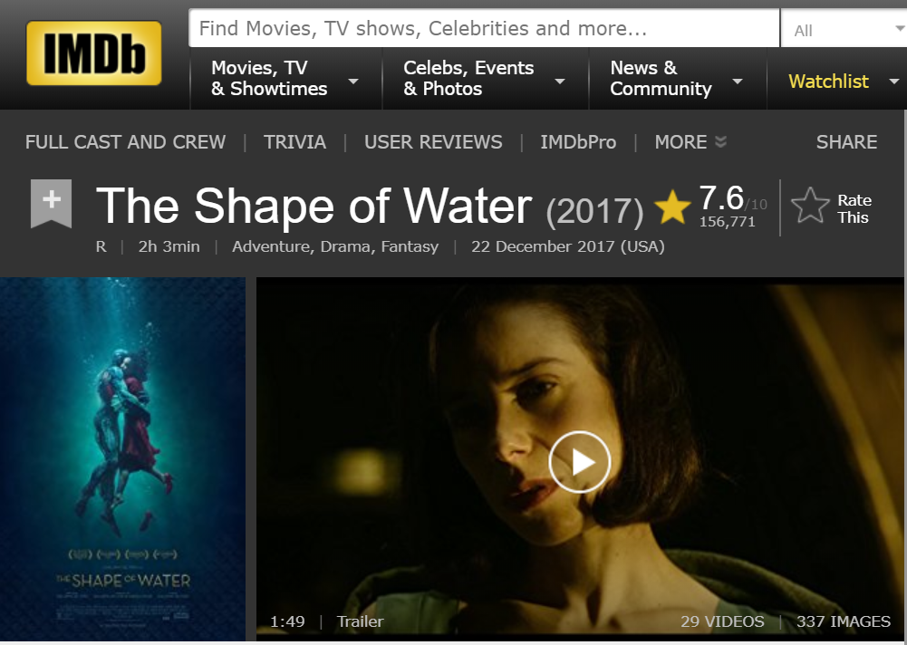
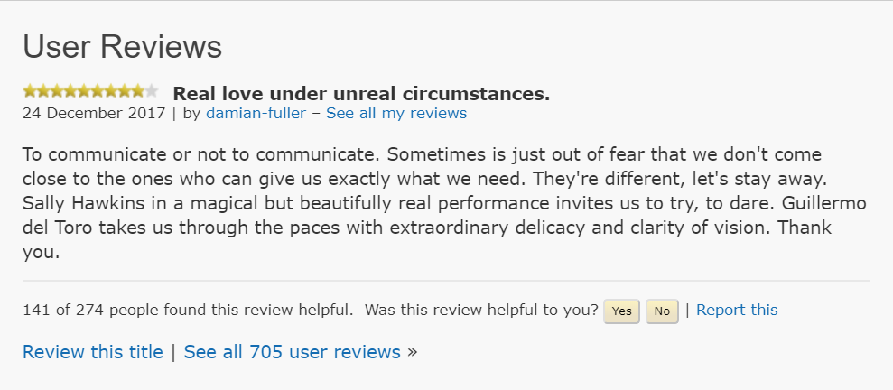
Introduction
In our daily life, we always discuss and review for our experiences (Yelp, IMDB, rate-my-professor)

Slide 5
Introduction
Text Mining
Text Mining is the process of deriving high-quality information from text data. (Data mining + Text Data)
Opinion mining
Generally speaking, opinion mining aims to determine the attitude of a speaker, writer, or other subject with respect to some topic or the overall contextual polarity or emotional reaction to a document, interaction, or event.
Topics:
Sentiment Analysis; Text classification; Annotation; Entailment; auto review; NLP.

Slide 6
Introduction
Target:
This project focuses on the movie reviews from IMDB for different movies and tries to extract effective sentiment ratings (binary and intensity) for the sentiment analysis.
The project also tries to train movie reviews as classifiers to predict and analyze the movie information (eg: genres, overall ratings, etc.)

Slide 7
Algorithm and literature review
Bag of words
N-grams
TF-IDF
Sentimental lexicon

Slide 8
Data
In this project, more than 27,000 movie reviews have been extracted from IMDB.
IMDB also provides the corresponding movie information (Title, year, rating, genres, etc.) and corresponding user information (User name, contact info, all his/her reviews, etc.)

Slide 9
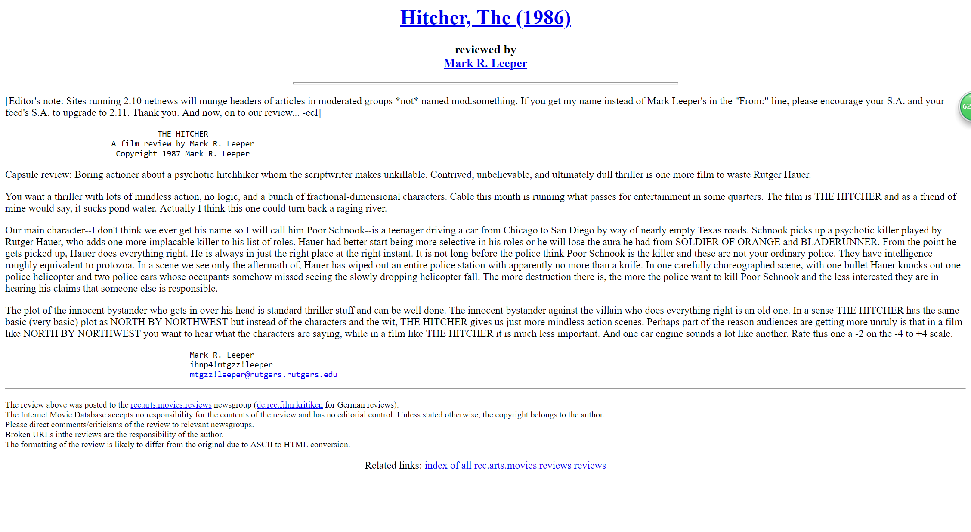
Movie review example
Example of Reviews

Slide 10
Data-Preprocessing
Punctuation.
Case normalization.
Number removal.
Stemming.
Stopping.
Threshold cutoff.

Slide 11
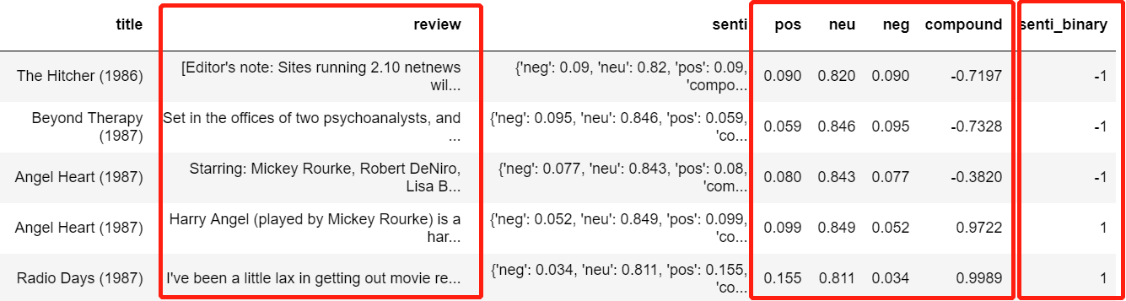
Results
Sentimental Analysis

Slide 12
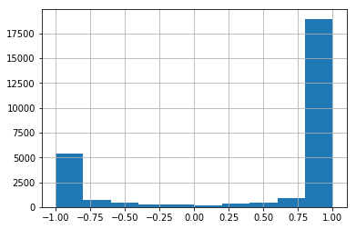
Results
Sentimental Analysis

Slide 13
Results
Movie Information
Info with API (rating-binary, genre, revenue, etc.)
Review keywords (features from tf-idf) top100
Classification (NB)
80%, 20%.
5 fold Cross validation.
Index | Value
Precision | 72%
Recall | 80%
F1 | 76%

Slide 14
Summary and future work
The current classification results can be improved by replace binary rating to ternary or nominal.
More features can be applied to improve the classifier.
Other models rather than NB can be tried for better classification.
Take into the sentimental analysis results as a parameter, and more parameters from users and items. It’s possible to construct a recommend system, if time allows.

Slide 15
Thanks for your time.

