Slide 1
Geographical Distribution of Biomedical Research in the USA and China
6/19/2017
by Yingjun Guan, Jing Du, Vetle I. Torvik

Slide 2
MapAffil: toponym resolution, geocoding, linked data http://abel.ischool.illinois.edu
8939791: High Level Research1251 Mountain View DriveSmithfield, Utah 84335, USA.
Smithfield, UT, USA (41.832,-111.825)
Census female(50.3%) white(94.2%)
CDC mortality: circulatory(134.1) neoplasms(130.6) respiratory(43.2) nervous(57.4) mental(56.8)
2725440: Department of Pharmacology, School of Pharmacy, University of Mississippi, University 38677.
EDU: University, MS, USA (34.366,-89.539)
Census female(50.6%) white(72.8%)
CDC mortality: circulatory(263.4) neoplasms(156.9); respiratory(83.7) nervous(58.1) mental(86.5)
2042550: Martin Army Community Hospital, Fort Benning, Georgia.
HOS: Fort Benning, GA, USA (32.358,-84.956)
Census female(37.5%) white(73.1%)

Slide 3
Place names with very low precision
University, MS, USA
Usa, Oita, Japan
Institute, WV, USA
York, NE, USA
London, KY, USA
Boston, Lincolnshire, UK
DE, USA; LA, USA; IN, USA
Washington, TX, USA
Street, Somerset, UK
North, VA, USA
Paris, IL, USA
Harvard, MA, USA
Cambridge, WI, USA
Carolina, PR, USA
Columbia, NJ, USA
Federal, NSW, Australia
Ontario, OR, USA
Houston, Renfrew, Renfrewshire, UK
Poland, ME, USA
Hopkins, MN, USA
Rochester, MO, USA
Florida, NY, USA
Oxford, IA, USA
Rome, NY, USA
Mexico, NY, USA
Victoria, TX, USA
Birmingham, MI, USA
Amsterdam, NY, USA
Barcelona, Anzoategui, Venezuela
Wa, Ghana
Berlin, WI, USA
Mayo, YT, Canada
Norway, MI, USA
Sydney, NS, Canada
Durham, CT, USA
King, NC, USA
Melbourne, AR, USA
Yale, MI, USA
Madison, MN, USA
Cleveland, TN, USA
Wales, WI, USA
Indiana, PA, USA
Athens, TN, USA
Delhi, CA, USA
Cornell, IL, USA
Mary, Turkmenistan
Anderson, IN, USA
Lake, MI, USA
Imperial, MO, USA
etc.

Slide 4
Top 10 most common cities
City | Precision | Recall | F1 | % of country output | % of country population*
London, UK | 91.8 | 91.5 | 91.7 | 29.2 | 13.7
New York, NY, USA | 68.0 | 87.6 | 76.6 | 5.5 | 2.7
Boston, MA, USA | 98.7 | 93.3 | 95.9 | 5.1 | 0.2
Paris, France | 99.0 | 68.7 | 81.1 | 39.5 | 18.5
Tokyo, Japan | 94.7 | 97.4 | 96.0 | 20.7 | 10.2
Beijing, China | 99.4 | 99.1 | 99.3 | 18.2 | 1.6
Seoul, Korea | 97.1 | 99.3 | 98.2 | 48.8 | 19.8
Baltimore, MD, USA | 99.5 | 94.9 | 97.2 | 2.7 | 0.2
Philadelphia, PA, USA | 99.5 | 95.1 | 97.2 | 2.7 | 0.5
Los Angeles, CA, USA | 99.6 | 86.5 | 92.6 | 2.6 | 1.2

Slide 5
MapAffil
100 million PubMed author name instances
37 million with affiliations
of which 10 million were harvested by cross-links to PMC, MAG, ADS, NIH grants (using a citation matcher called Patci)
Incomplete: ~2%
Errors and unresolved ambiguity: < 0.1%

Slide 6
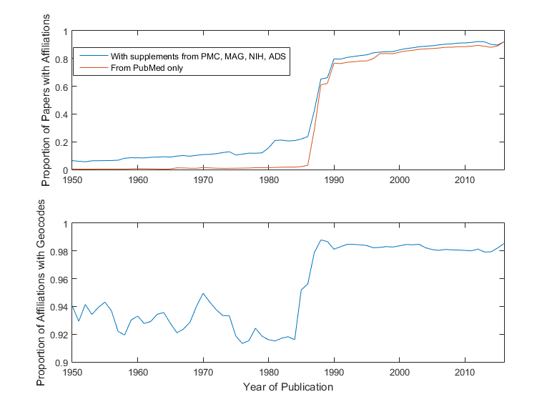

Slide 7
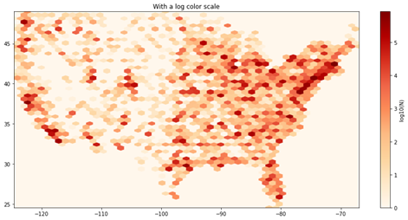
USA (lower 48)

Slide 8
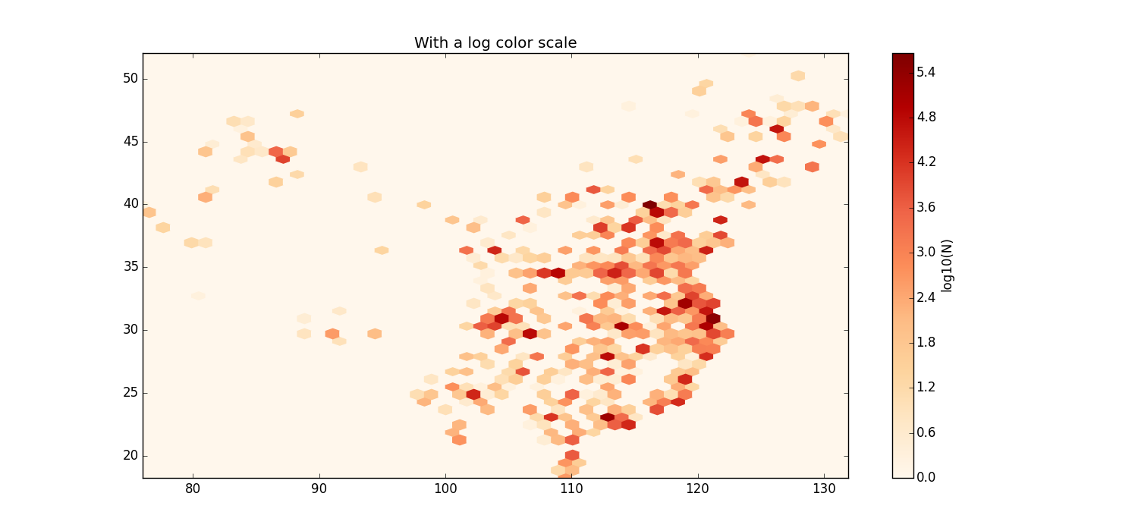
China (mainland)

Slide 9
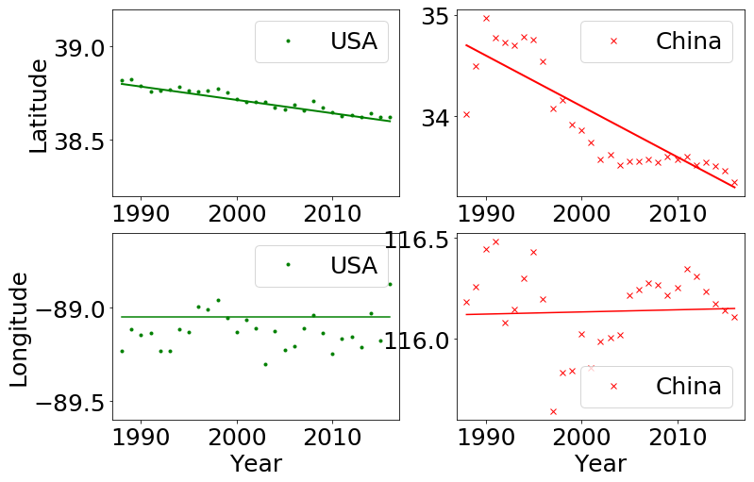
Change in centrality

Slide 10
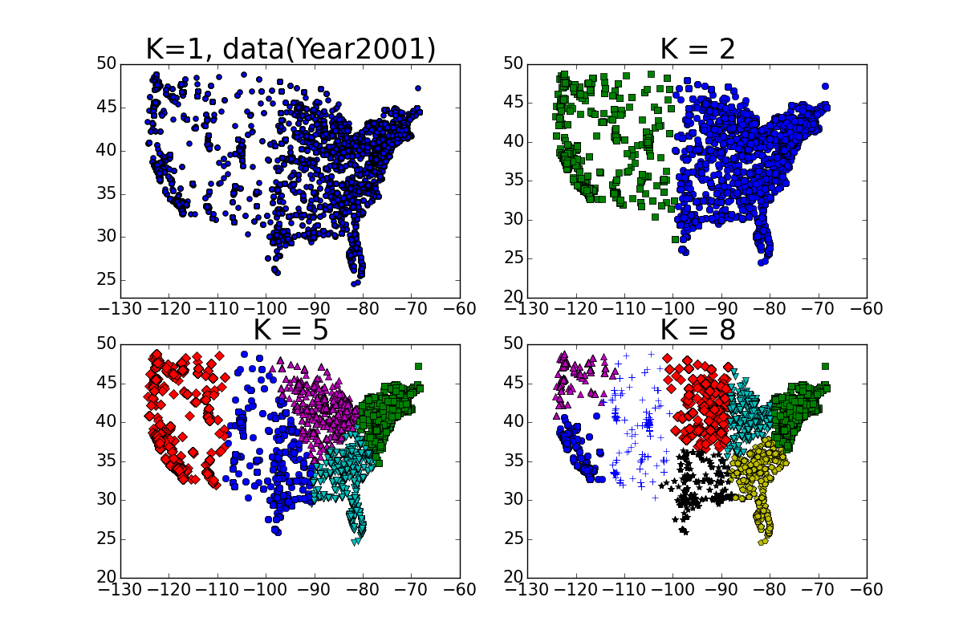
K-means clustering in the USA (using Vincenty distance)

Slide 11
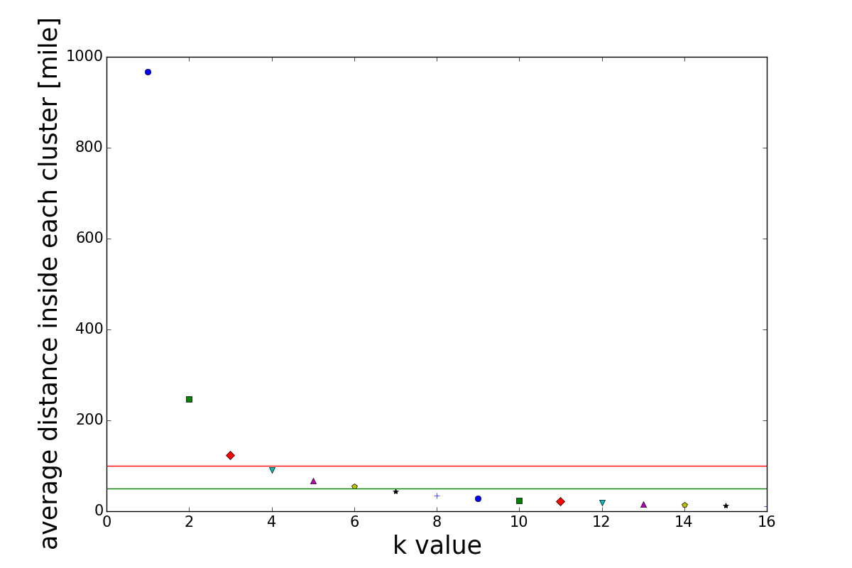

Slide 12
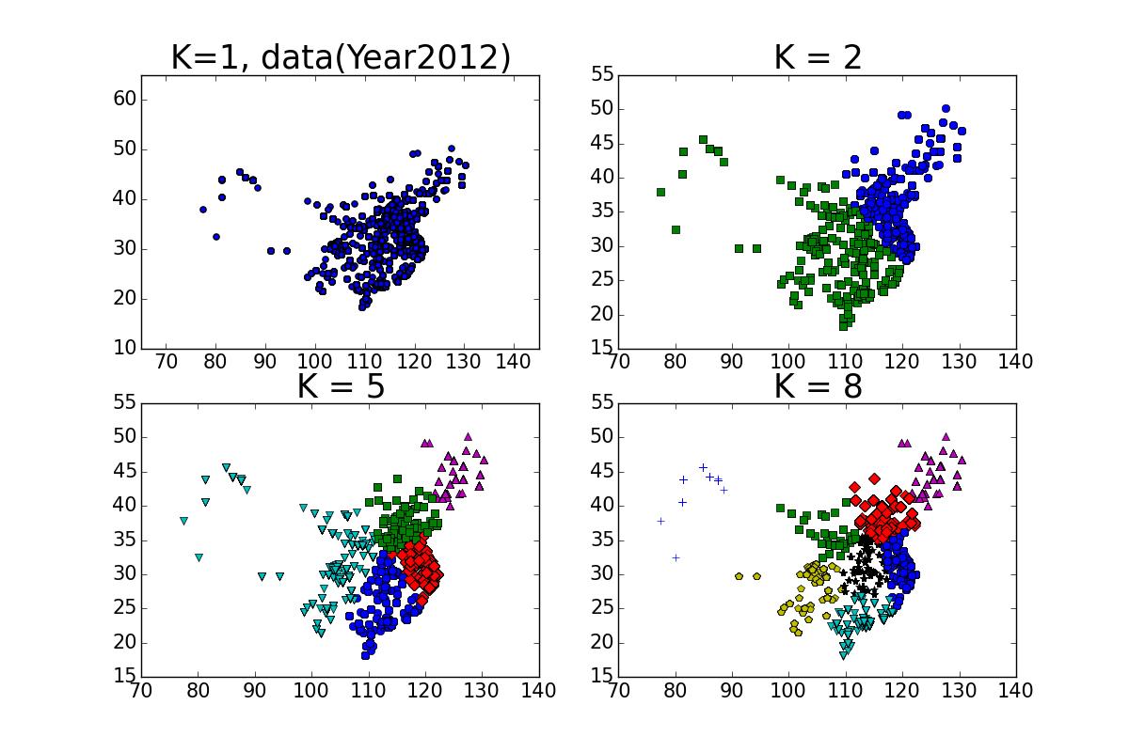
Clustering in China

Slide 13
Acknowledgements
National Institute on Aging of the US NIH grant P01AG039347

