Slide 1

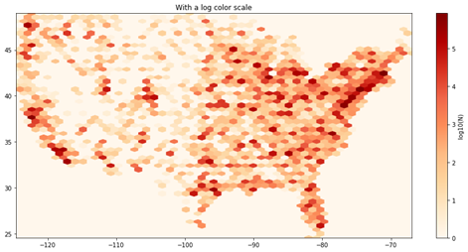
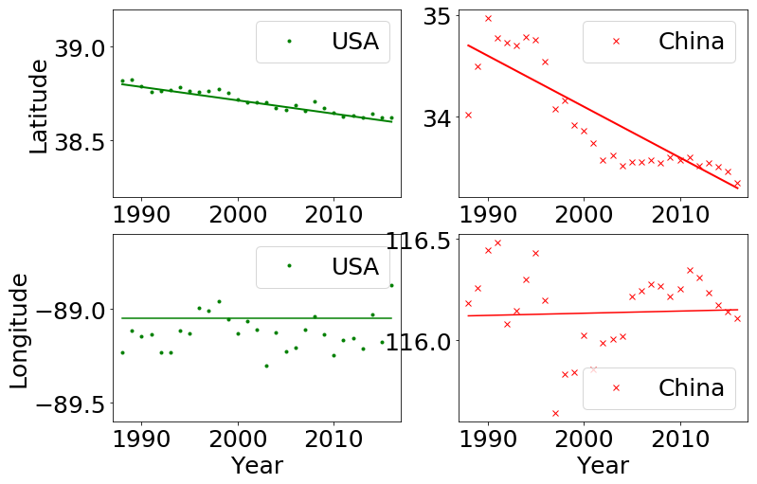
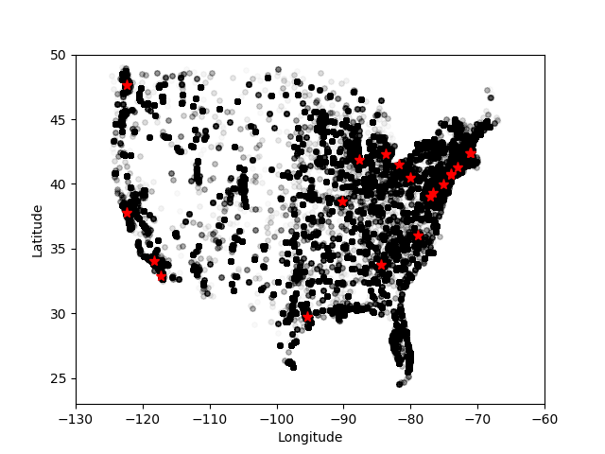
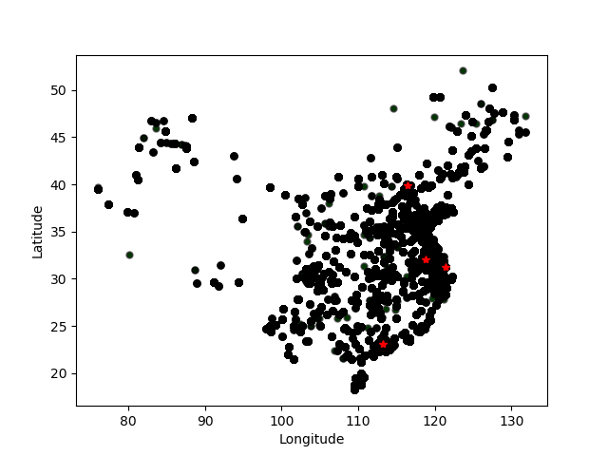
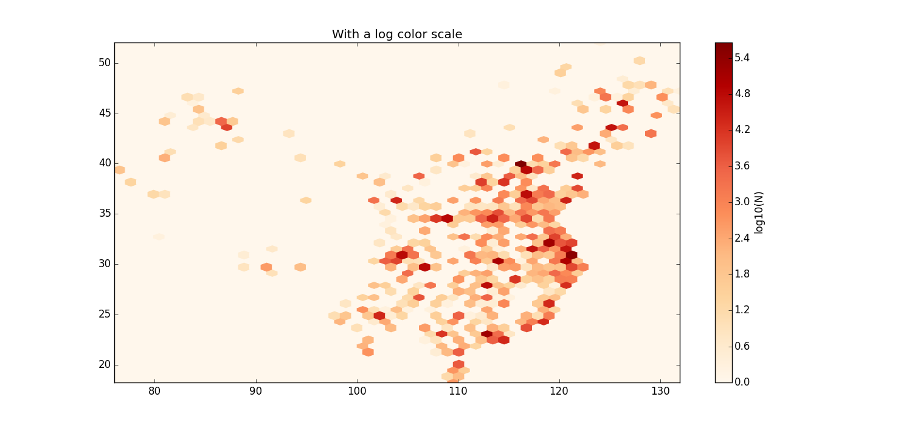
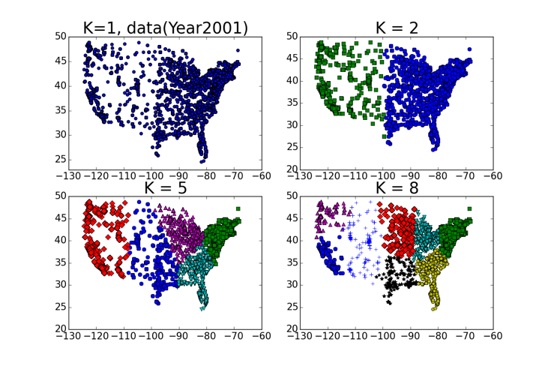
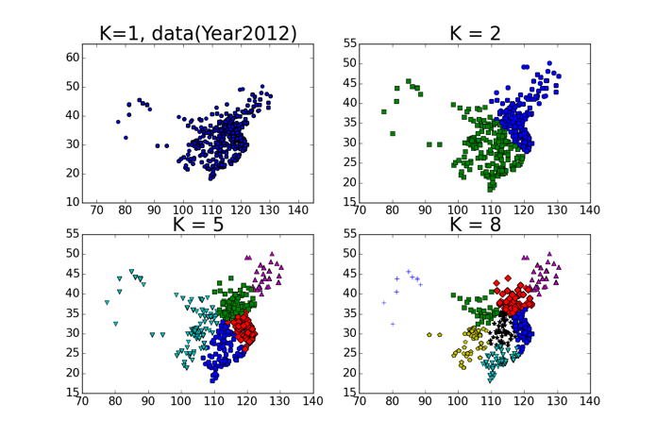
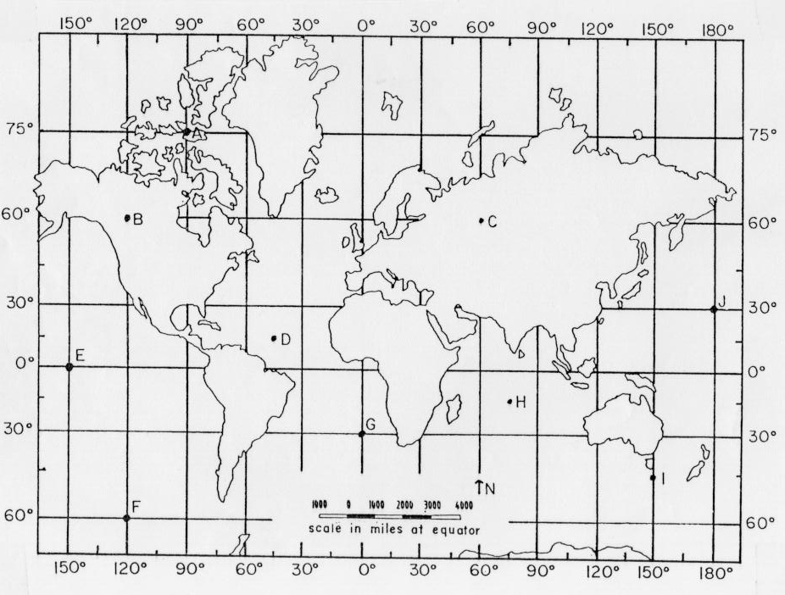
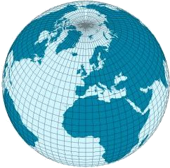
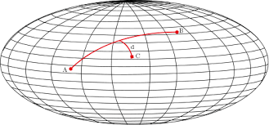
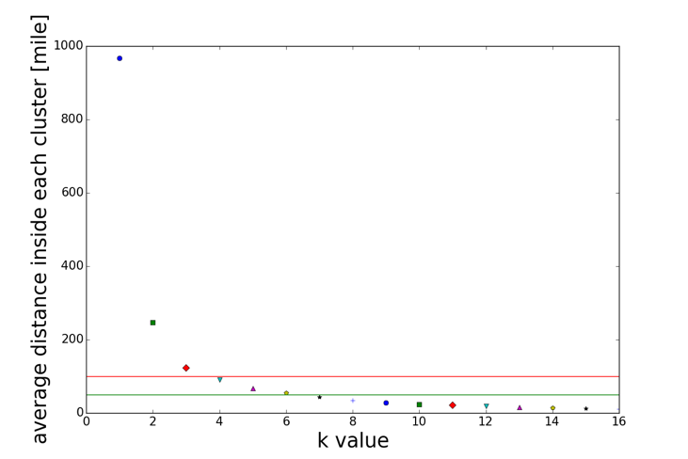

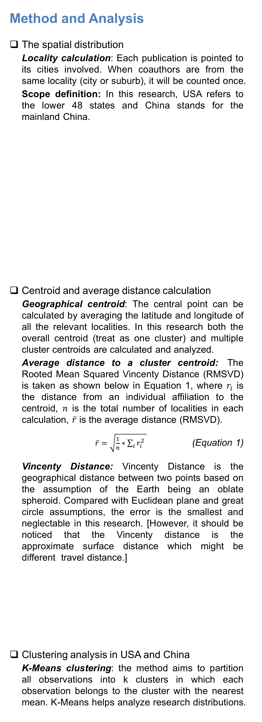
Geographical Distribution of Biomedical Research in USA and China
Yingjun Guan, Jing Du, Vetle Torvik School of Information Sciences, University of Illinois at Urbana-Champaign
Introduction
Using disambiguated and geocoded place names of 19.4 millions author affiliations in PubMed, we address the following questions:
What was the geospatial distribution of biomedical research in USA and China, and how has it changed over the past 30 years?
To what degree are the publications concentrated in a few cities or regions?
Method and Analysis
The spatial distribution
Locality calculation: Each publication is pointed to its cities involved. When coauthors are from the same locality (city or suburb), it will be counted once.
Scope definition: In this research, USA refers to the lower 48 states and China stands for the mainland China.
Centroid and average distance calculation
Geographical centroid: The central point can be calculated by averaging the latitude and longitude of all the relevant localities. In this research both the overall centroid (treat as one cluster) and multiple cluster centroids are calculated and analyzed.
Average distance to a cluster centroid: The Rooted Mean Squared Vincenty Distance (RMSVD) is taken as shown below in Equation 1, where $r_{i}$ is the distance from an individual affiliation to the centroid, $n$ is the total number of localities in each calculation, $\overline{r}$ is the average distance (RMSVD).
$\overline{r}=\sqrt{\frac{1}{n}∗\sum_{i}{r_{i}^{2}} }$ (Equation 1)
Vincenty Distance: Vincenty Distance is the geographical distance between two points based on the assumption of the Earth being an oblate spheroid. Compared with Euclidean plane and great circle assumptions, the error is the smallest and neglectable in this research. [However, it should be noticed that the Vincenty distance is the approximate surface distance which might be different travel distance.]
Clustering analysis in USA and China
K-Means clustering: the method aims to partition all observations into k clusters in which each observation belongs to the cluster with the nearest mean. K-Means helps analyze research distributions.
Overall and clustering analysis
Geospatial distribution in USA and China, and overall centroid movement over time (1988 - 2016).
Taking USA lower 48 states and mainland China as a overall cluster, the distribution is shown as Fig 3. The centroids locate in the State of Illinois and Province of Wuhan. Its change over time is shown in Fig. 5.
K-Means Clustering analysis
In this paper, K-Means method is applied in clustering the dataset. By trying different parameters of k value.
Top cities in USA and China
Top cities with most publications are analyzed in both countries. As shown in the figures and tables below, their behaviors are different: in USA, top 14 cities make up the 40% of all publications, where Boston contributes the most (6.5% of the publication)； whereas in China, there are only four. Two super cities, Beijing and Shanghai, both contribute the majority (15.7% and 12.0%).
Figure 3. The overall geospatial distribution of USA (the lower 48) and China (mainland) are shown as left.
In the US, eastern and western coasts are the two main hubs of medical publication, the meddle part, like the the state of Nebraska and Utah, has fewer publications. The center of the lower 48 is in Illinois!
In China mainland, the eastern coast enjoy the most medical publications, there are obviously fewer publications in the middle and western sections. The center of the mainland of China is in Anhui Province.
Figure 5. In the time period from 1988 to 2016, the overall centroid (averaged latitude and averaged longitude) in both USA and China moved southward.
For the US, the centroid keep almost unmoved: 0.2 degree to south (20 miles); and for China, the centroid moved around 1.7 degree (175 miles) to south.
Data
Large geocoded affiliation database
MapAffil geocoded and disambiguated place names 37M PubMed affiliations with 99.9% accuracy. A sample of low-precision places are shown in Figure 1 and Table 1. Top 20 countries with most publication (disambiguated) are listed in Figure 2.
USA
China
USA
China
Figure 9. Top cities （contributing up to 40%） in both US and China have been marked above and listed in the table on the right.
Table 2. The top cities in the US and China during 1988 - 2017
Country | ranking | name | publication% | accumulated% | Population%
USA | 1 | New York | 6.5 | 6.5 | 2.6
USA | 2 | Boston | 5.6 | 12.1 | 0.2
USA | 3 | Los Angeles | 3.2 | 18.9 | 1.2
USA | 4 | Philadelphia | 3.1 | 22.1 | 0.5
USA | 5 | Baltimore | 3 | 25 | 0.2
USA | 6 | Chicago | 2.8 | 27.8 | 0.8
USA | 7 | Houston | 2.6 | 30.4 | 0.7
USA | 8 | Bethesda | 2.4 | 32.9 | 0
USA | 9 | San Diego | 2.3 | 35.2 | 0.4
USA | 10 | Seattle | 2.1 | 37.3 | 0.2
USA | 11 | San Francisco | 2.1 | 39.4 | 0.3
USA | 12 | St. Louis | 1.9 | 41.3 | 0.1
USA | 13 | Durham | 1.7 | 39.4 | 0.1
USA | 14 | Atlanta | 1.7 | 41.1 | 0.1
China | 1 | Beijing | 18.2 | 18.2 | 1.6
China | 2 | Shanghai | 13 | 31.2 | 1.8
China | 3 | Guangzhou | 6.2 | 33.8 | 1
China | 4 | Nanjing | 5.9 | 39.8 | 0.7
University, MS, USA
Usa, Oita, Japan
Institute, WV, USA
York, NE, USA
London, KY, USA
DE, USA; LA, USA;
IN, USA
Washington, TX, USA
Street, Somerset, UK
North, VA, USA
Paris, IL, USA
Harvard, MA, USA
Cambridge, WI, USA
Carolina, PR, USA
Columbia, NJ, USA
Ontario, OR, USA
Poland, ME, USA
Hopkins, MN, USA
Rochester, MO, USA
Florida, NY, USA
Oxford, IA, USA
Rome, NY, USA
Mexico, NY, USA
Sydney, NS, Canada
Durham, CT, USA
King, NC, USA
Melbourne, AR, USA
Yale, MI, USA
Wales, WI, USA
Indiana, PA, USA
Athens, TN, USA
etc.
Figure 1. Sample of low-precision place names
Table 1. Ambiguity of top most frequent place names
City | Precision | Recall | % of nation output | % of nation population
London, UK | 91.8 | 91.5 | 29.2 | 13.7
New York, NY, USA | 68.0 | 87.6 | 5.5 | 2.7
Boston, MA, USA | 98.7 | 93.3 | 5.1 | 0.2
Paris, France | 99.0 | 68.7 | 39.5 | 18.5
Tokyo, Japan | 94.7 | 97.4 | 20.7 | 10.2
Beijing, China | 99.4 | 99.1 | 18.2 | 1.6
Seoul, Korea | 97.1 | 99.3 | 48.8 | 19.8
Baltimore, MD, USA | 99.5 | 94.9 | 97.2 | 2.7
Philadelphia, PA, USA | 99.5 | 95.1 | 97.2 | 2.7
Los Angeles, CA, USA | 99.6 | 86.5 | 92.6 | 2.6
Figure 6. The medical publication distribution in USA by different clusters.
References
[1] Guan, Y., Du, J. & Torvik, V. Geographical Distribution of Biomedical Research in the USA and China. 6th International Workshop on Mining Scientific Publications (WOSP2017), Toronto, Canada.
[2] Torvik VI. MapAffil: A bibliographic tool for mapping author affiliation strings to cities and their geocodes worldwide. D-Lib Magazine 2015; 21(11/12).
Acknowledgments
Research reported in this publication was supported in part by NIH National Institute on Aging P01AG039347. The content is solely the responsibility of the authors and does not necessarily represent the official views of the NIH.
Figure 7. The medical publication distribution in China by different clusters.
Figure 8. The change of average distance (in miles) versus the change of k values.
As the cluster number increases, the distance (averaged RMSVD) drops. And when the number of clusters reaches 4, the distance gets 100 miles, according to the USA dataset.
Figure 4. Model of Euclidean plane, Great Circle and Vincenty model
Figure 2. Top 20 countries with most publications in the database (1988 - 2017)

