Slide 1
Topic Modeling Part I: Theory
Matt Pitchford
Ph.D Student, Communication

Slide 2
Outline
What is a topic model?
What is it good for?
What kind of questions can it help answer?
What kinds of data do you need?
What issues should you be aware of?

Slide 3
What is a Topic Model?
Topic models are a representation of probability.
Latent Dirichlet allocation (LDA) treats each word as a unit of data, each document as a sequence of words, and each corpus as a collection of documents
words that consistently co-occur near each other in the text are more likely to relate to one another (topics)
each document (collection of words) is a mix of topics
For Example: Suppose two of the topics are politics and film. LDA will represent a book like James E. Combs and Sara T. Combs’ Film Propaganda and American Politics: An Analysis and Filmography as partly about politics and partly about film.

Slide 4
Example: Orlando shooting
# | Name | Probability | Words in Topic (descending order of likelihood).
0 | LGTBQ support | 0.26393 | people world lives gay it's many innocent one time lost want i'm know pride live like much change place
1 | Gun control | 0.12807 | guns gun don't need control ban holding would kill gays assault two islam men hands shooter get ar see
2 | Blood donations | 0.10334 | blood donate victims people please line support waiting need help shooting give urgent call rt donors ab plasma center
9 | News information and updates | 0.10681 | shooting mass orlando shootings florida live blood donations needed us statement since central area state list massacre donation updated
10 | Thoughts and prayers | 0.23943 | orlando victims prayers families thoughts heart affected go community tragedy stand horrific sending love ones city loved friends hearts
11 | Love wins over hate | 0.16041 | love hate stop violence beautiful lgbt spread peace support light stay safe much world want amazing instead afraid crime
12 | Islamic Terrorism | 0.15431 | attack terror act terrorist terrorism community obama orlando islamic us believe isis don't lgbt can't blame muslim president trump
14 | Historical status of shooting | 0.08371 | shooting see us history people worst dead need take news mass fifty pulse deadliest killed top american life beijos

Slide 5
Example: Orlando shooting
#orlando #pulse i pray that hate will end when people will learn #loveislove https://t.co/nyomf9rn3f
rt @halsey be proud of who we are. #loveislove https://t.co/rdgeox3uoh
rt @tracettehillman #domesticterrorism against #lgbt is unacceptable. #loveislove. #prayfororlando and the world we live in. #riseup https://t.co/peyser0mxq

Slide 6
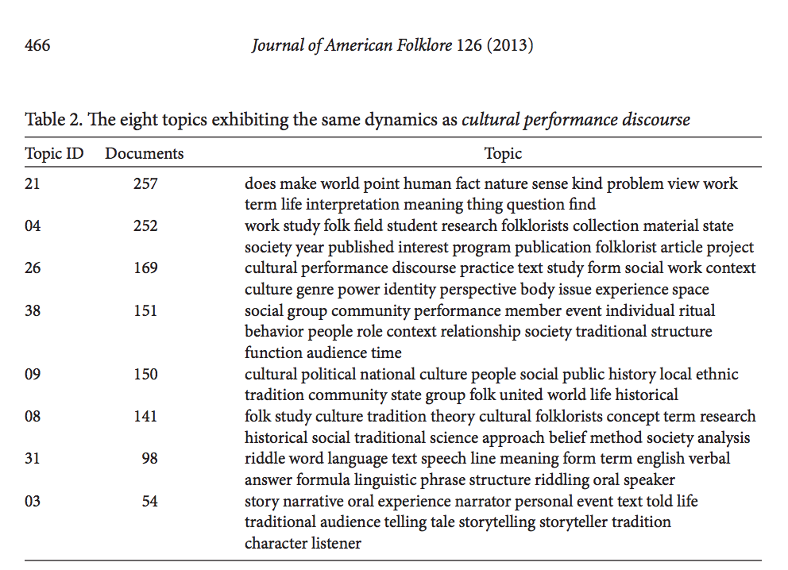
Example 2: Folklore Studies

Slide 7
What is a Topic Model Good For?
Indexing
Summarization
Discovery
Notes:
Topic modeling is a form of what Steven Ramsay would call “algorithmic criticism.” For Ramsey, algorithmic criticism “proposes that we create tools - practical, instrumental, verifiable mechanisms - that enable critical engagement, interpretation, conversation, and contemplation.” He views computer programming and tools, like tf-idf, as a productive constraint that invites new interpretive possibilities. Algorithms do not allow critics to “solve” an interpretive problem, and are not evidences through which a scientist’s hypothesis may be tested. Instead, “algorithmic criticism attempts to employ the rigid, inexorable, uncompromising logic of algorithmic transformation as the constraint under which critical vision may flourish.” It is a human based criticism, using computers, that rests on the “episteme of humanistic inquiry” to invite new interpretations and interpretive possibilities.
Stephen Ramsay, Reading Machines: Toward and Algorthmic Criticism, (Urbana: University of Illinois Press, 2011), X.
Ibid., 10.
Ibid., 9.
Ibid., 32.
Ibid., 67, 81.

Slide 8
What is your research question?
Methods are ways to answer questions.
Topic models area computational method of reading “at a distance.”
For example: “with what political imaginaries do U.S. citizens respond to terrorist attacks?”

Slide 9
What kind of data do you have?
Structured versus unstructured
Did humans write it. Is it in xml format?
Latent versus categorical analysis
Do you know what you are looking for in advance?
Big Data
Will humans code it too?
Is there “enough” for LDA to bite into?
LDA shines with large amounts of unstructured data that you need to analyze latently.

Slide 10
Issues to be aware of
Overfitting
LDA is designed for pattern recognition. It will always find a pattern. How do you know the pattern actually reflects your data?
Overreliance
LDA probably should not be the only tool you use to understand your corpus. It is one tool among many others.
Too much distance from the text
If you identify topics, you still need to go back and understand the actual corpus (depending, of course, on your question).

Slide 11
Where to go next
MALLET (Java)
http://mallet.cs.umass.edu/
ConText (standalone implementation of MALLET)
http://context.lis.illinois.edu/

Slide 12
Questions?
pitchfo2@illinois.edu

