Slide 1
PPTX-RS Element Showcase

Slide 2
Section: Slide Layouts

Slide 3
Text Formatting Options
Normal text (default)
Bold content text
Italic content text
Underlined content
Custom font size (28pt)
Custom color (#4F81BD)

Slide 4
Key Highlights
Large content area for emphasis
Perfect for key messages
Smaller title, bigger content

Slide 5
Two Column Comparison
Left Column Item 1
Left Column Item 2
Left Column Item 3
Right Column Item 1
Right Column Item 2
Right Column Item 3

Slide 7
Table with Cell Styling
Header 1 | Header 2 | Header 3
Bold Cell | Normal Cell | Colored
Red BG | Green BG | Blue BG
Row 3 Col 1 | Row 3 Col 2 | Row 3 Col 3

Slide 8
Chart Types: Bar, Line, Pie
Bar Chart: Compare categories
Line Chart: Show trends over time
Pie Chart: Show proportions

Slide 9
Shape Types with Color Fills
Rectangle
Ellipse
Rounded
Triangle
Diamond

Slide 10
Gradient Fills - Multiple Directions
Horizontal
Vertical
Diagonal
3-Color
135° Angle

Slide 11
Transparency Effects - Overlapping Shapes
Base (100%)
50% Transparent
25% Transparent
75% Transparent

Slide 12
Styled Connectors - Types, Arrows, Dashes
Start
Process
End
A
B
C

Slide 13
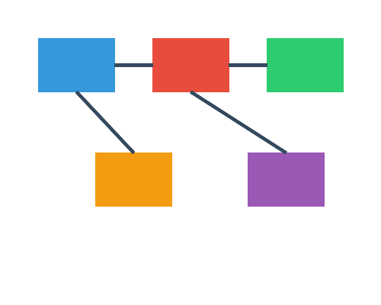

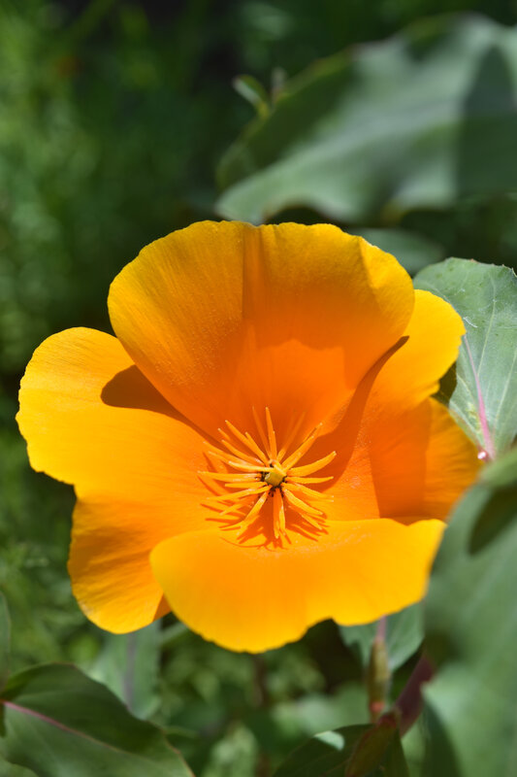
Image Effects: Shadow (Outer Shadow)

Slide 14
Image Effects: Reflection (Mirror Effect)

Slide 15
Image Cropping: All Sides, Top/Bottom, Left/Right

Slide 16
Image Effects: Glow (Golden Aura)

Slide 17
Image Effects: Soft Edges (Feathered)

Slide 18
Image Effects: Inner Shadow (Depth)

Slide 19
Image Effects: Blur (Artistic)

Slide 20
Combined Effects: Shadow + Reflection

Slide 21
Financial Report - Advanced Table
Q1 2024 Financial Report
Category | Revenue | Expenses | Profit
Product Sales | $1,250,000 | $450,000 | $800,000
Services | $890,000 | $320,000 | $570,000
Total | $2,140,000 | $770,000 | $1,370,000

Slide 22
Pricing Comparison Matrix
Feature | Basic | Pro | Enterprise
Storage | 5 GB | 50 GB | Unlimited
Users | 1 | 10 | Unlimited
Support | Email | 24/7 Chat | Dedicated
API Access | No | Yes | Yes + Priority
Price/month | $9 | $29 | $99

Slide 23
Development Process Flow
1. Research
2. Design
3. Develop
4. Deploy

Slide 24
Organization Structure
CEO
CTO
CFO
COO
Engineering
Product

Slide 25
PDCA Continuous Improvement Cycle
PLAN Define goals and strategy
DO Implement the plan
ACT Adjust and improve
CHECK Measure results

Slide 26
Maslow's Hierarchy of Needs
Self-Actualization
Esteem - Achievement, Respect
Love & Belonging - Relationships
Safety Needs - Security, Stability
Physiological Needs - Food, Water, Shelter

Slide 27
Finding Your Ikigai - Venn Diagram
Skills
Passion
IKIGAI
Market Need

Slide 28
Project Roadmap 2024-2025
Q1 2024 | Q2 2024 | Q3 2024 | Q4 2024 | Q1 2025
Research & Planning | Design Phase | Development Sprint 1-3 | Testing & QA | Launch & Support
✓ Complete | ✓ Complete | In Progress | Planned | Planned

Slide 29
Executive Dashboard - Q1 2024
Revenue $2.14M +15% YoY
Customers 12,450 +22% YoY
NPS Score 72 +8 pts
Retention 94% +3% YoY

Slide 30
Summary & Next Steps
Completed: Research, Design, Initial Development
In Progress: Sprint 3 Development
Next: QA Testing Phase (Q4 2024)
Launch Target: Q1 2025
Key Risks: Resource constraints, Timeline pressure
Notes:
Speaker Notes: 1. Emphasize the progress made 2. Highlight key achievements 3. Address any concerns about timeline 4. Open for Q&A

Slide 31
Bullet Styles - Numbered List
First numbered item
Second numbered item
Third numbered item
Fourth numbered item

Slide 32
Bullet Styles - Lettered Lists
Option A - First choice
Option B - Second choice
Option C - Third choice
Option D - Fourth choice

Slide 33
Bullet Styles - Roman Numerals
Chapter I - Introduction
Chapter II - Background
Chapter III - Methodology
Chapter IV - Results
Chapter V - Conclusion

Slide 34
Bullet Styles - Custom Characters
Star bullet point
Arrow bullet point
Check bullet point
Diamond bullet point
Heart bullet point

Slide 35
Bullet Styles - Hierarchical Lists
Main Topic 1
Supporting detail A
Supporting detail B
Main Topic 2
Supporting detail C
Supporting detail D
Main Topic 3

Slide 36
Text Enhancements - New Formatting
Strikethrough: This text is crossed out
Highlight: Yellow background for emphasis
Subscript: H₂O - for chemical formulas
Superscript: x² - for math expressions
Combined: Bold + Red color

Slide 37
Font Size Presets - Each line different size
LARGE: 36pt - Extra large text
HEADING: 28pt - Section headers
BODY: 18pt - Regular content
SMALL: 14pt - Smaller text
CAPTION: 12pt - Captions and notes

Slide 38
Theme Color Palettes
Corporate
Modern
Vibrant
Dark
Nature
Tech
Carbon

Slide 39
Material & Carbon Design Colors
M-Red
M-Blue
M-Green
M-Orange
M-Purple
C-Blue
C-Green
C-Red
C-Purple
C-Gray

Slide 40
Image Loading - New Methods
Image::new(path) - Load from file path
Image::from_base64(data) - Load from base64 string
Image::from_bytes(data) - Load from raw bytes
ImageBuilder for fluent API configuration
Built-in base64 decoder (no external deps)

Slide 41
New Features in v0.2.1
BulletStyle: Number, Letter, Roman, Custom
TextFormat: Strikethrough, Highlight
TextFormat: Subscript, Superscript
Font size presets in prelude
Image::from_base64 and from_bytes
Theme color palettes (7 themes)
Material & Carbon Design colors

Slide 42
Slide Show Settings - Mode Comparison
Setting | Speaker | Kiosk | Browsed
Loop | No | Yes | No
Narration | Yes | No | Yes
Animation | Yes | Yes | No
Timings | Yes | Auto | Yes
Slide Range | All | All | 1-10
Pen Color | Red | Red | Red
Speaker: Full control
Kiosk: Auto-loop
Browsed: Scrollbar

Slide 43
Print Handout - 6 Slides Per Page
Q1 2025 Strategy Review
Print Settings
Print What | Handouts
Color Mode | Grayscale
Layout | 6 slides/page
Frame Slides | Yes
Date | Yes
Page Numbers | Yes
Slide 1
Slide 2
Slide 3
Slide 4
Slide 5
Slide 6
Confidential - Internal Use Only

Slide 44
Advanced Table Merging - Merged Cells
Q1 2025 Revenue Report
Products | Hardware | $450,000 | +12%
 | Software | $680,000 | +25%
Services | Consulting | $320,000 | +8%
 | Support | $190,000 | +5%
Anchor (gridSpan/rowSpan)
hMerge (col covered)
vMerge (row covered)
Normal (no merge)

