Slide 1

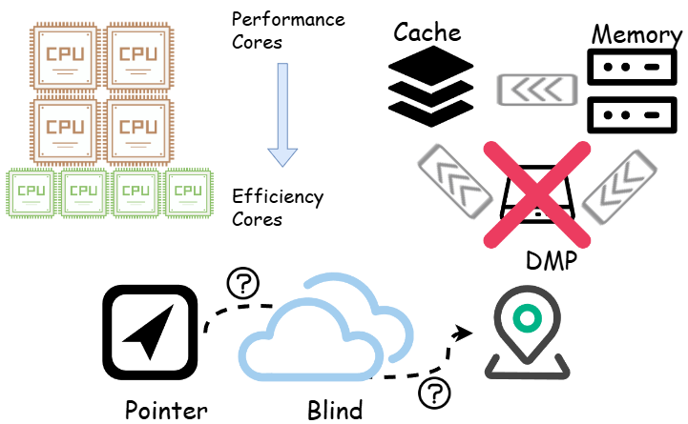
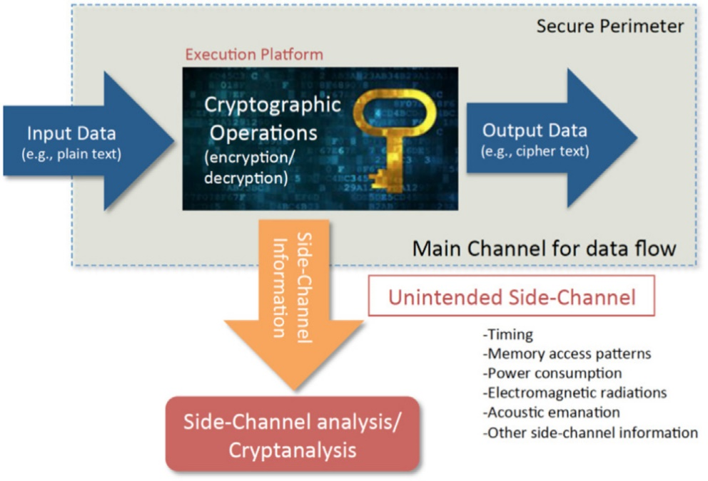
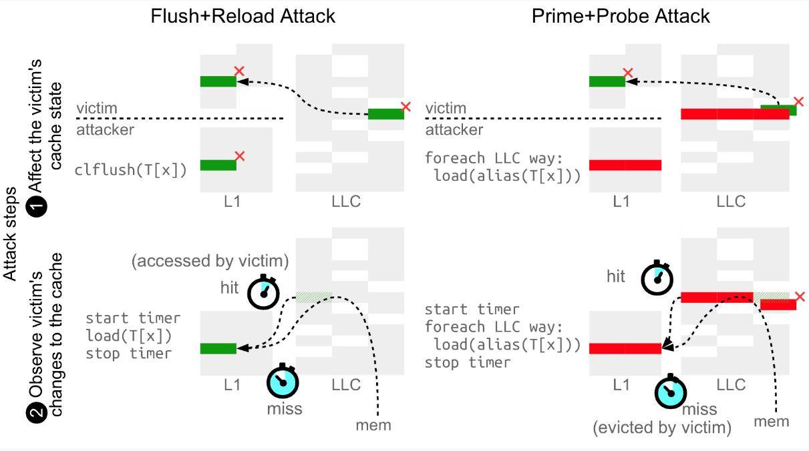
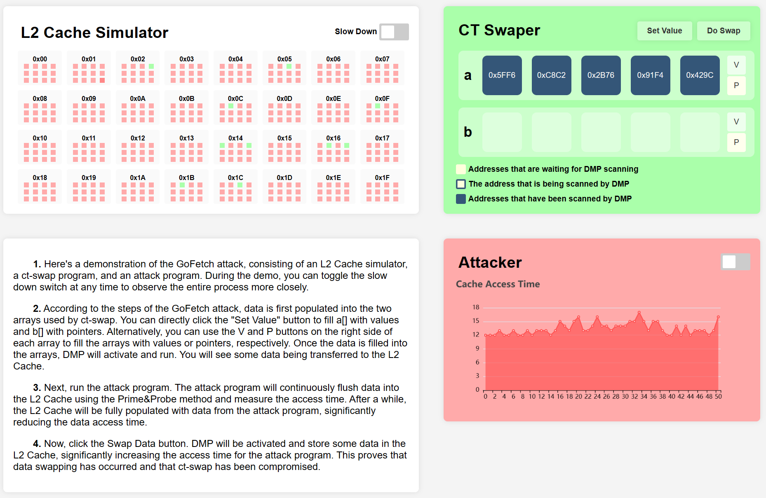
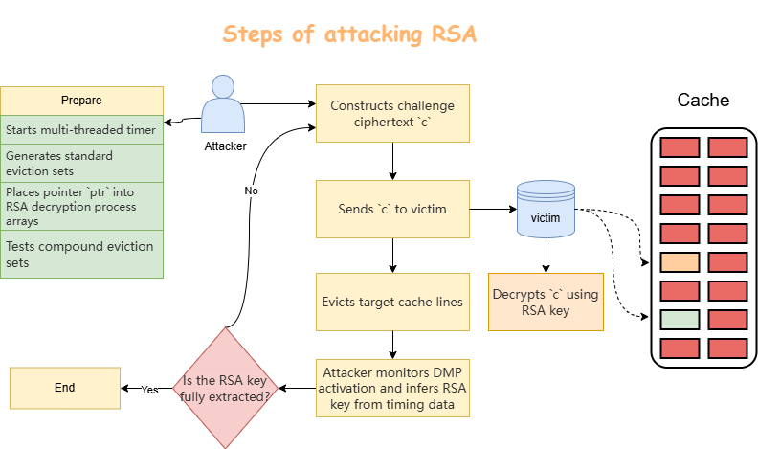
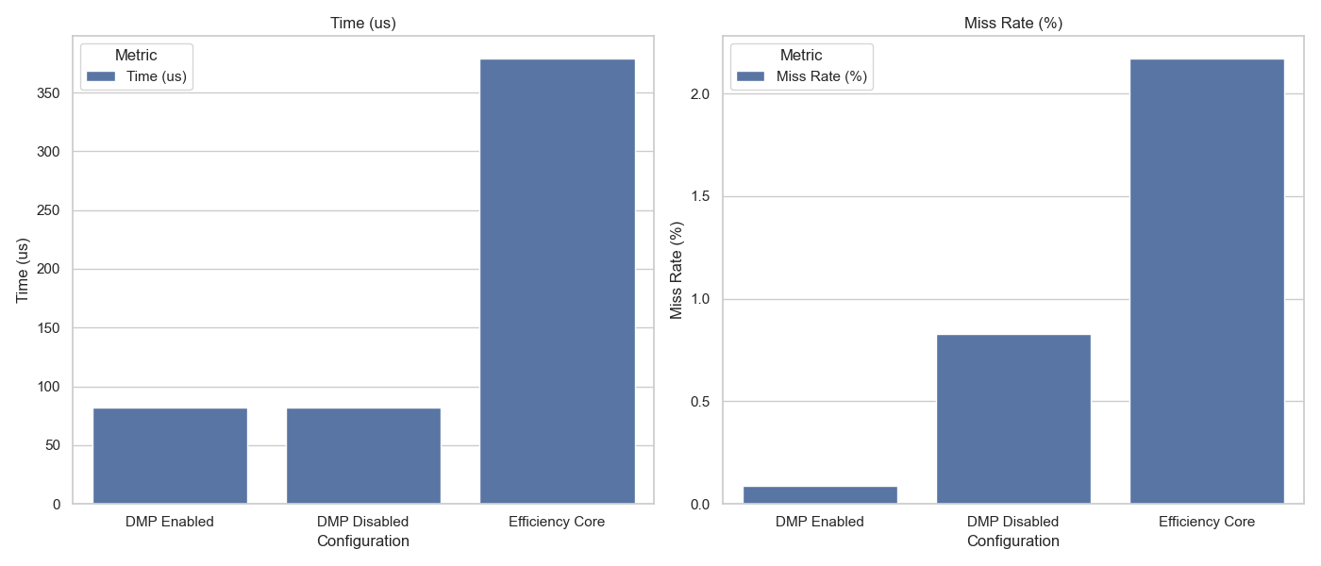
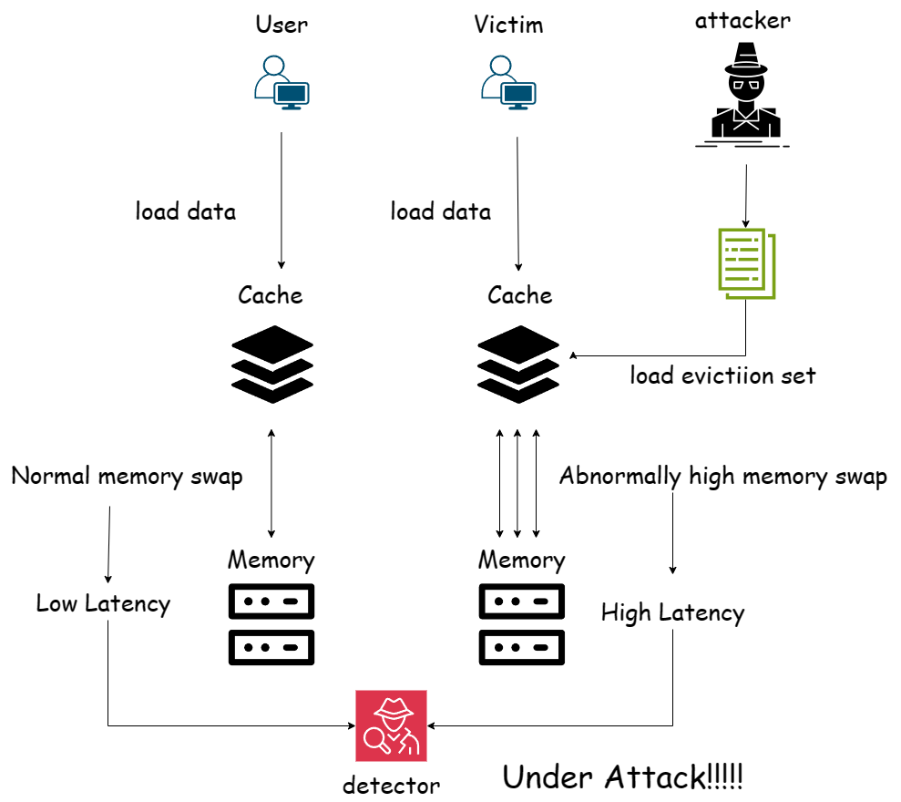
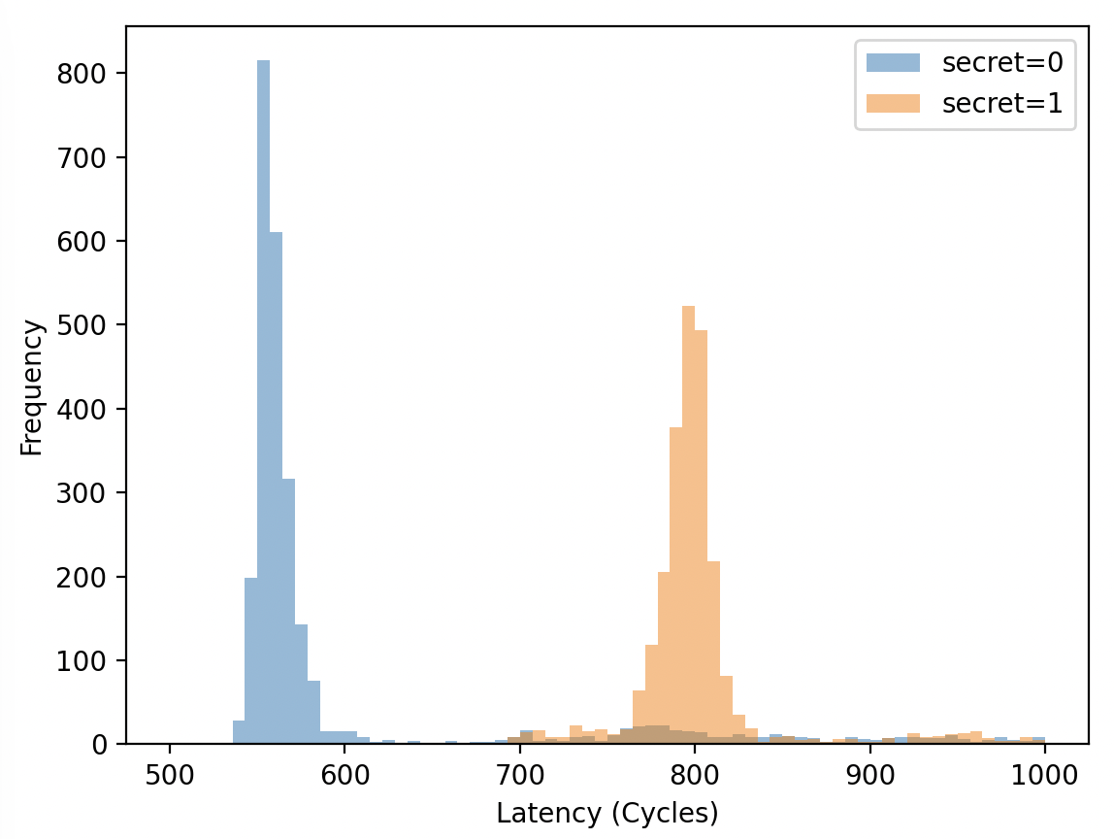

Demonstration and Defense of GoFetch Attack
2024_SW3011_5
Introduction
3. Defend this attack by using efficiency core, disabling DMP and blinding!
GoFetch[1] is a 2023 side-channel attack targeting Apple’s M-series CPUs' Data Memory-dependent Prefetcher (DMP) to infer sensitive data through manipulated memory access patterns.
This study explores GoFetch[1], demonstrates its principles through visualization, reproduction of the attack, and implementation of defense methods.
Objective
The objective of this study is to investigate the GoFetch , understand it, and try to reproduce, detect, and defend against it. Besides, we aim to assess the effectiveness of these defenses and measure the associated performance trade-offs.
4. An interactive webpage to simulate the attack, give it a try!
Methodology
Reproduce the attack and explain it in our own words, to learn more?
Evaluation
Evaluate the performance lost of denfense!
2.Successfully detect this Attack by detecting whether the array A has been evicted by attacker. That’s cool!
Conclusion
Finally, we successfully reproduce, detect, and defend against the GoFetch. Maybe in the future we will find other efficient way to detect and defend it.
References
[1] Boru Chen, Yingchen Wang, Pradyumna Shome, Christopher W. Fletcher, David Kohlbrenner, Riccardo Paccagnella, and Daniel Genkin. Gofetch: Breaking constant-time cryptographic implementations using data memory-dependent prefetchers. In USENIX Security, 2024.
NUS SOC Summer Workshop 2024

