Slide 1
Replicating the Conservative Formula
Yingni Chang and Yikai Shen · MTH 9897 Project 8 · CRSP replication, 1929–2024
Paper: Blitz and van Vliet (2018), The Conservative Formula, Journal of Portfolio Management 44(7)
Replicate the US results on the paper's sample, 1929–2016
Then examine factor exposure, later periods and trading costs
Main recent comparison: 1990–2024; the paper ends in 2016
Yingni Chang and Yikai Shen
Notes:
Hello everyone. We're Yingni Chang and Yikai Shen. Our project implements the Conservative Formula proposed by David Blitz and Pim van Vliet. The idea is to combine low volatility, momentum and shareholder payout in a portfolio of one hundred stocks.
We first try to reproduce the US results over 1929 to 2016, which is the paper's sample. We then extend the backtest through 2024. The historical comparison is fairly close, but the recent results are weaker after costs and factor adjustment. I'll explain the rule first, then the data and results, including the payout and sector issues raised in the assignment.
Transition: Let me start with what we wanted to test.
Presenter cue: Introduce both authors and the purpose of the project.

Slide 2
What we test
The rule: 1,000 largest US stocks → low-volatility half → rank on 12-1 momentum and net payout yield → best 100, equal weight, quarterly
1. Known factors: is the return explained by Carhart (primary) or FF5 + momentum (robustness)?
2. Decay: fixed periods 1929–1962, 1963–1989, 1990–2016, 2017–2024, plus rolling 120-month windows
3. Costs: net of 10 and 30 bps per dollar traded; break-even cost of the excess return and the alpha
All estimates with Newey–West (12 lags) or block-bootstrap intervals
Yingni Chang and Yikai Shen
Notes:
We organize the analysis around three comparisons. First, can we reproduce the paper's return, volatility and turnover? Second, how much of the return is explained by familiar equity factors? Third, what happens when we move to recent periods and include trading costs?
These questions matter because a strong result over almost ninety years does not necessarily mean that the strategy still has a useful advantage today. We use the Carhart model as our main factor adjustment and compare gross returns with returns at ten and thirty basis points per dollar traded. The fixed comparison periods were chosen before computing the post-2016 portfolio results.
Transition: Those comparisons depend on the data, so I'll turn to the CRSP inputs.
Presenter cue: Explain the distinction between replication and recent performance.

Slide 3
The data
CRSP monthly stock file via WRDS, extracted 2026-10-13; months 1925-12 to 2024-12
3,954,591 security-months, 26,746 securities, 22,869 delistings (2530 imputed, 317 set to zero)
Universe: 393 stocks in December 1928; the full 1,000 from 1964-06
One share class per company; dividends implied from total minus price return
Held stocks without a monthly return: stale-price carry or in-gap price ratio, every case counted
No release identifier on WRDS: the extract is identified by time stamp and file hashes
Yingni Chang and Yikai Shen
Notes:
We use the full monthly CRSP files from WRDS. After cleaning, the panel has about 3.95 million security-month observations and 26,746 securities. We combine stock returns with historical company information, delistings, distributions and the market index. We also use Fama-French factors.
Two choices are especially important. We keep stocks that disappear, including their terminal returns, instead of looking only at survivors. We also use one common share class per company to avoid double counting. The earliest portfolio universe has only 393 eligible stocks. It first reaches one thousand in June 1964, so the early backtest necessarily uses a smaller universe.
Transition: With those files cleaned, the selection rule is fairly simple.
Presenter cue: Point to the coverage counts, then emphasize delistings and the early universe.

Slide 4
The portfolio rule
Paper order: history screen → top 1,000 by market cap → low-volatility half → ranks among complete signals
Weights drift between rebalances; delisted holdings become cash; costs charged per dollar traded
Controls: Speculative (high-volatility half, weakest scores), standalone signals, Small, CRSP VW market
Excluded: Value (no book equity in CRSP) and Table 2 panels C–D (factors not in our sources)
deviation | our convention
Share-class selection | largest common class of each PERMCO per month (shrcd 10/11)
Size measure | security market cap for the top-1,000 cut
Dividends | implied from ret - retx (legacy retx includes non-ordinary distributions)
Missing-signal rule (NB-007) | partition first; complete cases ranked
Small early universe (DATA-001) | all history-eligible names when < 1,000 (393 at 1928-12; 500-name pool from 1964-06)
Missing monthly returns (DATA-002/010) | stale carry (0) or in-gap price ratio
Yingni Chang and Yikai Shen
Notes:
At each quarter-end, we first require thirty-six consecutive months of return history. We then select the largest one thousand eligible stocks by market capitalization. From this group, we keep the half with the lowest historical volatility.
Within that lower-volatility pool, we rank momentum and net payout favorably, average the two ranks, and select the best one hundred stocks. Each receives an equal weight. The holdings then drift with returns for the next three months. We rebalance using information available at the previous quarter-end. Applying the history requirement before the size cut is important because reversing that order changes the universe.
Transition: I'll show how we calculate the three inputs to those ranks.
Presenter cue: Follow the selection order on the slide.

Slide 5
Building the signals
Volatility: annualized standard deviation of 36 consecutive monthly total returns
Momentum: compound 11 monthly price returns, excluding the most recent month
Dividend yield: trailing 12 months of split-adjusted dividends divided by the current adjusted price
Net payout yield: dividend yield + 1 − latest adjusted shares / average adjusted shares over 24 months
A falling share count raises payout yield; new share issuance lowers it
Quarter-end information determines next month's holdings. No forward return enters selection.
Yingni Chang and Yikai Shen
Notes:
Volatility is the standard deviation of thirty-six monthly total returns, expressed in annual units. Momentum compounds eleven monthly price returns and skips the most recent month. Portfolio performance, in contrast, uses total returns including distributions and delistings.
Net payout combines dividend yield with the change in adjusted shares. We use the latest share count relative to its twenty-four-month average. Repurchases increase the signal, while issuance decreases it. Both prices and shares are split-adjusted, so a stock split should not create an artificial buyback. The twelve-month dividend window is a disclosed choice because the paper does not fully specify that part.
Transition: Now we can compare the backtest with the published figures.
Presenter cue: Explain each signal briefly; spend most of the time on payout.

Slide 6
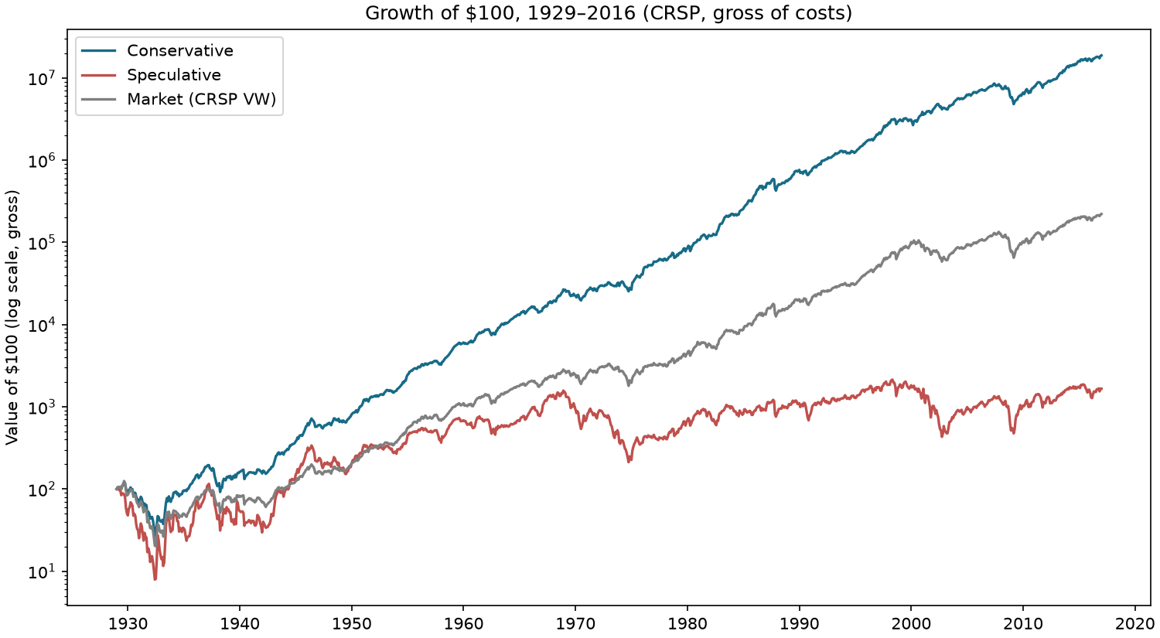
Our results versus the paper
Conservative 14.80% compounded, 17.06% volatility (paper 15.1%, 16.5%)
Market 9.15% (paper 9.3%)
Speculative 3.24% with 35.9% volatility
Conservative beats the market in 9 of 10 decades
Turnover 38.9% a quarter vs the paper's 32% (unexplained; measure not stated)
paper / ours | Formula | Market | Small | Momentum | Lowvol | NPY
Return (compounded) | 15.1% / 14.8% | 9.3% / 9.1% | 12.0% / 13.0% | 15.9% / 15.5% | 10.2% / 10.4% | 14.5% / 14.2%
Volatility | 16.5% / 17.1% | 18.7% / 18.7% | 31.4% / 33.5% | 25.7% / 26.1% | 13.3% / 14.4% | 20.1% / 21.1%
Yingni Chang and Yikai Shen
Notes:
Over the paper's sample, our Conservative portfolio compounds at 14.80 percent a year before costs, compared with 15.10 percent in the paper. Our volatility is 17.06 percent, compared with 16.50 percent. The broad return-and-risk result is therefore close.
The main unresolved difference is quarterly turnover: we get 38.9 percent, compared with 32.0 percent. Some control and regression results differ as well. Share-class choices, capitalization and dividend estimation could contribute, but we cannot separate their effects. We leave these gaps visible rather than adjusting the strategy to force a match.
Transition: Close raw returns are only part of the comparison; let's look at factor-adjusted returns.
Presenter cue: Point to the return/risk comparison and the growth chart.

Slide 7
Factor-adjusted returns
CMS (Conservative − Speculative), 1963–2016: CAPM 14.20% vs 14.0%; FF5 8.69% vs 8.8%; FF5 + MOM 3.12% vs 3.3%
1929–2016: CAPM 12.33% vs 13.9%; Carhart 7.74% vs 8.8% (full-sample gap remains)
Conservative long-only: Carhart alpha 3.23% (t 4.63)
  FF5 + momentum, 1963–2016: −0.11% (t −0.14) — adding profitability and investment reduces alpha
CMS net of 30 bps, both legs paying: Carhart 5.78% (t 3.99)
Yingni Chang and Yikai Shen
Notes:
Alpha here is the return left after accounting for the factors in the regression. A high raw return can still have little alpha if the portfolio mainly holds known factor exposures.
For the Conservative long-only portfolio, annual Carhart alpha over the paper sample is 3.23 percent. When we use the five Fama-French factors plus momentum over 1963 to 2016, the estimate falls to -0.11 percent. Adding profitability and investment changes the interpretation substantially. We also compare the Conservative-minus-Speculative contrast with the paper. The post-1963 comparisons are closer than the full-sample ones, but that does not establish the cause of the remaining difference.
Transition: Trading costs are another reason gross return can be misleading.
Presenter cue: Define alpha before discussing the factor models.

Slide 8
How costs change the result
Annual cost estimate: turnover × 8 × cost; quarterly turnover 38.9% vs 32%
Net of 30 bps, 1929–2016: 13.73% compounded
1990–2024 break-even: 52 bps (excess return), 36 bps (alpha)
2017–2024: gross excess return and alpha already ≤ 0, so no break-even
Early-period break-evens are high, but so were real trading costs then
break-even, bps | alpha | excess return
1929–1962 | 162 | 178
1963–1989 | 66 | 187
1990–2016 | 52 | 84
1990–2024 | 36 | 52
2017–2024 | none | none
Yingni Chang and Yikai Shen
Notes:
We charge costs on both purchases and sales. Thirty basis points means a charge of zero point three percent per dollar traded. Quarterly turnover on the slide is single-counted, so a purchase and sale are not counted twice in that measure.
At thirty basis points, the paper-period annual compound return falls to 13.73 percent. For 1990 to 2024, the break-even cost for Carhart alpha is approximately 36 basis points. Break-even means the cost at which the estimated advantage reaches zero. In the period after 2016, gross excess return and alpha are already nonpositive. These are flat cost scenarios, not a complete model of historical liquidity or market impact.
Transition: Let's look at how the estimates change across periods.
Presenter cue: Explain basis points and the single-counted turnover convention.

Slide 9
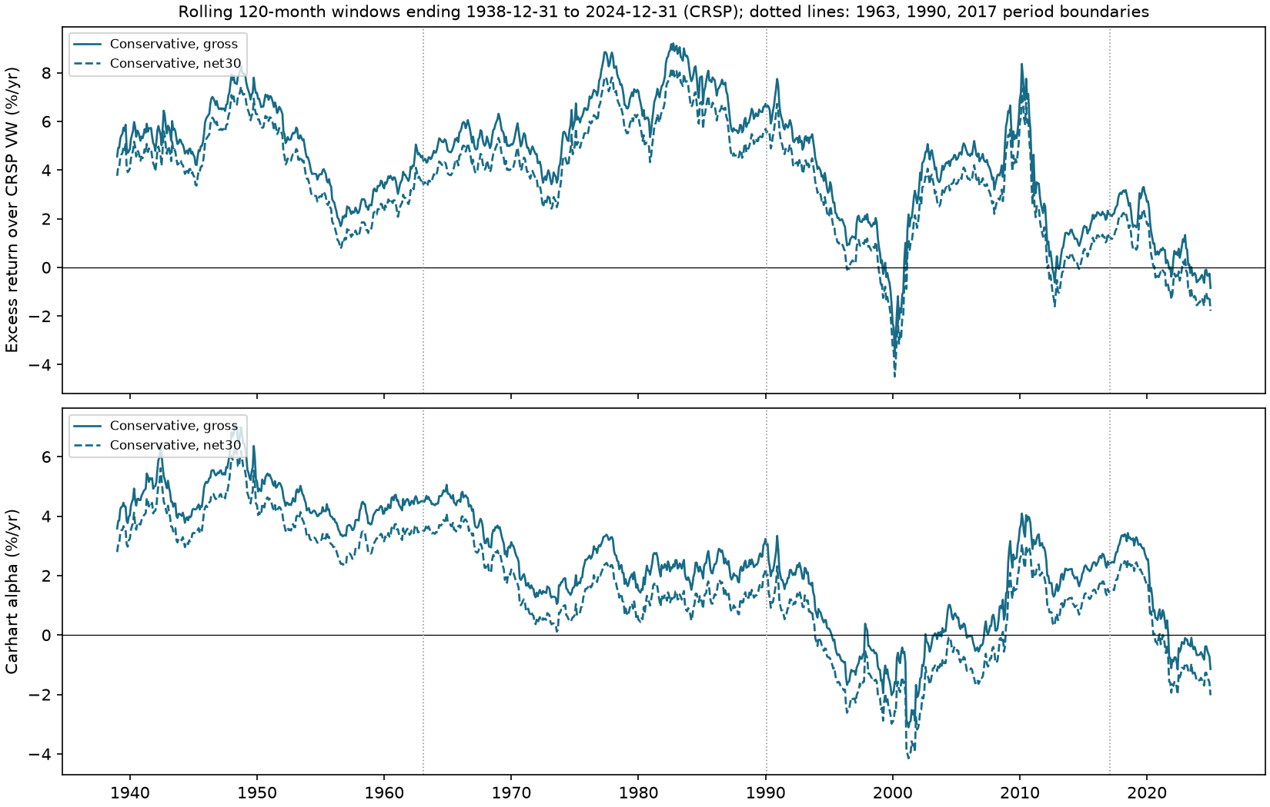
Results by period
Carhart alpha (gross): 4.7% → 2.1% → 1.7% → −1.2%
Carhart alpha is statistically significant in the two earlier periods
2017–2024 is only 96 months: interval [−5.1%, 2.7%]
period | months | excess, gross | Carhart α gross (t) | Carhart α net 30 (t)
1929–1962 | 408 | 5.2% | 4.7% (5.03) | 3.8% (4.14)
1963–1989 | 324 | 6.4% | 2.1% (2.90) | 1.2% (1.56)
1990–2016 | 324 | 2.7% | 1.7% (1.34) | 0.7% (0.56)
2017–2024 | 96 | −1.7% | −1.2% (−0.61) | −2.1% (−1.06)
1990–2024 | 420 | 1.7% | 1.2% (1.05) | 0.2% (0.18)
Yingni Chang and Yikai Shen
Notes:
The subperiods show why the long history needs to be broken up. The earlier Carhart estimates are stronger, while the recent estimates are weaker. The rolling plots show a similar pattern, although adjacent windows overlap and should not be treated as independent observations.
For 2017 to 2024, gross Carhart alpha is -1.21 percent. Its ninety-five-percent interval runs from -5.12 percent to 2.69 percent. That interval is wide because the sample contains only eight years. We do not find strong evidence of outperformance in that period, but an insignificant estimate is not proof that expected alpha is exactly zero.
Transition: We will now focus on the recent sample in more detail.
Presenter cue: Trace the early-to-recent pattern; do not read every table cell.

Slide 10
The recent sample: 1990–2024
Gross: excess over market 1.69% [−2.0%, 5.4%]; Carhart alpha 1.17% (t 1.05)
Net of 30 bps: excess 0.73% [−3.0%, 4.4%]; alpha 0.20% [−2.0%, 2.4%]
FF5 + momentum alpha, net of 30 bps: −2.00% (t −2.33)
Still lower risk: 12.2% compounded with 13.5% volatility (market 10.1%, 15.2%)
Cost-inclusive CMS alpha 3.72% (t 2.22)
Yingni Chang and Yikai Shen
Notes:
This is our main recent comparison. After thirty-basis-point trading costs, annual Carhart alpha is 0.20 percent. The ninety-five-percent interval is roughly -1.98 percent to 2.39 percent, so it includes zero. That makes a strong claim about recent factor-adjusted outperformance difficult to support.
The more consistent benefit is lower volatility than the market. The Conservative-minus-Speculative contrast still has a stronger result, but that includes shorting the Speculative portfolio. It is a different comparison from holding the Conservative portfolio alone, and its attribution result does not include actual borrow or financing costs.
Transition: Next are the two implementation checks highlighted in the assignment.
Presenter cue: Give the net-alpha estimate, interval and lower-risk result.

Slide 11
Dividends and share repurchases
NPY = trailing dividend yield + 1 − latest adjusted shares / 24-month average adjusted shares
Repurchases raise NPY; share issuance lowers it. Splits must leave the adjusted share count unchanged
1929–2016 gross CAGR: 14.80% using NPY versus 13.44% using dividends alone
Paired net-30 arithmetic gain from NPY: 1.22% per year [0.56%, 1.87%]
Same universe, low-volatility pool, momentum signal, weights, quarterly dates, and costs in the comparison
Share-count change measures net repurchases after issuance; it is not reported buyback cash flow
Yingni Chang and Yikai Shen
Notes:
This is one of the specific issues raised in the assignment. Dividend yield alone misses the indirect payout from repurchases. For example, with a three-percent dividend yield, ninety adjusted shares today and a one-hundred-share average, the net payout signal is thirteen percent. Issuance works in the opposite direction.
In the matched backtest, the net-payout rule earns 14.80 percent gross annually, compared with 13.44 percent using dividends alone. We hold the other rules constant so that we are comparing the payout ranking. This shows that the share-count term matters. It is still a proxy for net repurchases after issuance, not directly observed buyback cash spending or a causal estimate of the effect of buybacks.
Transition: The other concern is industry positioning.
Presenter cue: Emphasize the assignment's payout warning and the matched comparison.

Slide 12
Industry allocation and stock selection
Paper scores are compared across sectors (page 4); the professor's sector-aware variant is reported separately
1929–2016 gross arithmetic excess return: 4.80% per year
  Industry allocation 0.82% + stock selection 3.80% + reference-to-CRSP-market difference 0.18%
Reference: cap-weighted formation universe, quarterly constituents and industries fixed, weights drift, delistings to cash
Sector variant: 100 slots proportional to industry security counts; apply the rule separately within each FF12 industry. Gross CAGR 14.51%, net-30 13.37%
The sector variant is exploratory and changes the paper's global low-volatility screen. Contributions are arithmetic, not causal
Yingni Chang and Yikai Shen
Notes:
For sector positioning, we use Fama-French twelve industries. We compare our portfolio with a cap-weighted reference from the same formation universe, so a broad-market universe difference does not get mistaken for industry allocation.
Over the paper sample, industry allocation contributes about 0.82 percent a year and stock selection about 3.80 percent. A separate universe-to-market term completes the monthly identity. These are arithmetic contributions, not contributions to CAGR.
We also follow the course's quota idea: if an industry contains fifteen percent of universe stocks, it receives about fifteen of the one hundred holdings. That variant earns 14.51 percent gross annually. It changes the paper's global screen and was considered after the baseline results, so we treat it as an exploratory comparison.
Transition: We also test the signals outside the original stock-selection rule.
Presenter cue: Explain the reference universe and then the industry quota rule.

Slide 13
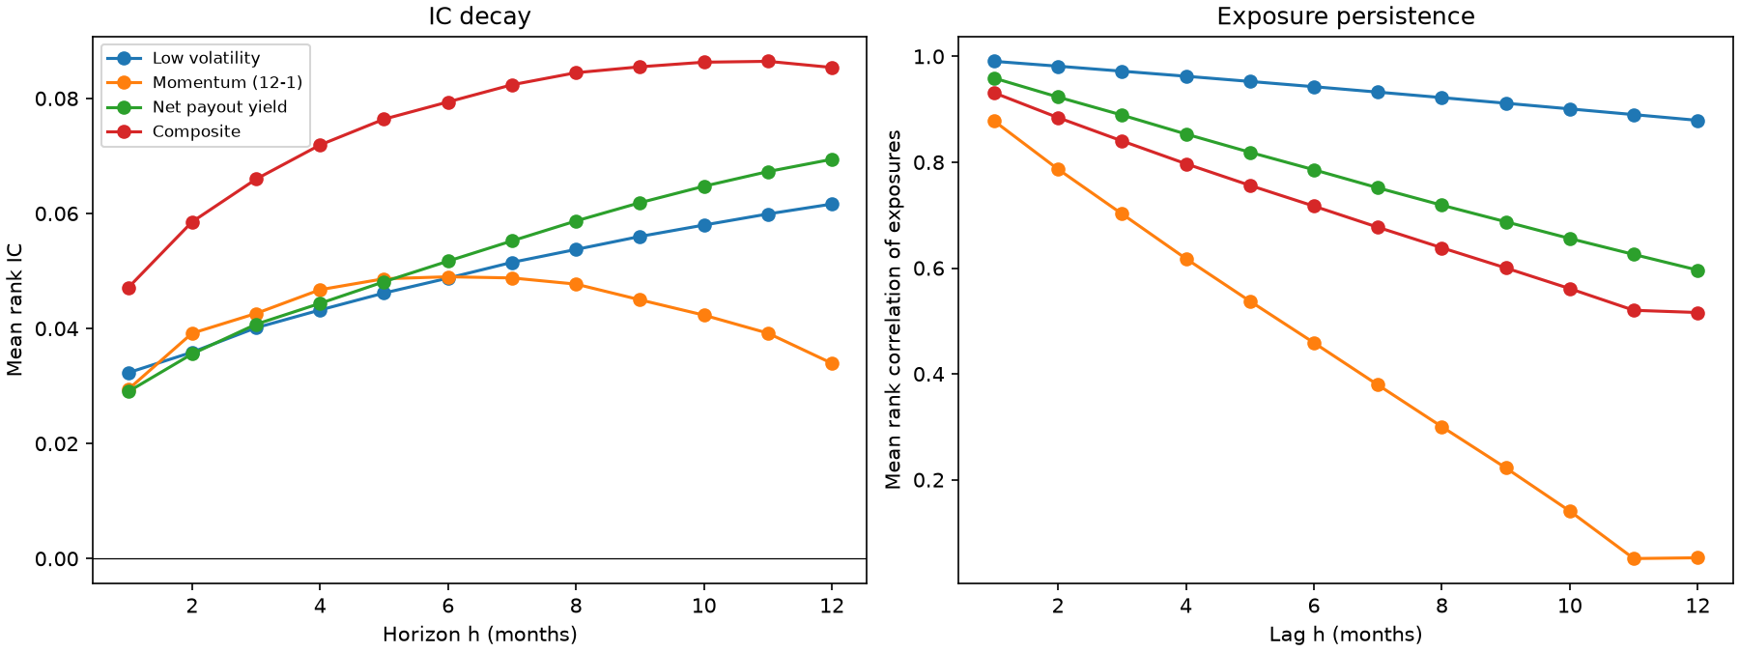
Signal tests
Composite rank IC (1 month): 0.047 (NW t 8.8)
Decile spread D10−D1: 1.02% (1963–1989), 0.68% (1990–2016), 0.40% (2017–2024)
Factor-mimicking paper portfolio: IR 0.59 at K = 1, 0.29 at K = 12
  2017–2024 IR at K = 1: 0.29
Low volatility: positive rank IC, flat mean spread (right-skewed high-volatility deciles)
Yingni Chang and Yikai Shen
Notes:
We next examine the signals separately. We remove industry means, standardize the exposures and clip extremes. The information coefficient, or IC, is the rank correlation between a signal and later industry-adjusted returns.
The composite's one-month IC is about 0.047. We also look at deciles, persistence and longer holding horizons. A positive rank correlation does not always imply a strong mean spread when returns are skewed. The factor-mimicking portfolios help separate signal exposures from industry, size and historical Fama-French controls. Their gross information ratio falls as we average more old portfolios, along with turnover. They are diagnostic portfolios with leverage, rather than a fully costed trading strategy.
Transition: That leads to the trading and portfolio-construction experiments.
Presenter cue: Define IC and explain why rank correlation differs from a mean return spread.

Slide 14
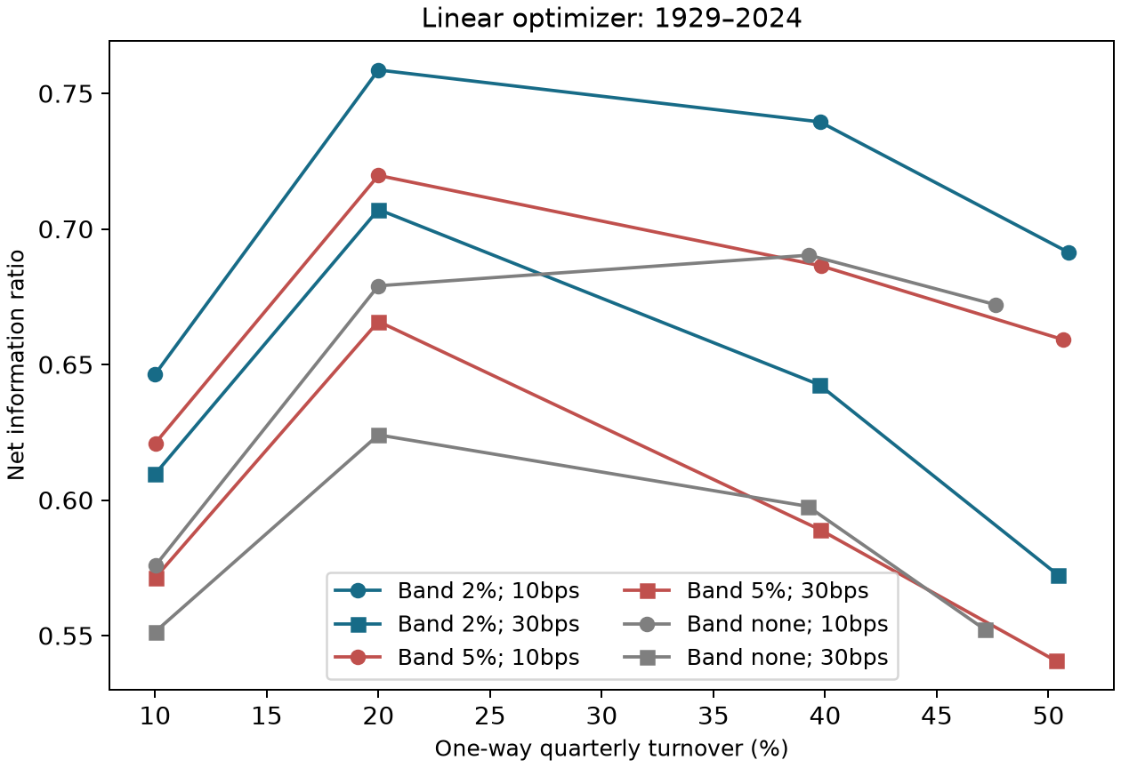
Long/short and linear optimization
Decile long/short, n = 3, 10 bps, borrow: 0.64% a year, IR 0.03, max drawdown −100.0%
  Monthly re-weighted cohorts: chosen after the pre-specified buy-and-hold cohorts were ruined (1932-08, 1933-05)
  Capacity 2020s ≈ $7.9B (scaled to 2024 market size; 10% of volume; no impact model)
Linear optimizer, 1990–2024 net 30: Carhart alpha 1.31%–1.95% (2–5% bands, 20–40% turnover budget); two of the four 95% intervals exclude zero
  Unadjusted intervals, selected from a 24-run grid; 2017–2024 alphas −2.71% to 0.07% (none of the twelve 95% intervals excludes zero); return-scaled alpha is a later sensitivity
We also test a portfolio covariance penalty
Yingni Chang and Yikai Shen
Notes:
The long/short exercise buys the top composite decile and sells the bottom decile. We compare holding periods, trading costs and monthly borrow fees. The original buy-and-hold cohorts lose all capital in the early data for several holding periods. We then examine monthly reweighting, which still has an extremely deep drawdown. That alternative was chosen after seeing the losses.
The linear optimizer gives stronger-looking recent results for some settings. It caps individual stocks, constrains industries and limits turnover. But two of the four 95% intervals exclude zero for the four displayed recent examples, and those intervals are unadjusted for testing many settings. The post-2016 estimates are weaker. We would need an unseen test before treating the best grid result as reliable.
Transition: The next model adds a covariance penalty.
Presenter cue: Separate the failed trading experiment from the optimizer grid.

Slide 15
Mean-variance portfolios
Maximize expected return − half risk aversion × portfolio variance − trading costs
Covariance: trailing 36 monthly returns, 50% diagonal shrinkage; the window ends at formation
Return alpha: completed trailing IC × annual volatility × √(3/12) × composite exposure
Quarterly: 2% stock cap, industry bands ±5pp, two-way turnover budget 40%; scaled costs start at 30bps
Two fixed risk aversions (5 and 20); max constraint violation 4.9e-09; turnover relaxations 0
We chose these settings after examining the baseline; an unseen test is still needed
1990–2024 | Net CAGR | Volatility | IR | Market corr.
γ = 5 | 11.59% | 12.51% | 0.14 | 0.89
γ = 20 | 10.39% | 11.51% | −0.03 | 0.87
Yingni Chang and Yikai Shen
Notes:
The quadratic model adds portfolio variance to the objective, alongside expected return and trading cost. We estimate covariance using the last thirty-six monthly returns. With about one thousand stocks and only thirty-six observations, sample covariance needs regularization, so we combine it equally with diagonal covariance.
For 1990 to 2024, risk aversion five gives net CAGR of 11.59 percent and volatility of 12.51 percent. At risk aversion twenty, those figures are 10.39 percent and 11.51 percent. More risk aversion lowers realized volatility, but market correlations remain high. These long-only portfolios are not market-neutral. We chose these settings after examining the baseline and have not established that they are optimal.
Transition: Finally, we test a simpler change aimed at reducing turnover.
Presenter cue: Use the table to compare the two risk-aversion settings.

Slide 16
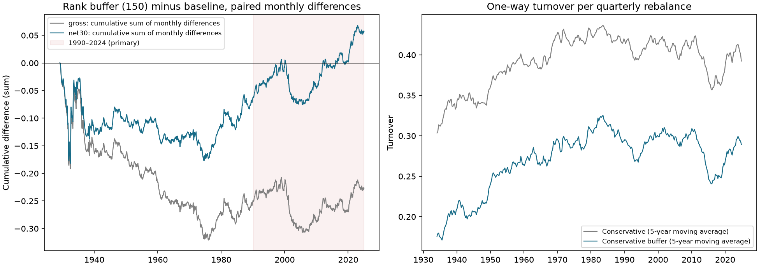
A buffer to reduce trading
Keep existing holdings while they remain in the eligible pool and within the best 150 ranks
Turnover 39.8% → 28.4% a quarter (28.7% lower)
Net-of-30 paired difference 0.34% a year [−0.10%, 0.78%]: not significant
Gross paired difference 0.06%; the buffer changes holdings as well as costs
The recent period was already seen when we tested this variant
Yingni Chang and Yikai Shen
Notes:
The buffer asks whether we need to sell a holding immediately when its rank slips below one hundred. We keep it while it remains eligible and among the best one hundred and fifty ranks, then fill vacancies. We fixed that buffer size before testing the variant.
Quarterly turnover falls from 39.8 percent to 28.4 percent. The net paired difference is 0.34 percent a year, but its interval includes zero. The modification reduces trading, while also changing holdings, so we cannot attribute the whole return difference to costs. We view it as a useful trading experiment, not proof of a better signal.
Transition: These comparisons lead us to the main conclusion.
Presenter cue: Point to the turnover reduction and the confidence interval.

Slide 17
What we conclude
Return and volatility are close to the paper; turnover and some regression results differ
Much of the historical return is associated with known equity factors
Alphas decay; 1990–2024 net of 30 bps: alpha 0.20% [−2.0%, 2.4%]
The recent net-alpha interval includes zero
Lower volatility is the most consistent feature of the portfolio
Limitations: no CRSP release identifier; implied dividends; share-class and size conventions; turnover above the paper's; selection across grids; a short post-sample
Yingni Chang and Yikai Shen
Notes:
Our implementation reproduces much of the paper's historical return and risk pattern, but it is not an exact replication. Turnover and some regression results still differ. We have also checked the two issues highlighted in the assignment: net payout includes the adjusted share-count term, and industry positioning is measured and tested separately.
For recent data, lower volatility is more consistent than positive net alpha. The buffer and optimizers change trading and risk, but their results do not yet show a stronger strategy on unseen data. Our conclusion is that this is a useful, understandable factor portfolio, with important limits to a claim of persistent outperformance.
Transition: I'll finish with the code and data needed to rerun the project.
Presenter cue: Pause on the main conclusion and the unresolved turnover difference.

Slide 18
Running the project
python -m crsp_pipeline.import_web (full web exports; licensed data kept private)
python -m crsp_pipeline build
python -m research.run_all → results/ (aggregates) + results/manifest.json
python build_notebook.py && python execute_notebook.py
python presentation/build_pdf.py (PDF slides and speaker notes)
85 result files with sha256 hashes; data manifest 4816d582000a…
Yingni Chang and Yikai Shen
Notes:
The main calculation command is python, dash m, research dot run all, from the Final folder. The notebook and PDFs read the saved aggregate results, so they can be opened without the licensed stock-level data. A full rebuild uses the private CRSP inputs and the cleaning code first.
We include the source, notebook, reports, data audits and run instructions in the course package. The public repository contains code and aggregate results; the licensed data stay in the private submission. This allows the calculations to be checked without putting the raw observations on GitHub. Thank you. We're happy to take questions.
Presenter cue: Give the entry point; finish without reading every command.

