Slide 1
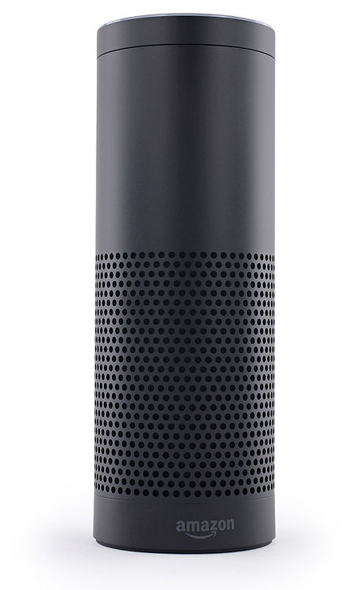


raspberry pi + alexa
Presented by Ying Lee

Slide 2

YING LEE
B.S., M.S., M.A., Ph.D., Sc.D
…OMG
MECHATRONICS DEVELOPER /ARCHITECT

Slide 3
DEVELOPMENT BACKGROUND
LANGUAGES
C#/XAML
C++
Silverlight / WPF
HTML / CSS
JavaScript
HDML/WAP/WML
CGI / Perl
Java
ASP/MVC
Processing
C#/XAML
C#/XAML
MOBILE DEV
Xamarin Hybrid
HTML 5/CSS/JS
PhoneGap
Hybrid
Native Android OS
Firefox OS
Native iOS
Windows
JavaME
HARDWARE DEV
Arduino / Netduino
Raspberry Pi
ARM Processors
Intel Quark / Galileo Series

Slide 4



WINDOWS DEV
2016
WINDOWS PLATFORM DEV
2015
CLIENT DEV
2014
XAMARIN INSIDER
SINCE 2014
TELERIK INSIDER
SINCE 2013

Slide 5
Objectives
Overview of Amazon Echo / Alexa
Overview of Raspberry Pi GPIO Pins (General Purpose Input Output)
Python programming language
Step-by-step building of the Raspberry Pi - Echo
Setting up an Amazon Developer Account / Alexa Voice Services

Slide 6
Objectives Continue
Setting up the Raspberry Pi – Echo User Environment
Setting up IFTTT (If This Then That) Recipes to expand Echo’s capabilities
Demonstrate Echo/Alexa
Q & A

Slide 7


Who here uses a personal voice assistance?
Apple
Siri
Google
Now
Notes:
Can I ask you what you use it for?
Before we start, I want to show you what we will be building today.
SHOW device
We have a lot of information to go over today, so let’s begin.

Slide 8
Overview of Amazon Echo / Alexa
What is it?
Amazon Echo is a wireless speaker and voice command device from Amazon.com
Release Date: November 6, 2014
Price: $179.99
Input: Voice Command
Connectivity: Wi-Fi and Bluetooth

Slide 9
Features
Voice interactions
Music playback
Making to-do lists
Setting Alarms
Streaming podcasts
Play audiobooks
Provide weather, traffic, real-time information
Control other devices

Slide 10
How does it work?
Seven-piece microphone array
What does this mean?
360° audio capturing
Simply speak to Alexa through the microphone on your device and Alexa will respond through your device's speakers using Alexa Voice Services (AVS)

Slide 11
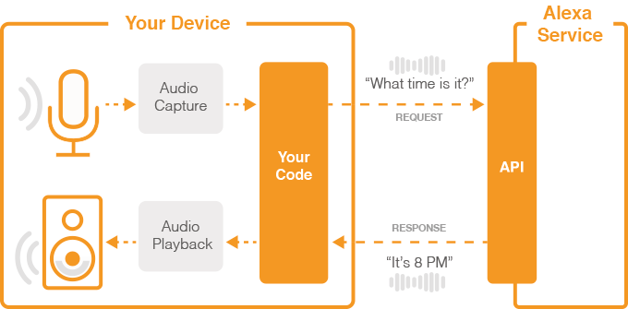
Alexa Voice Services
Alexa API (Application Program Interface) workflow diagram

Slide 12
IT’S FREE!

Slide 13
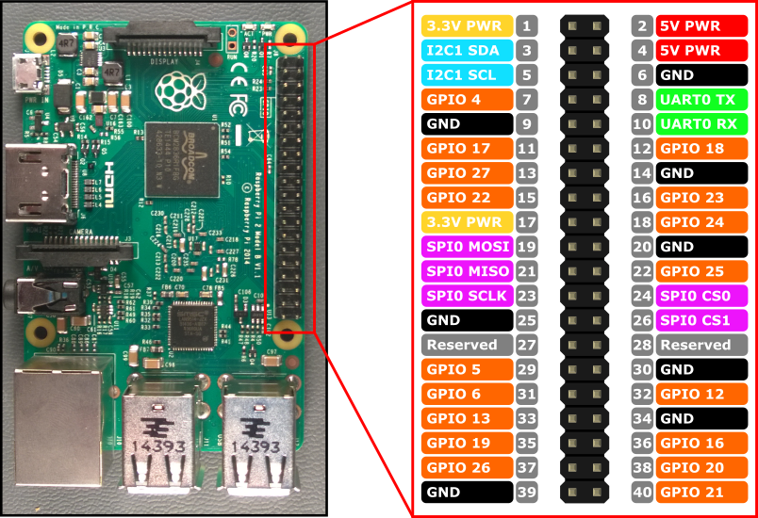
Overview of Raspberry Pi GPIO Pins (General Purpose Input Output)
These pins are to communicate with other circuitry such as extension boards, custom circuits and much more.

Slide 14
Warning: Experimenting with the GPIO is risky and has a chance of bricking your Raspberry Pi. Knowing the power limitations of the GPIO pins and also understanding what you’re plugging in is a must.

Slide 15
GPIO ACRONYMS
GPIO are your standard pins that simply be used to turn devices on and off. We will use them for LED’s and a button.
I2C (Inter-Integrated Circuit) pins allow you to connect and talk to hardware modules that support this protocol (I2C Protocol). This will typically take up 2 pins.
SPI (Serial Peripheral Interface Bus) pins can be used to connect and talk to SPI devices. Pretty much the same as I2C but makes use of a different protocol.

Slide 16
ACRONYMS CONTINUE
UART (Universal asynchronous receiver/transmitter) are the serial pins used to communicate with other devices.
DNC stands for do not connect, this is pretty self-explanatory.
GND are the pins you use to ground your devices. It doesn’t matter which pin you use as they are all connected to the same line.
Power is pulled directly from the Raspberry Pi.

Slide 17
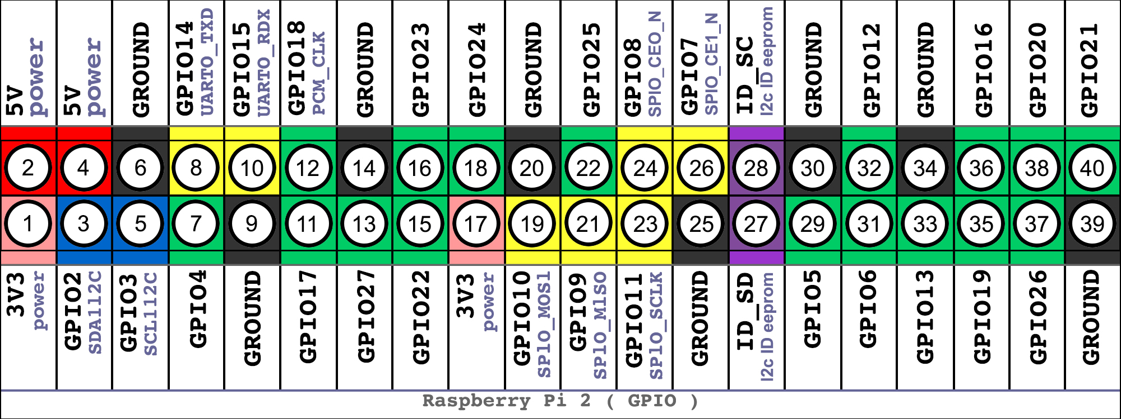
Pin Layout
Notes:
Explain PINS
Labeled 1 – 40
Be sure not to confuse these with GPIO Pin Numbers

Slide 18
Python – Programming Language
Python is the default programming language for GPIO on the Raspberry Pi
Python is white space sensitive

Slide 19
Simple Python Script Example- Blinking LED
#import the GPIO and time package import RPi.GPIO as GPIO import time
#sets up board to use physical pins, pin 7 as output GPIO.setmode(GPIO.BOARD) GPIO.setup(7, GPIO.OUT)
# loop through 50 times, on/off for 1 second for i in range(50): GPIO.output(7,True) time.sleep(1) GPIO.output(7,False) time.sleep(1) GPIO.cleanup()

Slide 20
Step by step building of the Raspberry Pi – Echo, Cost: ~$62
Parts List | Cost | Parts List | Cost
2 LED’s | Free | Wireless Keyboard | $6
USB Microphone or Web camera w/ microphone | Repurposed Playstation 3 Eye Toy | Raspberry Pi 2, Power Supply, microSD, Wi-Fi Dongle | $50
Momentary Button | Free | Wireless Mouse | Free
Powered Bluetooth Speaker | $5 @ RadioShack | Case Housing @ Dollar Tree | $1
Mounting Hardware | Free | Wire | Free

Slide 21
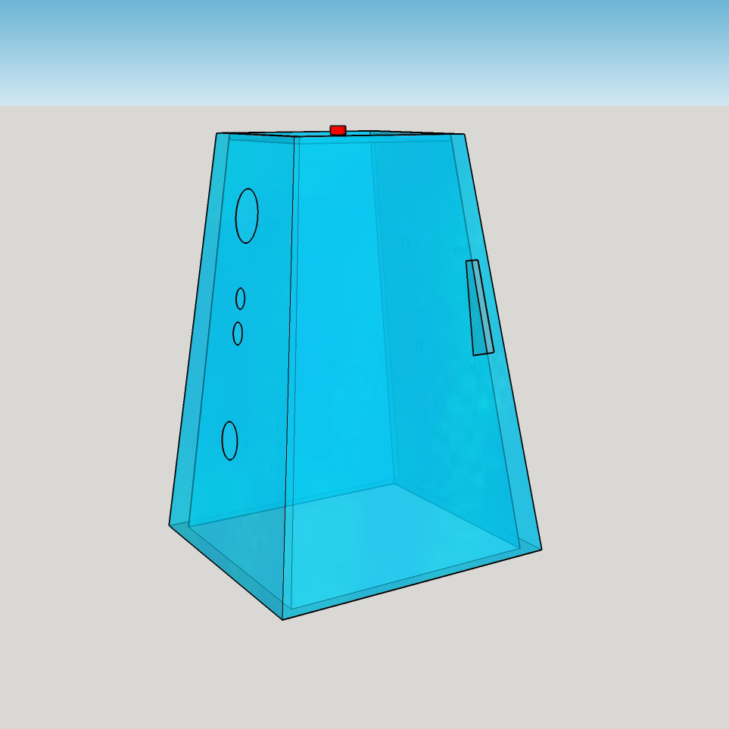
Step by step building of the Raspberry Pi – Echo, continue
LED
Speaker Hole
Port Hole
Camera Hole
LED

Slide 22
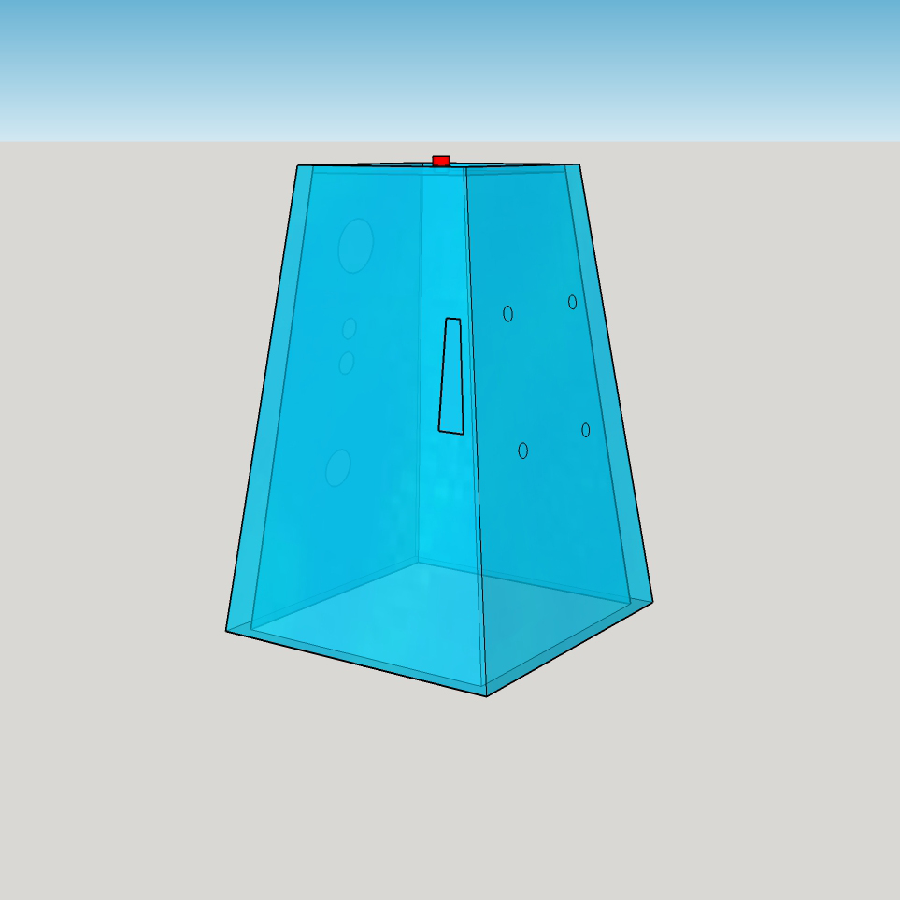
Step by step building of the Raspberry Pi – Echo, continue
Raspberry Pi
Mounting Holes

Slide 23
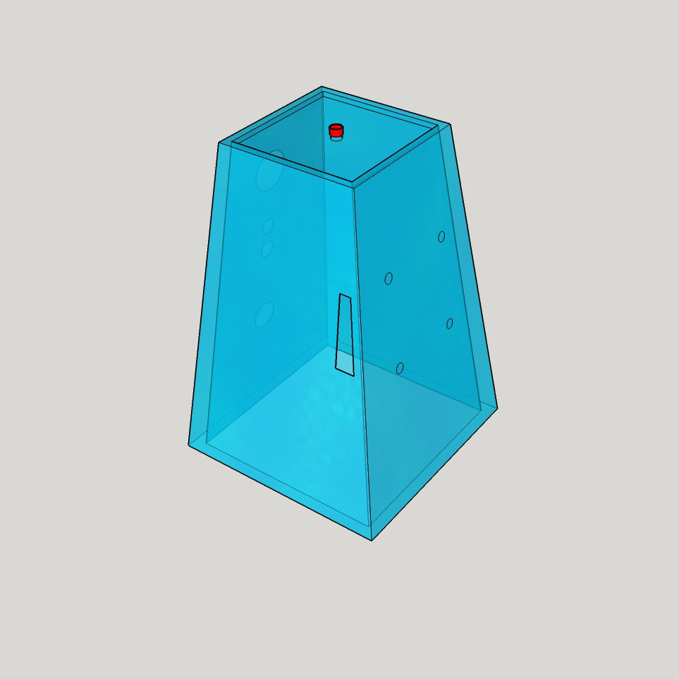
Step by step building of the Raspberry Pi – Echo, continue
Activation
Button

Slide 24
Setting up an Amazon Developer Account
Navigate to https://developer.amazon.com/
Click Sign In or Create Account
Click “I am a new customer”
Enter in name, email address, password
Click “Create Account”

Slide 25
Setting up an Amazon Developer Account, continue
Fill in contact information
Click “Save and Continue”
Click “Accept and Continue” to App Distribution Agreement
Enter in payment information, don’t worry, it’s FREE.

Slide 26
Setting up the Raspberry Pi – Echo User Environment
(Assumes you have Raspbian Jessie installed)
Open a terminal window
Run command: sudo apt-get install git (this will allow us to download the source code from github)
Navigate to the Downloads folder by running command: cd Downloads
Notes:
sudo apt-get update
sudo apt-get install tightvncserver
tightvncserver

Slide 27
Setting up the Raspberry Pi – Echo User Environment, continue
Download the source code from github by running command: git clone https://github.com/yingopilee/AlexaPi (this will download the source code into a folder called AlexaPi in the Downloads folder)
Navigate to AlexaPi by running command: cd AlexaPi
In your browser, log into your Amazon Developer Account

Slide 28
Setting up the Raspberry Pi – Echo User Environment, continue
Click App and Services
Click Alexa
Click Alexa Voice Services
Click Register a Product Type -> Choose Device
Enter a Device Type ID -> RaspberryEcho
Enter a Display Name -> RaspberryEcho
Click Next
Notes:
Be sure to remember the spelling and casing of ID

Slide 29
Setting up the Raspberry Pi – Echo User Environment, continue
Under Security Profile, choose Create a new profile
Set Security Profile Name to: Raspberry Echo
Set Security Profile Description to: Raspberry Echo
Click on Web Settings Tab
Click Edit

Slide 30
Setting up the Raspberry Pi – Echo User Environment, continue
Allowed Origins, Click Add another http://localhost:5000 http://ipaddress:5000
Allowed Return URLS, Click Add another http://localhost:5000/code http://ipaddress:5000/code
Click Next

Slide 31
Setting up the Raspberry Pi – Echo User Environment, continue
Under Category, Choose Other
Set Description to Raspberry Pi Echo
Set expected timeline for commercialization to Longer than 4 months/TBD
Set How many devices are you planning to commercialize, to 1
Click Next

Slide 32
Setting up the Raspberry Pi – Echo User Environment, continue
Enable Amazon Music? Choose Yes or No
Click Submit, you will be brought back to Register your product with Alexa Voice Services
Click on Edit
Navigate to Security Profile Leave this page open as we will need the “Keys”

Slide 33
Setting up the Raspberry Pi – Echo User Environment, continue
Return to your terminal on the Raspberry Pi
Run command: sudo ./setup.sh
Continue: Yes
Enter in your Product ID: RaspberryEcho
Enter in your Security Profile Description: Raspberry Echo

Slide 34
Setting up the Raspberry Pi – Echo User Environment, continue
Copy/Paste Security Profile ID from browser to terminal
Copy/Paste Security Client ID from browser to terminal
Copy/Paste Security Client Secret from browser to terminal
Navigate to your ipaddress:5000 in a browser
Click Continue
Run Service by running command: python main.py

Slide 35
Setting up IFTTT (If This Then That) Recipes to expand Echo’s capabilities
Sign up for an IFTTT account at https://ifttt.com
Use pre-built recipes / build your own recipes
To build, click on My Recipes
Click Create Recipe, click “this”
Choose a “Channel” (Choose Amazon Alexa)

Slide 36
Setting up IFTTT (If This Then That) Recipes to expand Echo’s capabilities, continue
Choose a Trigger
Click Create Trigger
Click “that”
Choose a “Channel” (Can be anything you want)
Click Create Recipe
Alternatively, download the IFTTT app from the Apple App Store or Google Play Store to set up recipes

Slide 37
Demonstrate Echo/Alexa
DEMO

Slide 38
Q & A
Questions

Slide 39
Review
Overview of Amazon Echo / Alexa
Overview of Raspberry Pi GPIO Pins (General Purpose Input Output)
Python Programming Language
Step-by-step building of the Raspberry Pi – Echo
Setting up an Amazon Developer Account / Alexa Voice Services
Setting up the Raspberry Pi – Echo User Environment
Setting up IFTTT (If This Then That) Recipes to expand Echo’s capabilities
Demonstrate Echo/Alexa

Slide 40

Thank you!
https://github.com/yingopilee/AlexaPi

