Slide 1
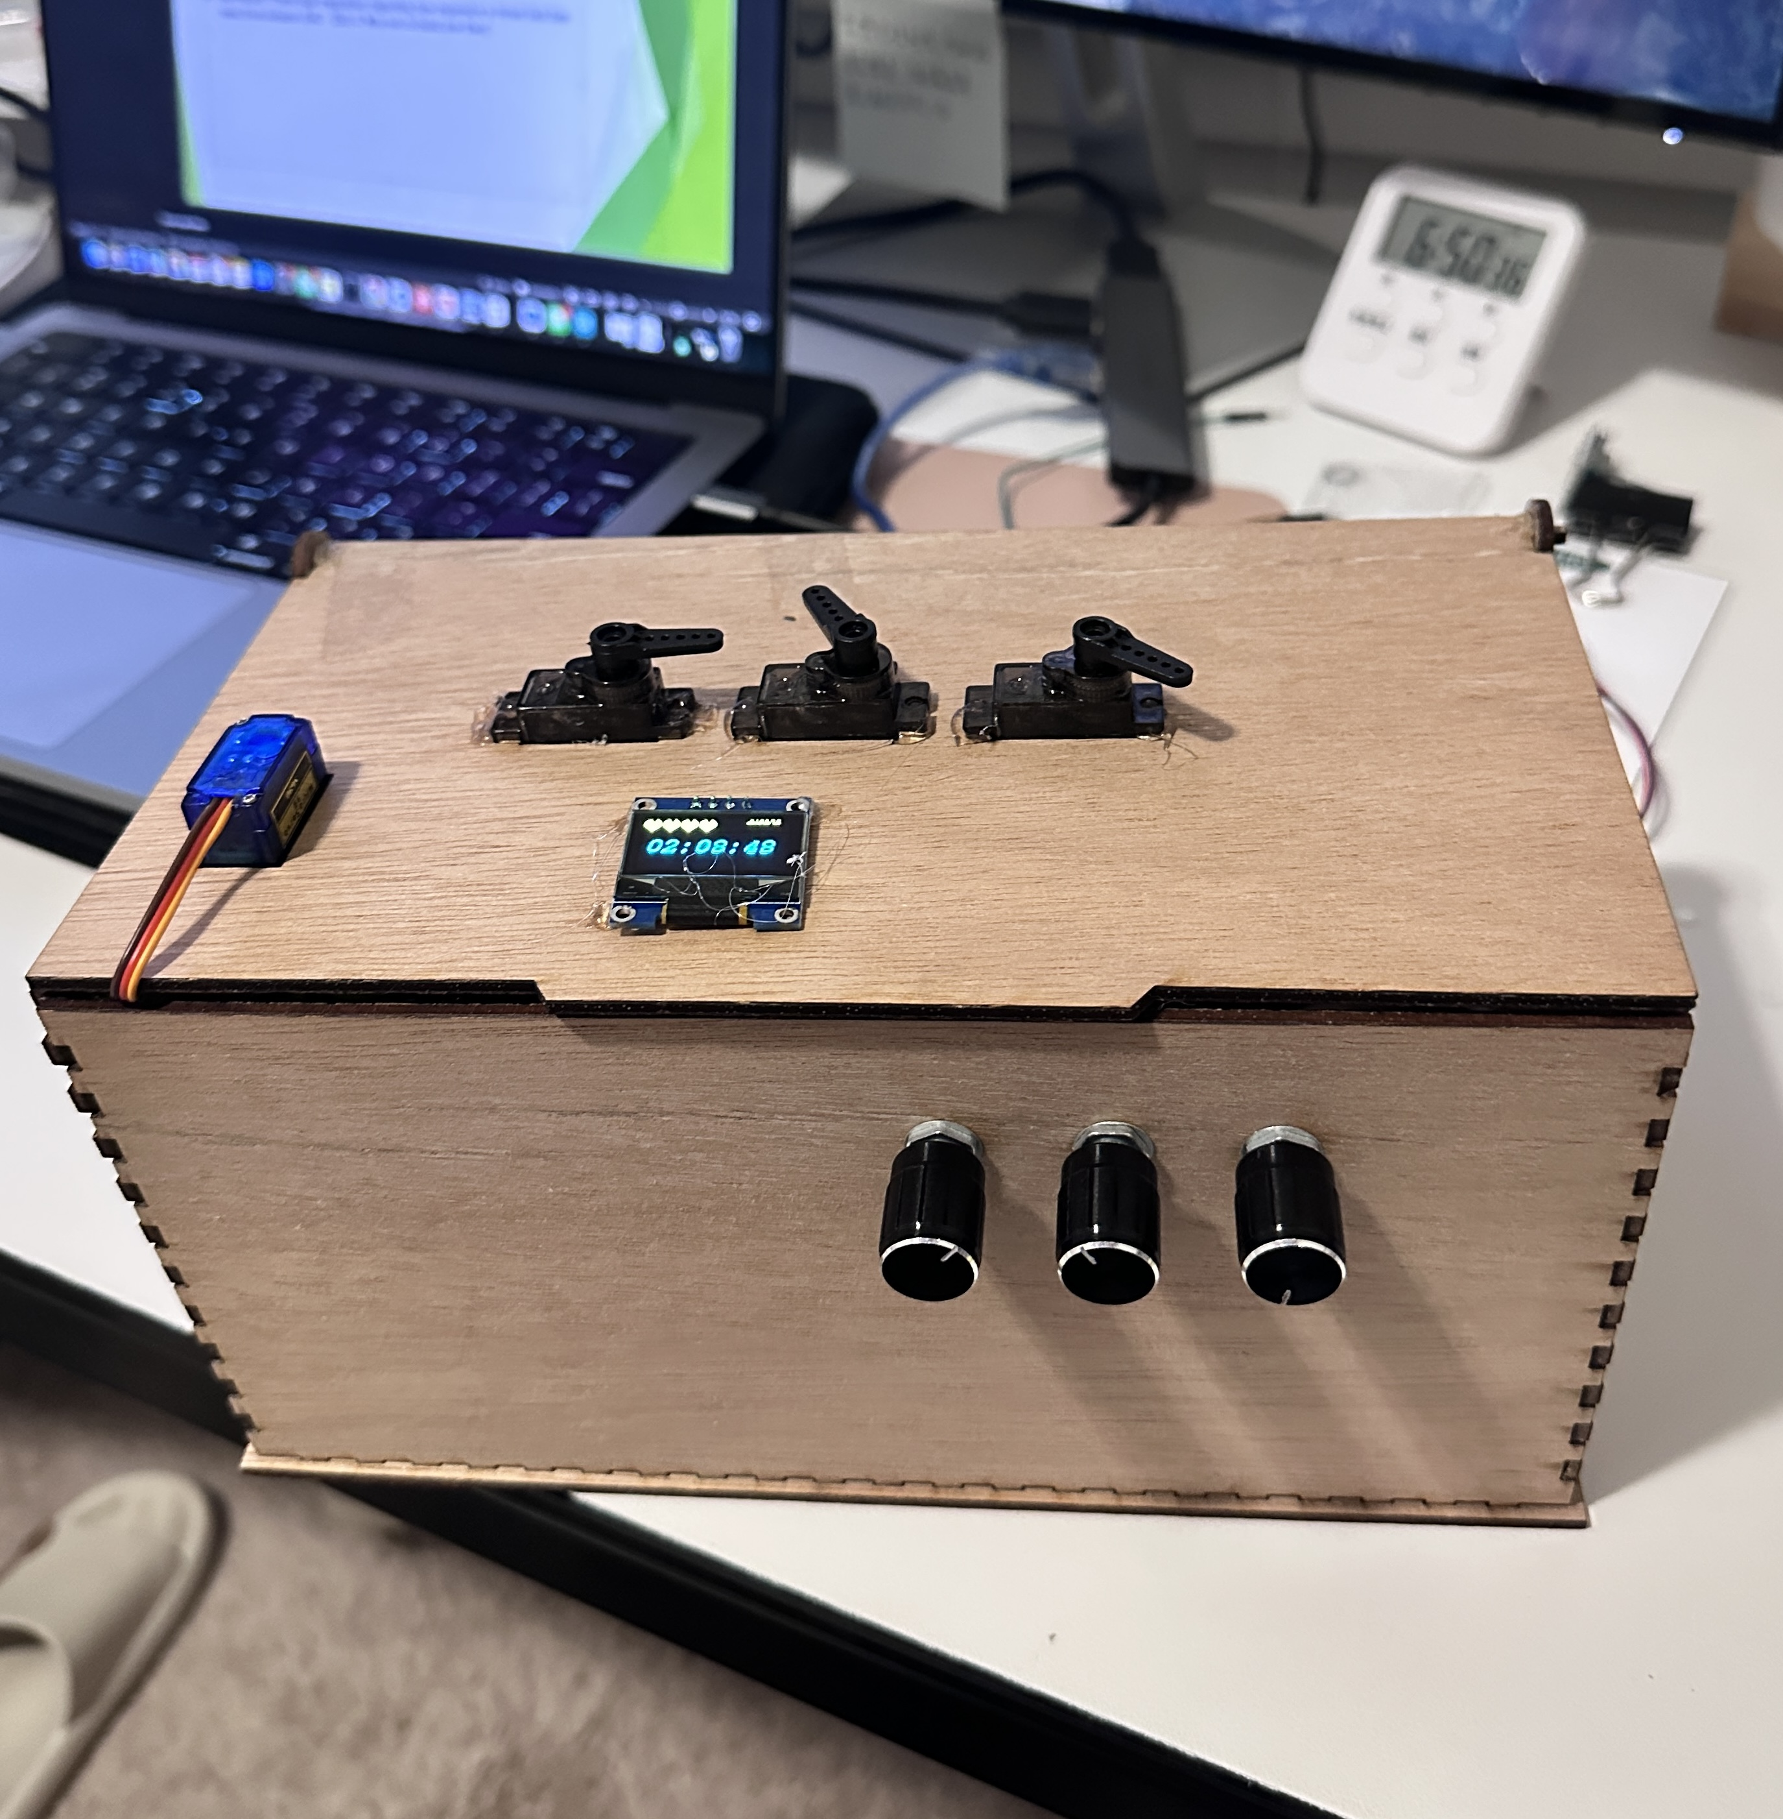
Timed Lock Box
Yingqi Chen

Slide 2
What it is?
This is a timed lock box for procrastinator to lock their phone while they are aiming for focusing on other important priority tasks
Motivation: Friend talk inspiration regarding how expensive a timed lock box need from Amazon ($40 ~ $50) ☺ Why not to build one then?
User can see the OLED display to set the timer.
User can use rolling encoder to adjust hour:minute:seconds independently.
When click the button, user is able to see the timer start counting down.
User can use emergency function to unlock the box.
User can visualize seeing 3 servos speed differences to indicate current time left.

Slide 3
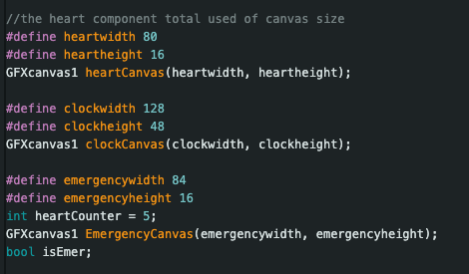
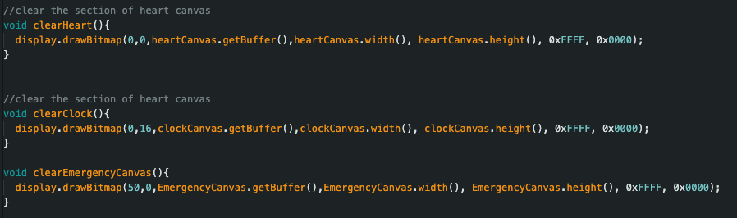
Implementation Process
Starting with basic I2C connection to test out OLED display
Connection with the right address
Figuring out element display via bitmap (binary codes)
Cleaning display problem
Using library GFXcanvas to separate different segment and being able to clean the pixels independently.

Slide 4
Implementation Process – cont.
Rolling encoder implementation with correct clockwise and counter- clockwise
It takes 3 states, not 2 states where the mid point of the rolling itself also made impact (found from tutorials explanation of how the rolling encoder works for PWM)
Issue: the OLED display does not compatible with regular GPIO rolling encoder → using interrupt to solve.
Using additional library of pressing event <BfButton.h> to identify single push, long push, double push, etc → for detecting countdown vs. using emergency feature.
Implemented continuous rotation servos to indicate current time status.
Hard to find the initial position and full round time interval.

Slide 5
Challenges
Was trying to use servos to indicate current time position, but IT IS the continuous rotation servo, hard to find the current position degree. So instead, using the speed to indicate current time left.
Running from full speed to slower state and to stop while the timer hit 0:0:0.
When doing display.clear(), it clears the whole canvas. Seeking a method to separate the sections and being able to clean each section separately.
The OLED display does not work while I connect to a 9v battery to run button pressed. Need to connect to the laptop to fully functional.

