Slide 1
GO enrichment analysis

Slide 2
library(gProfileR)
de <- read.csv("./results/de_results.csv", header = TRUE)
goresults <- gprofiler(as.character(de$external_gene_name),
organism = "mmusculus",
ordered_query = F, significant = T, exclude_iea = F, underrep = F,
evcodes = F, region_query = F, max_p_value = 0.05, min_isect_size = 0,
correction_method = "gSCS", hier_filtering = "strong", domain_size = "annotated",
#custom_bg = as.character(df_final$external_gene_name),
numeric_ns = "", png_fn = NULL, include_graph = F, src_filter = "GO")

Slide 3
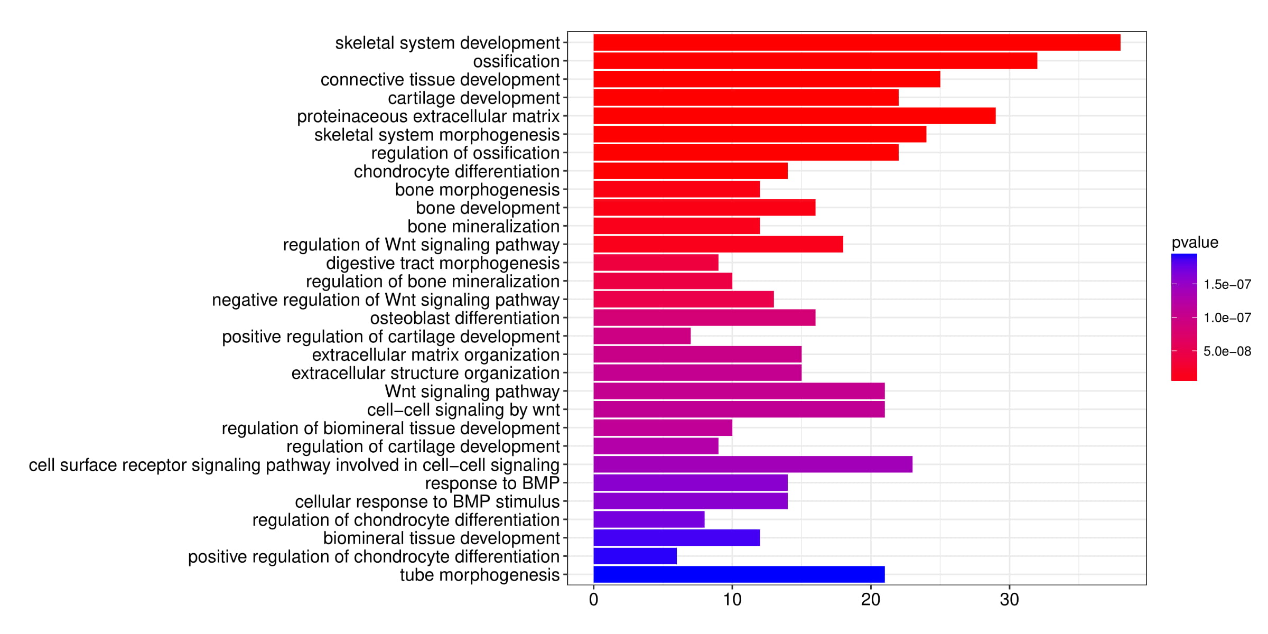
goview <- function(goresults){
ggplot2::ggplot(data=goresults, aes(x=reorder(term.name, -p.value), y=overlap.size,fill=p.value))+
geom_bar(stat="identity")+
scale_fill_gradient2(mid='red', high='blue', space='Lab')+
labs(title="GO enrichment", x ="GO terms", y = "number of genes", fill = "P value")+
theme(plot.title = element_text(hjust = 0.5, size = 12))+
coord_flip()
}

Slide 4
Work with range data

Slide 5

Bioinformatics Data Skills
https://github.com/vsbuffalo/bds-files

Slide 6
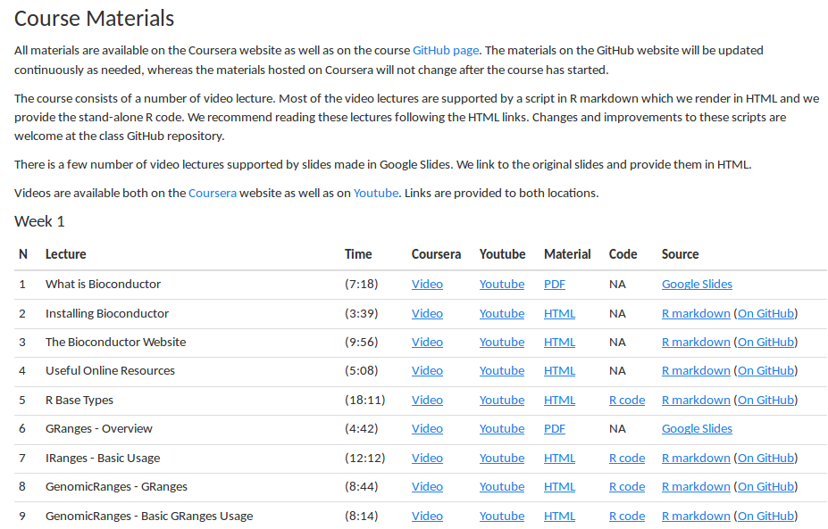

http://kasperdanielhansen.github.io/genbioconductor/

Slide 7
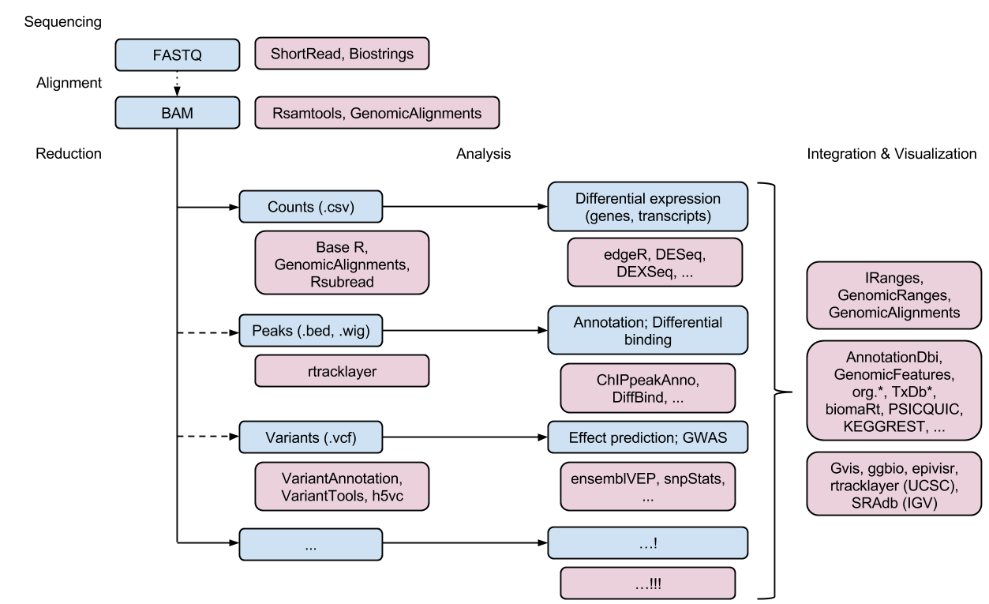
Bioconductor
http://bioconductor.org/packages/release/BiocViews.html#___Software

