Slide 1
Work with range data

Slide 2

Bioinformatics Data Skills
https://github.com/vsbuffalo/bds-files

Slide 3
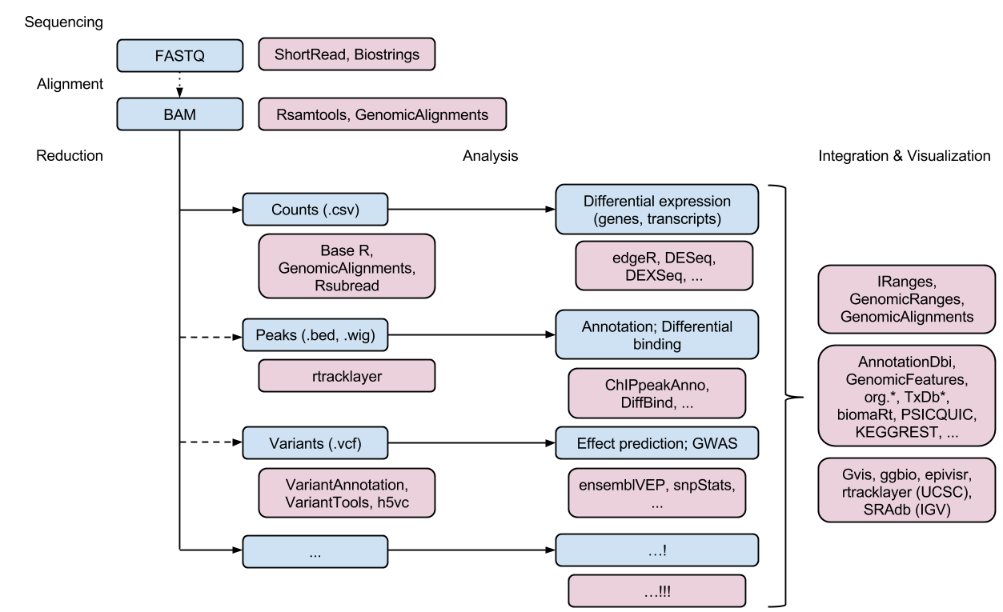
Bioconductor
http://bioconductor.org/packages/release/BiocViews.html#___Software

Slide 4
Today’s topic
GenomicRanges: package dealing with genomic intervals
- built on more general package IRanges
- provide a rich collection of functions for genomic interval operations
GenomicFeatures: package for transcript centric genomic annotations

Slide 5
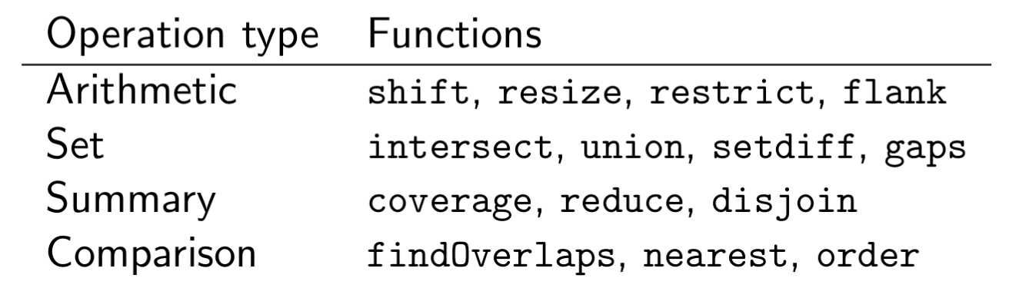

Slide 6
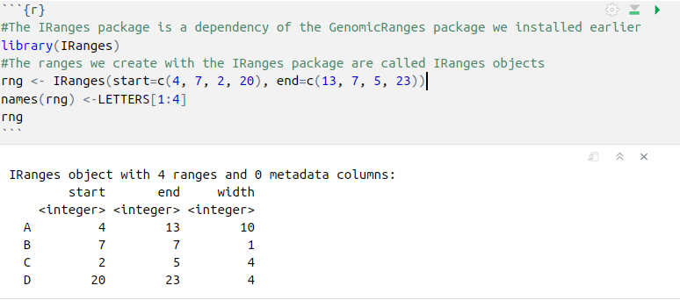
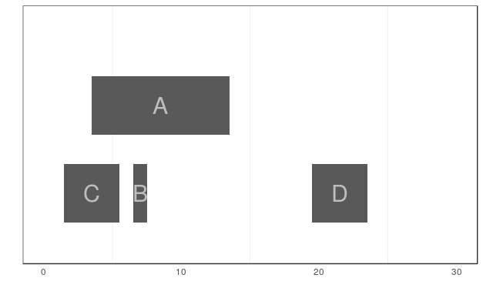
Storing Generic Ranges with IRanges
IRanges(start=NULL, end=NULL, width=NULL, names=NULL)

Slide 7
Basic Range Operations
start(rng)
end(rng)
width(rng)
range(rng)
rng[1:3]
rng["C"]
rng[start(rng) > 5]
m <- IRanges(start = 3, width = 5)
n <- IRanges(start = 6, width = 8)
c(m, n)

Slide 8
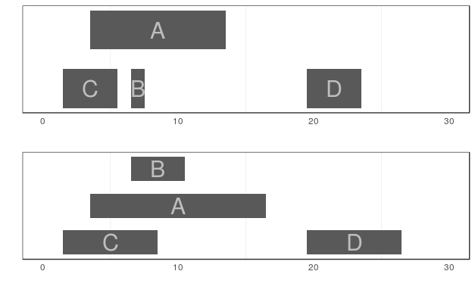
Basic Range Operations
With IRanges objects, addition (subtraction) will grow (shrink) a range symmetrically by the value added (subtracted) to it
end(rng) <- end(rng) + 3

Slide 9
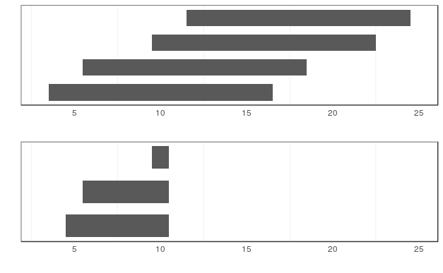
Basic Range Operations
restrict() cuts a set of ranges such that they fall inside of a certain bound
y <- IRanges(start = c(4, 6, 10, 12), width = 13)
y.r <- restrict(y, start = 5, end = 10)

Slide 10
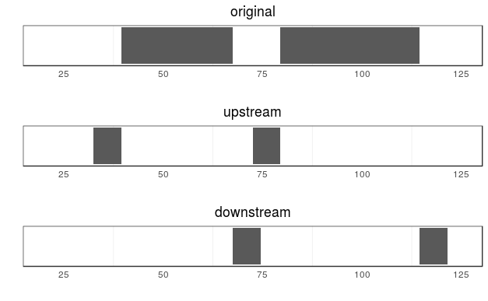
Basic Range Operations
flank() returns the regions that flank (are on the side of) each range in an IRanges object.
flank() is useful in creating ranges upstream and downstream of protein coding genes that could contain promoter sequences.
x <- IRanges(start=c(40, 80), end=c(67, 114))
flank(x, width = 7)
flank(x, width = 7, start = FALSE)

Slide 11
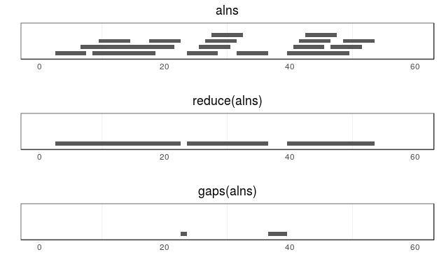
Basic Range Operations
reduce() operation takes a set of possibly overlapping ranges and reduces them to a set of nonoverlapping ranges that cover the same positions
gaps() returns the gaps (uncovered portions) between ranges

Slide 12
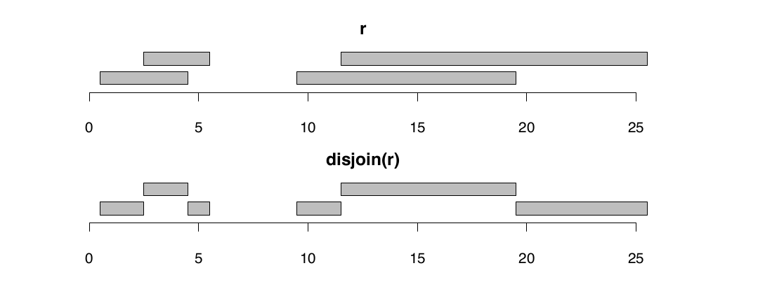
Basic Range Operations
Return a set of non-overlapping ranges satisfying:
(1) the union of results is the same as the union of the inputs.
(2) for every range in the result, its overlapping pattern with the input is constant.

Slide 13
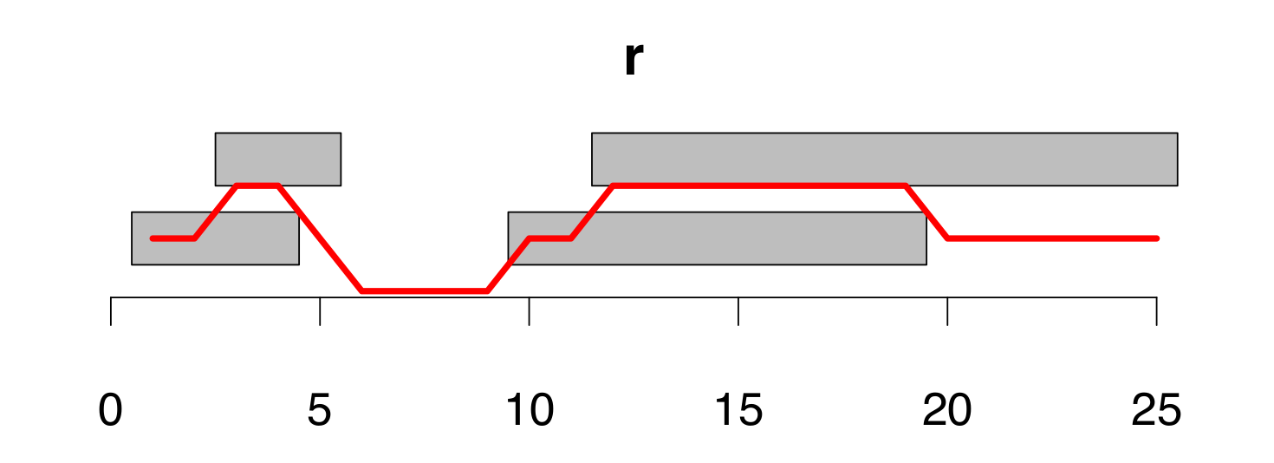
Basic Range Operations
coverage()
Compute the coverage depth by the input ranges of each position.

Slide 14
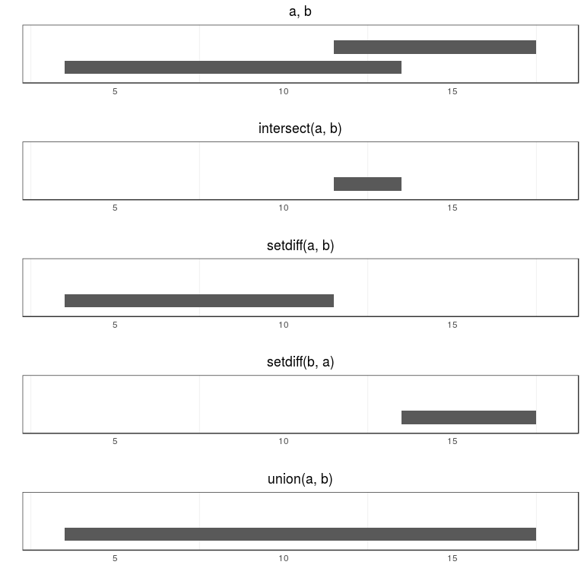
Basic Range Operations

