Slide 1

House Sales Price Prediction
Team - 6
Bhanuja Nagore
Sushma Suttakote Parameshappa

Slide 2

Goals of the Project
Predict the House Sales Price which will be used by
Buyer
Seller
Real Estate Agent
Evaluate the Performance and Predictive power of Models using
Linear Regression
Random Forest Regression

Slide 3

Use Cases
User – Buyer or Seller
User – Buyer or Seller
User will input the Data
Year Built
Number of Bedroom
Pool
Garage and more
User will get the Predicted Sales Price of the house based on the data entered
User, if willing to proceed further to buy/sell house will enter his Contact details
- First Name, Last Name, Mobile, Email, Buyer/Seller
The details will be sent to the Real Estate Agent

Slide 4

Use Cases
User – Real Estate Agent
User will receive the information from Buyer and Seller who are willing to proceed with the Real Estate Agent
Buyer/Seller Contact details
User will get the customer details which will be used to contact the customers.

Slide 5





Methodology
Data Discovery and Data Pre-processing
Data Exploration
Model Building: Linear Regression and Random Forest Regression
Data Visualization
Application Development: Play Framework

Slide 6
Architecture
Data Processing & Cleaning
Feature Generation and saving the processed Data in MySQL
Building Linear Regression and Random Forest Prediction Models
Training, Testing and Saving the Models
Comparison of Models
Predicting Sales Price on the User Requirements
The Sales price is predicted & the user decides whether to proceed or not with the real estate agent
The Buyer/Seller information is send to the Real Estate Agent

Slide 7

Infrastructure
User Interface - Play Framework, Scala Controllers, JavaScript, HTML
Database - MySQL and Slick for database querying
Apache Spark - Scala Integration - Linear Regression and Random Forest Prediction Algorithm implemented in Scala using Spark ML Lib
Data Cleaning & Preprocessing – Spark/Scala
Data Analysis and Visualization – Apache Zeppelin
Unit Tests - Scala

Slide 8
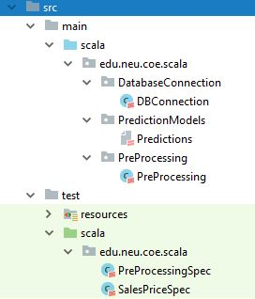
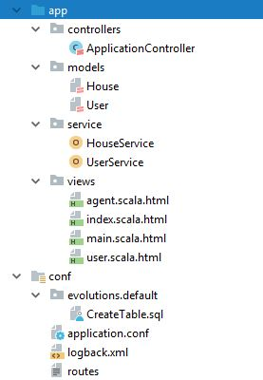
Programming in Scala
DBConnection
Preprocessing
Predictions
Unit Tests
House
User
HouseService
USerService
ApplicationController

Slide 9
Architecture of User Interface
Controller
Business Model
Play UI
Display screen - Enter House Details
Display Predictions - “Sales Price”
Display Screen – Enter Buyer/Seller information
Display Customer Information – Information available to Real Estate Agent
Responds to User Requests
Fetches results from MySQL using Slick
House details
Stored in MySQL
Buyer/Seller contact Information

Slide 10
Data Sources & Code Repository
House Prices Dataset on Kaggle:
https://www.kaggle.com/c/house-prices-advanced-regression-techniques
https://www.kaggle.com/harlfoxem/housesalesprediction
Magnitude of data: 25000 rows
Number of features: 80
Code Repository: Github
https://github.com/sushmasp/ScalaProject_Team-6_Fall2017

Slide 11
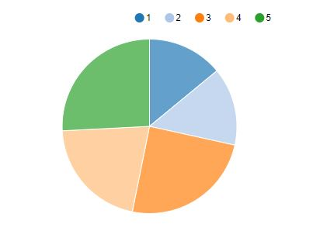
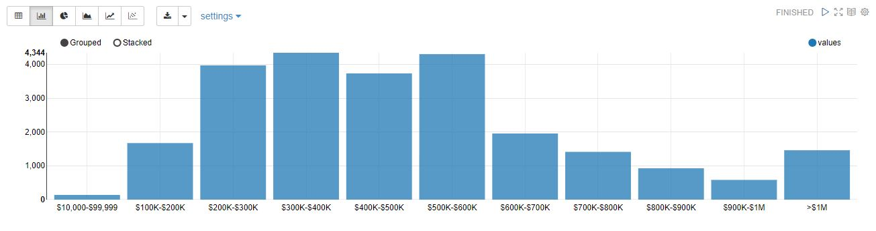
Data Visualization
Living Area, Number of Bathrooms, Bedrooms and Floors are highly correlated with Sales Price and are good predictors of Sales Price.
We get to know that more number of houses are in the range from $200K-$600K.

Slide 12
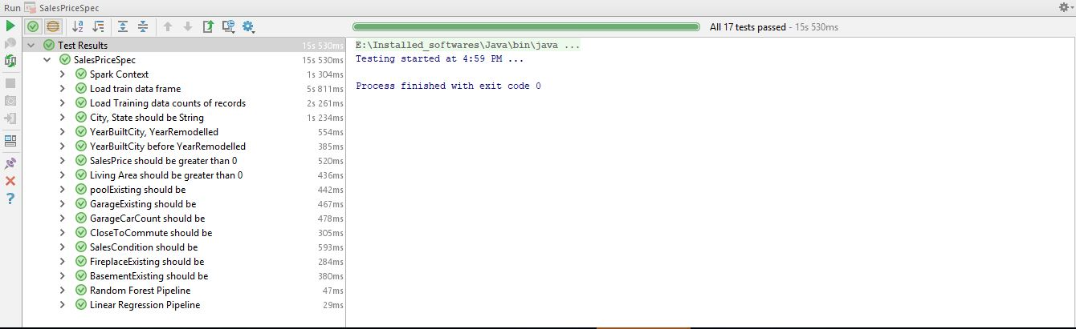
Unit Tests

Slide 13


Comparison of Prediction Models
 | Linear Regression | Random Forest Regression
R^2 Co-efficient | 0.54 | 0.56
RMSE | 0.47 | 0.46

Slide 14
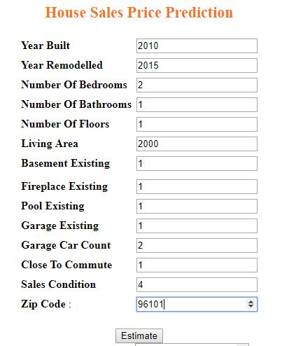
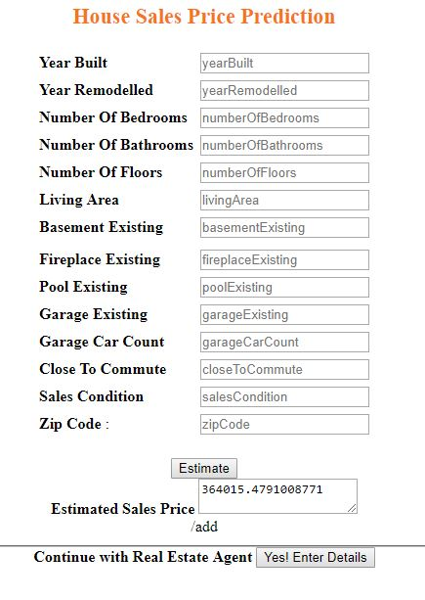
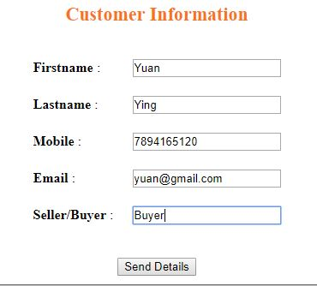
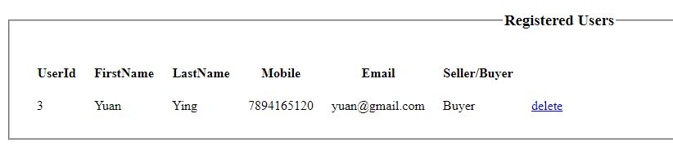
User Interface

Slide 15
Thank You!

