Slide 1


Major Video Assignment Part A Muskoka & Windex
Sian Kim 1046836
Feb 09 . 2022

Slide 2
Script
I bet that everyone has experienced having a hard time with human relations and hyper-tasking.
Though we can be happy by resolving problems that are causing our stress, people can't resolve worries easily.
Such as, the reason why they can't quite work is for their family and stable life.
Through working in collaboration with the Windex brand, I'm trying to give a message 'hang in there.
Like people use Windex brand products for getting rid of dust and virus in the window,
I try to deliver that you can get rid of dust that is like stress in your mind by drinking Muskoka beer.

Slide 3
Onscreen
You look such a cool person when you work and when you control feelings by yourself.
We are here to end the day with you.
Muskoka will get rid of the stress that got today.
good morning
good evening
good Muskoka!
Muskoka is for you.

Slide 4




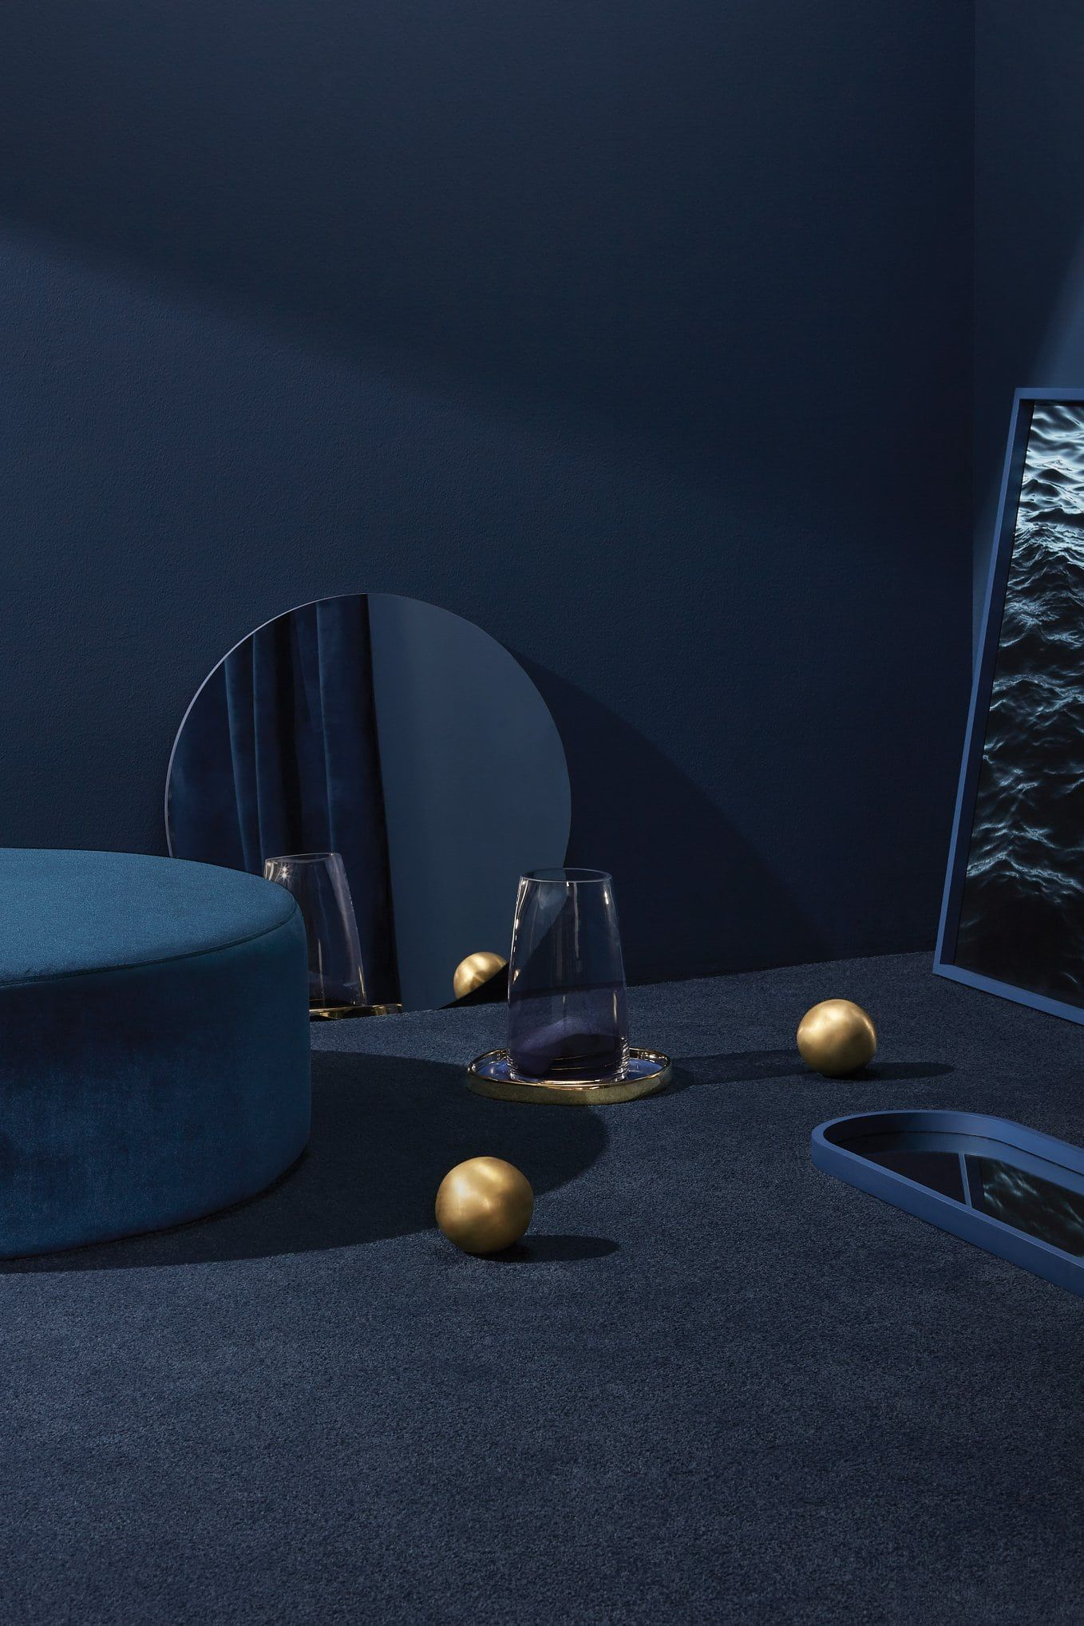
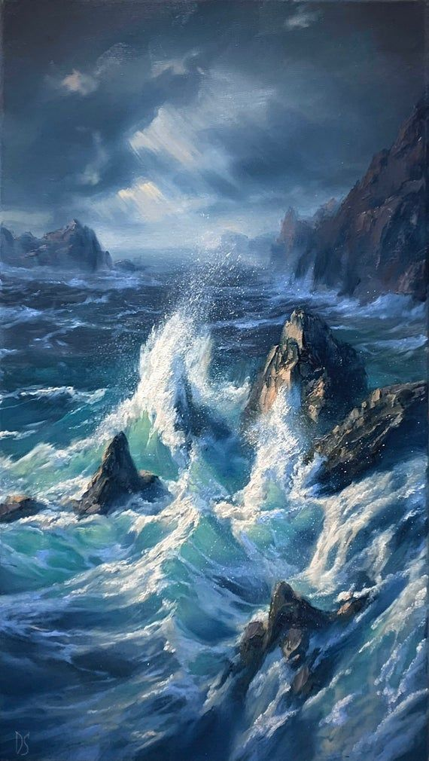
Mood Board
Franklin Gothic
Franklin Gothic
Franklin Gothic

Slide 5
MUSIC
Bright Future
https://www.bensound.com/royalty-free-music/track/bright-future-bright-pop
Breathe Deep
https://www.bensound.com/royalty-free-music/track/breath-deep

Slide 6


Style frame

Slide 7
Videos
https://www.youtube.com/watch?v=HH1_px17utk
https://www.youtube.com/watch?v=bG_xdkGrwSA
https://www.youtube.com/watch?v=iyVyMSYqlkU

