Slide 1


Major Video Assignment Part A Muskoka & Windex Let’s drink Muskoka
Sian Kim 1046836
Ying Yang 1037592
Feb 09 . 2022

Slide 2
Script（First Half）
[A female Betty gives a call to other clients in her office, but she cannot get through. She shook her head disappointed.]
Narrator: “You are a good person when you work but you always get bad feedback.”
[A second female Kayla stays in her room and struggles with her tasks because she is an online worker. However, she was disturbed by outside noise.]
Narrator:” We can solve the problems, but we do not happy to live in the situation.”
Kayla: could you be quiet?
Narrator: “They can't quite work for their family and stable life.”
[The logo fades into the middle in a black.]
Narrator:” We are always by your side.”

Slide 3
Script（Second Half）
[A sun ray gets across the window. Audiences can see a Muskoka bottle besides the window.]
Narrator:” Muskoka takes the pressure off you.”
[The first lady Betty drinks a beer in the morning.]
Narrator:” Good morning”.
[The second lady Kayla drinks a beer in the evening.]
Narrator:” Good evening”.
[5 photos of Muskoka bottles are changed per second. Those photos are decorated by cinema 4D and photo.]
Narrator: “Good Muskoka”.
[A group of Muskoka bottles with different flavor are in the center of the screen. ]
Narrator:” Muskoka is for you.”

Slide 4
Onscreen
You are a good person when you work but you always get bad feedback.
We can solve the problems, but we do not happy to live in the situation.
They can't quite work for their family and stable life.
We are always by your side.
Muskoka takes the pressure off you.
Good morning！
Good evening！
Good Muskoka!
Muskoka is for you.

Slide 5





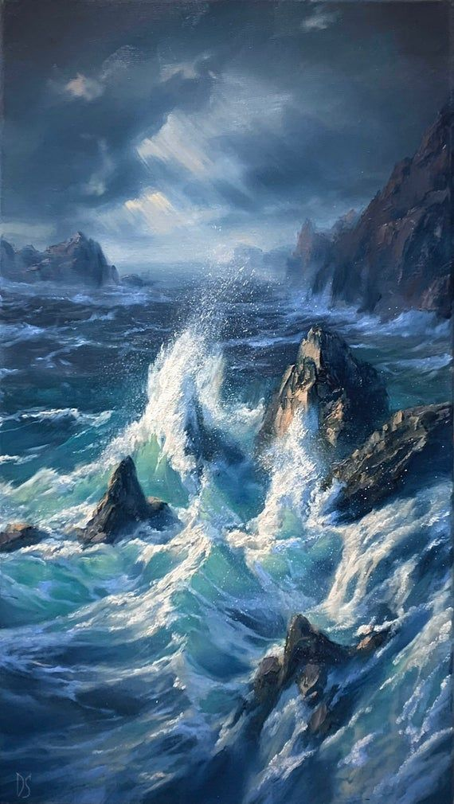
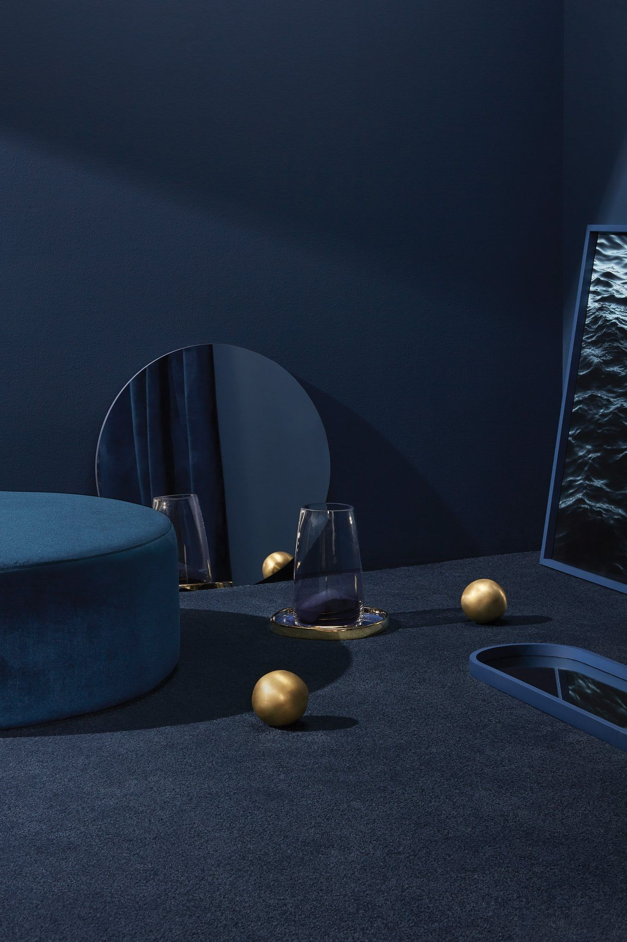
Mood Board
Franklin Gothic
Franklin Gothic
Franklin Gothic

Slide 6
MUSIC
Bright Future
https://www.bensound.com/royalty-free-music/track/bright-future-bright-pop
Breathe Deep
https://www.bensound.com/royalty-free-music/track/breath-deep
Happy energic music
https://www.youtube.com/watch?v=WJBKQUG5E4M
Feeling good playlist
https://www.youtube.com/watch?v=pRbxlpvXw2s
Sad songs
https://www.youtube.com/watch?v=Y_oD111dK7c
Sad music instrument
https://www.youtube.com/watch?v=1wT3flPjQ2Y

Slide 7


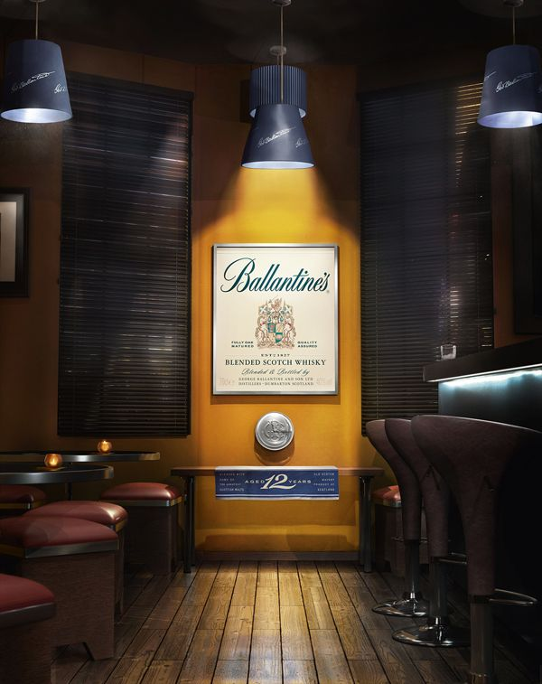
Style frame

Slide 8
Videos
Dying from 'overwork'—Japan's toxic office culture
https://www.youtube.com/watch?v=HH1_px17utk
The Devil Wears Prada Opening Scene https://www.youtube.com/watch?v=bG_xdkGrwSA
Work Hard - Motivational Video
https://www.youtube.com/watch?v=iyVyMSYqlkU
Let’s grab beer
https://www.youtube.com/watch?v=WDvNUJUVmGk
Mighty Millers Craft Beer Commercial
https://www.youtube.com/watch?v=4uI8KIphtjc
Bernard Beer commercial video
https://www.youtube.com/watch?v=wGwW6aYTF90

