Slide 1
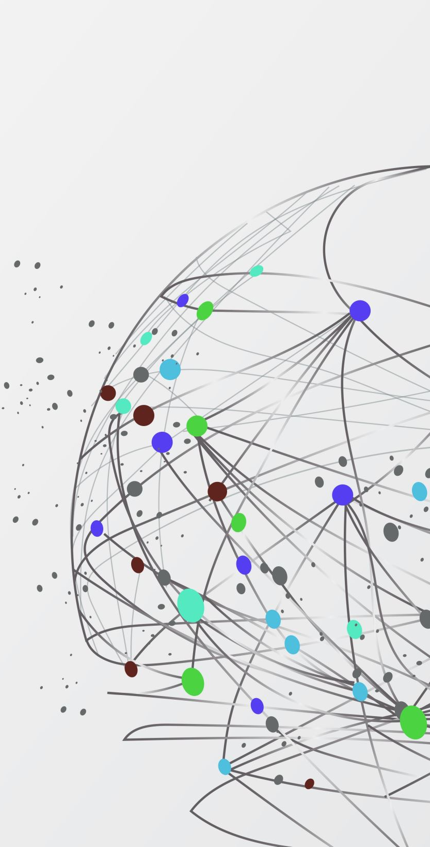
Ruko Router Map
Cristine Noronha and Ying Yang

Slide 2
Basic Structure
Login
ID
Password
Choose Media
Music
TV
Choose Your Time
90
Destination
Film
80
70
60
50
Recommend Program
Top 10 program
Menu includes search and my profile etc.

Slide 3
Menu Structure
Home
Back to you Destination page
Search
You can choose any media if you want
My profile
Your profile includes all information about yours, such as, your id name, changing your password or your favorite etc.
Profile Kids
This is a kid module. You can change adult module to kid module.
More
You can set up your watching time and your media type again.

Slide 4
Login Page
After a user click the logo image, the page opens a new window that inputting users’ name and password.
If the user does not have a valid ID and password, the window will show a new page that registering the ID and password.
The user can get into the next page with a valid ID and password.
The application should be created a good data base with PHP.

Slide 5
Choose Media Page
The user can choose a media type, such as, music, TV programmes, or films.
If the user choose a certain type of media, the APP can show the next page.
In this page, the developer can fetch files with JS, VUE JS and AJAX.

Slide 6
Choose Your Time
At this page, the user can choose the watching time from 50 to 90 mins.
If the user choose the time, the APP shows the destination page.
In this page, the developer can fetch files with JS, VUE JS and AJAX.

Slide 7
Destination Page
The user can see his or her selected media type on this page.
For example, if the user chooses film, one of the most popular movies can be shown on the middle of the page.
The user also can see three button beside the display part. If the user likes the display movie, he or she can add the movie into the list. Or, the user just clicks the play button to watch it. All information of the media can be seen if the user clicks the info button.
This page should fetch the media with AJAX and JS. And the developer should create a database to contain all information about the display media.
The user also see top 10 popular movies on the bottom of the page. All the media can be fetched with AJAX and JS.

Slide 8

Menu Page
Home page is connected with the destination page.
Search button should be connected with a database. The database contains all the media’ name and image. Once the user click the image, the image is triggered and a new page is displayed. The user can see the page that contains all information about the selected media and play button. The selected media can play after the user clicks the play button.

Slide 9

Media Database
The target file is the result of filtering through the database.
The search button is connected with a database. And the databased should be created by a filter page.
The user can set up the filter, such as, year, type, genre, area etc.

Slide 10
Profile Kids
This is a kid’s module.
The user can set the filter for kids.
The filter includes maturity rating, internet required, compatibility, language, controller, and category.
After finishing the setting, the user can get into the kid’s module.

Slide 11
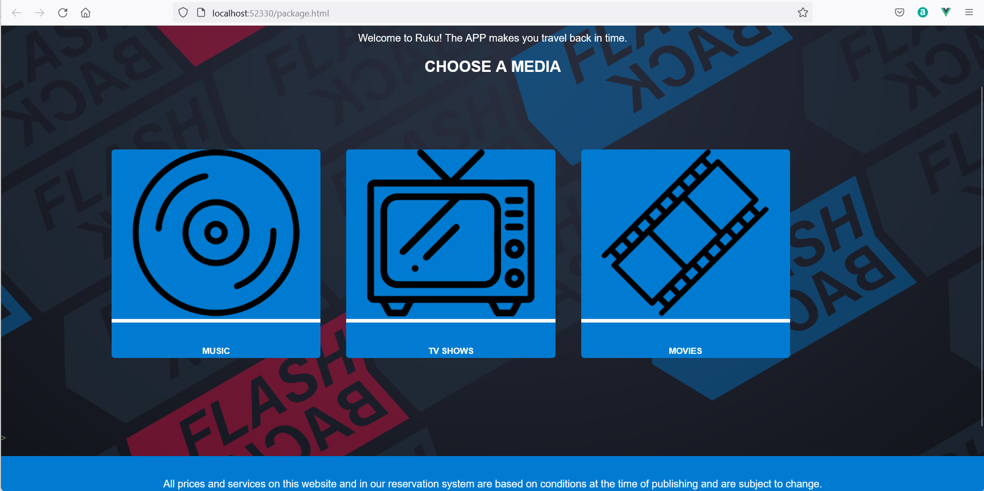
A Test Page

Slide 12
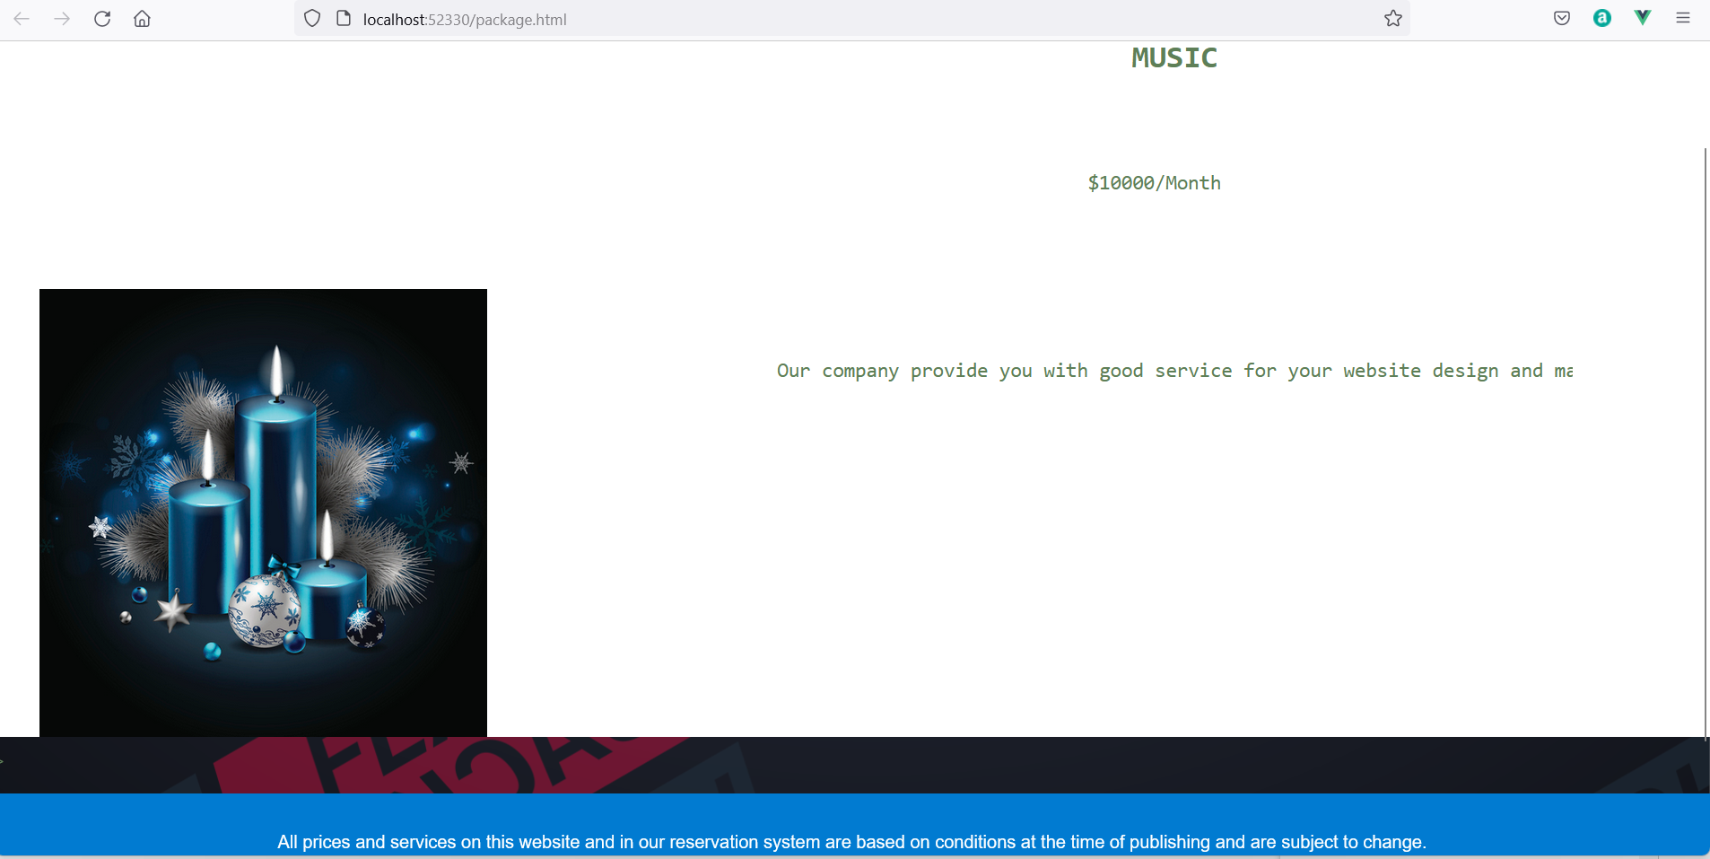
A fetch

