Slide 1
A Multiobjective Evolutionary Approach for Solving Large-Scale Network Reconstruction Problems via Logistic Principal Component Analysis (IEEE Transactions on Cybernetics 2021)
Chaolong Ying
Advisor：Prof. Jing Liu
GIT, Xidian University, Guangzhou
Oct.22th, 2021 @ Jing Group

Slide 2
Background
What is network reconstruction?
Missing or unobservable links
Reconstruct
Available node states or attributes
Observe and record
Optimize
Model
广州研究院 Guangzhou Institute of Technology

Slide 3
Background
Physical Review X
(evolutionary game data,
compressive sensing)
Physics Reports
(review)
Physical Review Letters
(lasso)
TCYB
(online)
TCYB
(multitask, multilayer)
2011
2014
2016
2018
2020
2021
Nature Communications
(propagation network,
compressive sensing)
Scientific Reports
(MOEA)
KBS
(MA)
TEVC
(community)
KBS
(multitask)
TCYB
(large-scale)
广州研究院 Guangzhou Institute of Technology

Slide 4
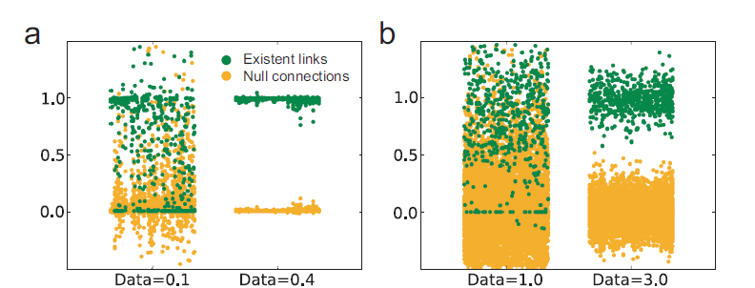
Motivation
Previous works
existence/inexistence
广州研究院 Guangzhou Institute of Technology

Slide 5
Motivation
Previous works
existence/inexistence
Cut-off = 0.3
Why not use binary coding directly?
Cut-off = 0.5
Cut-off = 0.7
广州研究院 Guangzhou Institute of Technology

Slide 6
Motivation
Large-scale problems
Curse of dimensionality
Decomposition
Dimension reduction
广州研究院 Guangzhou Institute of Technology

Slide 7
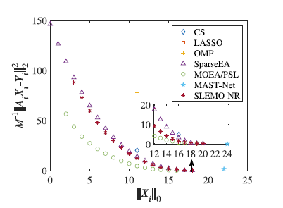
Motivation
Preference-based local search operator
Network reconstruction
MOEA
Non-dominated solutions
k-sparse solutions
广州研究院 Guangzhou Institute of Technology

Slide 8
Motivation
Preference-based local search operator
Network reconstruction
Binary coding
MOEA
Alternative representation
Rely on gradient
Local search operator
广州研究院 Guangzhou Institute of Technology

Slide 9
Contribution
Binary coding and alternative representations
Network structure subspace
Preference-based local search operator
Binary coding
Logistic principal component analysis
Probability distribution
Natural parameters
广州研究院 Guangzhou Institute of Technology

Slide 10
Contribution
Binary coding and alternative representations
Network structure subspace
Preference-based local search operator
No cut-off
With gradient
Improve search efficiency
Find k-sparse solutions
广州研究院 Guangzhou Institute of Technology

Slide 11
Methodology
Network model
They satisfy
广州研究院 Guangzhou Institute of Technology

Slide 12
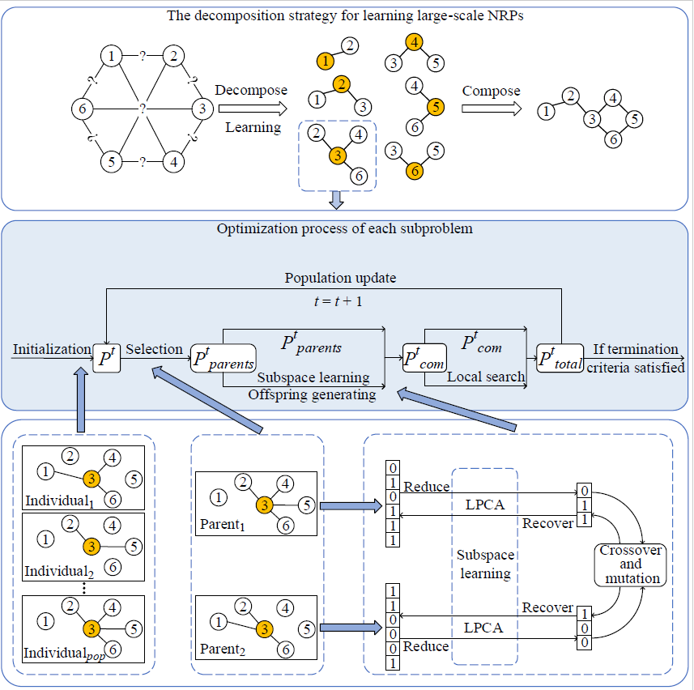
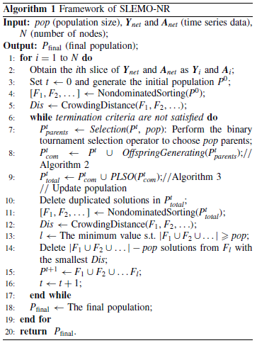
Methodology
广州研究院 Guangzhou Institute of Technology

Slide 13
Methodology
Alternative representations
(Bernoulli distribution)
Binary coding
Probability distribution
Natural parameters
广州研究院 Guangzhou Institute of Technology

Slide 14
Methodology
Logistic principal component analysis (LPCA)
reduce
recover
Reduced dimension d
广州研究院 Guangzhou Institute of Technology

Slide 15
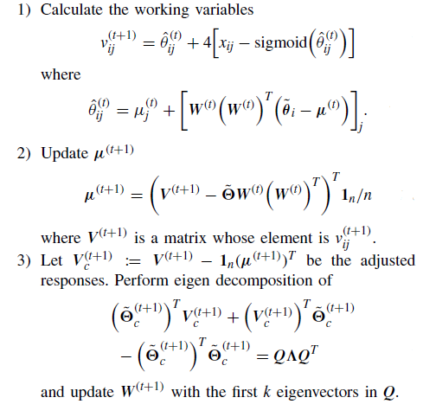
Methodology
Majorization-minimization (MM)
广州研究院 Guangzhou Institute of Technology

Slide 16
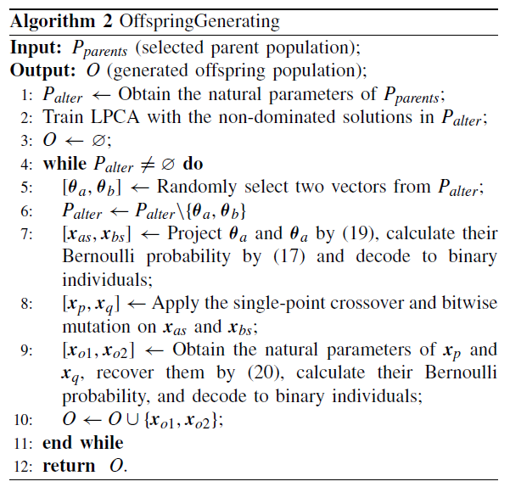
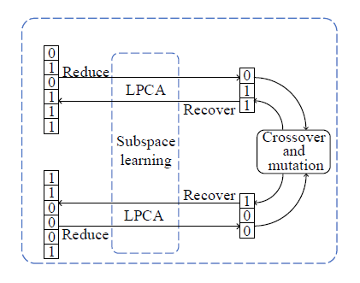
Methodology
广州研究院 Guangzhou Institute of Technology

Slide 17
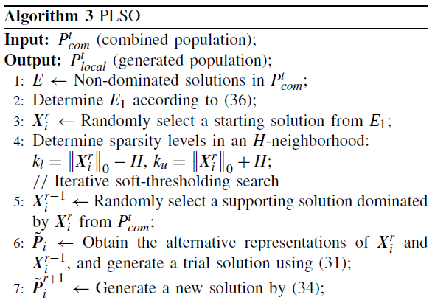
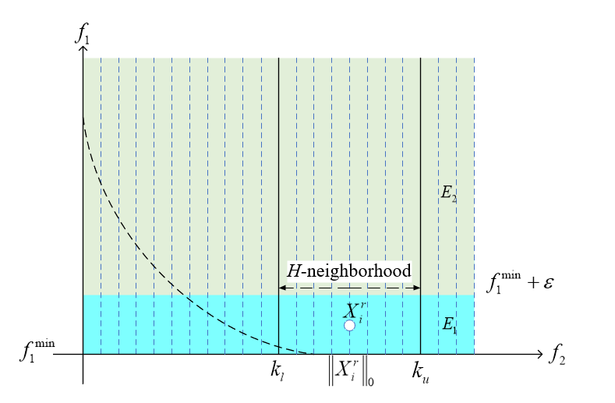
Methodology
广州研究院 Guangzhou Institute of Technology

Slide 18
Methodology
Gradient descent
Parameter setting
Soft-thresholding truncation
广州研究院 Guangzhou Institute of Technology

Slide 19
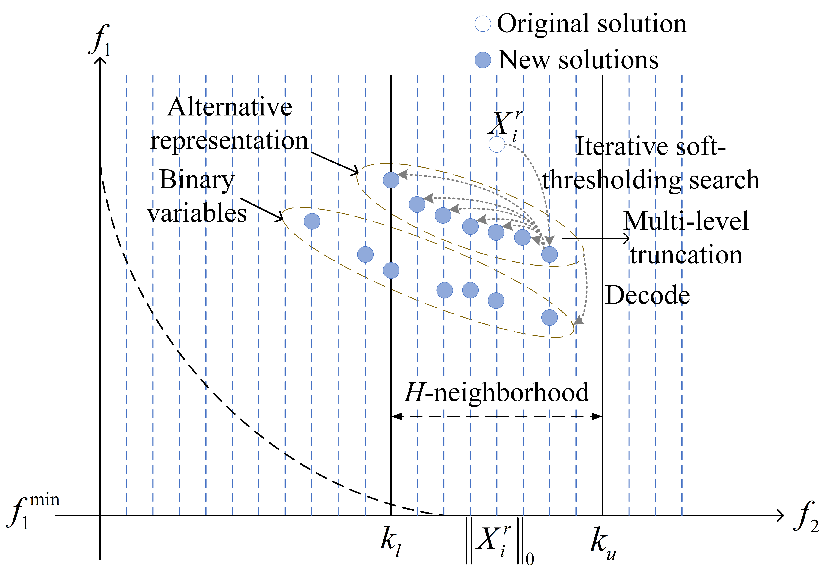
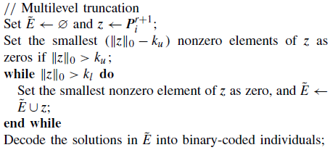
Methodology
广州研究院 Guangzhou Institute of Technology

Slide 20
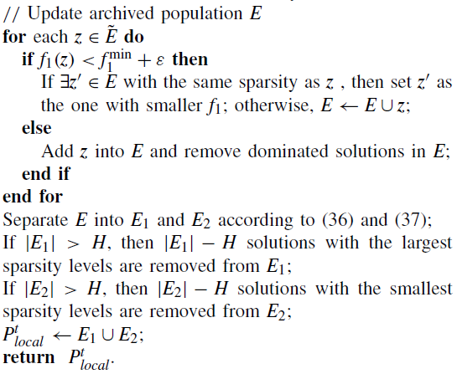
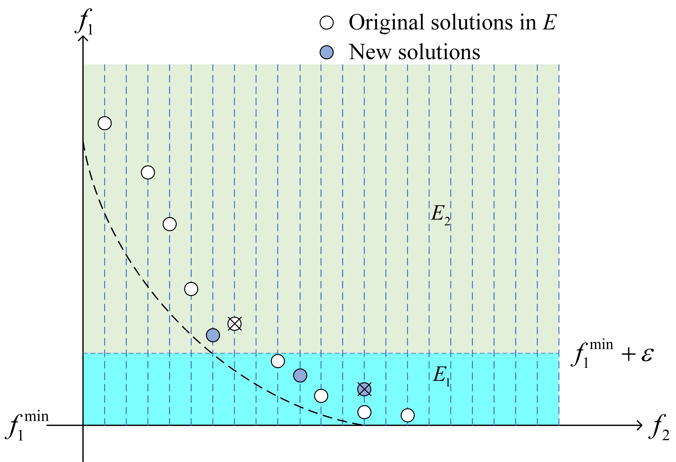
Methodology
广州研究院 Guangzhou Institute of Technology

Slide 21
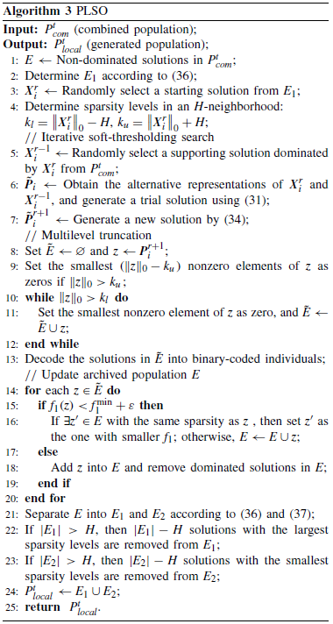
Methodology
广州研究院 Guangzhou Institute of Technology

Slide 22
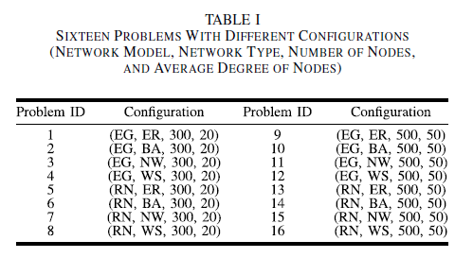
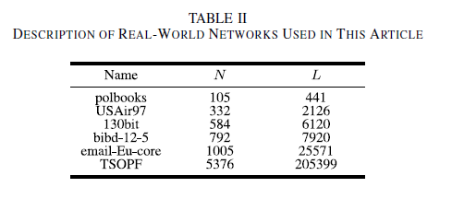
Results
广州研究院 Guangzhou Institute of Technology

Slide 23
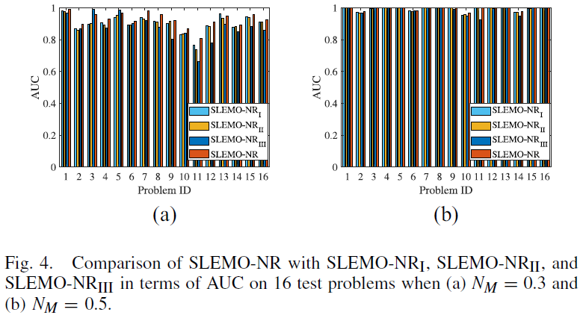
Results
SLEMO-NR_{I}: without LPCA
SLEMO-NR_{II}: with RBM
SLEMO-NR_{III}: with PCA
SLEMO-NR: our work
广州研究院 Guangzhou Institute of Technology

Slide 24
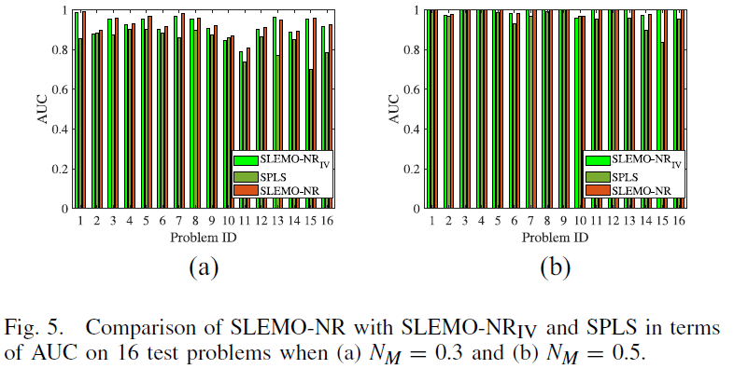
Results
SLEMO-NR_{IV}: without preference-based local search operator
SPLS: a representative IST-based MOEA
SLEMO-NR: our work
广州研究院 Guangzhou Institute of Technology

Slide 25
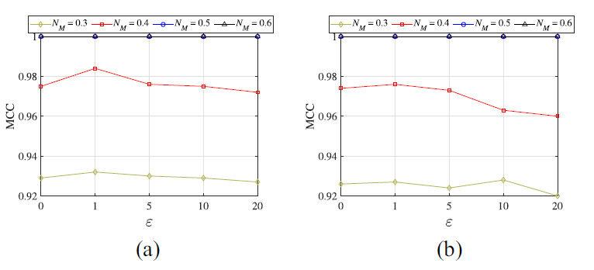
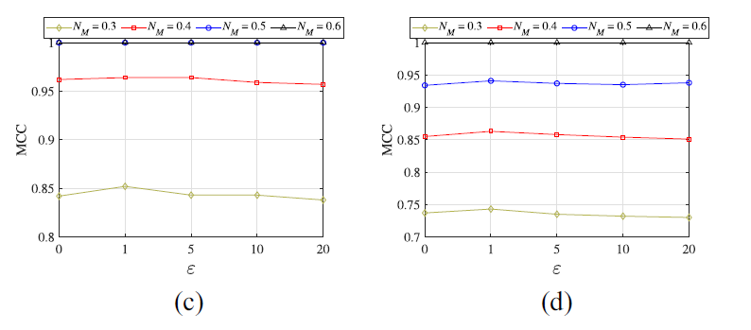
Results
广州研究院 Guangzhou Institute of Technology

Slide 26
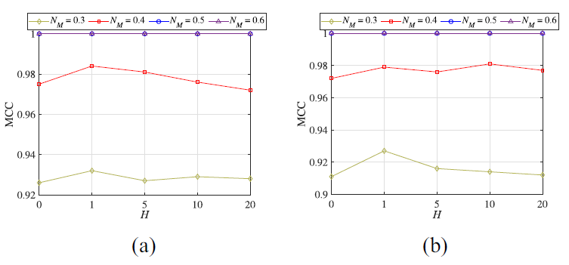
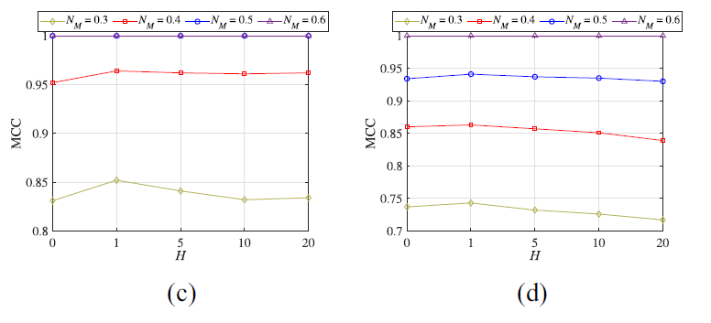
Results
广州研究院 Guangzhou Institute of Technology

Slide 27
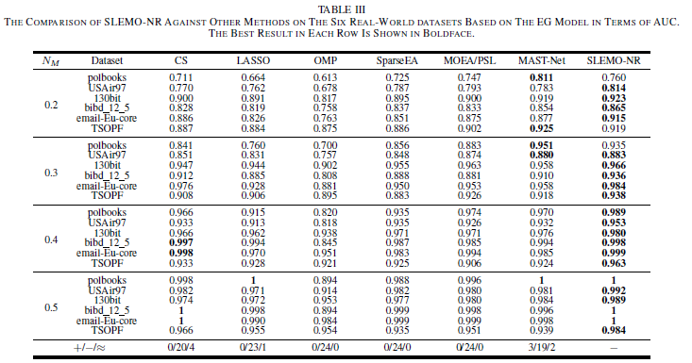
Results
广州研究院 Guangzhou Institute of Technology

Slide 28
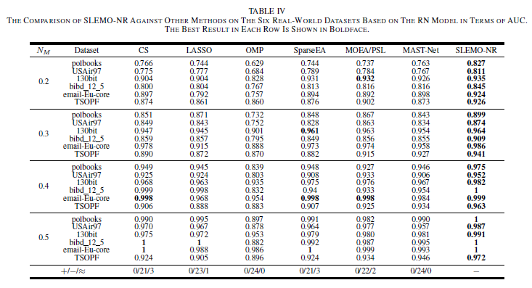
Results
广州研究院 Guangzhou Institute of Technology

Slide 29
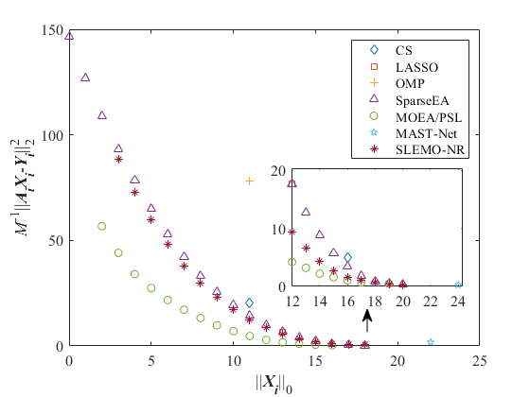
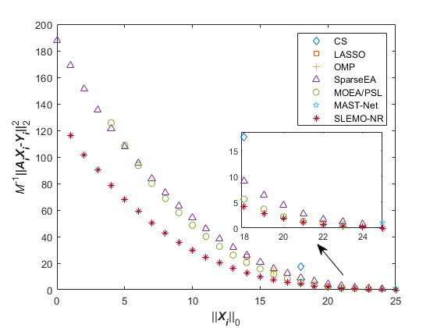
Results
广州研究院 Guangzhou Institute of Technology

Slide 30
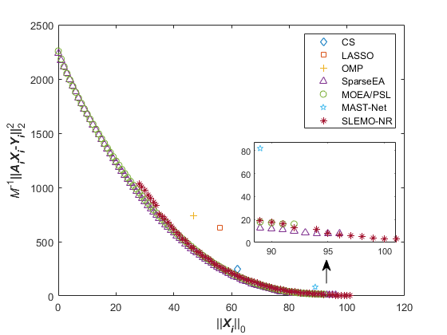
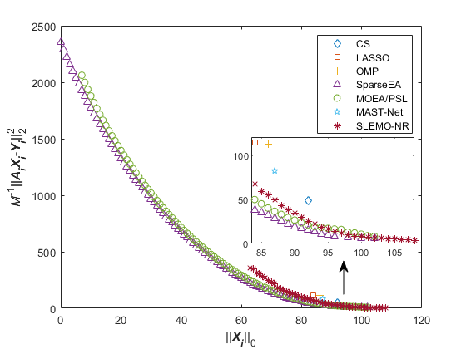
Results
广州研究院 Guangzhou Institute of Technology

Slide 31
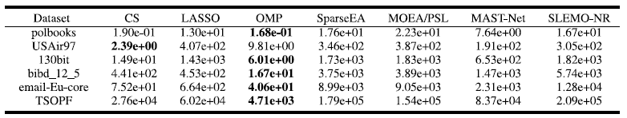
Results
Complexity
广州研究院 Guangzhou Institute of Technology

Slide 32
Results
Refer to our paper and supplementary materials for more experimental results.
广州研究院 Guangzhou Institute of Technology

Slide 33
Thanks！
Q&A
广州研究院 Guangzhou Institute of Technology

