Slide 1
Enhanced DSCP by in-band signaling for latency guaranteed service
Lin Han (lin.han@futurewei.com)
Yingzhen Qu (yingzhen.qu@futurewei.com)

Slide 2
Introduction
In-band signaling was introduced in TSVWG
The presentation will use it to work with DSCP idea to achieve the bounded latency service
Focus on
the architecture, math and experiments on bounded latency service
Not about
In-band signaling details, TCP/UDP changes, congestion control etc.
Objective
Provide more scalable control and data plane solution for guaranteed service, latency and bandwidth
Provide E2E Bandwidth Guaranteed Service (BGS) and Latency Guaranteed Service (LGS)
Solution
In-band signaling carries the user’s service expectation (Bandwidth and/or Latency)
Network device on the path check if the resource is enough and update signaling accordingly.
Flows will be classified according to application expectations and network resource reservation status.
New DSCP values are needed to represent new classes, the number is TBD
Class Based queuing and scheduling applied to the class of traffic
For LGS flow, either the 1st or 2nd PQ are mapped.
For BGS flow, the WRR shared Q are mapped.

Slide 3
Design targets
Service Guarantee
Provide guaranteed and minimized (queuing) latency for LGS (Latency Guaranteed Service) flows
The maximum latency is guaranteed, minimized and predictable at each hop, if LGS flow rate is confirmed with their pre-claimed parameters (CIR,PIR,CBS,EBS)
Provide guaranteed bandwidth for BGS (Bandwidth Guaranteed Service) flows
The bandwidth of CIR is guaranteed at each hop, if BGS flow rate is confirmed with their pre-claimed parameters (CIR,PIR,CBS,EBS)
No starvation
LGS flows will never starve other types of lower priority flows (BGS and BES)
BGS flows will never starve BE flows
No sacrifice of link utilization
When the total rate of LGS flow is less than the committed rate (sum of CIR of all LGS flows), other class flows (BGS and BES) can use the remained bandwidth
When the total rate of LGS flow is less than the committed rate (sum of CIR of all LGS flows), and, the total rate of BGS flow is less than the committed rate (sum of CIR of all BGS flows), other class flows (BES) can use the remained bandwidth
Fairness within the same class
All LGS flows will share the bandwidth within its class
All BGS flows will share the bandwidth within its class
All BE flows will share the bandwidth within BE class
Backward compatible with current DiffServ, and can coexist and can be deployed incrementally.

Slide 4
Review of in-band signaling
IPv6 hdr
HbH ext hdr
Payload
QoS dir
HbH-aware-router
Configure to process hop-by-hop IPv6 ext hdr
Only needed for throttle devices
Signal processing distributed to NPU on line card
Per flow state kept in line card
Per flow state self-maintained by data flow, deleted if aged
Basic security for signaling and data forwarding are provided
IPv6 hdr
Dst ext hdr
Payload
report
DSL
Access
PON
Router
BNG
P Router
Mobile
OLT
PE
FTTH
Metro Aggregation
IP Core
Content Provider network
RSG
PGW
AGG
L3 network
CSG
EPC
Provider’s network, one AS
Backhaul

Slide 5
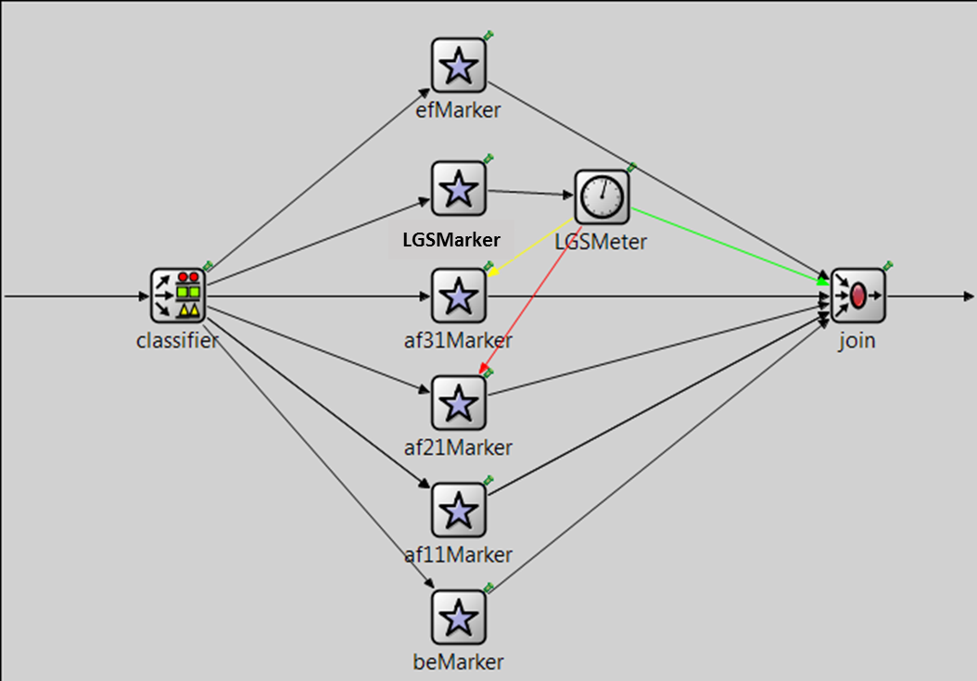
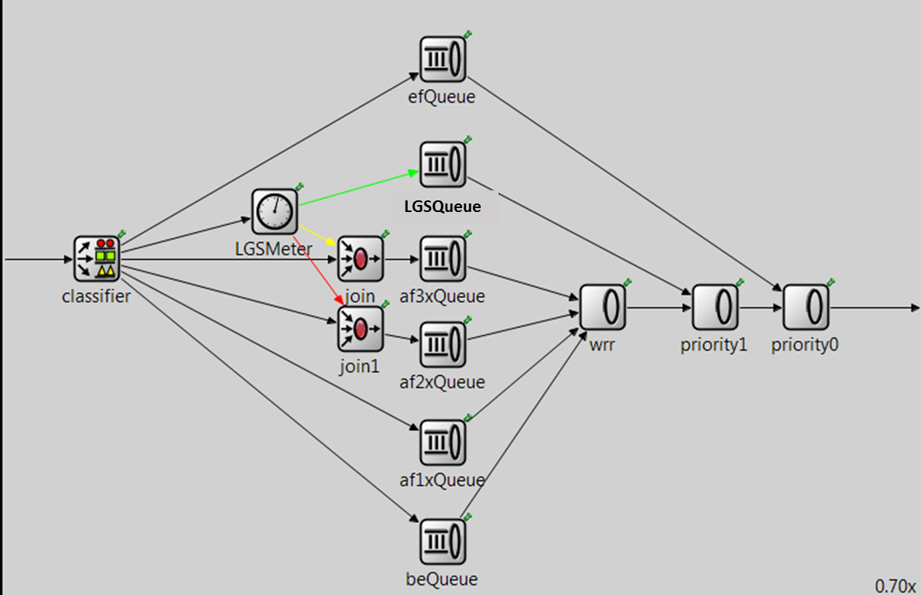
Network modeling
New DSCP value is used to identify the new class for LGS flows
LGS flows are queued into the 2nd priority queue
Rate is checked for LGS flows, colored packets are remarked to lower class or discarded
Rate is checked for LGS flows, colored packets are remarked to lower class or discarded
PQ+WRR for scheduling
Switch
Fabric
Ingress Traffic Classification Module at
All Ingress Routers’ ingress interface
Egress Queuing and Scheduling Module at
All Routers’ egress interface

Slide 6
Signaling and rules for a new connection
In-band signaling will notify the host about the resource reservation status on path, host then knows the status of connection
If (total ingress flow’s CIR < ingress interface rate)
Allowed, classify as LGS flow, update meter DB, flow DB and in-band signaling
else
not allowed, classified as BE, update in-band signaling
If (total egress flow’s CIR < egress interface rate)
allowed, update meter DB, flow DB and in-band signaling
else
not allowed, update in-band signaling
Switch
Fabric
Ingress Traffic Classification Module at
All Ingress Routers’ ingress interface
Egress Queuing and Scheduling Module at
All Routers’ egress interface

Slide 7
Configuration: Ingress shaper at PE ingress interface

Slide 8
Configuration: Egress shaper, queuing and scheduler at all routers egress interfaces

Slide 9
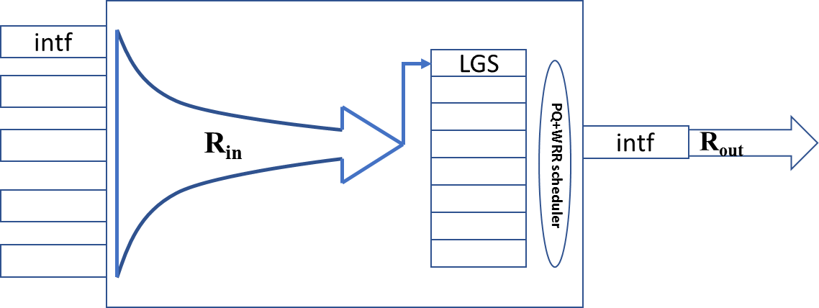


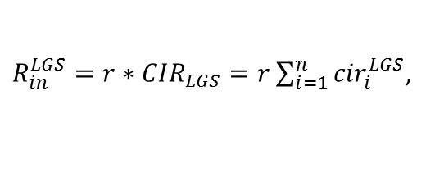
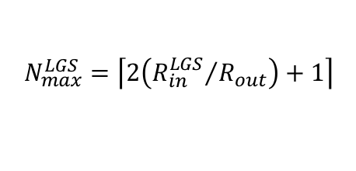

Queuing latency estimation per hop - 1
Estimate the worst scenario conservatively per hop, thus the E2E latency can be guaranteed to be below the maximum value statistically
Only queuing delay is estimated, other delays (switching and propagation etc.) are relatively small and fixed.
Assume all packet sizes are the longest packet size
If LGS flows queued in the highest priority queue
The maximum queue depth is
The maximum delay of queuing at each hop is
$$N_{max}^{LGS}=\left\lceil 2\left({R_{in}^{LGS}}/{R_{out}}\right)+1\right\rceil$$
$$D_{max}^{LGS}=N_{max}^{LGS}∗L_{max}∗8/R_{out}$$
${R_{in}^{LGS}=r∗CIR}_{LGS}=r\sum_{i=1}^{n}{{cir}_{i}^{LGS}}$,
${cir}_{i}^{LGS}$ is the cir for the ith LGS flow, r is the ratio of peak cir to avg cir
${ R}_{out}$ is the link rate;
$L_{max}$is the maximum packet size

Slide 10
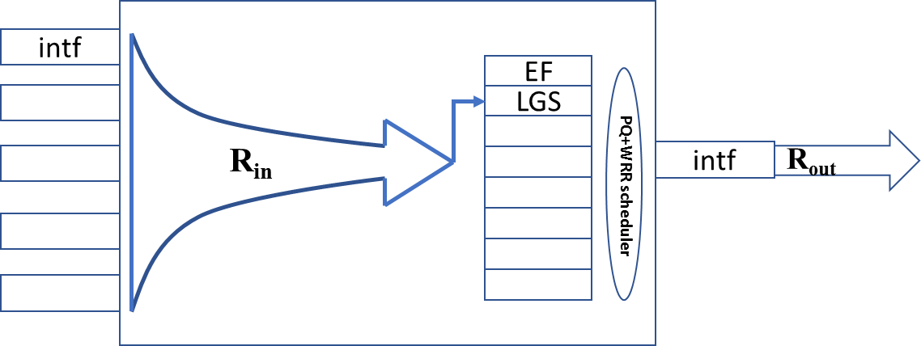

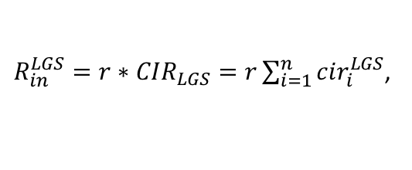
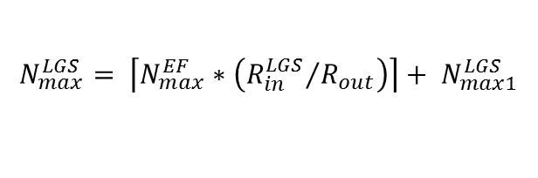
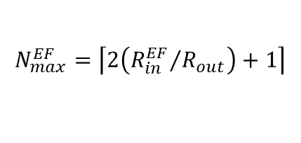

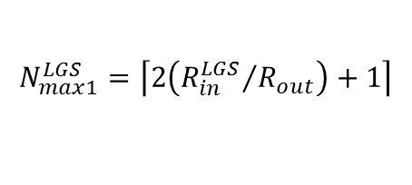
Queuing latency estimation per hop - 2
If LGS flows queued into the 2nd highest priority queue, assume the 1st queue is EF:
The maximum queue depth is
The maximum delay of queuing at the hop is
$$N_{max}^{LGS}= \left\lceil N_{max}^{EF}∗\left({R_{in}^{LGS}}/{R_{out}}\right)\right\rceil + N_{max1}^{LGS}$$
$$N_{max1}^{LGS}=\left\lceil 2\left({R_{in}^{LGS}}/{R_{out}}\right)+1\right\rceil$$
$$N_{max}^{EF}=\left\lceil 2\left({R_{in}^{EF}}/{R_{out}}\right)+1\right\rceil$$
$${D2}_{max}^{LGS}=\left({N_{max}^{EF}+N}_{max}^{LGS}\right)∗L_{max}∗8/R_{out}$$
${R_{in}^{LGS}=r∗CIR}_{LGS}=r\sum_{i=1}^{n}{{cir}_{i}^{LGS}}$,
${cir}_{i}^{LGS}$ is the cir for the ith LGS flow, r is the ratio of peak cir to avg cir
$R_{in}^{EF}$is the peak rate for EF flows from management knowledges
${ R}_{out}$ is the link rate;
$L_{max}$is the maximum packet size

Slide 11
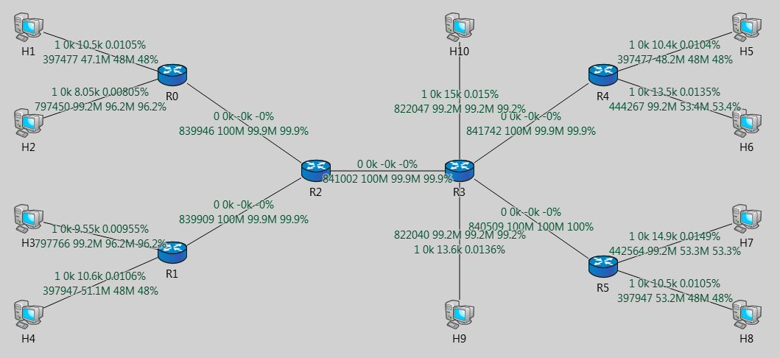
Experiment results and analysis
Severely congested at all routers by uncontrolled BE traffic
Continuous and bursty UDP traffic is used
Most severe bottle neck for LGS
BE traffic
EF and LGS traffic

Slide 12
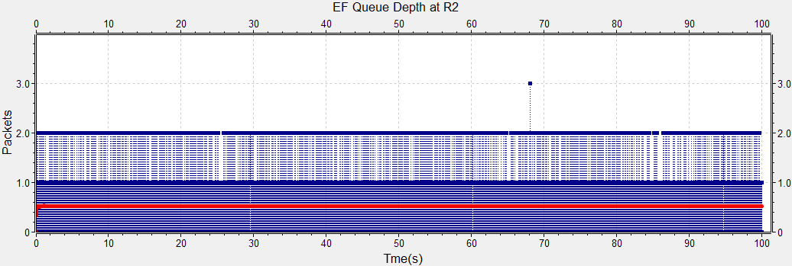
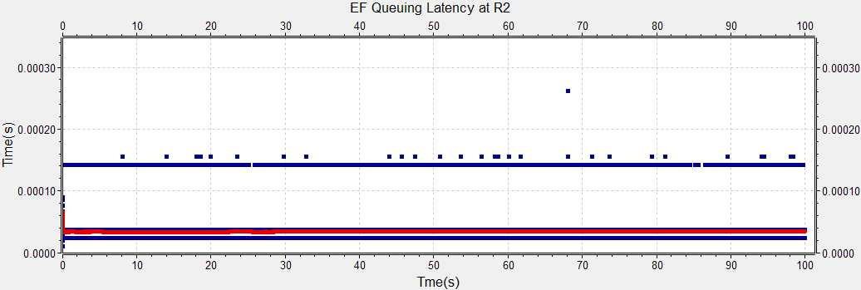
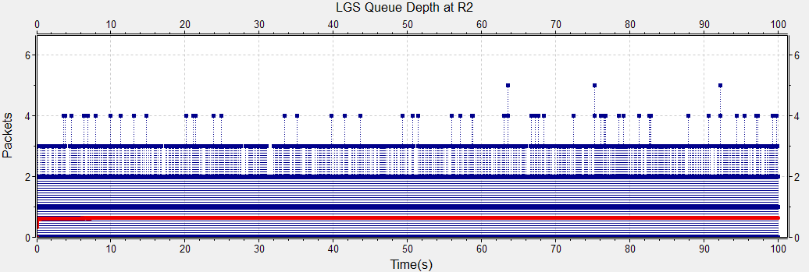
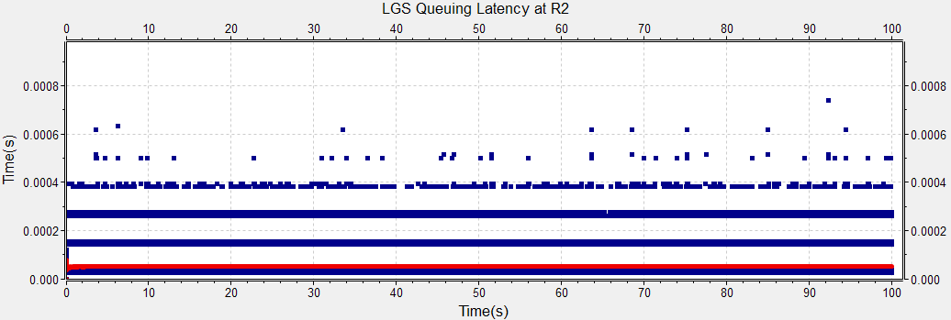
Case 1: EF+LGS < 50% link rate
Theorical value(r=1)
Theorical value(r=1)
Mean
Mean
Theorical value(r=1)
Theorical value(r=1)
Mean
Mean
EF flows =4, LGS flows = 16; R_{EF}=8.14M, R_{LGS}=26.67M; Burst traffic, Burst duration = Exp(0.02s), Burst sleep = Exp(0.001s).
Fully congested at all routers by BE, All Link Util =~100

Slide 13
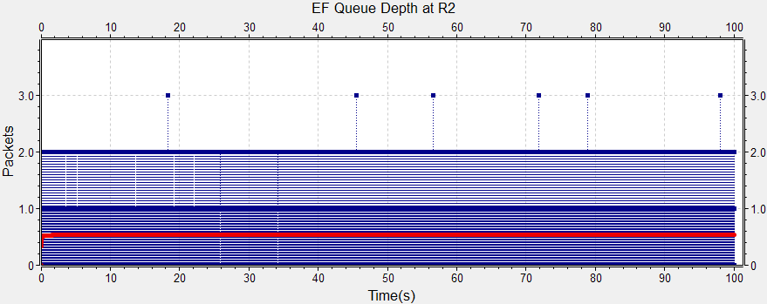
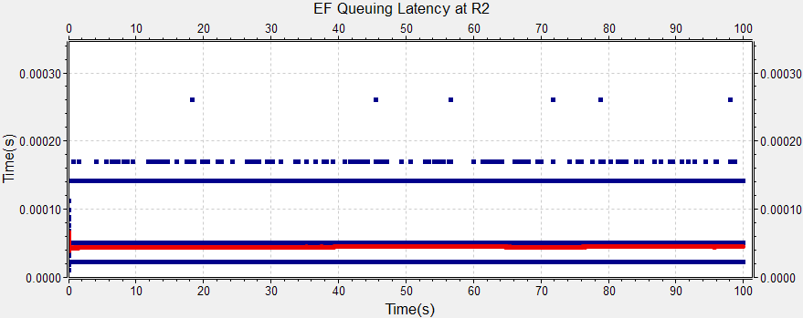
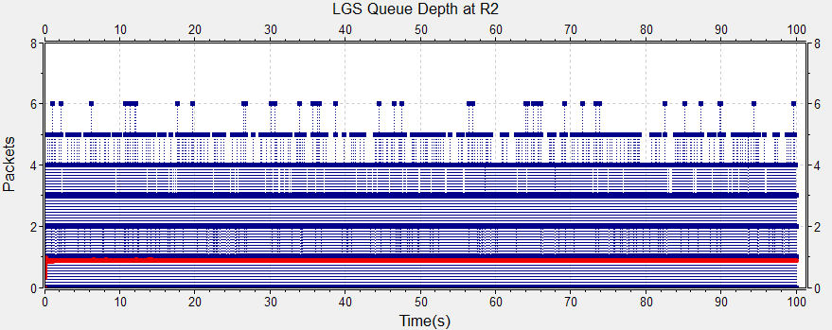
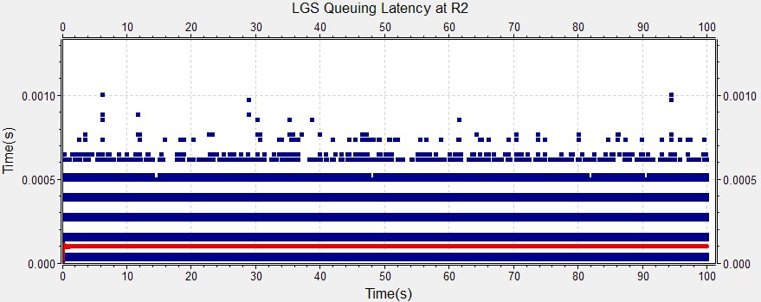

Case 2: EF+LGS $≅$65% link rate
Theorical value(r=1)
Theorical value(r=1)
Mean
Mean
Theorical value(r=1)
Theorical value(r=1)
Mean
Mean
EF flows =4, LGS flows = 16; R_{EF}=14.385M, R_{LGS}=50.11M; Burst traffic, Burst duration = Exp(0.02s), Burst sleep = Exp(0.001s).
Fully congested at all routers by BE, All Link Util =~100

Slide 14
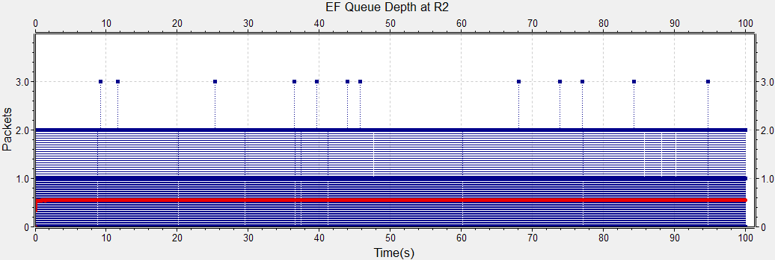
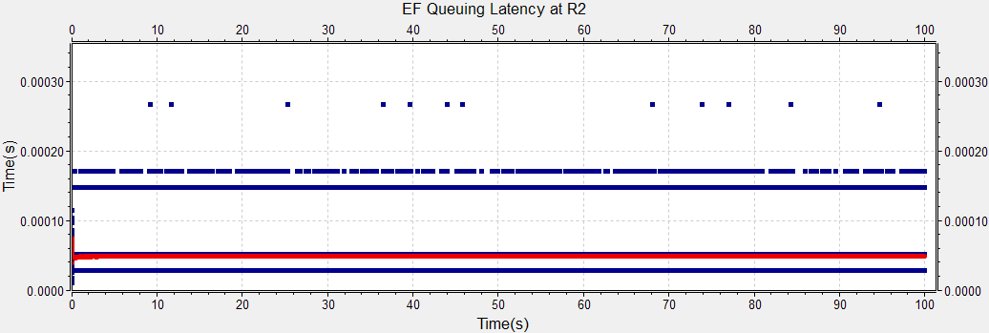
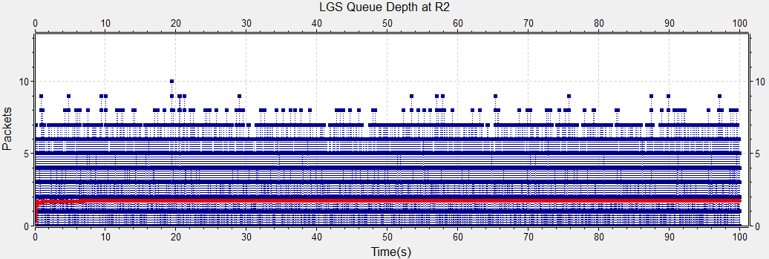
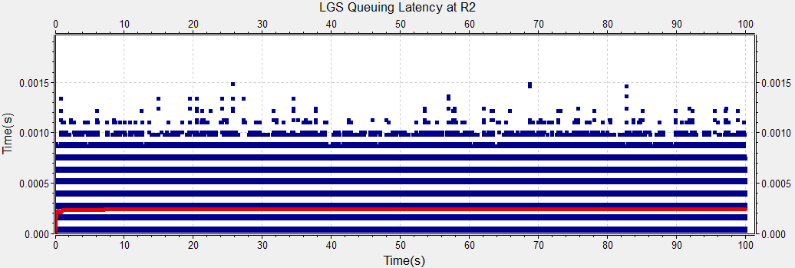

Case 3: EF+LGS $≅$ link rate
Theorical value(r=1)
Theorical value(r=1)
Mean
Mean
Theorical value(r=1)
Theorical value(r=1)
Mean
Mean
EF flows =4, LGS flows = 16; R_{EF}=21.84M, R_{LGS}=69.66M; Burst traffic, Burst duration = Exp(0.02s), Burst sleep = Exp(0.001s). Fully congested at all routers by BE, All Link Util =~100

Slide 15
Experiment results analysis
Design targets can be satisfied by the Class Based Queuing + In-band Signaling
The queuing latency of PQ is very short, it is not impacted by the congestion of WRR queues. The latency is related to link rate: 100M ~hundreds us; 100G~ hundreds ns.
The queuing latency can be estimated with acceptable accuracy when EF+LGS flow rate is not close to the egress link rate.
The estimation accuracy may decrease when the EF+LGS flow rate is close to the egress link rate. This can be explained by the impact of the jitter of the ingress traffic rate deviated from the average rate. When the jitter of ingress rate cause the rate exceeding the link rate, packet cannot be sent out in time and will build up.

Slide 16
Conclusion
In-band signaling
Configuration automation for DiffServ
Support the guaranteed service for E2E flows in a managed domain
New service can coexist with the current DiffServ
The current DiffServ capable hardware can be reused with minimum changes
Design targets can be satisfied
Only flow state is kept, No per flow scheduling. It is not heavy considering the new service is only a small portion of the whole network.
Further research
To make better use of the new services, TCP CC should be improved so the BGS and LGS could have different CC.
New meter to smooth the burst of traffic to achieve better latency and jitter
Other technologies such as DeltaQ to smooth the bursts in network
In-band signaling work with other queuing algorithms to achieve the LGS
Interworking with other protocols such as TSN and Detnet

Slide 17
Q & A

