Slide 1
PCA HeatMap
File created on: 10/20/19 15:28:00 PDT

Slide 2
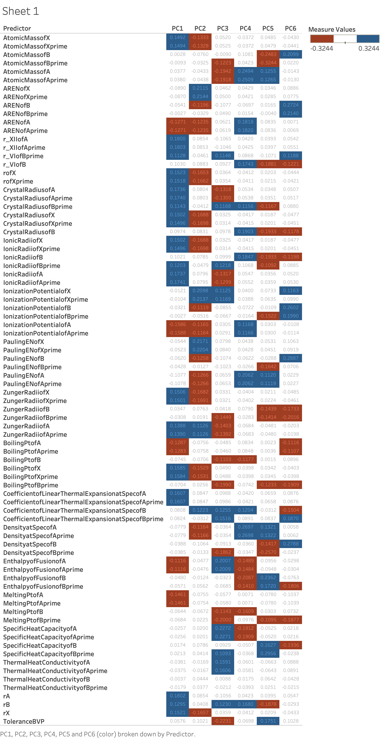

Slide 3
