Slide 1
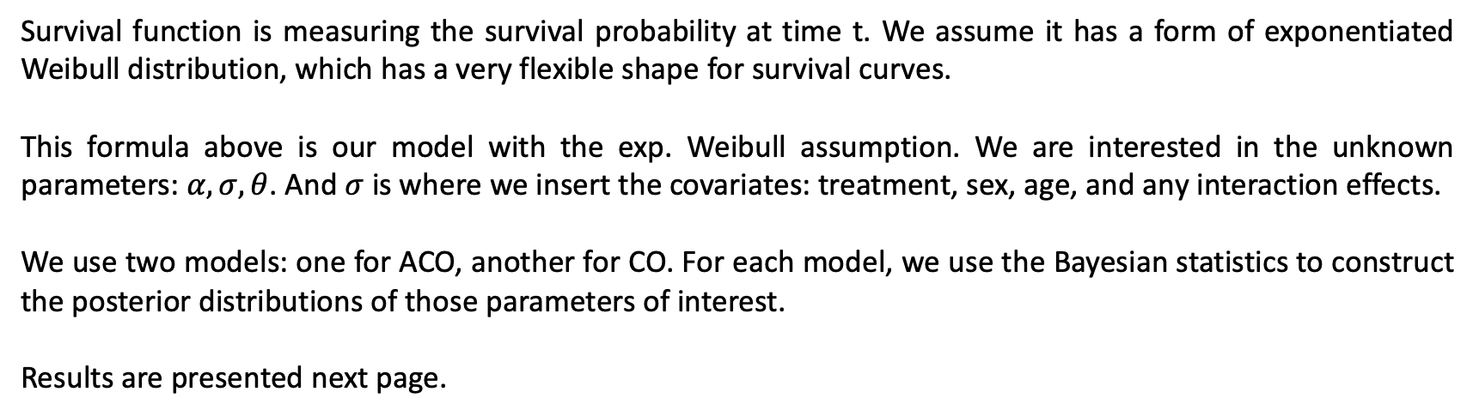
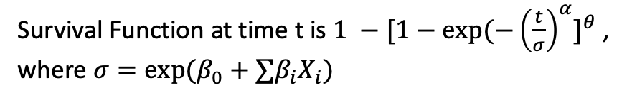
Exponentiated Weibull regression model
Survival Function at time t is $1 −[1−exp⁡(−{\left(\frac{t}{σ}\right)}^{α}]^{θ}$,
where $σ=exp⁡(β_{0}+∑{β_{i}X}_{i})$
Survival function is measuring the survival probability at time t. We assume it has a form of exponentiated Weibull distribution, which has a very flexible shape for survival curves.
This formula above is our model with the exp. Weibull assumption. We are interested in the unknown parameters: $α,σ, θ$. And $σ$ is where we insert the covariates: treatment, sex, age, and any interaction effects.
We use two models: one for ACO, another for CO. For each model, we use the Bayesian statistics to construct the posterior distributions of those parameters of interest.
Results are presented next page.

Slide 2
Model on ACO

Slide 3
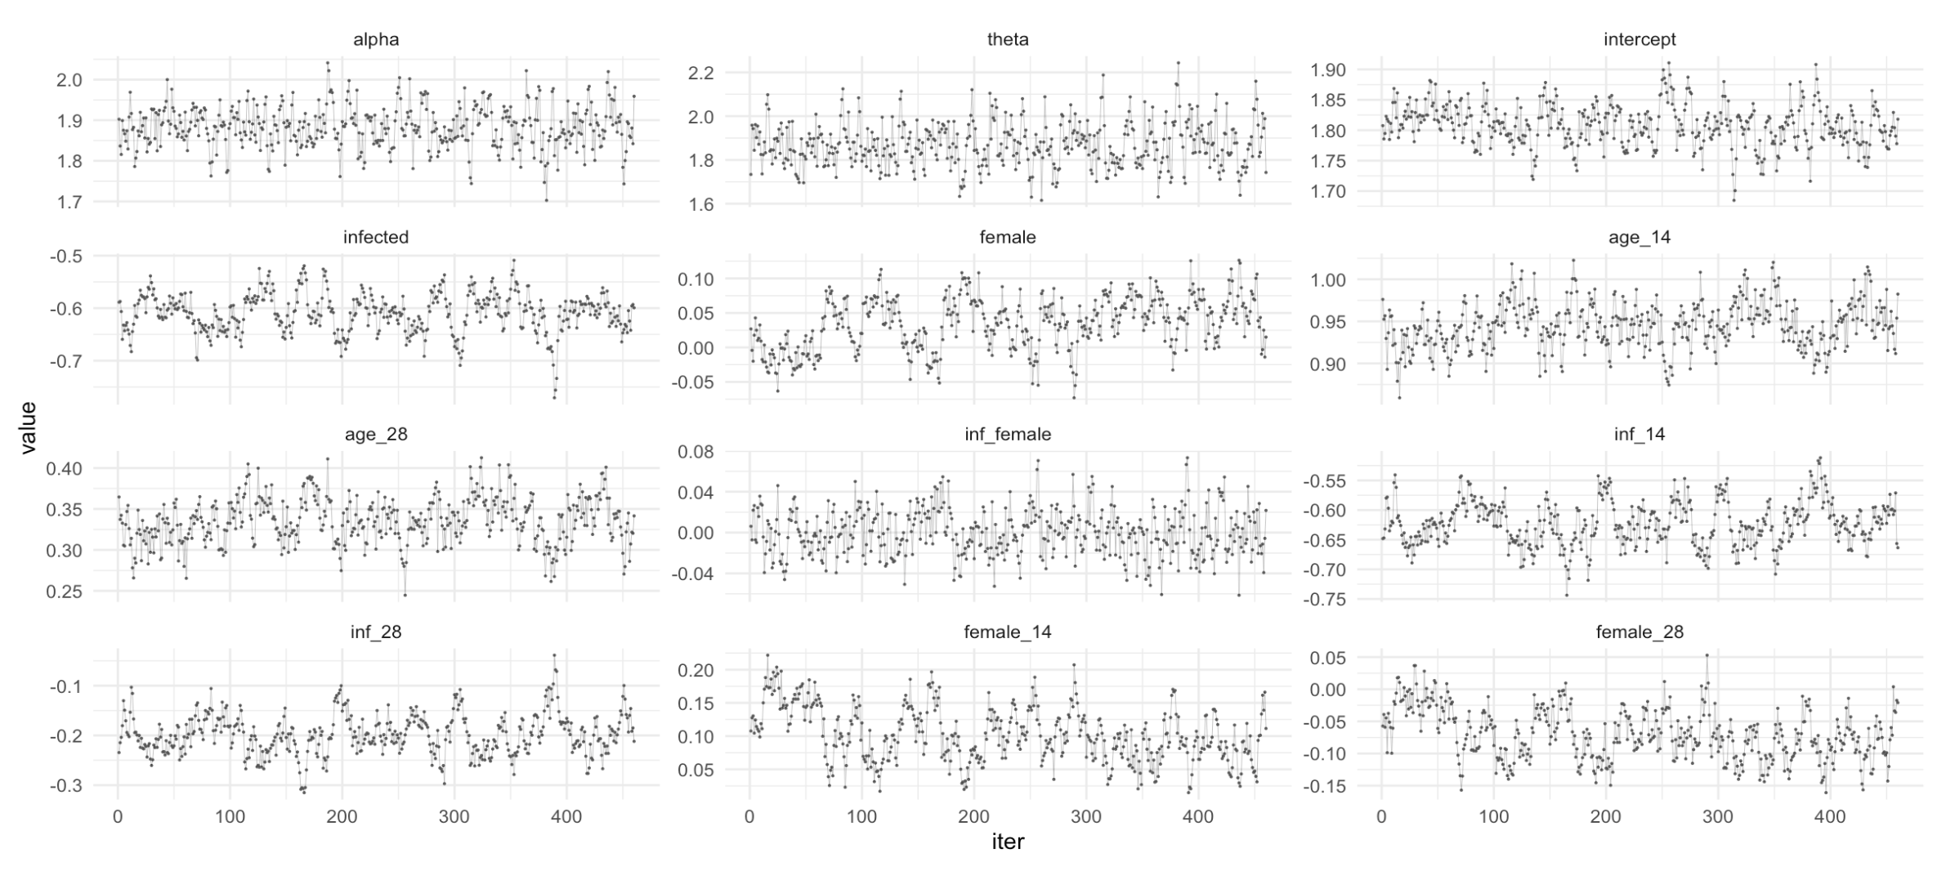
Model on ACO
These are the posterior draws (after thinning) for parameters of interest. Using these draws/distributions, we can find the estimate and 95% interval for each parameter below.

Slide 4
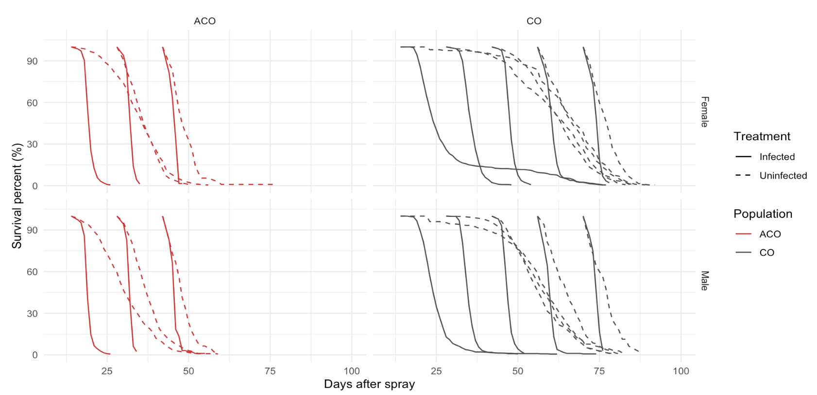
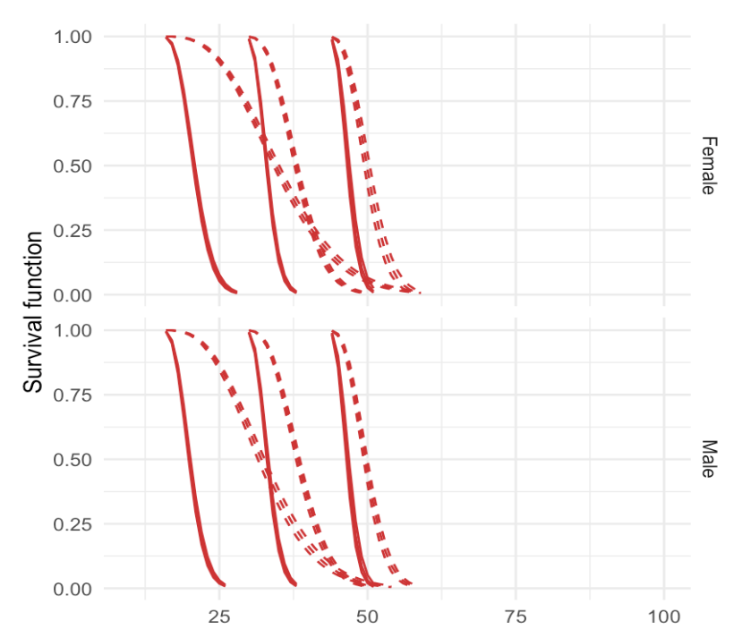
Model on ACO
Our model survival curves (right) is quite close to the raw data (left). If you zoom in a little to the model plot, there are three lines for each sub-group. They are the estimate line, 95% lower bound, and 95% upper bound.
Raw Data Plot
Model Plot

Slide 5
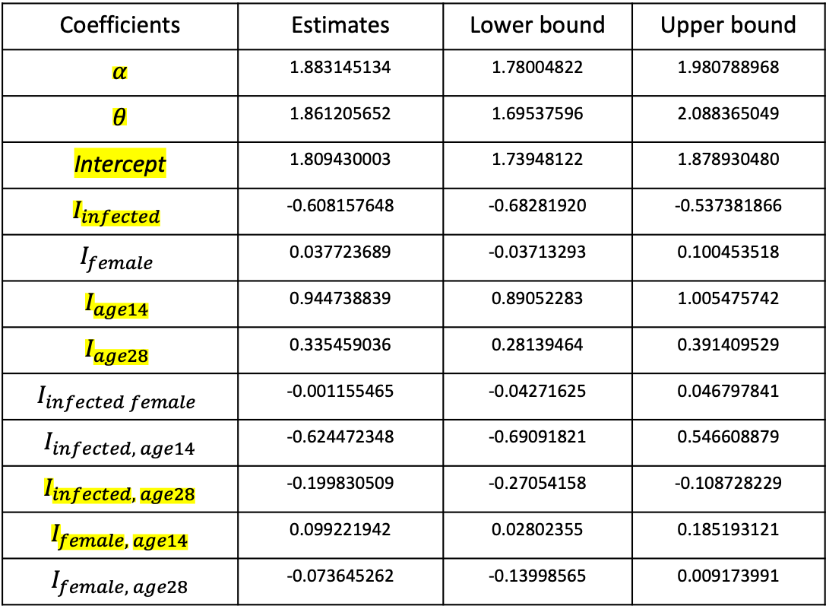
Model on ACO
Significant
Coefficients | Estimates | Lower bound | Upper bound
$$α$$ | 1.883145134 | 1.78004822 | 1.980788968
$$θ$$ | 1.861205652 | 1.69537596 | 2.088365049
Intercept | 1.809430003 | 1.73948122 | 1.878930480
$$I_{infected}$$ | -0.608157648 | -0.68281920 | -0.537381866
$$I_{female}$$ | 0.037723689 | -0.03713293 | 0.100453518
$$I_{age14}$$ | 0.944738839 | 0.89052283 | 1.005475742
$$I_{age28}$$ | 0.335459036 | 0.28139464 | 0.391409529
$$I_{infected female}$$ | -0.001155465 | -0.04271625 | 0.046797841
$$I_{infected, age14}$$ | -0.624472348 | -0.69091821 | 0.546608879
$$I_{infected, age28}$$ | -0.199830509 | -0.27054158 | -0.108728229
$$I_{female, age14}$$ | 0.099221942 | 0.02802355 | 0.185193121
$$I_{female, age28}$$ | -0.073645262 | -0.13998565 | 0.009173991

Slide 6
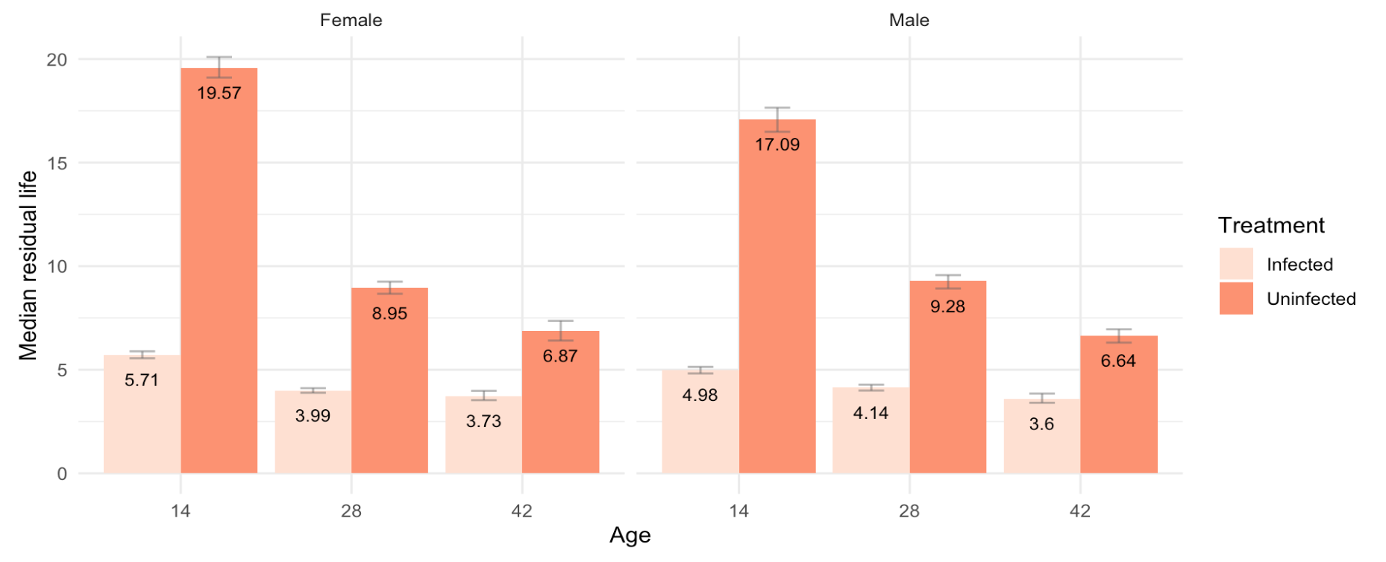
Model on ACO
Below are median estimates and 95% intervals.
Median lifetime

Slide 7
Model on CO

Slide 8
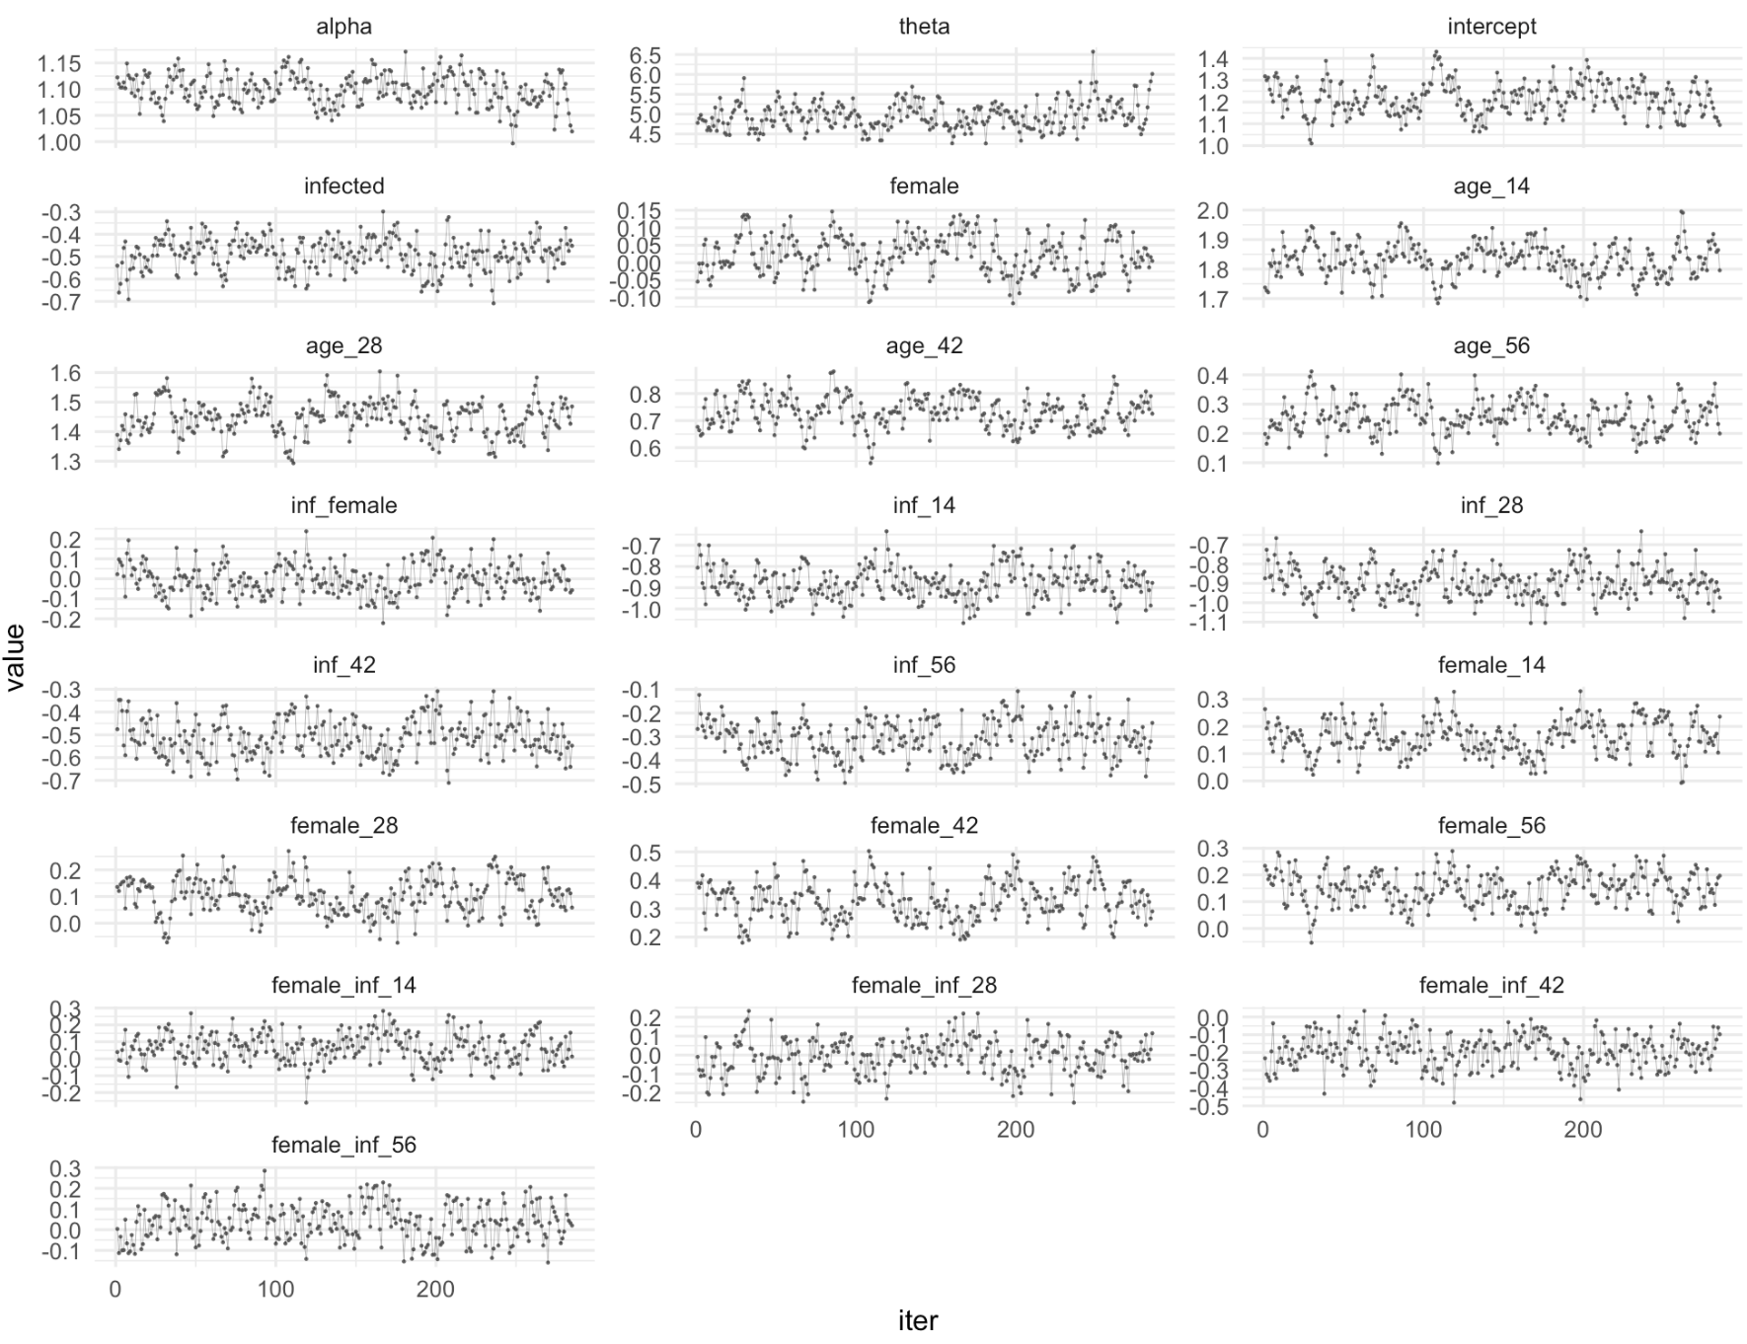
Model on CO
These are the posterior draws (after thinning) for parameters of interest. Using these draws, we can find the estimate and 95% interval for each parameter below.
Here I include the interaction effects between three covariates. Otherwise, the survival function curves are quite off.
But according to the 95% interval, none of these three-way interaction effects is significant.

Slide 9
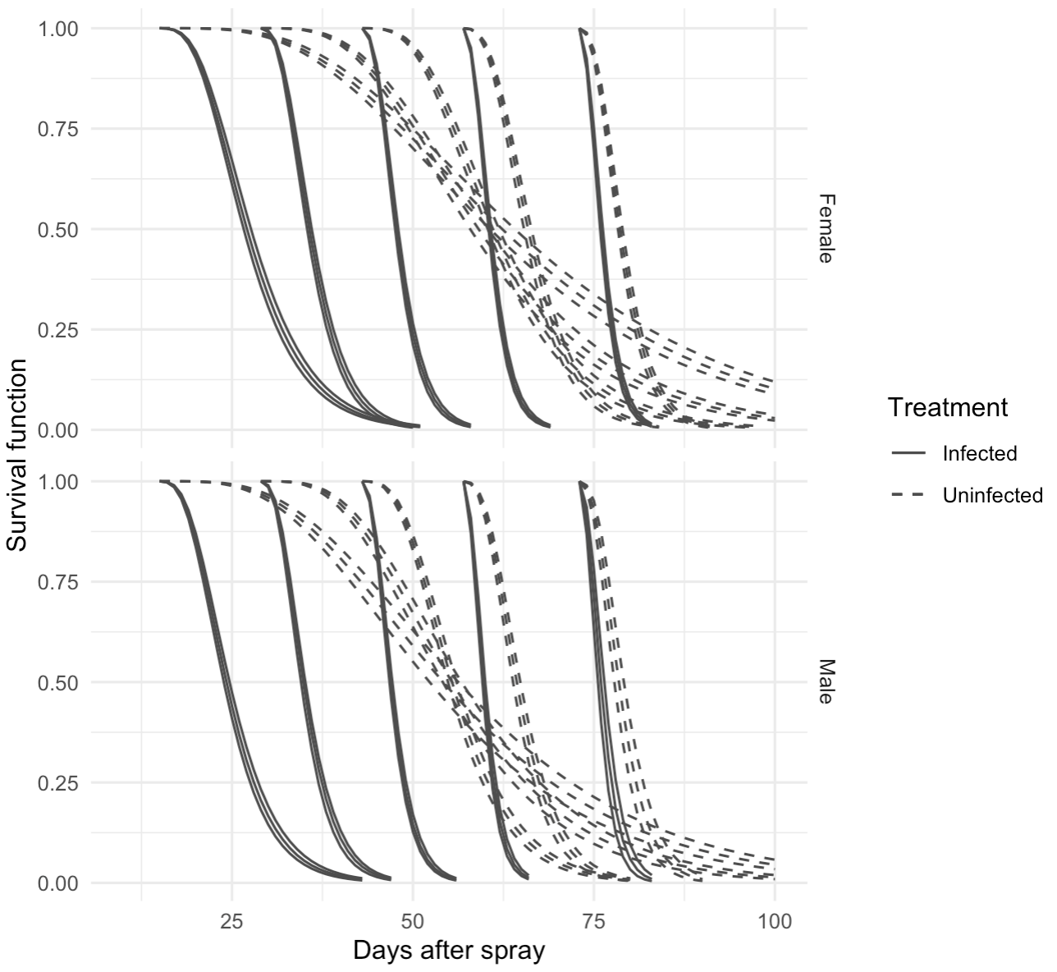
Model on CO
Our model survival curves (right) is quite close to the raw data (left), except that uninfected model curves have very long trails.
Raw Data Plot
Model Plot

Slide 10
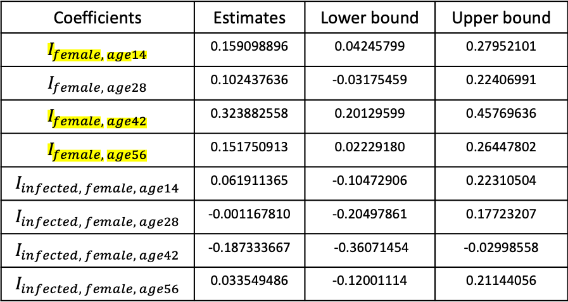
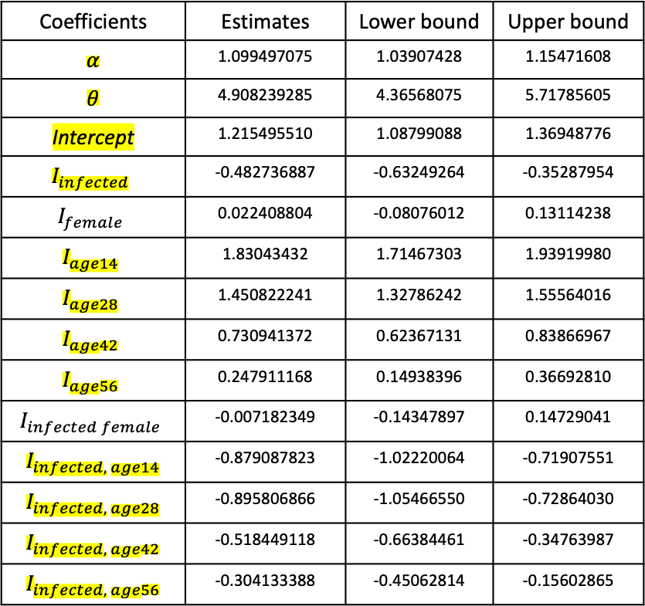
Model on CO
Significant
Coefficients | Estimates | Lower bound | Upper bound
$$α$$ | 1.099497075 | 1.03907428 | 1.15471608
$$θ$$ | 4.908239285 | 4.36568075 | 5.71785605
Intercept | 1.215495510 | 1.08799088 | 1.36948776
$$I_{infected}$$ | -0.482736887 | -0.63249264 | -0.35287954
$$I_{female}$$ | 0.022408804 | -0.08076012 | 0.13114238
$$I_{age14}$$ | 1.83043432 | 1.71467303 | 1.93919980
$$I_{age28}$$ | 1.450822241 | 1.32786242 | 1.55564016
$$I_{age42}$$ | 0.730941372 | 0.62367131 | 0.83866967
$$I_{age56}$$ | 0.247911168 | 0.14938396 | 0.36692810
$$I_{infected female}$$ | -0.007182349 | -0.14347897 | 0.14729041
$$I_{infected, age14}$$ | -0.879087823 | -1.02220064 | -0.71907551
$$I_{infected, age28}$$ | -0.895806866 | -1.05466550 | -0.72864030
$$I_{infected, age42}$$ | -0.518449118 | -0.66384461 | -0.34763987
$$I_{infected, age56}$$ | -0.304133388 | -0.45062814 | -0.15602865
Coefficients | Estimates | Lower bound | Upper bound
$$I_{female, age14}$$ | 0.159098896 | 0.04245799 | 0.27952101
$$I_{female, age28}$$ | 0.102437636 | -0.03175459 | 0.22406991
$$I_{female, age42}$$ | 0.323882558 | 0.20129599 | 0.45769636
$$I_{female, age56}$$ | 0.151750913 | 0.02229180 | 0.26447802
$$I_{infected, female, age14}$$ | 0.061911365 | -0.10472906 | 0.22310504
$$I_{infected, female, age28}$$ | -0.001167810 | -0.20497861 | 0.17723207
$$I_{infected, female, age42}$$ | -0.187333667 | -0.36071454 | -0.02998558
$$I_{infected, female, age56}$$ | 0.033549486 | -0.12001114 | 0.21144056

Slide 11
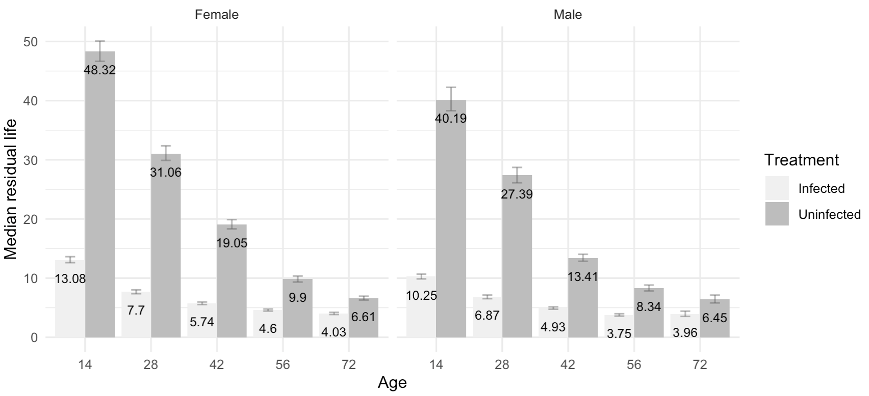
Model on CO
Below are median life estimates and 95% intervals.
Median lifetime

