Slide 1
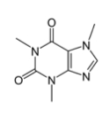
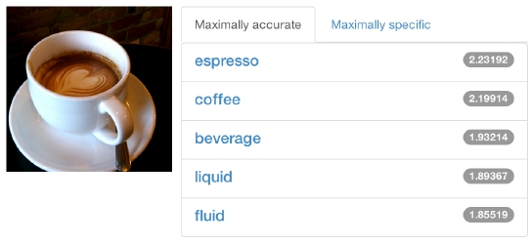



DIY Deep Learning for Vision:
the Caffe framework
caffe.berkeleyvision.org
github.com/BVLC/caffe
Evan Shelhamer
adapted from the Caffe tutorial with
Jeff Donahue, Yangqing Jia, and Ross Girshick.

Slide 2
Outline
Why deep learning
What is deep learning
Caffe

Slide 3
Outline
Why deep learning
What is deep learning
Caffe

Slide 4
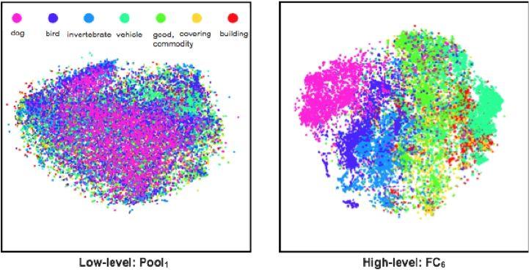
Why Deep Learning?
The Unreasonable Effectiveness of Deep Features
Classes separate in the deep representations and transfer to many tasks.
[DeCAF] [Zeiler-Fergus]

Slide 5
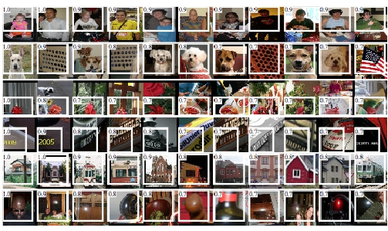
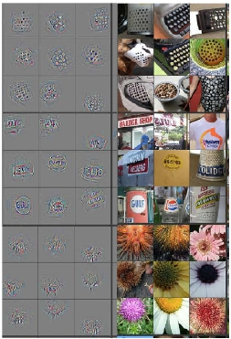
Why Deep Learning?
The Unreasonable Effectiveness of Deep Features
Maximal activations of pool5 units
[R-CNN]
Rich visual structure of features deep in hierarchy.
conv5DeConv visualization
[Zeiler-Fergus]

Slide 6
Outline
Why deep learning
What is deep learning
Caffe

Slide 7
What is Deep Learning?
Compositional Models
Learned End-to-End

Slide 8
What is Deep Learning?
Compositional Models
Learned End-to-End
Hierarchy of Representations
-
-
-
vision: pixel, motif, part, object
text: character, word, clause, sentence
speech: audio, band, phone, word
concrete
abstract
learning

Slide 9
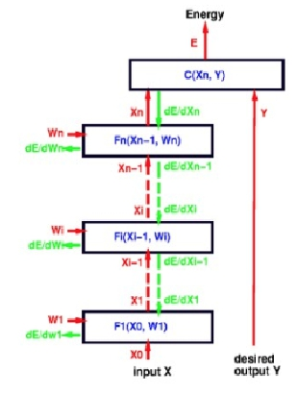
What is Deep Learning?
Compositional Models
Learned End-to-End
Back-propagation: take the gradient of
the model layer-by-layer by the chain rule
to yield the gradient of all the parameters.
figure credit Yann LeCun, ICML ‘13 tutorial

Slide 10
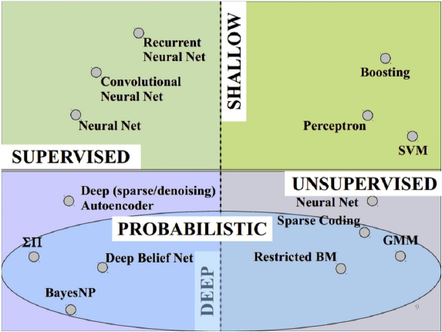
What is Deep Learning?
Vast space of models!
Caffe models are loss-driven:
-
-
supervised
unsupervised
slide credit Marc’aurelio Ranzato,
CVPR ‘14 tutorial.

Slide 11
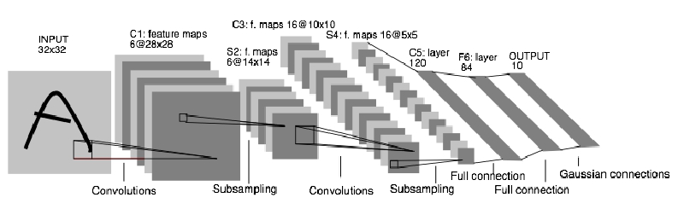
Convolutional Neural Nets (CNNs): 1989
LeNet: a layered model composed of convolution and
subsampling operations followed by a holistic representation
and ultimately a classifier for handwritten digits. [ LeNet ]

Slide 12
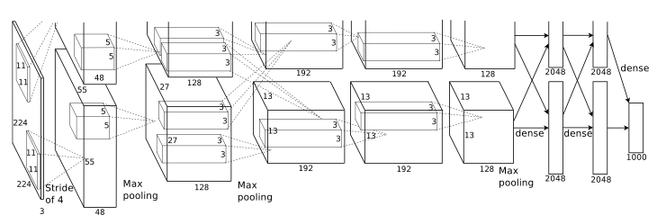
Convolutional Nets: 2012
AlexNet: a layered model composed of convolution,
subsampling, and further operations followed by a holistic
representation and all-in-all a landmark classifier on
ILSVRC12. [ AlexNet ]
+ data
+ gpu
+ non-saturating nonlinearity
+ regularization

Slide 13
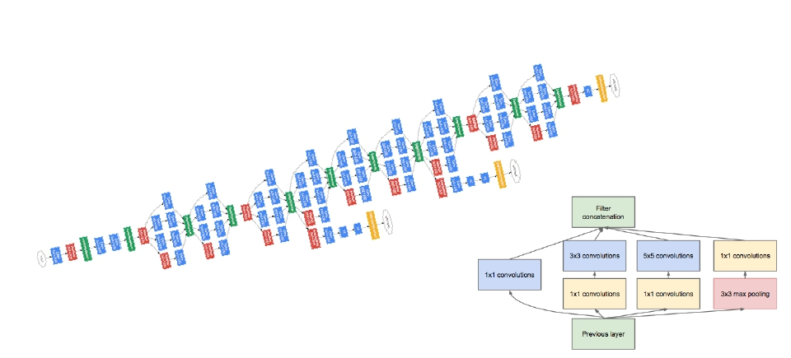
Convolutional Nets: 2014
ILSVRC14 Winners: ~6.6% Top-5 error
-
-
GoogLeNet: composition of multi-scale dimension-
reduced modules
VGG: 16 layers of 3x3 convolution interleaved with
max pooling + 3 fully-connected layers
+ depth
+ data
+ dimensionality reduction

Slide 14
Outline
Why deep learning
What is deep learning
Caffe

Slide 15
Why Caffe? In one sip…
●
●
●
●
●
Expression: models + optimizations are plaintext schemas, not code.
Speed: for state-of-the-art models and massive data.
Modularity: to extend to new tasks and settings.
Openness: common code and reference models for reproducibility.
Community: joint discussion and development through BSD-2 licensing.

Slide 16
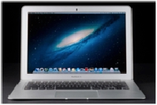
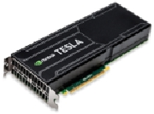
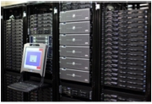
So what is Caffe?
● Pure C++ / CUDA architecture for deep learning
○ command line, Python, MATLAB interfaces
● Fast, well-tested code
● Tools, reference models, demos, and recipes
● Seamless switch between CPU and GPU
○ Caffe::set_mode(Caffe::GPU);
Prototype
Training
All with essentially the same code!
Deployment

Slide 17
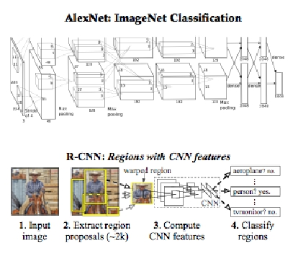
Reference Models
Caffe offers the
● model definitions
● optimization settings
● pre-trained weights
so you can start right away.
The BVLC reference models
are for unrestricted use.

Slide 18
Open Model Collection
The Caffe Model Zoo
- open collection of deep models to share innovation
- VGG ILSVRC14 + Devil models in the zoo
- Network-in-Network / CCCP model in the zoo
- MIT Places scene recognition model in the zoo
- help disseminate and reproduce research
- bundled tools for loading and publishing models
Share Your Models! with your citation + license of course

Slide 19
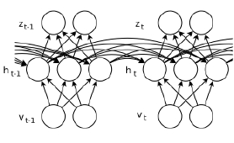
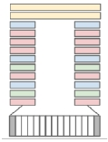
Architectures
DAGs
Weight Sharing
Recurrent (RNNs)
Sequences
[ Sutskever13 ]
multi-input
multi-task
[ Karpathy14 ]
Define your own model from our catalogue
of layers types and start learning.

Slide 20
Brewing by the Numbers...
● Speed with Krizhevsky's 2012 model:
○ K40 / Titan: 2 ms / image, K20: 2.6ms
○ Caffe + cuDNN: 1.17ms / image on K40
○ 60 million images / day
○ 8-core CPU: ~20 ms/image
● ~ 9K lines of C/C++ code
○ with unit tests ~20k
* Not counting I/O time. Details at http://caffe.berkeleyvision.org/performance_hardware.html

Slide 21
CAFFE INTRO

Slide 22
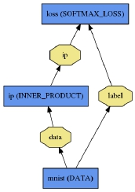

Net
● A network is a set of layers
connected as a DAG:
name: "dummy-net"
layers { name: "data" …}
layers { name: "conv" …}
layers { name: "pool" …}
… more layers …
layers { name: "loss" …}
LogReg ↑
●
Caffe creates and checks the net from
the definition.
LeNet →
●
Data and derivatives flow through the
net as blobs – a an array interface
ImageNet, Krizhevsky 2012 →

Slide 23
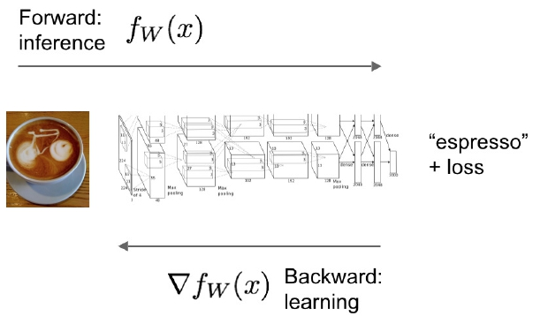
Forward / Backward the essential Net computations
Caffe models are complete machine learning systems for inference and learning.
The computation follows from the model definition. Define the model and run.

Slide 24
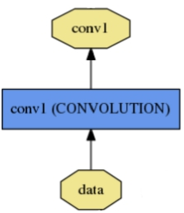
Layer
name: "conv1"
type: CONVOLUTION
bottom: "data"
top: "conv1"
convolution_param {
num_output: 20
kernel_size: 5
stride: 1
weight_filler {
name, type, and the
connection structure
(input blobs and
output blobs)
layer-specific
parameters
type: "xavier"
}
}
- Setup
●
Every layer type defines
- Forward
- Backward
* Nets + Layers are defined by protobuf schema

Slide 25
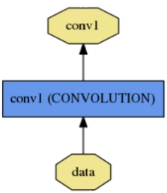
Layer Protocol
Setup: run once for initialization.
Reshape: set dimensions.
Forward: make output given input.
Backward: make gradient of output
- w.r.t. bottom
- w.r.t. parameters (if needed)
Model Composition
The Net forward and backward passes
are the composition the layers’.
Layer Development Checklist

Slide 26
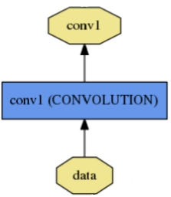



Blob
Blobs are 4-D arrays for storing and
communicating information.
● hold data, derivatives, and parameters
● lazily allocate memory
name: "conv1"
type: CONVOLUTION
bottom: "data"
top: "conv1"
… definition …
top
blob
●
shuttle between CPU and GPU
Data
Number x K Channel x Height x Width
256 x 3 x 227 x 227 for ImageNet train input
Parameter: Convolution Weight
N Output x K Input x Height x Width
96 x 3 x 11 x 11 for CaffeNet conv1
Parameter: Convolution BIas
96 x 1 x 1 x 1 for CaffeNet conv1
bottom
blob

Slide 27
Model Schema: Protocol Buffer
name: "conv1"
type: CONVOLUTION
bottom: "data"
top: "conv1"
convolution_param {
num_output: 20
kernel_size: 5
stride: 1
weight_filler {
type: "xavier"
}
}
●
●
●
Defines domain-specific language
in caffe.proto to determine
○ text schema
○ binary model format
Generates programmer API
Makes configuring, saving, and
loading models simple

Slide 28
Solving: Training a Net
Optimization like model definition is configuration.
train_net: "lenet_train.prototxt"
base_lr: 0.01
momentum: 0.9
weight_decay: 0.0005
max_iter: 10000
snapshot_prefix: "lenet_snapshot"
All you need to run things
on the GPU.
solver_mode: GPU
> caffe train -solver lenet_solver.prototxt
Stochastic Gradient Descent (SGD) + momentum ·
Adaptive Gradient (ADAGRAD) · Nesterov’s Accelerated Gradient (NAG)

Slide 29
Step-by-Step Recipe...
● Convert the data to a Caffe format
○
lmdb, leveldb, hdf5 / .mat, list of images, etc.
● Define the Net
● Configure the Solver
● caffe train -solver solver.prototxt -gpu 0
● Examples are your friends
○
○
caffe/examples/mnist,cifar10,imagenet
caffe/build/tools/*

Slide 30
Thanks

Slide 31
FINE-TUNING

Slide 32
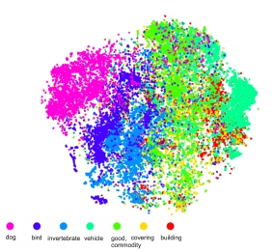
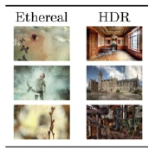
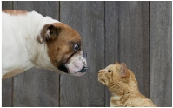
Fine-tuning Transferring learned weights to kick-start models
● Take a pre-trained model and fine-tune to new tasks
[DeCAF] [Zeiler-Fergus] [OverFeat]
Style
Recognition
Dogs vs.
Cats
top 10 in
10 minutes
© kaggle.com
Your Task

Slide 33
From ImageNet to Style
Simply change a few lines in the layer definition.
layers {
name: "data"
type: DATA
layers {
name: "data"
type: DATA
data_param {
source: "ilsvrc12_train_leveldb"
mean_file: "../../data/ilsvrc12"
...
}
...
}
...
layers {
data_param {
source: "style_leveldb"
mean_file: "../../data/ilsvrc12"
...
}
...
}
...
layers {
Input:
A different source
name: "fc8"
type: INNER_PRODUCT
blobs_lr: 1
blobs_lr: 2
weight_decay: 1
weight_decay: 0
name: "fc8-style"
type: INNER_PRODUCT
blobs_lr: 1
blobs_lr: 2
weight_decay: 1
weight_decay: 0
new name = new params
Last Layer:
A different classifier
inner_product_param {
num_output: 1000
...
}
inner_product_param {
num_output: 20
...
}
}
}

Slide 34
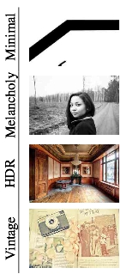
From ImageNet to Style
> caffe train -solver models/finetune_flickr_style/solver.prototxt
-weights bvlc_reference_caffenet.caffemodel
Under the hood (loosely speaking):
net = new Caffe::Net(
"style_solver.prototxt");
net.CopyTrainedNetFrom(
pretrained_model);
solver.Solve(net);

Slide 35
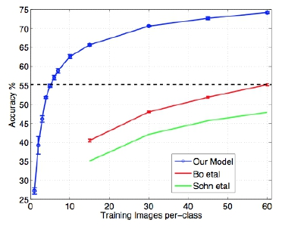
When to Fine-tune?
A good first step!
- More robust optimization – good initialization helps
- Needs less data
- Faster learning
State-of-the-art results in
- recognition
- detection
- segmentation
[Zeiler-Fergus]

Slide 36
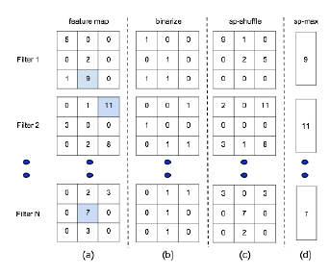

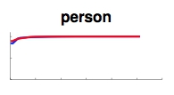

Training & Fine-tuning Analysis
- Supervised pre-training does not overfit
- Representation is (mostly) distributed
- Sparsity comes “for free” in deep representation
P. Agarwal et al. ECCV 14

Slide 37
Fine-tuning Tricks
Learn the last layer first
-
-
-
Caffe layers have local learning rates: blobs_lr
Freeze all but the last layer for fast optimization
and avoiding early divergence.
Stop if good enough, or keep fine-tuning
Reduce the learning rate
-
-
Drop the solver learning rate by 10x, 100x
Preserve the initialization from pre-training and avoid thrashing

Slide 38
LOSS

Slide 39
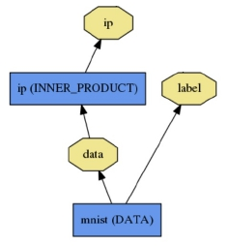
Loss
What kind of model is this?

Slide 40
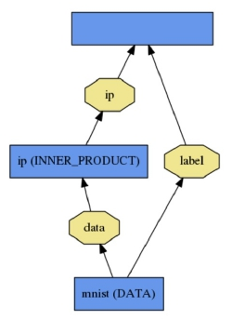
Loss
loss (LOSS_TYPE)
Classification
SOFTMAX_LOSS
What kind of model is this?
HINGE_LOSS
Linear Regression
EUCLIDEAN_LOSS
Attributes / Multiclassification
SIGMOID_CROSS_ENTROPY_LOSS
Others…
New Task
NEW_LOSS
Who knows! Need a loss function.

Slide 41
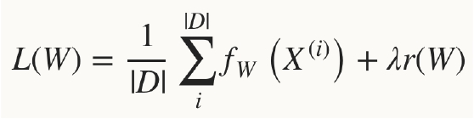
Loss
Loss function determines the learning task.
Given data D, a Net typically minimizes:
Data term: error averaged
over instances
Regularization
term: penalize
large weights to
improve
generalization

Slide 42

Loss
● The data error term is computed
by Net::Forward
● Loss is computed as the output of Layers
● Pick the loss to suit the task – many different
losses for different needs

Slide 43
SOLVER

Slide 44
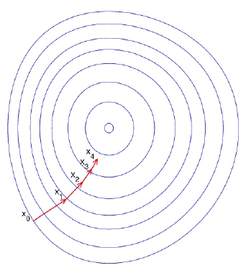

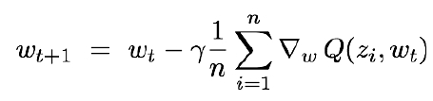
Optimization
How to minimize loss?
Descend the gradient.
Fast, incremental learning by
Stochastic Gradient Descent (SGD)

Slide 45
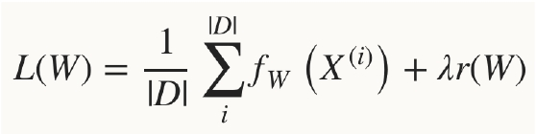
Solver
● Solver optimizes the network weights W
to minimize the loss L(W) over the data D
● Coordinates forward / backward, weight
updates, and scoring.

Slide 46

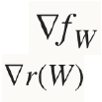
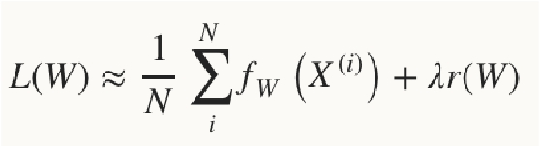
Solver
● Computes parameter update
from
○ The stochastic error gradient
○ The regularization gradient
○ Particulars to each solving method
, formed

Slide 47
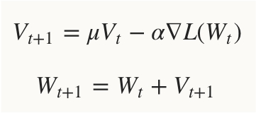
SGD Solver
● Stochastic gradient descent, with momentum
● solver_type: SGD

Slide 48
SGD Solver
● “AlexNet” [1] training strategy:
○ Use momentum 0.9
○ Initialize learning rate at 0.01
○ Periodically drop learning rate by a factor of 10
● Just a few lines of Caffe solver specification:
base_lr: 0.01
lr_policy: "step"
gamma: 0.1
stepsize: 100000
max_iter: 350000
momentum: 0.9
[1] A. Krizhevsky, I. Sutskever, and G. Hinton. ImageNet Classification with Deep Convolutional Neural Networks. Advances in Neural
Information Processing Systems, 2012.

Slide 49
Solver Showdown: MNIST Autoencoder
AdaGrad
I0901 13:36:30.007884 24952 solver.cpp:232] Iteration 65000, loss = 64.1627
I0901 13:36:30.007922 24952 solver.cpp:251] Iteration 65000, Testing net (#0) # train set
I0901 13:36:33.019305 24952 solver.cpp:289] Test loss: 63.217
I0901 13:36:33.019356 24952 solver.cpp:302]
I0901 13:36:33.019773 24952 solver.cpp:302]
Test net output #0: cross_entropy_loss = 63.217 (* 1 = 63.217 loss)
Test net output #1: l2_error = 2.40951
SGD
I0901 13:35:20.426187 20072 solver.cpp:232] Iteration 65000, loss = 61.5498
I0901 13:35:20.426218 20072 solver.cpp:251] Iteration 65000, Testing net (#0) # train set
I0901 13:35:22.780092 20072 solver.cpp:289] Test loss: 60.8301
I0901 13:35:22.780138 20072 solver.cpp:302]
I0901 13:35:22.780146 20072 solver.cpp:302]
Test net output #0: cross_entropy_loss = 60.8301 (* 1 = 60.8301 loss)
Test net output #1: l2_error = 2.02321
Nesterov
I0901 13:36:52.466069 22488 solver.cpp:232] Iteration 65000, loss = 59.9389
I0901 13:36:52.466099 22488 solver.cpp:251] Iteration 65000, Testing net (#0) # train set
I0901 13:36:55.068370 22488 solver.cpp:289] Test loss: 59.3663
I0901 13:36:55.068410 22488 solver.cpp:302]
I0901 13:36:55.068418 22488 solver.cpp:302]
Test net output #0: cross_entropy_loss = 59.3663 (* 1 = 59.3663 loss)
Test net output #1: l2_error = 1.79998

Slide 50

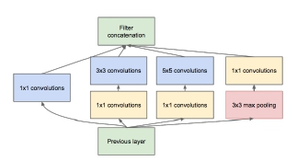
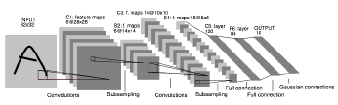
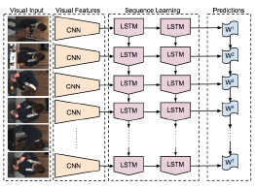
DAG
SDS two-stream net
Many current deep models
have linear structure
GoogLeNet Inception Module
but Caffe nets can have any
directed acyclic graph (DAG)
structure.
Define bottoms and tops
and Caffe will connect the net.
LRCN joint vision-sequence model

Slide 51
layers: {
WEIGHT SHARING
● Name parameters
name: 'innerproduct1'
type: INNER_PRODUCT
inner_product_param {
num_output: 10
bias_term: false
weight_filler {
type: 'gaussian'
by the param field
std: 10
}
● Layers with the same param
name share the parameter,
accumulating gradients
accordingly
● Use cases
}
param: 'sharedweights'
bottom: 'data'
top: 'innerproduct1'
}
layers: {
name: 'innerproduct2'
type: INNER_PRODUCT
inner_product_param {
num_output: 10
○ multi-scale pyramid
bias_term: false
}
○ sequences
param: 'sharedweights'
bottom: 'data'
○ regularization
top: 'innerproduct2'
}

Slide 52
RECENT MODELS
- Network-in-Network (NIN)
- GoogLeNet
- VGG

Slide 53
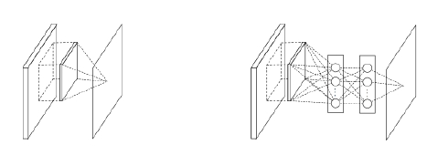
Network-in-Network
- filter with a nonlinear
composition instead of a
linear filter
- 1x1 convolution +
nonlinearity
- reduce dimensionality,
deepen the
representation
Linear Filter
CONV
NIN / MLP filter
1x1 CONV

Slide 54
GoogLeNet
-
composition of multi-scale dimension-reduced
“Inception” modules
“Inception” module
-
-
-
1x1 conv for dimensionality reduction
concatenation across filter scales
multiple losses for training to depth

Slide 55
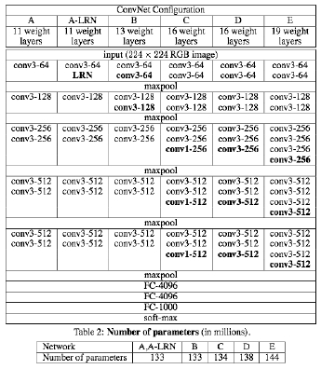
VGG
-
-
-
3x3 convolution all the way down...
fine-tuned progression of deeper models
16 and 19 parameter layer variations
in the model zoo

Slide 56
NOW ROASTING
-
-
-
-
-
-
-
Parallelism
Pythonification
Fully Convolutional Networks
Sequences
cuDNN v2
Gradient Accumulation
More
-
-
-
FFT convolution
locally-connected layer
...

Slide 57
Parallelism
Parallel / distributed training across
GPUs, CPUs, and cluster nodes
- collaboration with Flickr + open source community
- promoted to official integration branch in PR #1148
- faster learning and scaling to larger data

Slide 58
Pythonification
Python Layer
- layer prototyping and ease of expression
- call Python from C++, C++ from Python,
and around we go
Complete instrumentation in Python
- data preparation
- solving
- inference
- model definition
Jon Long

Slide 59
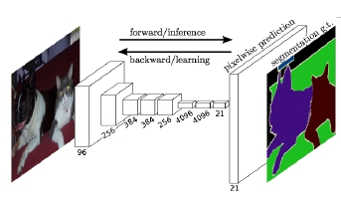
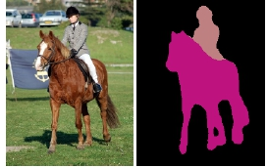
Fully Convolutional Network: FCN
A framework for spatial prediction by conv. net
applied to semantic segmentation
-
-
-
end-to-end learning
efficiency in inference and learning
0.3 s for whole image prediction
multi-modal, multi-task
Further applications
-
-
depth estimation
denoising
arXiv
Jon Long & Evan Shelhamer

Slide 60
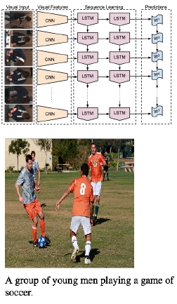
Sequences
Recurrent Net RNN and Long Short Term Memory LSTM
are sequential models
-
-
-
video
language
dynamics
learned by back-propagation through time.
LRCN: Long-term Recurrent Convolutional Network
-
-
-
activity recognition
image captioning
video captioning
arXiv
Jeff Donahue et al.

Slide 61
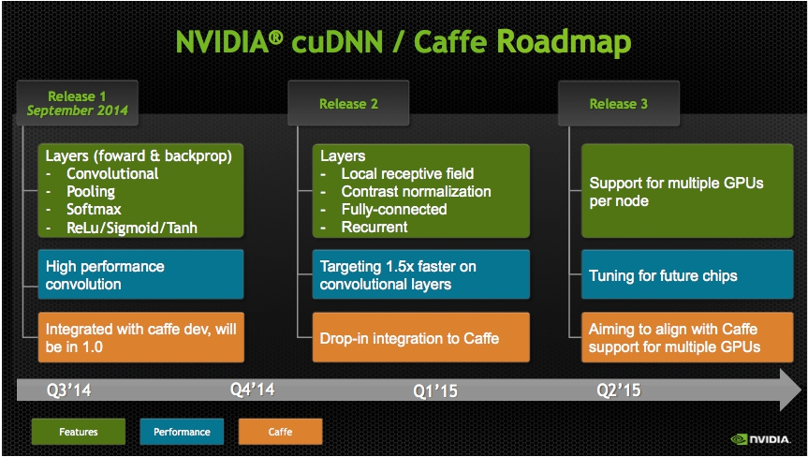

Slide 62
Gradient Accumulation
- decouple computational and learning mini-
batch size
- tune optimization independently of
resource constraints
- conserve memory
...and share convolution buffers for further memory savings.
Jon Long & Sergio Guadarrama

Slide 63
LAST SIP
Caffe...
● is fast
● is state-of-the-art
● has tips, recipes, demos, and models
● brings together an active community
● ...all for free and open source

Slide 64
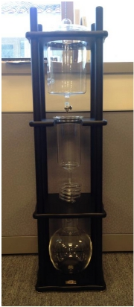
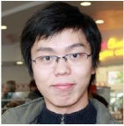
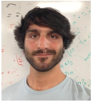

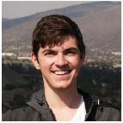



Thanks to the Caffe crew
Yangqing Jia, Evan Shelhamer, Jeff Donahue, Sergey Karayev
Jonathan Long, Ross Girshick, Sergio Guadarrama
...plus the
cold-brew
and our open source contributors!

Slide 65











Acknowledgements
Thank you to the Berkeley Vision and Learning Center Sponsors.
Thank you to NVIDIA
for GPU donation and
collaboration on cuDNN
Thank you to A9 and AWS
for a research grant for Caffe dev
and reproducible research
Thank you to our 50+
open source contributors
and vibrant community.

Slide 66
References
[ DeCAF ] J. Donahue, Y. Jia, O. Vinyals, J. Hoffman, N. Zhang, E. Tzeng, and T. Darrell. Decaf: A deep
convolutional activation feature for generic visual recognition. ICML, 2014.
[ R-CNN ] R. Girshick, J. Donahue, T. Darrell, and J. Malik. Rich feature hierarchies for accurate object detection
and semantic segmentation. CVPR, 2014.
[ Zeiler-Fergus ] M. Zeiler and R. Fergus. Visualizing and understanding convolutional networks. ECCV, 2014.
[ LeNet ] Y. LeCun, L. Bottou, Y. Bengio, and P. Haffner. Gradient-based learning applied to document
recognition. IEEE, 1998.
[ AlexNet ] A. Krizhevsky, I. Sutskever, and G. Hinton. Imagenet classification with deep convolutional neural
networks. NIPS, 2012.
[ OverFeat ] P. Sermanet, D. Eigen, X. Zhang, M. Mathieu, R. Fergus, and Y. LeCun. Overfeat: Integrated
recognition, localization and detection using convolutional networks. ICLR, 2014.
[ Image-Style ] S. Karayev, M. Trentacoste, H. Han, A. Agarwala, T. Darrell, A. Hertzmann, H. Winnemoeller.
Recognizing Image Style. BMVC, 2014.
[ Karpathy14 ] A. Karpathy, G. Toderici, S. Shetty, T. Leung, R. Sukthankar, and L. Fei-Fei. Large-scale video
classification with convolutional neural networks. CVPR, 2014.
[ Sutskever13 ] I. Sutskever. Training Recurrent Neural Networks.
PhD thesis, University of Toronto, 2013.
[ Chopra05 ] S. Chopra, R. Hadsell, and Y. LeCun. Learning a similarity metric discriminatively, with application to
face verification. CVPR, 2005.

Slide 67


UPCOMING GTC EXPRESS WEBINARS
Wednesday, December 10 ArrayFire: A Productive Open Source GPU
Software Library
Shehzan Mohammed, ArrayFire
Thursday, December 18
Photorealistic Visualization with Speed and
Ease Using Iray+ for Autodesk 3ds Max
Shehzan Mohammed, ArrayFire
www.gputechconf.con/gtcexpress

Slide 68

REGISTRATION IS OPEN!
20% OFF
GM15WEB
March 17-20, 2015 | San Jose, CA
www.gputechconf.com #GTC15
CONNECT
Connect with experts
from NVIDIA and other
organizations across a
wide range of fields
LEARN
Get key learnings and
hands-on training in the
400+ sessions and 150+
research posters
DISCOVER
Discover the latest
technologies shaping
the GPU ecosystem
INNOVATE
Hear about disruptive
innovations as early-stage
start-ups present their work
4 Days | 3400+ Attendees | 400+ Sessions | 150+ Research Posters
40+ Countries | 180+ Press & Analytics | 100+ Exhibitors

