Slide 1
Deep Learning Tutorial
Thanks Hung-yi Lee
Notes:
Not memtion
DT v.s. Deep!!!!!

Slide 2
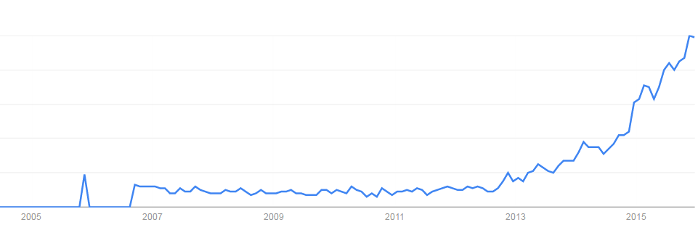
Deep learning attracts lots of attention.
Google Trends
Deep learning obtains many exciting results.
The talks in this afternoon
This talk will focus on the technical part.
2007
2009
2011
2013
2015

Slide 3
Outline
Part III: Tips for Training Deep Neural Network
Part IV: Neural Network with Memory
Part I: Introduction of Deep Learning
Part II: Why Deep?
Notes:
What people already knew in 1980s

Slide 4
Part I: Introduction of Deep Learning
What people already knew in 1980s
Notes:
Three questions:
Model
Cost
Train

Slide 5
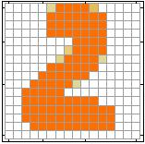
Example Application
Handwriting Digit Recognition
Machine
“2”
Notes:
“Hello world” for deep learning
Data: http://yann.lecun.com/exdb/mnist/

Slide 6
Handwriting Digit Recognition
Input
Output
y₁
is 1
0.1
y₂
is 2
0.7
The image is “2”
……
……
……
y₁₀
0.2
is 0
16 x 16 = 256
Ink → 1
No ink → 0
Each dimension represents the confidence of a digit.
Notes:
The same for even more complex tasks.

Slide 7

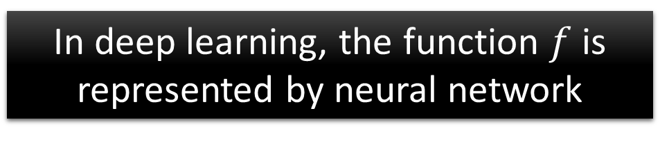
Example Application
Handwriting Digit Recognition
y₁
Machine
y₂
“2”
……
……
y₁₀
$$f:R^{256}→R^{10}$$
In deep learning, the function $f$ is represented by neural network

Slide 8

Element of Neural Network
Neuron
$$f:R^{K}→R$$
…
Activation function
weights
bias
Notes:
sigmoid

Slide 9
Neural Network
neuron
Input
Layer 1
Layer 2
Layer L
Output
……
y₁
……
y₂
……
……
……
……
……
……
y_{M}
Input Layer
Output Layer
Hidden Layers
Deep means many hidden layers
Notes:
Fully Connected Feedforward Network
You can always connect the neurons in your own way.
“+” is ignored
Each dimension corresponds to a digit (10 dimension is needed)

Slide 10
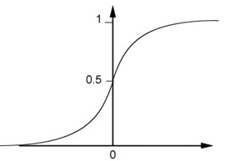
Example of Neural Network
1
4
0.98
1
-2
1
-1
-2
0.12
-1
1
0
Sigmoid Function
Notes:
Ignore +

Slide 11
Example of Neural Network
1
4
0.98
2
0.86
3
0.62
1
-2
-1
-1
1
0
-2
-1
-2
0.12
-2
0.11
-1
0.83
-1
1
-1
4
0
0
2

Slide 12
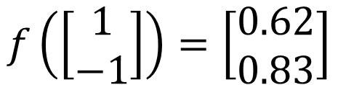

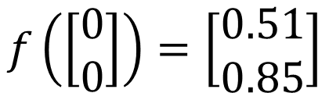
Example of Neural Network
1
0.73
2
0.72
3
0.51
0
-2
-1
-1
1
0
-2
-1
0.5
-2
0.12
-1
0.85
0
1
-1
4
0
0
2
$$f:R^{2}→R^{2}$$
$$f\left(\left[\begin{matrix}1 \\ −1\end{matrix}\right]\right)=\left[\begin{matrix}0.62 \\ 0.83\end{matrix}\right]$$
$$f\left(\left[\begin{matrix}0 \\ 0\end{matrix}\right]\right)=\left[\begin{matrix}0.51 \\ 0.85\end{matrix}\right]$$
Different parameters define different function
Notes:
For example, if we modify “1” to “2”, then we have another function

Slide 13


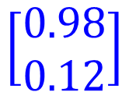

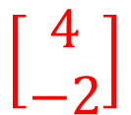
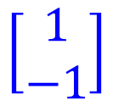

Matrix Operation
1
4
0.98
1
-2
1
-1
-2
0.12
-1
1
0
$$\left[\begin{matrix}1 & −2 \\ −1 & 1\end{matrix}\right]$$
$$\left[\begin{matrix}1 \\ −1\end{matrix}\right]$$
$$\left[\begin{matrix}1 \\ 0\end{matrix}\right]$$
$$=$$
$$\left[\begin{matrix}0.98 \\ 0.12\end{matrix}\right]$$
$$σ\left( \right)$$
$$+$$
$$\left[\begin{matrix}4 \\ −2\end{matrix}\right]$$
Notes:
Make sure you know how to do it
author: Adam Coates, Baidu, Inc.
Deep Learning (hopefully faster)
http://videolectures.net/deeplearning2015_coates_deep_learning/

Slide 14



Neural Network
……
y₁
W¹
W²
W^{L}
……
y₂
b¹
b²
b^{L}
……
……
……
……
……
x
a¹
a²
y
……
y_{M}
W¹
x
b¹
+
$$σ\left( \right)$$
a¹
b²
W²
+
$$σ\left( \right)$$
W^{L}
b^{L}
a^{L-1}
+
$$σ\left( \right)$$
Notes:
Draw it?

Slide 15


Neural Network
……
y₁
W¹
W²
W^{L}
……
y₂
b¹
b²
b^{L}
……
……
……
……
……
x
a¹
a²
y
……
y_{M}
y
x
Using parallel computing techniques to speed up matrix operation
$$=f\left( \right)$$
W^{L}
…
W²
W¹
x
b¹
b²
…
b^{L}
+
+
+
$$σ\left( \right)$$
$$=σ\left( \right)$$
$$σ\left( \right)$$
x
Notes:
Draw it?

Slide 16
Softmax
Softmax layer as the output layer
Ordinary Layer
In general, the output of network can be any value.
May not be easy to interpret
Notes:
Original output layer is local

Slide 17
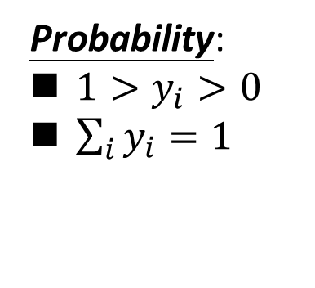
Softmax
Probability:
$1>y_{i}>0$
$\sum_{i}{y_{i}=1}$
Softmax layer as the output layer
Softmax Layer
3
20
0.88
1
2.7
0.12
-3
0.05
≈0
Notes:
Why it is name soft max?
Monotonicity of softmax
Non-locality of softmax

Slide 18


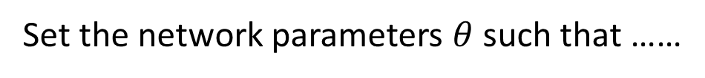
How to set network parameters
$$θ=\left\{W^{1},b^{1},W^{2},b^{2},⋯W^{L},b^{L}\right\}$$
……
y₁
is 1
0.1
……
y₂
0.7
is 2
Softmax
……
……
……
……
y₁₀
is 0
0.2
16 x 16 = 256
Ink → 1
No ink → 0
Set the network parameters $θ$ such that ……
Input:
How to let the neural network achieve this
y₁ has the maximum value
Input:
y₂ has the maximum value

Slide 19








Training Data
Preparing training data: images and their labels
“5”
“0”
“4”
“1”
“9”
“2”
“1”
“3”
Using the training data to find the network parameters.

Slide 20
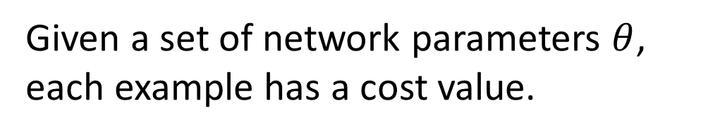

Cost
Given a set of network parameters $θ$, each example has a cost value.
“1”
……
y₁
0.2
1
……
y₂
0
0.3
……
……
……
Cost
……
……
……
y₁₀
$$L(θ)$$
0
0.5
target
Cost can be Euclidean distance or cross entropy of the network output and target
Notes:
With softmax, the summation of all the ouputs would be one.
Can be considered as probability if you want ……

Slide 21
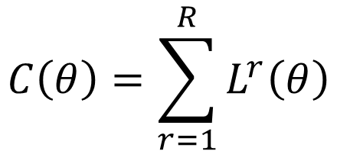
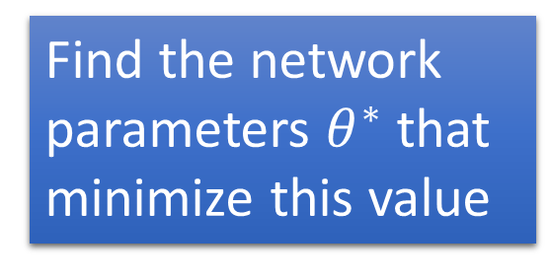
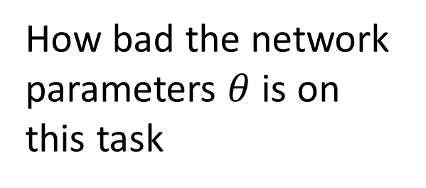








Total Cost
For all training data …
Total Cost:
NN
$$C\left(θ\right)=\sum_{r=1}^{R}{L^{r}\left(θ\right)}$$
x¹
y¹
$${\hat{y}}^{1}$$
$$L^{1}\left(θ\right)$$
x²
NN
y²
$${\hat{y}}^{2}$$
How bad the network parameters $θ$ is on this task
$$L^{2}\left(θ\right)$$
x³
NN
y³
$${\hat{y}}^{3}$$
$$L^{3}\left(θ\right)$$
……
……
……
……
Find the network parameters $θ^{∗}$ that minimize this value
x^{R}
NN
y^{R}
$${\hat{y}}^{R}$$
$$L^{R}\left(θ\right)$$
Notes:
Randomly picked one
Two approaches update the parameters towards the same direction, but stochastic is faster!
Better!

Slide 22
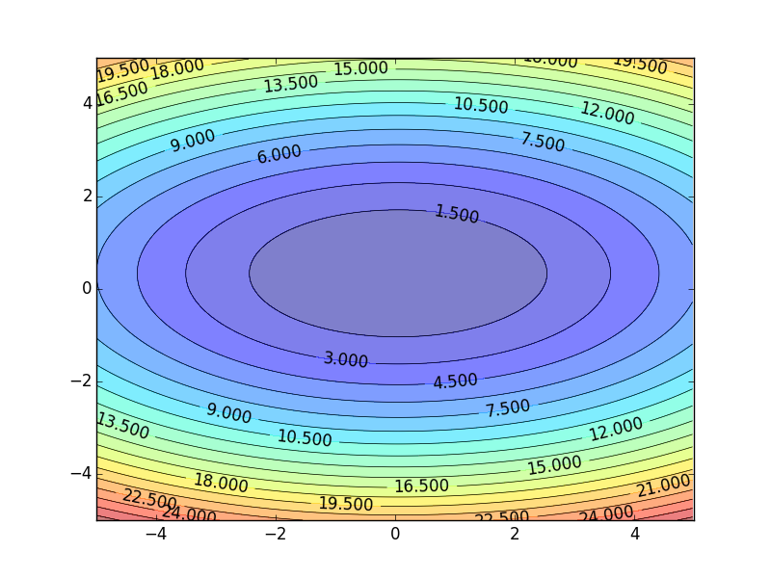

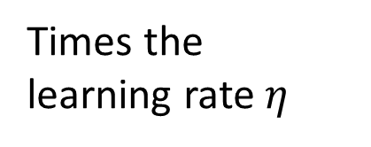

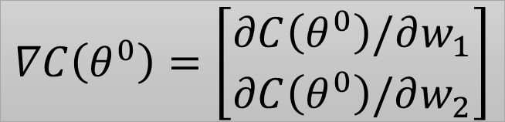





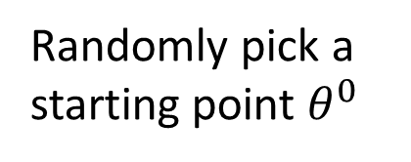
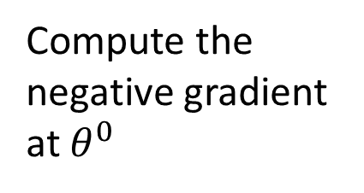


Gradient Descent
Assume there are only two parameters w₁ and w₂ in a network.
Error Surface
$$θ=\left\{w_{1},w_{2}\right\}$$
The colors represent the value of C.
Randomly pick a starting point $θ^{0}$
Compute the negative gradient at $θ^{0}$
$$w_{2}$$
$$θ^{∗}$$
$$−η∇C\left(θ^{0}\right)$$
$$−∇C\left(θ^{0}\right)$$
$$−∇C\left(θ^{0}\right)$$
Times the learning rate $η$
$$∇C\left(θ^{0}\right)=\left[\begin{matrix}∂C\left(θ^{0}\right)/∂w_{1} \\ ∂C\left(θ^{0}\right)/∂w_{2}\end{matrix}\right]$$
$$θ^{0}$$
$$−η∇C\left(θ^{0}\right)$$
$$w_{1}$$
Notes:
Eta
人站在 ｔｈｅｔａ０ 環顧四周 看看哪裡最低，那個方向就是 ｇｒａｄｉｅｎｔ

Slide 23






Gradient Descent
Eventually, we would reach a minima …..
Randomly pick a starting point $θ^{0}$
Compute the negative gradient at $θ^{0}$
$$θ^{2}$$
$$−η∇C\left(θ^{2}\right)$$
$$−η∇C\left(θ^{1}\right)$$
$$w_{2}$$
$$−∇C\left(θ^{2}\right)$$
$$−∇C\left(θ^{1}\right)$$
$$θ^{1}$$
$$−∇C\left(θ^{0}\right)$$
Times the learning rate $η$
$$θ^{0}$$
$$−η∇C\left(θ^{0}\right)$$
$$w_{1}$$

Slide 24
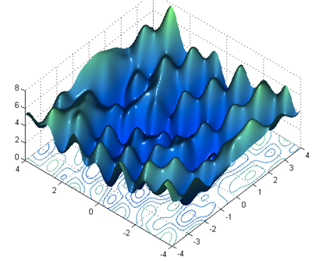



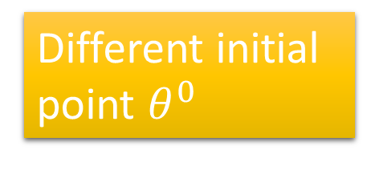
Local Minima
Gradient descent never guarantee global minima
Different initial point $θ^{0}$
Reach different minima, so different results
$$C$$
Who is Afraid of Non-Convex Loss Functions?
http://videolectures.net/eml07_lecun_wia/
$$w_{1}$$
$$w_{2}$$

Slide 25



Besides local minima ……
cost
Very slow at the plateau
Stuck at saddle point
Stuck at local minima
$$∇C\left(θ\right)≈0$$
$$∇C\left(θ\right)=0$$
$$∇C\left(θ\right)=0$$
parameter space

Slide 26
In physical world ……
Momentum
How about put this phenomenon in gradient descent?
Notes:
Momentum: 動量

Slide 27
Momentum
Still not guarantee reaching global minima, but give some hope ……
cost
Movement =
Negative of Gradient + Momentum
Negative of Gradient
Momentum
Real Movement
Gradient = 0
Notes:
What can we see?

Slide 28




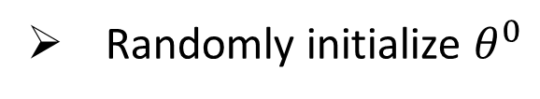








Mini-batch
Randomly initialize $θ^{0}$
x¹
NN
y¹
Pick the 1st batch
$${\hat{y}}^{1}$$
$$L^{1}$$
$$C=L^{1}+L^{31}+⋯$$
Mini-batch
NN
x³¹
y³¹
$${\hat{y}}^{31}$$
$$θ^{1}←θ^{0}−η∇C\left(θ^{0}\right)$$
$$L^{31}$$
Pick the 2nd batch
……
$$C=L^{2}+L^{16}+⋯$$
NN
$$θ^{2}←θ^{1}−η∇C\left(θ^{1}\right)$$
x²
y²
$${\hat{y}}^{2}$$
$$L^{2}$$
…
Mini-batch
C is different each time when we update parameters!
x¹⁶
NN
y¹⁶
$${\hat{y}}^{16}$$
$$L^{16}$$
……
Notes:
Each time we update paramters, we have different target -> 不安
Shuffle data, and repeat above process

Slide 29
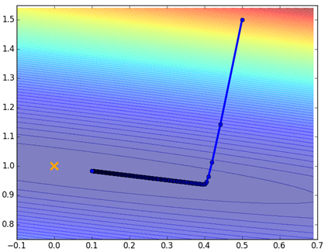
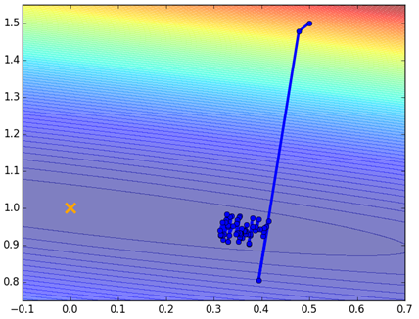
Mini-batch
Original Gradient Descent
With Mini-batch
unstable
The colors represent the total C on all training data.
Notes:
Hopefully, when the match size is large enough,
Not that stateble

Slide 30






Mini-batch
Faster
Better!
Randomly initialize $θ^{0}$
x¹
NN
y¹
Pick the 1st batch
$${\hat{y}}^{1}$$
$$C^{1}$$
$$C=C^{1}+C^{31}+⋯$$
Mini-batch
NN
x³¹
y³¹
$${\hat{y}}^{31}$$
$$θ^{1}←θ^{0}−η∇C\left(θ^{0}\right)$$
$$C^{31}$$
Pick the 2nd batch
……
$$C=C^{2}+C^{16}+⋯$$
NN
$$θ^{2}←θ^{1}−η∇C\left(θ^{1}\right)$$
x²
y²
$${\hat{y}}^{2}$$
$$C^{2}$$
…
Until all mini-batches have been picked
Mini-batch
x¹⁶
NN
y¹⁶
$${\hat{y}}^{16}$$
$$C^{16}$$
one epoch
……
Repeat the above process
Notes:
Ｉｎ ｏｐｅｎ ｅｐｏｃｈ， ｕｐｄａｔｅ ｍａｎｙ ｔｉｍｅｓ
Shuffle data, and repeat above process

Slide 31



Backpropagation
A network can have millions of parameters.
Backpropagation is the way to compute the gradients efficiently (not today)
Ref: http://speech.ee.ntu.edu.tw/~tlkagk/courses/MLDS_2015_2/Lecture/DNN%20backprop.ecm.mp4/index.html
Many toolkits can compute the gradients automatically
Ref: http://speech.ee.ntu.edu.tw/~tlkagk/courses/MLDS_2015_2/Lecture/Theano%20DNN.ecm.mp4/index.html
Notes:
Just a function

Slide 32
Part II: Why Deep?

Slide 33
Deeper is Better?
Layer X Size | Word Error Rate (%) | Layer X Size | Word Error Rate (%)
1 X 2k | 24.2
2 X 2k | 20.4
3 X 2k | 18.4
4 X 2k | 17.8
5 X 2k | 17.2 | 1 X 3772 | 22.5
7 X 2k | 17.1 | 1 X 4634 | 22.6
 |  | 1 X 16k | 22.1
Not surprised, more parameters, better performance
Seide, Frank, Gang Li, and Dong Yu. "Conversational Speech Transcription Using Context-Dependent Deep Neural Networks." Interspeech. 2011.
Notes:
SWB
For a fixed number of parameters, a deep model is clearly better than the shallow one.

Slide 34
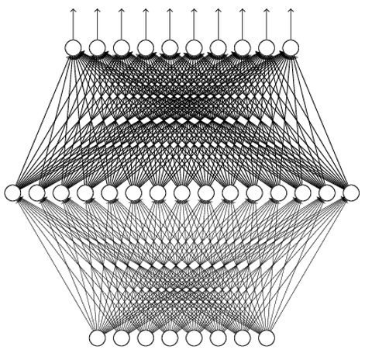
Universality Theorem
Any continuous function f
Can be realized by a network with one hidden layer
(given enough hidden neurons)
Reference for the reason: http://neuralnetworksanddeeplearning.com/chap4.html
Why “Deep” neural network not “Fat” neural network?

Slide 35
Fat + Short v.s. Thin + Tall
The same number of parameters
Which one is better?
……
……
……
Shallow
Deep

Slide 36
Fat + Short v.s. Thin + Tall
Layer X Size | Word Error Rate (%) | Layer X Size | Word Error Rate (%)
1 X 2k | 24.2
2 X 2k | 20.4
3 X 2k | 18.4
4 X 2k | 17.8
5 X 2k | 17.2 | 1 X 3772 | 22.5
7 X 2k | 17.1 | 1 X 4634 | 22.6
 |  | 1 X 16k | 22.1
Seide, Frank, Gang Li, and Dong Yu. "Conversational Speech Transcription Using Context-Dependent Deep Neural Networks." Interspeech. 2011.

Slide 37
Why Deep?
Deep → Modularization
Classifier 1
Girls with
long hair
長髮女
長髮女
長髮女
長髮女
Classifier 2
Boys with
long hair
長髮男
Image
weak
Little examples
Classifier 3
Girls with
short hair
短髮女
短髮女
短髮女
短髮女
Classifier 4
Boys with short hair
短髮男
短髮男
短髮男
短髮男
Notes:
Programming -> all in main -> so long and bad
-> function -> shorter

Slide 38
Why Deep?
Each basic classifier can have sufficient training examples.
Deep → Modularization
長髮女
長髮男
長髮女
Boy or Girl?
短髮女
長髮女
短髮女
長髮女
短髮女
v.s.
短髮男
短髮女
短髮男
Image
短髮男
短髮男
Basic
Classifier
長髮女
短髮女
Long or short?
長髮女
短髮女
長髮女
短髮女
長髮女
短髮女
v.s.
短髮男
長髮男
短髮男
Classifiers for the attributes
短髮男
短髮男

Slide 39
Why Deep?
can be trained by little data
Deep → Modularization
Classifier 1
Girls with
long hair
Boy or Girl?
Classifier 2
Boys with
long hair
Image
Basic
Classifier
fine
Little data
Classifier 3
Girls with
short hair
Long or short?
Classifier 4
Boys with short hair
Sharing by the following classifiers as module

Slide 40
Why Deep?
Deep Learning also works on small data set like TIMIT.
→ Less training data?
Deep → Modularization
……
The modularization is automatically learned from data.
……
……
……
……
……
……
The most basic classifiers
Use 1st layer as module to build classifiers
Use 2nd layer as module ……
Notes:
Need less data!!!!!

Slide 41
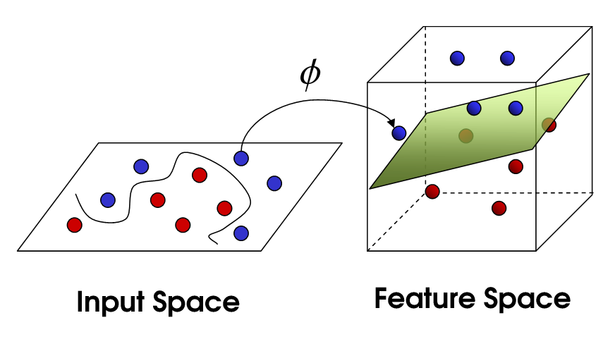


Hand-crafted
kernel function
SVM
Apply simple classifier
Source of image: http://www.gipsa-lab.grenoble-inp.fr/transfert/seminaire/455_Kadri2013Gipsa-lab.pdf
Deep Learning
simple classifier
Learnable kernel
$$φ\left(x\right)$$
……
y₁
$$x$$
……
y₂
…
…
…
…
…
……
y_{M}

Slide 42
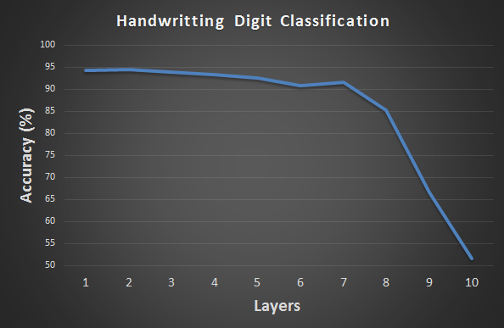
Hard to get the power of Deep …
Before 2006, deeper usually does not imply better.

Slide 43
Part III: Tips for Training DNN
Notes:
The techniques people did not know in 1980s.

Slide 44
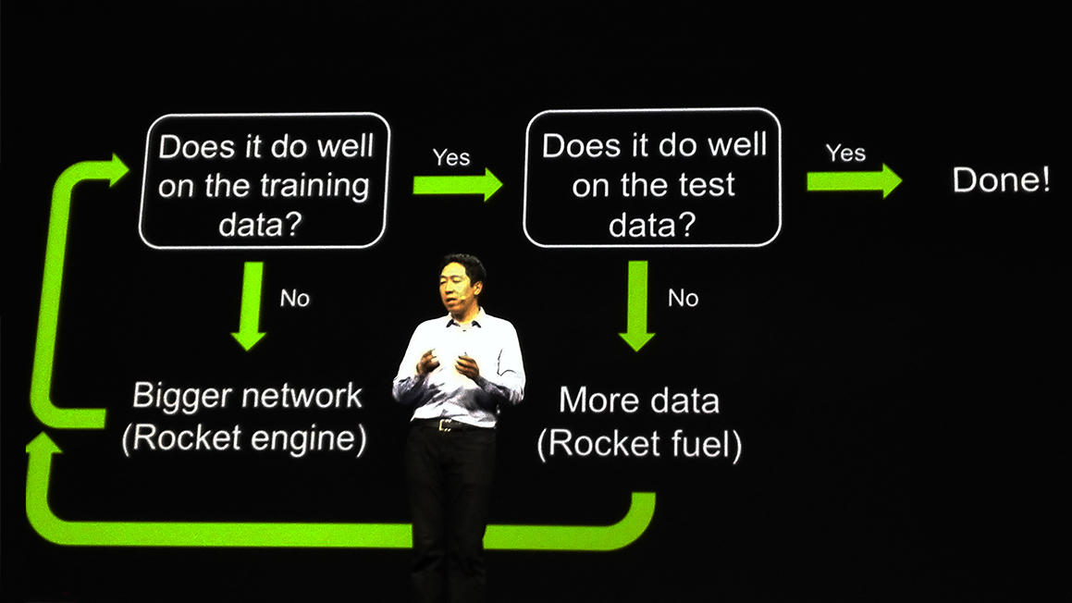
Recipe for Learning
http://www.gizmodo.com.au/2015/04/the-basic-recipe-for-machine-learning-explained-in-a-single-powerpoint-slide/
Notes:
今年四月的 GTC

Slide 45
Recipe for Learning
Don’t forget!
overfitting
Modify the Network
Preventing
Overfitting
Better optimization Strategy
http://www.gizmodo.com.au/2015/04/the-basic-recipe-for-machine-learning-explained-in-a-single-powerpoint-slide/
Notes:
Last one is on training set
Sometimes students ask

Slide 46
Recipe for Learning
Modify the Network
Better optimization Strategy
Prevent Overfitting
New activation functions, for example, ReLU or Maxout
Adaptive learning rates
Dropout
Only use this approach when you already obtained good results on the training data.

Slide 47
Part III: Tips for Training DNN
New Activation Function

Slide 48





ReLU
Rectified Linear Unit (ReLU)
Reason:
$$a$$
$$σ\left(z\right)$$
1. Fast to compute
$$a=z$$
2. Biological reason
$$a=0$$
3. Infinite sigmoid with different biases
$$z$$
4. Vanishing gradient problem
[Xavier Glorot, AISTATS’11]
[Andrew L. Maas, ICML’13]
[Kaiming He, arXiv’15]
Notes:
Parametric ReLU, -> PReLU
Ref: Glorot, Xavier, Antoine Bordes, and Yoshua Bengio. "Deep sparse rectifier neural networks." International Conference on Artificial Intelligence and Statistics. 2011.
No differentailalbe how about 0
Benefit:
2011
Where does it come from?
fast to compute
biology?
many sigmoid

Slide 49
Vanishing Gradient Problem
……
y₁
In 2006, people used RBM pre-training.
In 2015, people use ReLU.
……
y₂
……
……
……
……
……
……
y_{M}
Smaller gradients
Larger gradients
Learn very slow
Learn very fast
Almost random
Already converge
based on random!?
Notes:
The problem of gradient vanish is very hard to explain ……………….!!!!!!!!!!!!!!!!!!!!!!!!!!!!!!!!!
See Gradient flow in recurrent nets: the difficulty of learning long-term dependencies, by Sepp Hochreiter, Yoshua Bengio, Paolo Frasconi, and Jürgen Schmidhuber (2001). This paper studied recurrent neural nets, but the essential phenomenon is the same as in the feedforward networks we are studying. See also Sepp Hochreiter's earlier Diploma Thesis,Untersuchungen zu dynamischen neuronalen Netzen (1991, in German).
Stuck at a bad local minima
When deep learning is difficult in early year
Need initialization
Another point of view
Definition of gradient

Slide 50
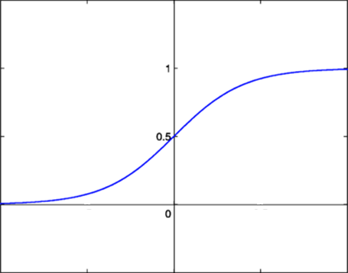






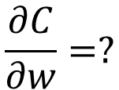



Vanishing Gradient Problem
Smaller gradients
……
$$y_{1}$$
$${\hat{y}}_{1}$$
Small output
……
$$y_{2}$$
$${\hat{y}}_{2}$$
……
……
……
……
……
$$C$$
……
$$+∆C$$
……
$$y_{M}$$
$${\hat{y}}_{M}$$
Large input
$$+∆w$$
Intuitive way to compute the gradient …
$$\frac{∂C}{∂w}=?$$
$$\frac{∆C}{∆w}$$

Slide 51
ReLU
$$a$$
$$a=z$$
$$a=0$$
$$z$$
0
0
0
0

Slide 52
ReLU
$$a$$
$$a=z$$
A Thinner linear network
$$a=0$$
$$z$$
Do not have smaller gradients

Slide 53












Maxout
ReLU is a special cases of Maxout
Learnable activation function [Ian J. Goodfellow, ICML’13]
+
neuron
+
$$5$$
$$1$$
Input
Max
$$7$$
Max
$$2$$
+
$$7$$
+
$$2$$
+
$$−1$$
+
$$4$$
Max
$$1$$
Max
$$4$$
+
$$1$$
+
$$3$$
You can have more than 2 elements in a group.
Notes:
How to train? Latter
2013
Ian J. Goodfellow goodfeli@iro.umontreal.ca David Warde-Farley wardefar@iro.umontreal.ca Mehdi Mirza mirzamom@iro.umontreal.ca Aaron Courville aaron.courville@umontreal.ca Yoshua Bengio

Slide 54
Maxout
ReLU is a special cases of Maxout
Learnable activation function [Ian J. Goodfellow, ICML’13]
Activation function in maxout network can be any piecewise linear convex function
How many pieces depending on how many elements in a group
2 elements in a group
3 elements in a group
Notes:
3,4,5

Slide 55
Part III: Tips for Training DNN
Adaptive Learning Rate

Slide 56




Learning Rate
Set the learning rate η carefully
$$−η∇C\left(θ^{0}\right)$$
If learning rate is too large
Cost may not decrease after each update
$$w_{2}$$
$$−∇C\left(θ^{0}\right)$$
$$θ^{0}$$
$$w_{1}$$

Slide 57

Learning Rate
Can we give different parameters different learning rates?
Set the learning rate η carefully
If learning rate is too large
Cost may not decrease after each update
$$w_{2}$$
If learning rate is too small
$$−∇C\left(θ^{0}\right)$$
$$−η∇C\left(θ^{0}\right)$$
$$θ^{0}$$
Training would be too slow
$$w_{1}$$

Slide 58

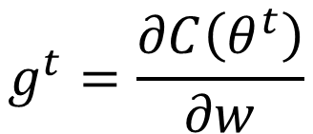
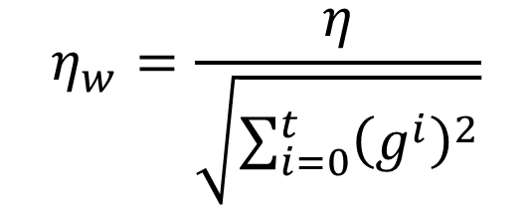

Adagrad
Original Gradient Descent
$$θ^{t}←θ^{t−1}−η∇C\left(θ^{t−1}\right)$$
Each parameter w are considered separately
$$g^{t}=\frac{∂C\left(θ^{t}\right)}{∂w}$$
$$w^{t+1}←w^{t}−{\text{η}}_{w}g^{t}$$
Parameter dependent learning rate
constant
$${\text{η}}_{w}=\frac{η}{\sqrt{\sum_{i=0}^{t}{{\left(g^{i}\right)}^{2}}}}$$
Summation of the square of the previous derivatives

Slide 59
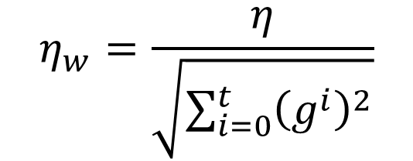


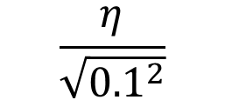
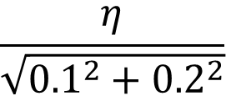
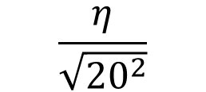
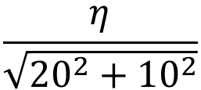
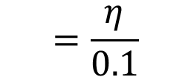
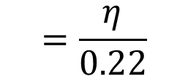
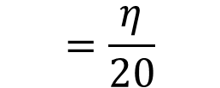
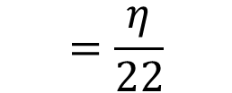
Adagrad
$${\text{η}}_{w}=\frac{η}{\sqrt{\sum_{i=0}^{t}{{\left(g^{i}\right)}^{2}}}}$$
g⁰ | g¹ | ……
0.1 | 0.2 | ……
g⁰ | g¹ | ……
20.0 | 10.0 | ……
$$w_{1}$$
$$w_{2}$$
Learning rate:
Learning rate:
$$\frac{η}{\sqrt{{0.1}^{2}}}$$
$$=\frac{η}{0.1}$$
$$\frac{η}{\sqrt{{20}^{2}}}$$
$$=\frac{η}{20}$$
$$\frac{η}{\sqrt{{0.1}^{2}+{0.2}^{2}}}$$
$$=\frac{η}{0.22}$$
$$\frac{η}{\sqrt{{20}^{2}+{10}^{2}}}$$
$$=\frac{η}{22}$$
Observation:
1. Learning rate is smaller and smaller for all parameters
2. Smaller derivatives, larger learning rate, and vice versa
Why?
Notes:
反差
http://seed.ucsd.edu/mediawiki/images/6/6a/Adagrad.pdf
http://courses.cs.washington.edu/courses/cse547/15sp/slides/adagrad.pdf

Slide 60
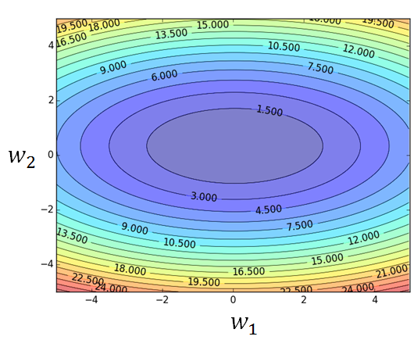
Larger derivatives
Smaller Learning Rate
Smaller Derivatives
Larger Learning Rate
2. Smaller derivatives, larger learning rate, and vice versa
Why?

Slide 61
Not the whole story ……
Adagrad [John Duchi, JMLR’11]
RMSprop
https://www.youtube.com/watch?v=O3sxAc4hxZU
Adadelta [Matthew D. Zeiler, arXiv’12]
Adam [Diederik P. Kingma, ICLR’15]
AdaSecant [Caglar Gulcehre, arXiv’14]
“No more pesky learning rates” [Tom Schaul, arXiv’12]
Notes:
Ada delta: http://www.matthewzeiler.com/pubs/googleTR2012/googleTR2012.pdf
Adam: http://arxiv.org/pdf/1412.6980.pdf
AdaSecant
http://arxiv.org/pdf/1412.7419v4.pdf
“No more pesky learning rates”
http://arxiv.org/pdf/1206.1106.pdf
Adasecodn: Yoshua Bengio
No learning rate: Yann LeCun
SECANT: sec (not mentioned)
http://arxiv.org/pdf/1412.7419v4.pdf

Slide 62
Part III: Tips for Training DNN
Dropout

Slide 63

Dropout
Pick a mini-batch
$$θ^{t}←θ^{t−1}−η∇C\left(θ^{t−1}\right)$$
Training:
Each time before computing the gradients
Each neuron has p% to dropout
Notes:
Iteration v.s. epoch!!!!!!!!

Slide 64
Dropout
Pick a mini-batch
$$θ^{t}←θ^{t−1}−η∇C\left(θ^{t−1}\right)$$
Training:
Thinner!
Each time before computing the gradients
Each neuron has p% to dropout
The structure of the network is changed.
Using the new network for training
For each mini-batch, we resample the dropout neurons
Notes:
Do not worry that someone will not update

Slide 65
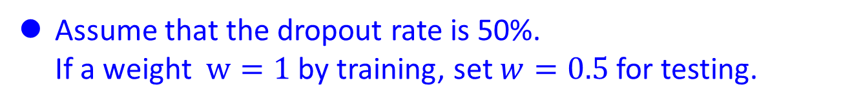
Dropout
Testing:
No dropout
If the dropout rate at training is p%, all the weights times (1-p)%
Assume that the dropout rate is 50%.
If a weight $w=1$ by training, set $w=0.5$ for testing.
Notes:
Bias do not have to multiply !!!!!!!!!!!!!!!!!!!!!!!!!!!!!!!!!!!
Reasonable !!!!!!!!!!!!!!!!!!!!

Slide 66
Dropout - Intuitive Reason
我的 partner 會擺爛，所以我要好好做
When teams up, if everyone expect the partner will do the work, nothing will be done finally.
However, if you know your partner will dropout, you will do better.
When testing, no one dropout actually, so obtaining good results eventually.
Notes:
Why the weights should multiply p (dropout rate) at testing?

Slide 67
















Dropout - Intuitive Reason
Why the weights should multiply (1-p)% (dropout rate) when testing?
Training of Dropout
Testing of Dropout
Assume dropout rate is 50%
No dropout
Weights from training
$$w_{1}$$
$$0.5×$$
$$w_{1}$$
$$z^{′}≈2z$$
$$w_{2}$$
$$z$$
$$0.5×$$
$$w_{2}$$
$$z^{′}$$
$$w_{3}$$
$$0.5×$$
$$w_{3}$$
$$w_{4}$$
$$0.5×$$
$$w_{4}$$
Weights multiply (1-p)%
$$z^{′}≈z$$
Notes:
important

Slide 68
Dropout is a kind of ensemble.
Training Set
Ensemble
Set 1
Set 2
Set 3
Set 4
Network
1
Network
2
Network
3
Network
4
Train a bunch of networks with different structures

Slide 69
Dropout is a kind of ensemble.
Ensemble
Testing data x
Network
1
Network
2
Network
3
Network
4
y₁
y₂
y₃
y₄
average

Slide 70
Dropout is a kind of ensemble.
minibatch
1
minibatch
2
minibatch
3
minibatch
4
Training of Dropout
M neurons
……
2^{M} possible networks
Using one mini-batch to train one network
Some parameters in the network are shared

Slide 71
Dropout is a kind of ensemble.
Testing of Dropout
testing data x
All the weights multiply (1-p)%
……
y₁
y₂
y₃
average
≈
y
Notes:
0,0 -> 0
1,0 -> 1
0,-1 -> -2
1,-1 -> -1
½, -1/2 -> -0.5
1,2
Geometric Mean?

Slide 72
More about dropout
More reference for dropout [Nitish Srivastava, JMLR’14] [Pierre Baldi, NIPS’13][Geoffrey E. Hinton, arXiv’12]
Dropout works better with Maxout [Ian J. Goodfellow, ICML’13]
Dropconnect [Li Wan, ICML’13]
Dropout delete neurons
Dropconnect deletes the connection between neurons
Annealed dropout [S.J. Rennie, SLT’14]
Dropout rate decreases by epochs
Standout [J. Ba, NISP’13]
Each neural has different dropout rate

Slide 73
Part IV: Neural Network with Memory
Notes:
Not just process, but memory

Slide 74
Neural Network needs Memory
Name Entity Recognition
Detecting named entities like name of people, locations, organization, etc. in a sentence.
1
DNN
0.1
people
apple
0
…
0.1
location
0
0.5
organization
0.3
none
0

Slide 75
Neural Network needs Memory
Name Entity Recognition
Detecting named entities like name of people, locations, organization, etc. in a sentence.
target
ORG
target
NONE
y¹
y²
y³
y⁴
y⁵
y⁶
y⁷
DNN
DNN
DNN
DNN
DNN
DNN
DNN
x¹
x²
x³
x⁴
x⁵
x⁶
x⁷
the president of apple eats an apple
DNN needs memory!
Notes:
DNN: input and output are both vector

Slide 76
Recurrent Neural Network (RNN)
The output of hidden layer are stored in the memory.
copy
Memory can be considered as another input.

Slide 77
RNN
y¹
y²
y³
Wº
copy
Wº
copy
Wº
a¹
a²
a³
a¹
a²
W^{h}
W^{h}
W^{i}
W^{i}
W^{i}
x¹
x²
x³
The same network is used again and again.
Output y^{i} depends on x¹, x², …… x^{i}
Notes:
General idea

Slide 78



RNN
How to train?
$${\hat{y}}^{1}$$
target
$${\hat{y}}^{2}$$
target
$${\hat{y}}^{3}$$
target
L¹
L²
L³
y¹
y²
y³
Wº
Wº
Wº
W^{h}
W^{h}
……
W^{i}
W^{i}
W^{i}
x¹
x²
x³
Find the network parameters to minimize the total cost:
Backpropagation through time (BPTT)
Notes:
General idea

Slide 79
Of course it can be deep …
y^{t}
y^{t+1}
y^{t+2}
……
……
……
……
……
……
……
……
……
x^{t}
x^{t+1}
x^{t+2}

Slide 80
Bidirectional RNN
……
x^{t}
x^{t+1}
x^{t+2}
……
y^{t}
y^{t+1}
y^{t+2}
……
……
x^{t}
x^{t+1}
x^{t+2}
Notes:
To determine yi, you have to consider a lot ……
You should see the whole sequence

Slide 81

Many to Many (Output is shorter)
Both input and output are both sequences, but the output is shorter.
E.g. Speech Recognition
Output:
“好棒”
(character sequence)
Problem?
Trimming
Why can’t it be “好棒棒”
好
好
好
棒
棒
棒
棒
棒
(vector
sequence)
Input:

Slide 82
Many to Many (Output is shorter)
Both input and output are both sequences, but the output is shorter.
Connectionist Temporal Classification (CTC) [Alex Graves, ICML’06][Alex Graves, ICML’14][Haşim Sak, Interspeech’15][Jie Li, Interspeech’15][Andrew Senior, ASRU’15]
“好棒”
Add an extra symbol “φ” representing “null”
“好棒棒”
好
φ
φ
棒
φ
φ
φ
φ
好
φ
φ
棒
φ
棒
φ
φ
Notes:
English is successful, ASRU’15 better than HMM + N-gram
Chinese is still diffucult

Slide 83
Many to Many (No Limitation)
Both input and output are both sequences with different lengths. → Sequence to sequence learning
E.g. Machine Translation (machine learning→機器學習)
Containing all information about input sequence
machine
learning
Notes:
中翻英 英翻中 沒有哪一個一定比較長或比較短

Slide 84
Many to Many (No Limitation)
Both input and output are both sequences with different lengths. → Sequence to sequence learning
E.g. Machine Translation (machine learning→機器學習)
機
器
學
習
慣
性
……
……
machine
learning
Don’t know when to stop
Notes:
中翻英 英翻中 沒有哪一個一定比較長或比較短

Slide 85
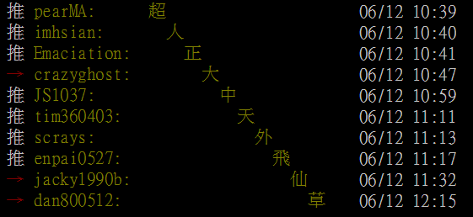
Many to Many (No Limitation)
推 tlkagk: =========斷==========
Ref:http://zh.pttpedia.wikia.com/wiki/%E6%8E%A5%E9%BE%8D%E6%8E%A8%E6%96%87 (鄉民百科)
Notes:
推文接龍

Slide 86
Many to Many (No Limitation)
Both input and output are both sequences with different lengths. → Sequence to sequence learning
E.g. Machine Translation (machine learning→機器學習)
機
器
學
習
===
machine
learning
Add a symbol “===“ (斷)
[Ilya Sutskever, NIPS’14][Dzmitry Bahdanau, arXiv’15]
Notes:
中翻英 英翻中 沒有哪一個一定比較長或比較短

Slide 87
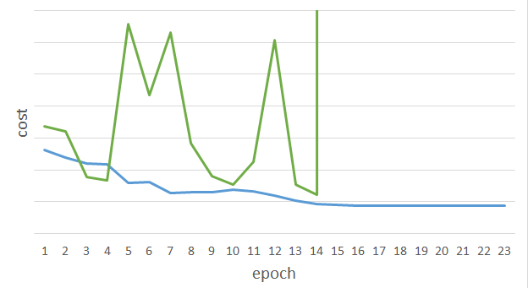
Unfortunately ……
感謝 曾柏翔 同學提供實驗結果
RNN-based network is not always easy to learn
Real experiments on Language modeling
sometimes
Lucky
Notes:
Not because you have bug haha

Slide 88
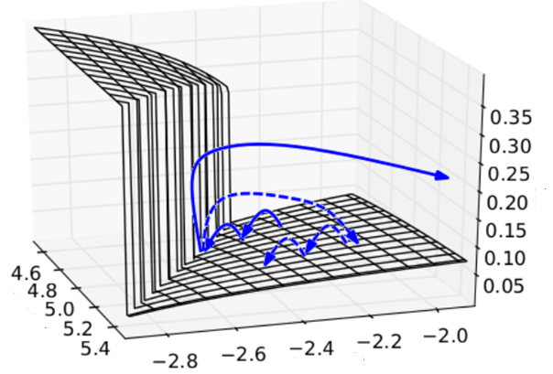

The error surface is rough.
The error surface is either very flat or very steep.
Clipping
Cost
w₂
w₁
[Razvan Pascanu, ICML’13]
Notes:
Even adagrad can not handle this problem, maybe RMS prop is better
Source: http://jmlr.org/proceedings/papers/v28/pascanu13.pdf
Large or small is fine. Change quickly is bad

Slide 89








Why?
$$w=1$$
$$y^{1000}=1$$
Large gradient
Small Learning rate?
$$w=1.01$$
$$y^{1000}≈20000$$
$$w=0.99$$
$$y^{1000}≈0$$
small gradient
Large Learning rate?
$$w=0.01$$
$$y^{1000}≈0$$
=w⁹⁹⁹
y¹
y²
y³
y¹⁰⁰⁰
Toy Example
1
1
1
1
……
w
w
w
1
1
1
1
1
0
0
0
Notes:
Gradient Explode/Gradient Vanishing
Echo state network -> …..

Slide 90
Helpful Techniques
Nesterov’s Accelerated Gradient (NAG):
Advance momentum method
RMS Prop
Advanced approach to give each parameter different learning rates
Considering the change of Second derivatives
Long Short-term Memory (LSTM)
Can deal with gradient vanishing (not gradient explode)
Notes:
Reference: http://colah.github.io/posts/2015-08-Understanding-LSTMs/

Slide 91
Long Short-term Memory (LSTM)
Other part of the network
Special Neuron:
4 inputs,
1 output
Signal control the output gate
Output Gate
(Other part of the network)
Memory
Cell
Forget Gate
Signal control the forget gate
(Other part of the network)
Signal control the input gate
Input Gate
LSTM
(Other part of the network)
Other part of the network
Notes:
Normal neuron
1 input, 1 output
This one
4 input, 1 output

Slide 92

$$a$$
$$=h\left(c^{′}\right)f\left(z_{o}\right)$$
$$z_{o}$$
multiply
Activation function f is usually a sigmoid function
$$f\left(z_{o}\right)$$
$$h\left(c^{′}\right)$$
Between 0 and 1
Mimic open and close gate
$$c$$
$$f\left(z_{f}\right)$$
c
$$c^{′}$$
$$z_{f}$$
$$cf\left(z_{f}\right)$$
$$c^{′}=g\left(z\right)f\left(z_{i}\right)+cf\left(z_{f}\right)$$
$$f\left(z_{i}\right)$$
$$g\left(z\right)f\left(z_{i}\right)$$
$$z_{i}$$
multiply
$$g\left(z\right)$$
$$z$$

Slide 93
Original Network:
Simply replace the neurons with LSTM
……
……
$$a_{1}$$
$$a_{2}$$
$$z_{1}$$
$$z_{2}$$
x₁
x₂
Input
Notes:
Use a same set of information
Note about the memory

Slide 94
$$a_{1}$$
$$a_{2}$$
+
+
+
+
+
+
+
+
4 times of parameters
x₁
x₂
Input
Notes:
Use a same set of information
Note about the memory

Slide 95

LSTM
Extension: “peephole”
y^{t}
y^{t+1}
c^{t-1}
c^{t}
c^{t+1}
$$×$$
$$＋$$
$$×$$
$$×$$
$$＋$$
$$×$$
$$×$$
$$×$$
z^{f}
z^{i}
z
zº
z^{f}
z^{i}
z
zº
c^{t-1}
h^{t-1}
x^{t}
c^{t}
h^{t}
x^{t+1}
Notes:
Identiy
C is vector

Slide 96


Other Simpler Alternatives
Structurally Constrained Recurrent Network (SCRN)
Gated Recurrent Unit (GRU)
[Tomas Mikolov, ICLR’15]
[Cho, EMNLP’14]
Vanilla RNN Initialized with Identity matrix + ReLU activation function [Quoc V. Le, arXiv’15]
Outperform or be comparable with LSTM in 4 different tasks
Notes:
Gated Recurrent Unit (GRU):
Structurally Constrained Recurrent Network (SCRN).
Cloclwise RNN

Slide 97
What is the next wave?
Internal memory or information from output
Attention-based Model
……
……
Reading Head
Writing Head
Reading Head Controller
Writing Head Controller
Input x
DNN/LSTM
output y
Already applied on speech recognition, caption generation, QA, visual QA
Notes:
Need an example …… ok, in the future

Slide 98
What is the next wave?
Attention-based Model
End-To-End Memory Networks. S. Sukhbaatar, A. Szlam, J. Weston, R. Fergus. arXiv Pre-Print, 2015.
Neural Turing Machines. Alex Graves, Greg Wayne, Ivo Danihelka. arXiv Pre-Print, 2014
Ask Me Anything: Dynamic Memory Networks for Natural Language Processing. Kumar et al. arXiv Pre-Print, 2015
Neural Machine Translation by Jointly Learning to Align and Translate. D. Bahdanau, K. Cho, Y. Bengio; International Conference on Representation Learning 2015.
Show, Attend and Tell: Neural Image Caption Generation with Visual Attention. Kelvin Xu et. al.. arXiv Pre-Print, 2015.
Attention-Based Models for Speech Recognition. Jan Chorowski, Dzmitry Bahdanau, Dmitriy Serdyuk, Kyunghyun Cho, Yoshua Bengio. arXiv Pre-Print, 2015.
Recurrent models of visual attention. V. Mnih, N. Hees, A. Graves and K. Kavukcuoglu. In NIPS, 2014.
A Neural Attention Model for Abstractive Sentence Summarization. A. M. Rush, S. Chopra and J. Weston. EMNLP 2015.

Slide 99
Concluding Remarks

Slide 100
Concluding Remarks
Introduction of deep learning
Discussing some reasons using deep learning
New techniques for deep learning
ReLU, Maxout
Giving all the parameters different learning rates
Dropout
Network with memory
Recurrent neural network
Long short-term memory (LSTM)

Slide 101
Reading Materials
“Neural Networks and Deep Learning”
written by Michael Nielsen
http://neuralnetworksanddeeplearning.com/
“Deep Learning” (not finished yet)
Written by Yoshua Bengio, Ian J. Goodfellow and Aaron Courville
http://www.iro.umontreal.ca/~bengioy/dlbook/

Slide 102
Thank you for your attention!

Slide 103
Acknowledgement
感謝 Ryan Sun 來信指出投影片上的錯字

Slide 104
Appendix

Slide 105
Matrix Operation
1
4
0.98
1
-2
1
-1
-2
0.12
1
-1
0
W
x
b
a
$$\left[\begin{matrix}1 & −2 \\ −1 & 1\end{matrix}\right]$$
$$\left[\begin{matrix}1 \\ −1\end{matrix}\right]$$
$$\left[\begin{matrix}1 \\ 0\end{matrix}\right]$$
$$=$$
$$\left[\begin{matrix}0.98 \\ 0.12\end{matrix}\right]$$
$$σ\left( \right)$$
$$+$$
Notes:
Make sure you know how to do it
author: Adam Coates, Baidu, Inc.
Deep Learning (hopefully faster)
http://videolectures.net/deeplearning2015_coates_deep_learning/

Slide 106


Why Deep? – Logic Circuits
A two levels of basic logic gates can represent any Boolean function.
However, no one uses two levels of logic gates to build computers
Using multiple layers of logic gates to build some functions are much simpler (less gates needed).
Notes:
Any Boolean function can be written as a sum of products (disjunctive normal form: AND gates on the first layer with optional negation of inputs, and OR gate on the second layer) or a product of sums (conjunctive normal form: OR gates on the first layer with optional negation of inputs, and AND gate on the second layer).
同位元檢查(Parity Check)
00 1
01 0
10 0
11 1

Slide 107

Boosting
Weak classifier
Input
$$x$$
Weak classifier
Combine
……
Weak classifier
Deep Learning
Weak classifier
Boosted weak classifier
Boosted Boosted weak classifier
……
……
…
…
…
…
……
Notes:
Adaboost

Slide 108



















Maxout
ReLU is a special cases of Maxout
+
$$z_{1}^{}$$
$$z$$
ReLU
Input
$$w$$
$$a$$
Input
$$w$$
Max
$$b$$
$$a$$
$$0$$
+
$$z_{2}^{}$$
$$max\left\{z_{1}^{},z_{2}^{}\right\}$$
$$b$$
$$0$$
$$a$$
$$a$$
$$z=wx+b$$
$$z_{1}=wx+b$$
$$x$$
$$x$$
$z_{2}=$0

Slide 109



Maxout
ReLU is a special cases of Maxout
+
$$z_{1}^{}$$
$$z$$
ReLU
Input
$$w$$
$$a$$
Input
$$w$$
Max
$$b$$
$$a$$
+
$$z_{2}^{}$$
$$w^{′}$$
$$max\left\{z_{1}^{},z_{2}^{}\right\}$$
$$b$$
$$b^{′}$$
Learnable Activation Function
$$a$$
$$a$$
$$z=wx+b$$
$$z_{1}=wx+b$$
$$x$$
$$x$$
$$z_{2}=w^{′}x+b^{′}$$

