Slide 1


Hello!
BAN 675 Class
We are Team 6
You can find us at:
@Guojun W
@Ying H
@ChinWang L
@YinJia L

Slide 2


Airline Review
Text Mining
Where are we flying to…..
Data Overview
Sentiment Analysis
Summary

Slide 3
1.
Data Overview

Slide 4
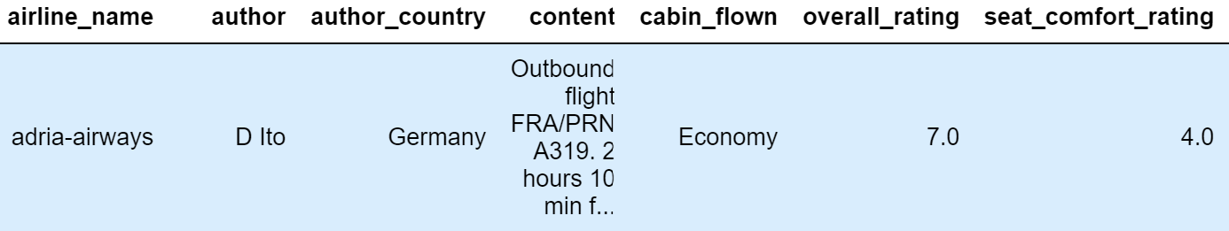
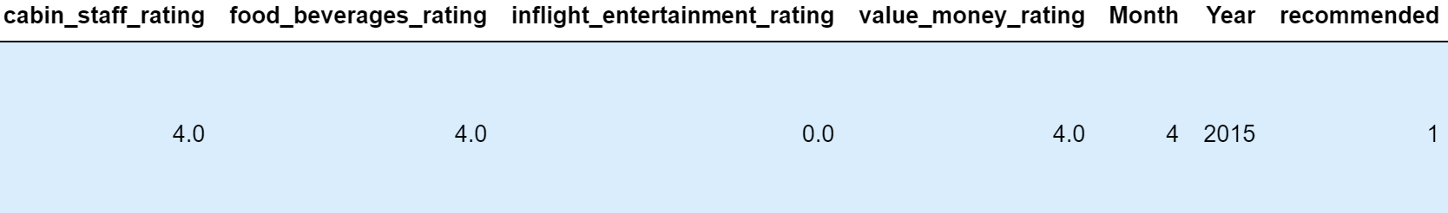
Row 27284 | Column 14

Slide 5
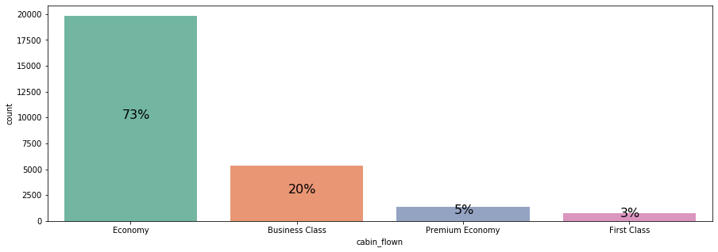

Slide 6
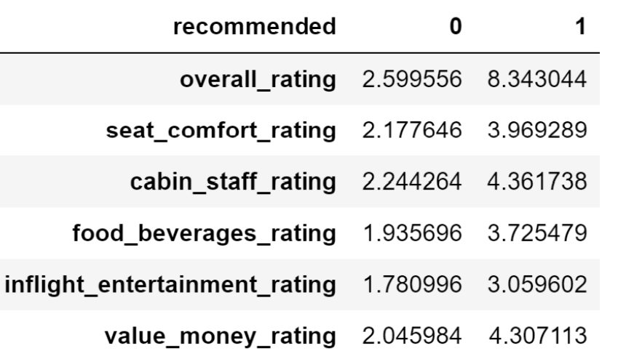
Ratings of not recommended (0) is significantly lower than recommended (1)

Slide 7
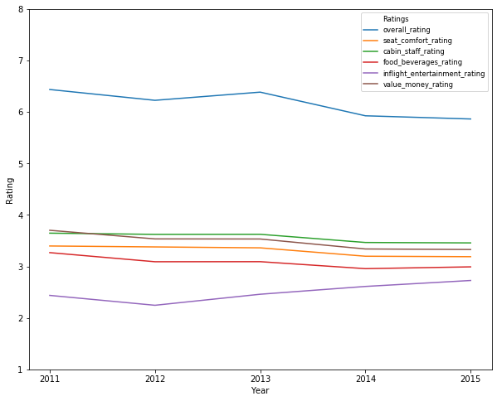
Inflight Entertainment
Cabin Staff
Value Money
Seat Comfort
Food Beverage
Overall Rating

Slide 8
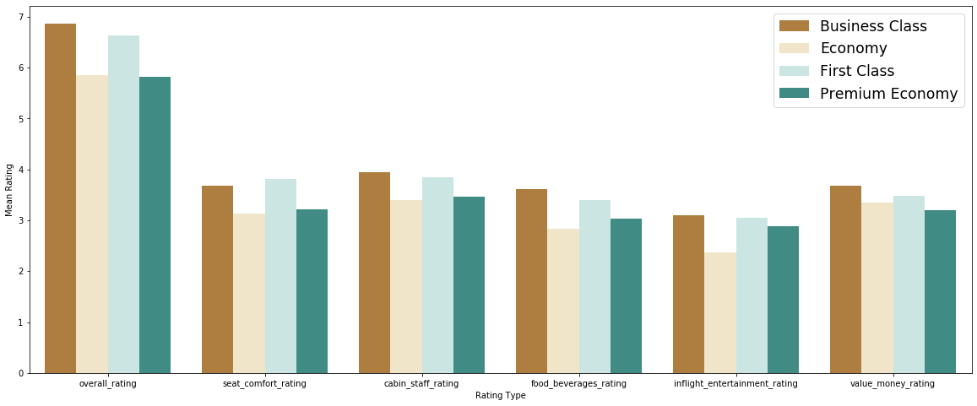
First & Business Class have higher mean ratings than Economy & Premium Economy Class
Business Class has higher mean ratings than First Class

Slide 9
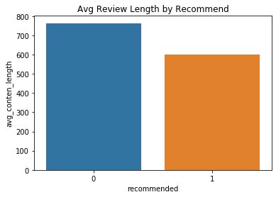
Not Recommend (0) has higher avg review length than Recommend (1)

Slide 10
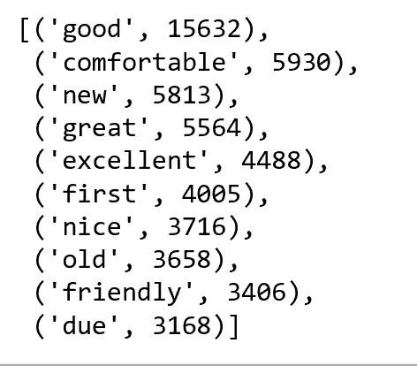
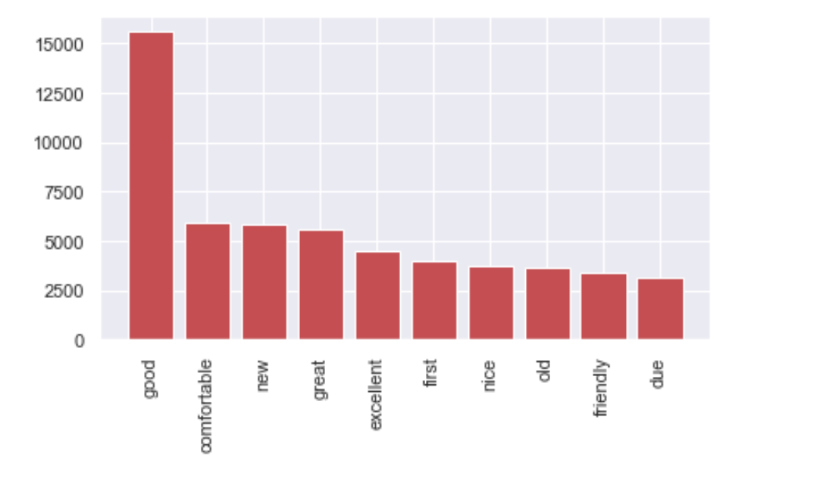
The most common words are…….

Slide 11
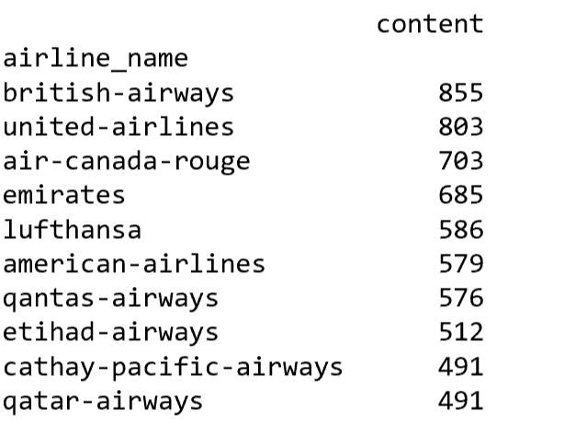
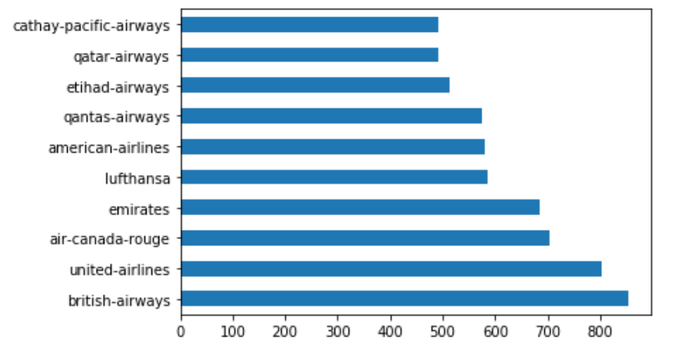
British Airways, United Airlines, Air Canada Rouge
Have the the Greatest number of reviews

Slide 12
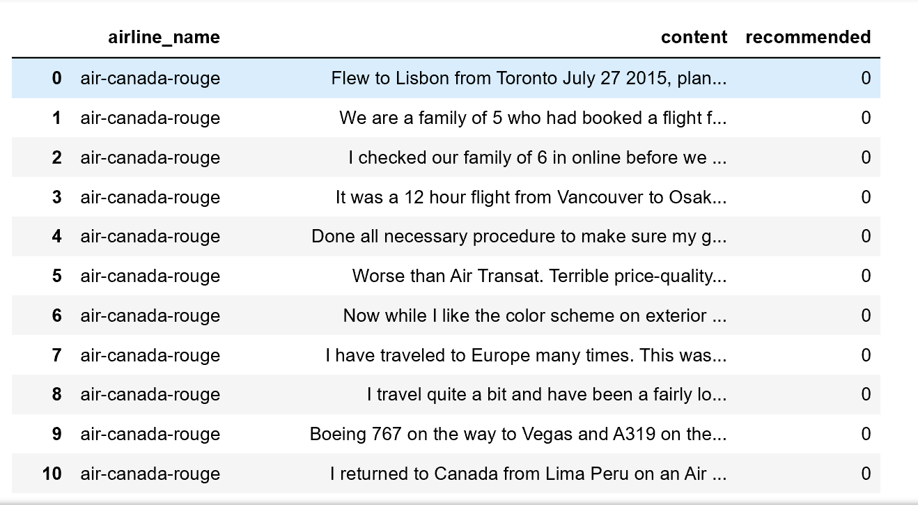
Dataset will be used for analysis: Companies: 1. Air-Canada-rouge 2. British-airways 3. United-airlines Attributes: 1. Airline name 2. Content 3. Recommended

Slide 13
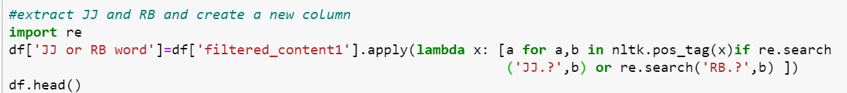
Word Cloud
Highlight some trending terms among the whole set of data
and 3 airlines with both positive and negative reviews
Filter out adjective and adverb from the reviews
Segment the data into different airlines
Generate word cloud based on pos/neg reviews
Making hypothesis on passenger’s concern

Slide 14
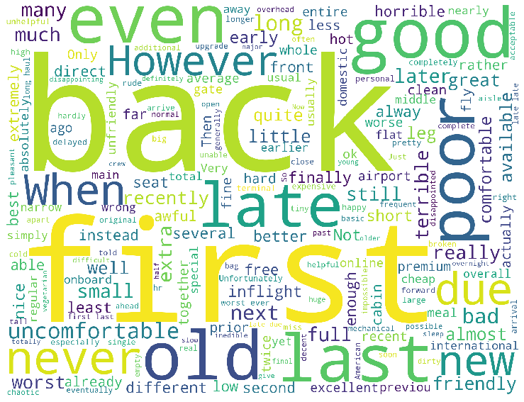
Negative Reviews of All Airlines

Slide 15
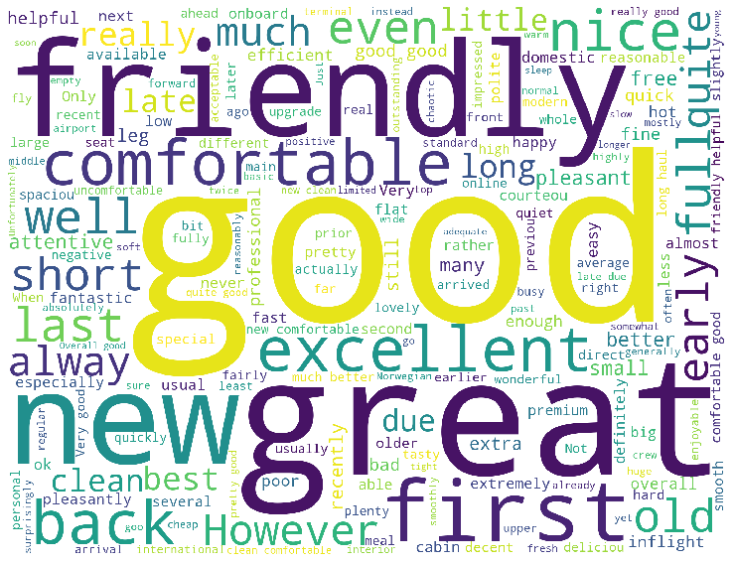
Positive Reviews of All Airlines

Slide 16
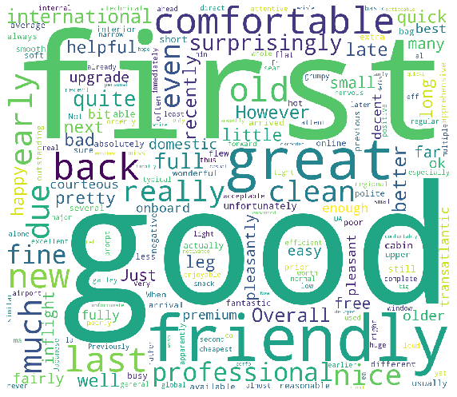
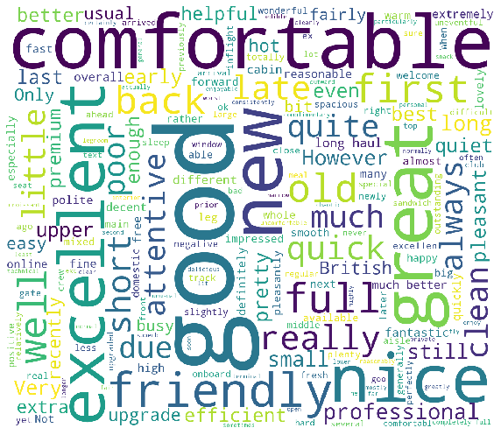
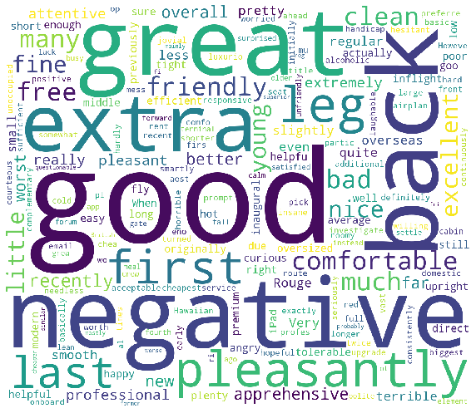
Positive Reviews
United Airline
British Airways
Air Canada Rouge
Friendly
Clean
Great
Comfortable
Surprisingly
Professional
Comfortable
Friendly
Nice
Attentive
Great
Professional
Pleasantly
Friendly
Leg
Premium
Excellent

Slide 17
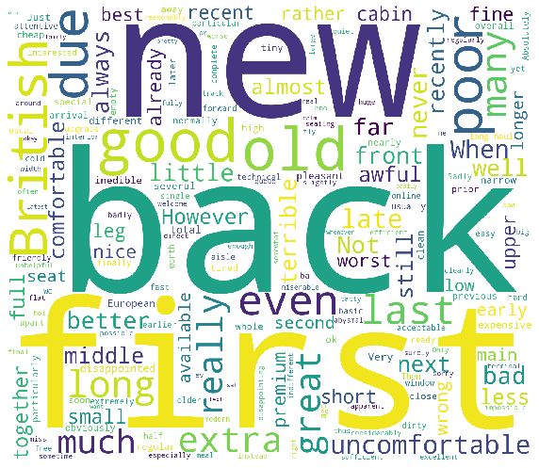
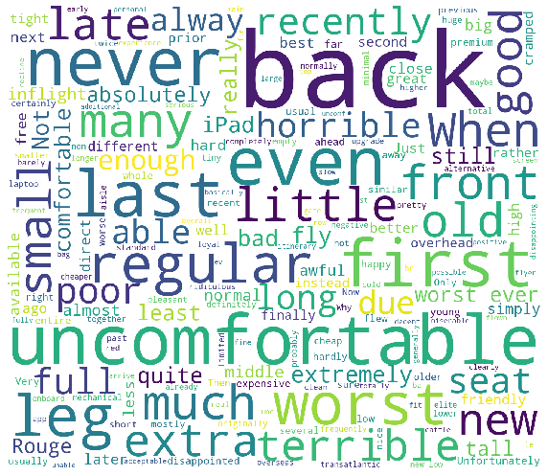
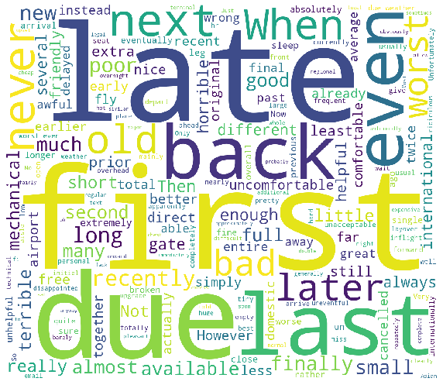
Negative Reviews
United Airline
British Airways
Air Canada Rouge
Late
Last
Never
Bad
Surprisingly
Professional
Uncomfortable
Seat
Poor
Cabin
old
Uncomfortable
Worst
Terrible
Little
Poor
Never

Slide 18
2.
Sentiment Analysis

Slide 19
Classification
Chunking
Issues Faced By Airlines
Most Informative Words
Chunk Styles
Noun Phrase
Verb Phrase
Features
Most Common Words
Least Common Words
Most Common Adjectives
TF-IDF

Slide 20
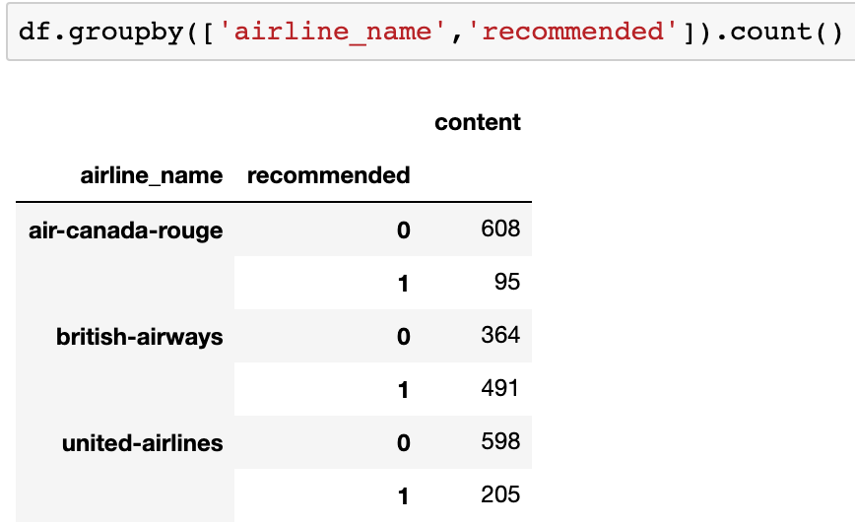
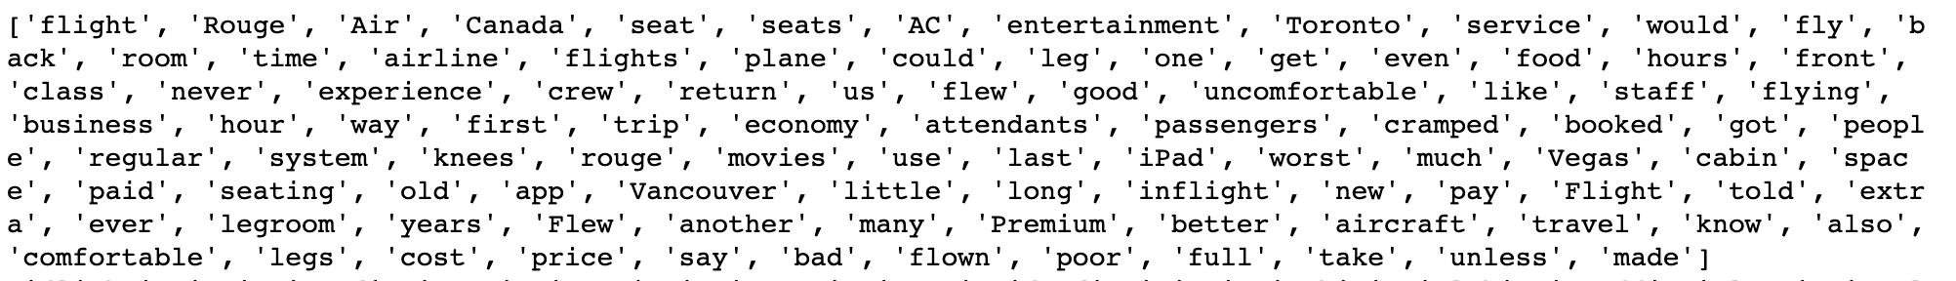
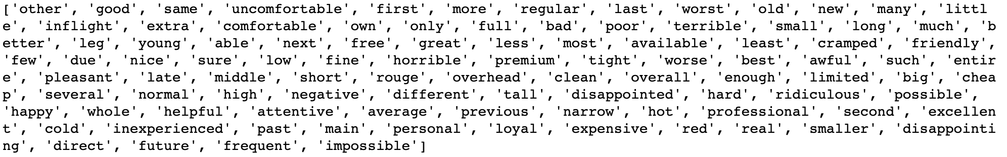
Total reviews: air-canada-rouge: 703 british-airways: 855 united-airlines: 803
Features: most common words least commn words most common adjectives TF-IDF
Training and Testing Division: 80/20 Model: NaiveBayesClassifier

Slide 21
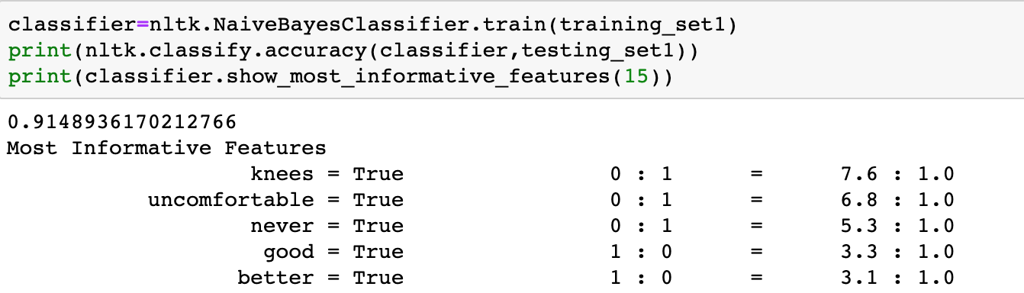
Model Accuracy Comparison
 | Most Common Words | Least Common Words | Most Common adj | TF-IDF | Most Informative Words
Air Canada Rouge | 0.91 | 0.86 | 0.91 | 0.87 | uncomfortable, knees,
British Airways | 0.78 | 0.76 | 0.84 | 0.56 | awful,terrible,disappointed
United Airlines | 0.77 | 0.75 | 0.89 | 0.78 | worst,terrible,rude,wrong

Slide 22
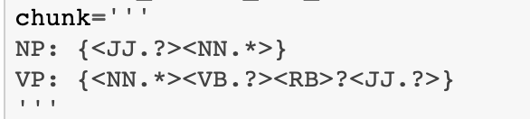
Chunking to find customers’ concerns
when JJ is 'uncomfortable'
when NN is 'knees'
when ‘JJ’ in a list

Slide 23
Chunking to find customers’ concerns
when ‘JJ’ in a list
when NN in lst
air-canada-rouge issues
uncomfortable seats, especially for knees
british-airways issues
uncomfortable seats, awful food
united-airlines issues:
poor service, poor customer

Slide 24
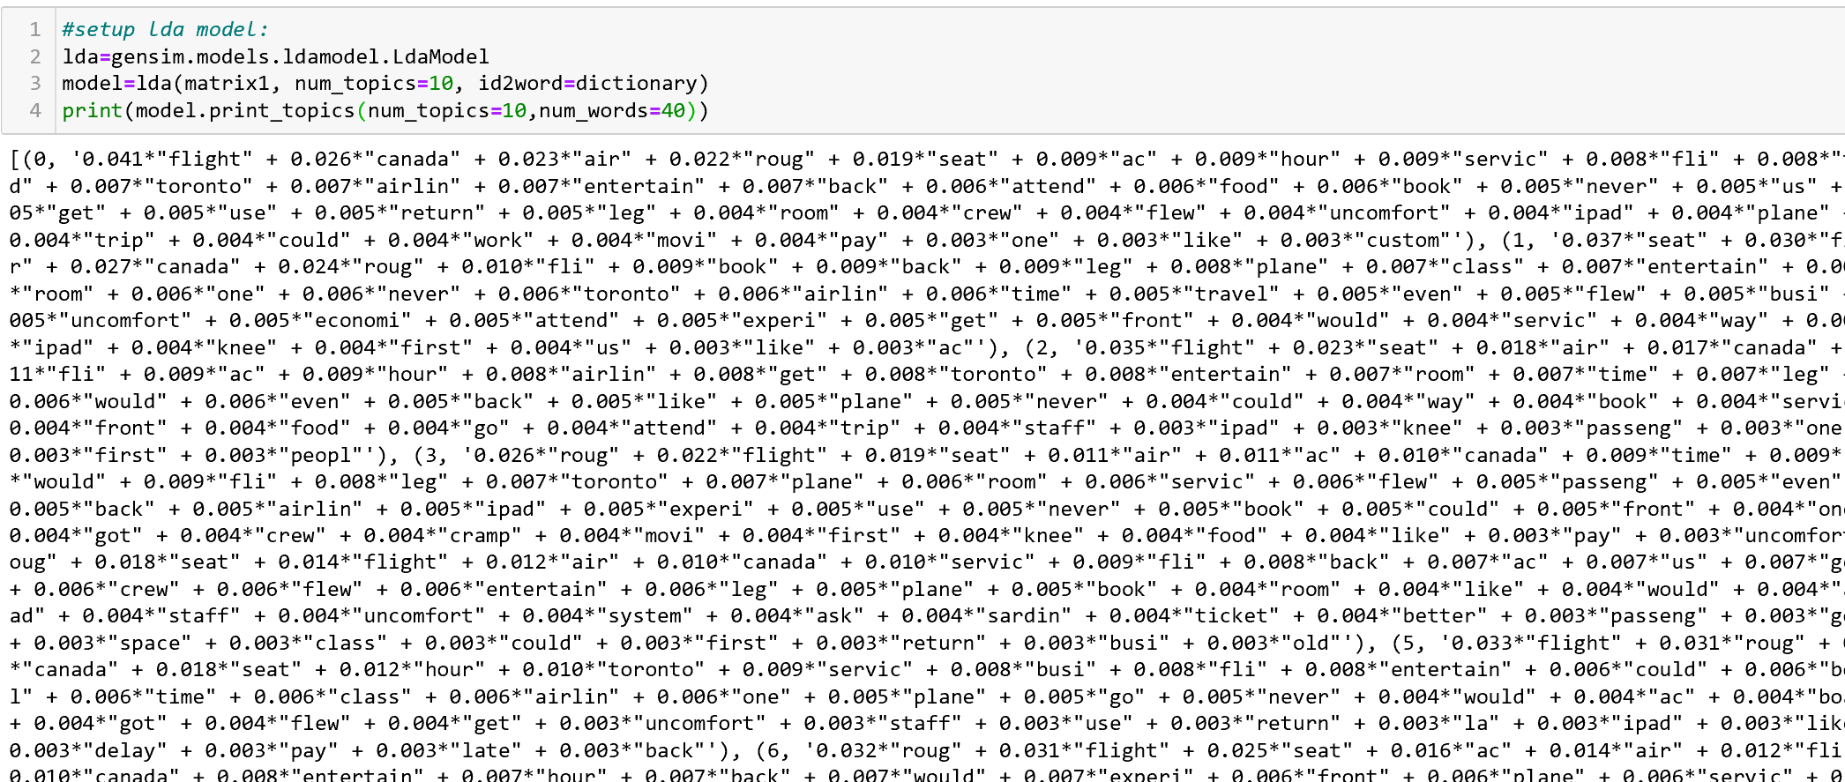
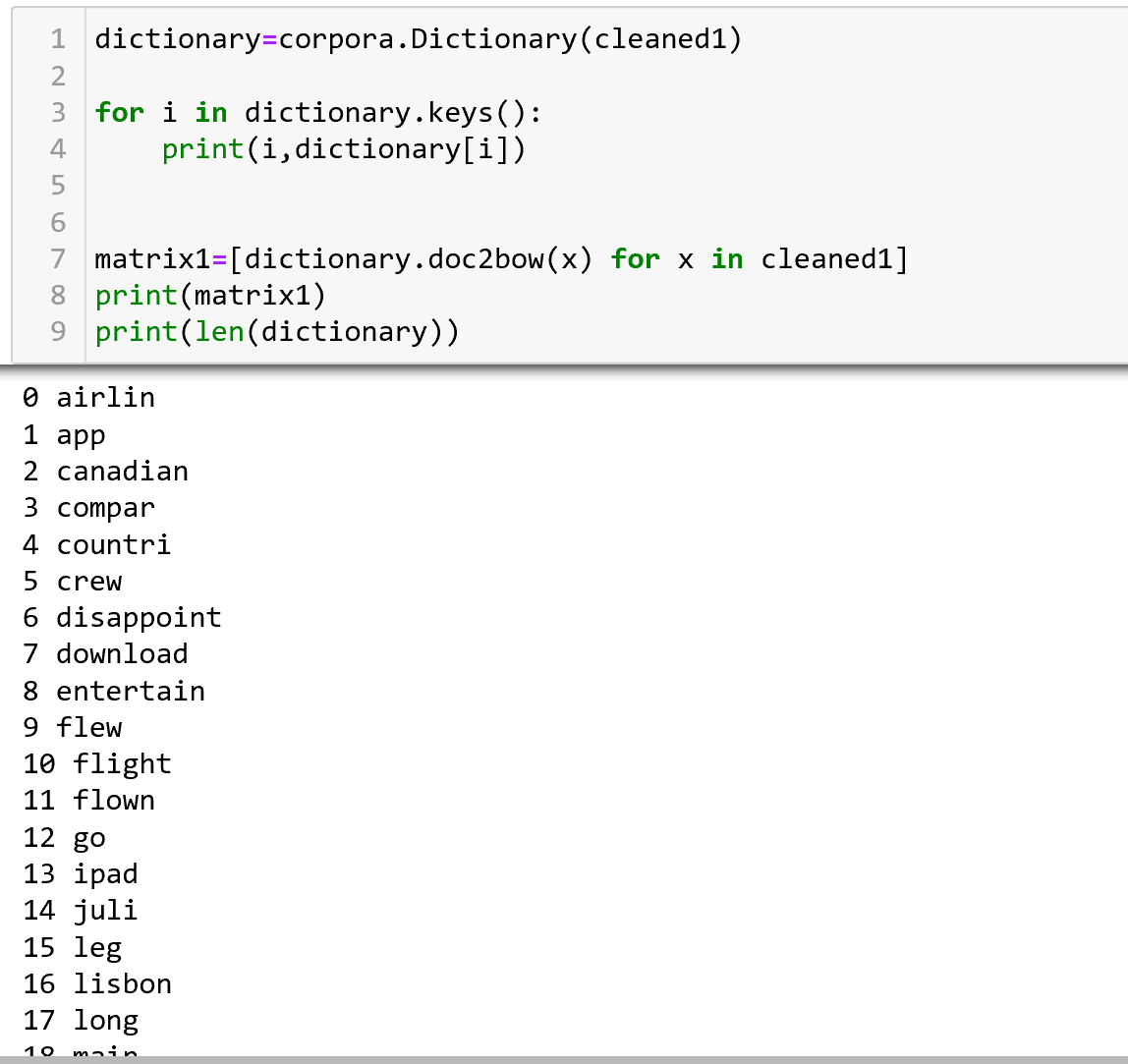
Topic Modeling
LDA modeling
Dictionary and corpus

Slide 25
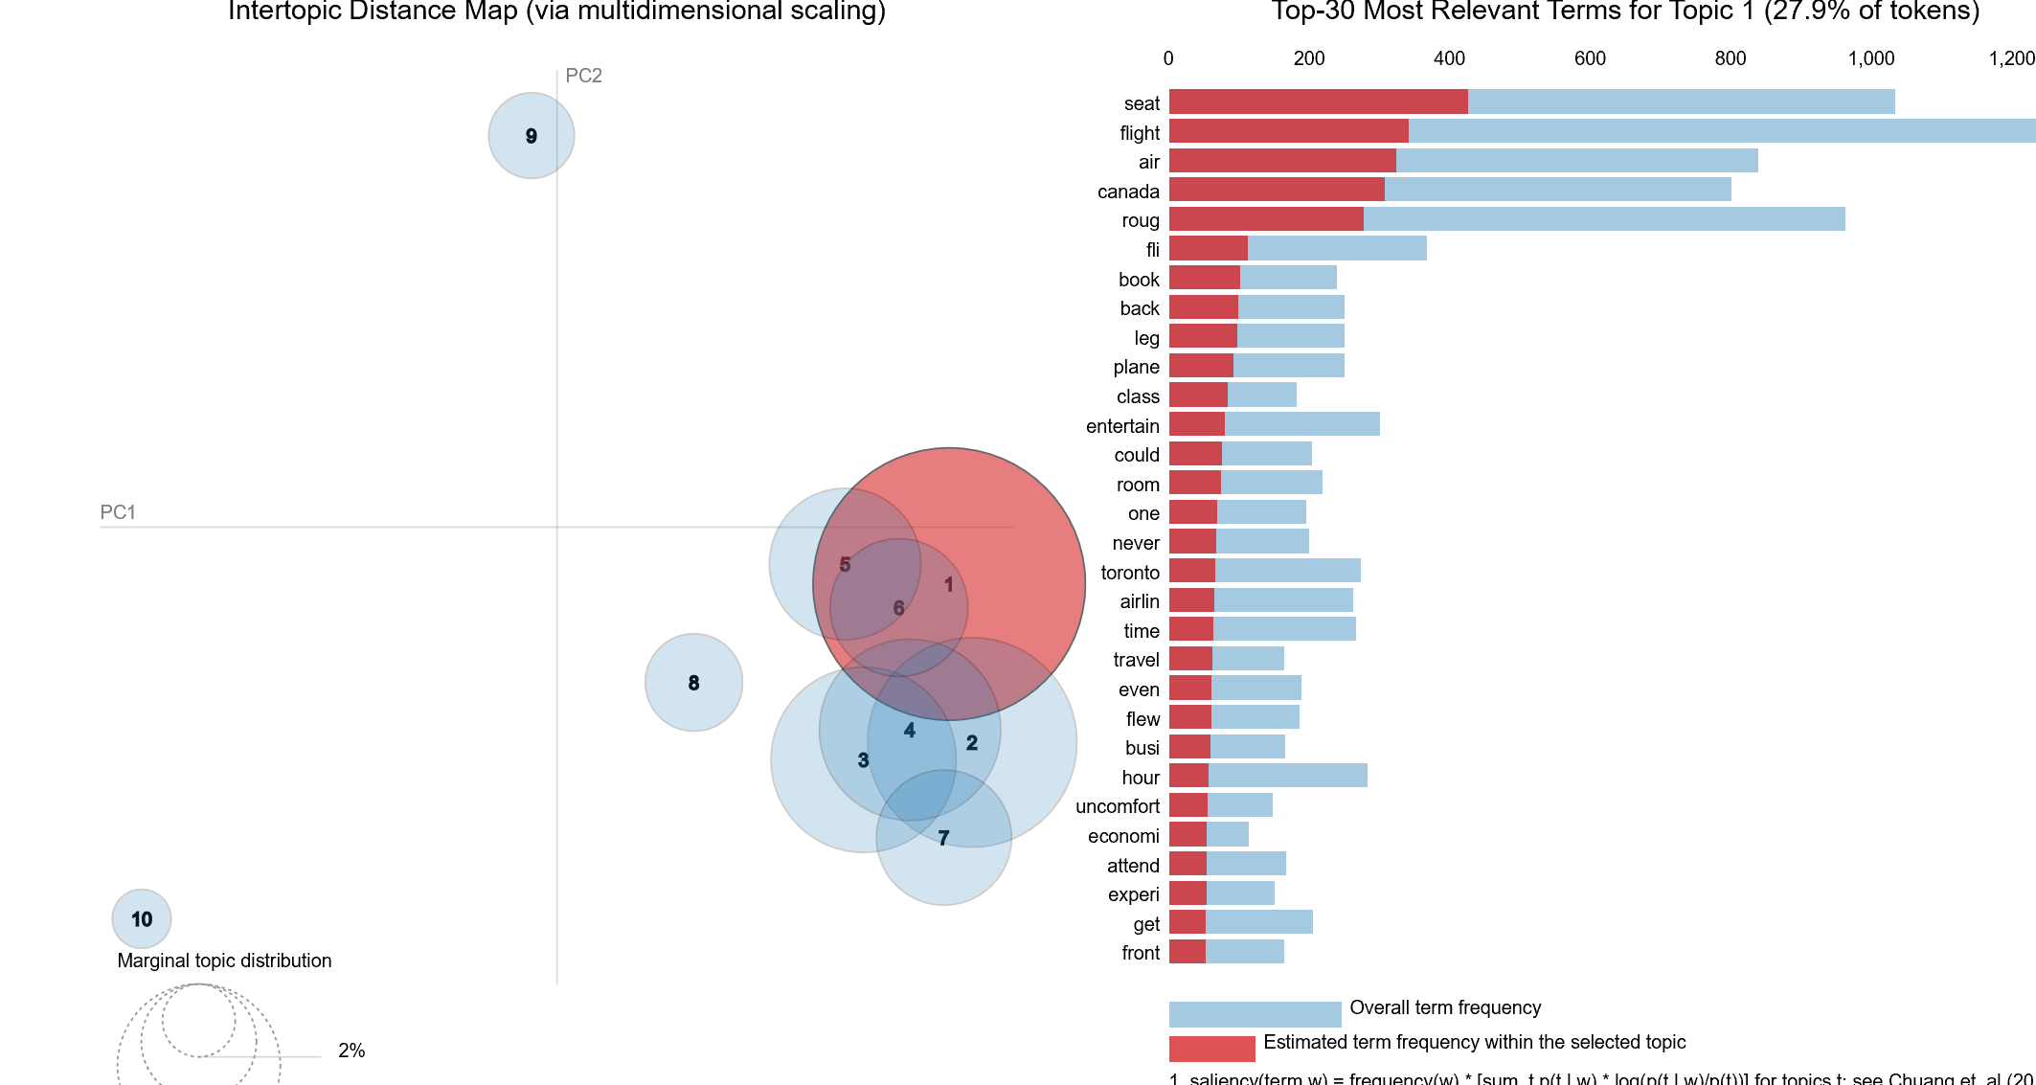
Result - Air-Canada-rouge
Keywords: seat, roug, leg, back…

Slide 26
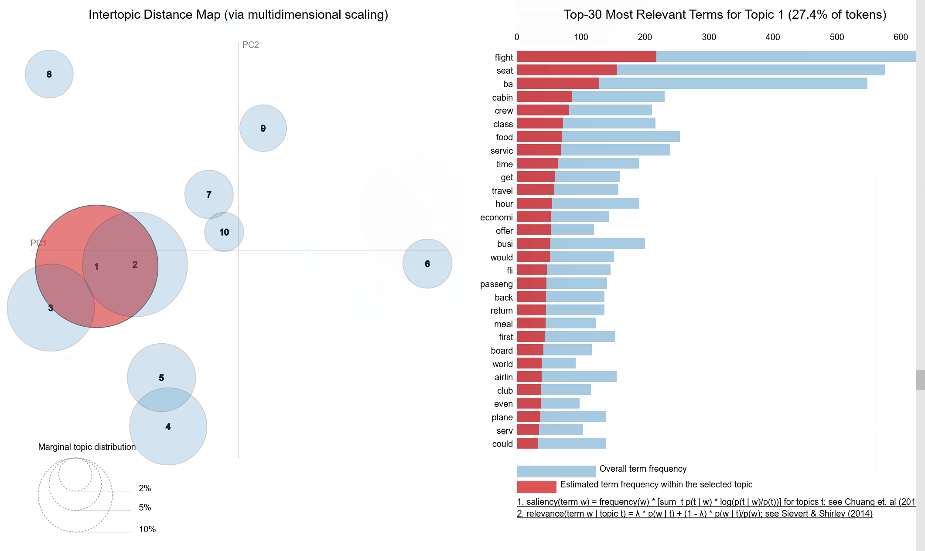
Result - British-airways
Keywords: Seat, food, service, hour, meal…

Slide 27
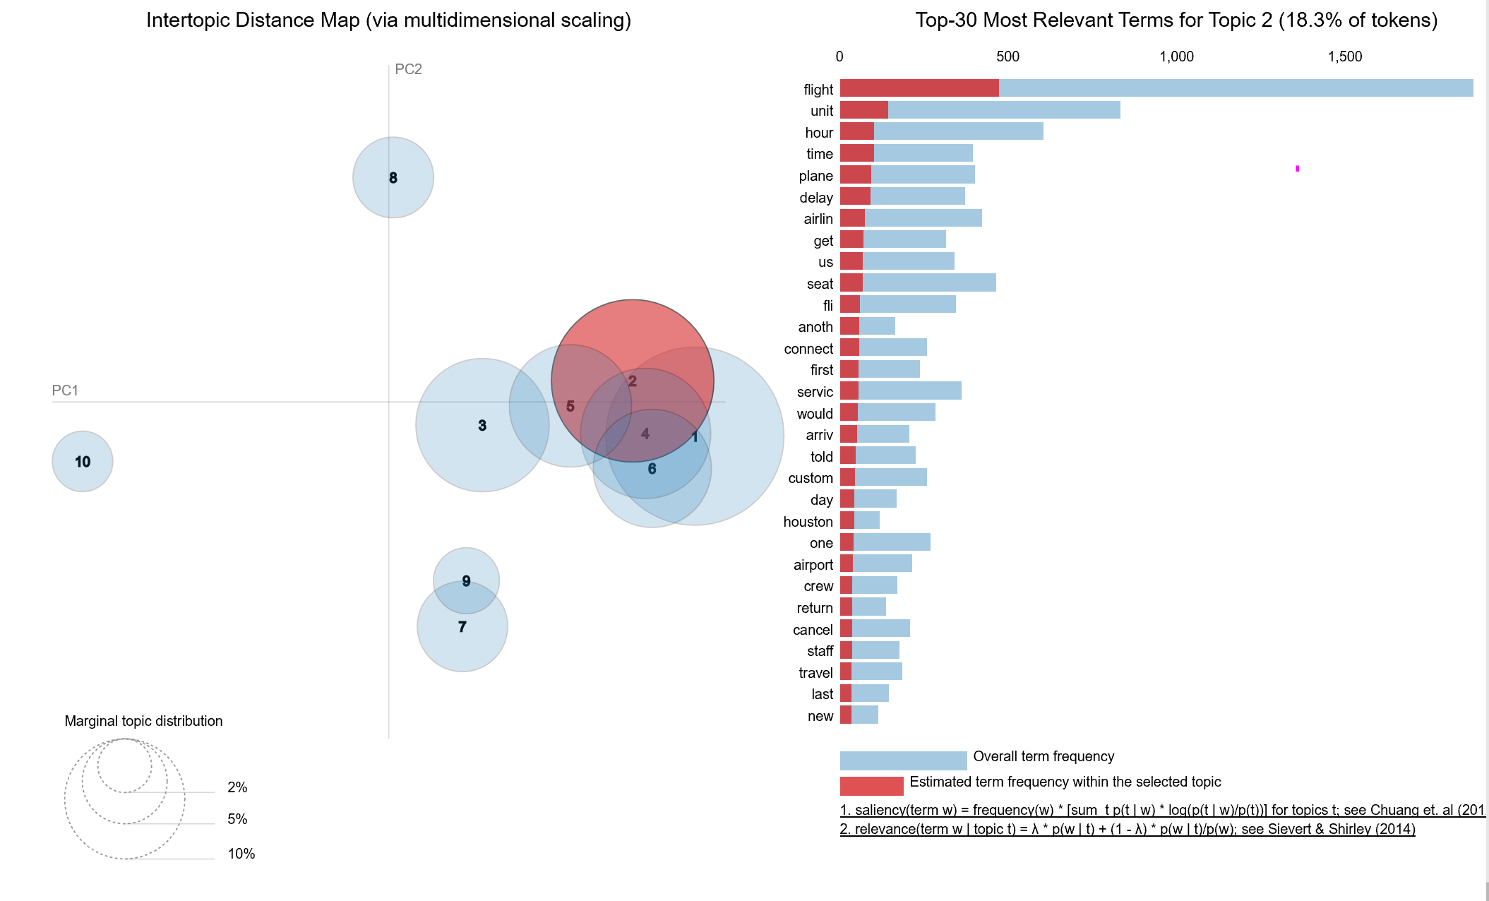
Result - United-airlines:
Keywords: seat, delay, service, hour…

Slide 28
3.
Summary

Slide 29
Air Canada Rouge
Budget Airline, Uncomfortable Seats
United Airline
Uncomfortable Seats, Low Food Quality
British Airways
Poor Customer Service, Delayed.

Slide 30
😉
What is your Feedback?

