Slide 1
XTERMinators
By: Shruthi Shangar, Yin Ji Sheng, Zou Yun, Bernard Yim

Slide 2
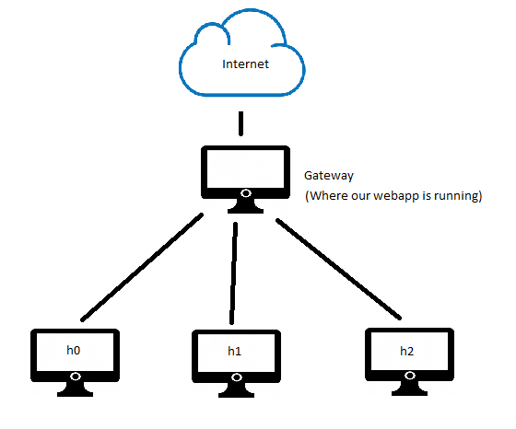
Functions
Objective
Web application that allows user visibility into network layer traffic from an application layer point of view and allow them insight into the network congestion and to act accordingly.
Bandwidth per user,
No. packets sent by user
No. of retransmitted packets

Slide 3
Use Case
Current Implementations drawback:
Wireshark running on the gateway does not provide easy-to-use information from a user-level perspective
Basic network monitoring applications on the gateways do not contain information that a network manager might find useful (eg packet retransmission count)
Our Solution:
Using Python Flask, Chart.js and Scapy, we created a web application running on the gateway that a user can access to monitor the network conditions

Slide 4
Frontend - Web App
Built using Flask’s RESTful API framework
Incorporated Chart.js to visualize network traffic information with charts and graphs

Slide 5
Backend - Scapy
What is scapy?
Scapy is a Python program that enables the user to send, sniff and dissect and forge network packets. This capability allows construction of tools that can probe, scan or attack networks.
Enables you to see all aspect of a packet transmitted.
Similar to wireshark but with more functionality

Slide 6
Part 1 - Identifying No. of Packets/Host
Objective
Count number of packets transmitted per host
What is packet sniffing?
“Packet sniffing is the act of capturing packets of data flowing across a computer network.”
Arguments for Sniff:
interface = wlp3s0, time= determined by user, prn= operation on every packet

Slide 7
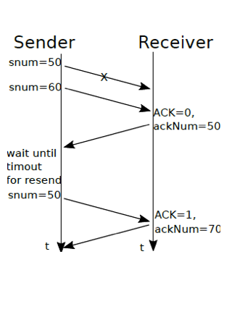
Part 2 - No. of Retransmitted Packets/Host
Objective
Count the total no. of retransmitted packets/host
Method
Retransmitted packets share segment id

Slide 8
Part 3 - Bandwidth/User
Objective
To obtain the amount of bandwidth used by each user on the network within a specified time frame
How is it calculated?
Total size of all the packets from host, divided by the time spent monitoring
What it reveals?
Relative usage of the network for each user, independent of the number of packets each user sends.

Slide 9
DEMO

