Slide 1
Distributed Databases for GeoSpatial Applications
Dr. Junjun Yin
Social Science Research Institute
The Pennsylvania State University
jyin@psu.edu

Slide 2
Outline
What are “distributed databases”
Relational database vs NoSQL database
Big Data requirements
Data management, storage and query performance

Slide 3
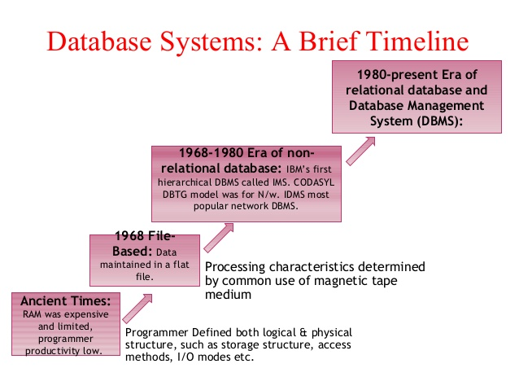
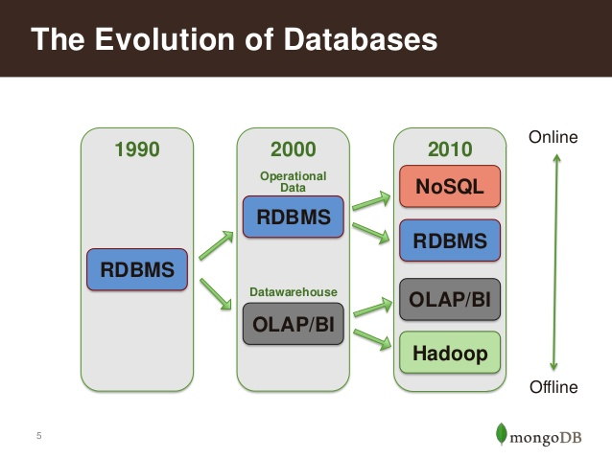
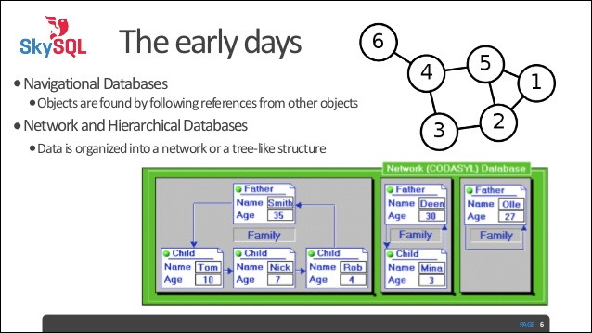
Evolution of Databases
Source:
1. http://www.slideshare.net/wlaforest/why-nosql-and-mongodb-for-big-data

Slide 4
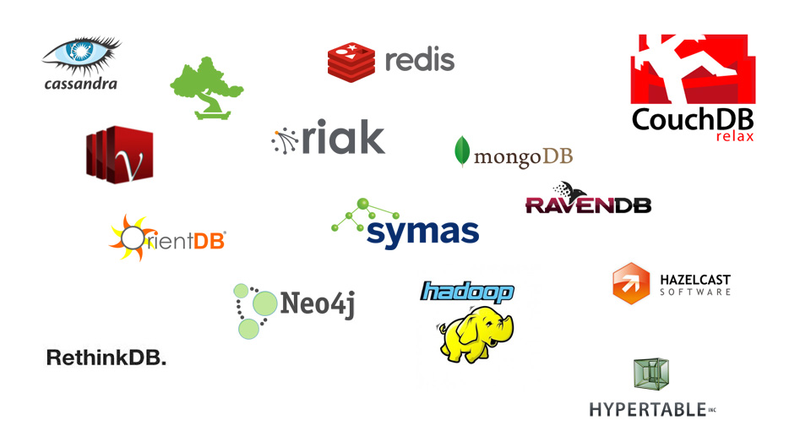
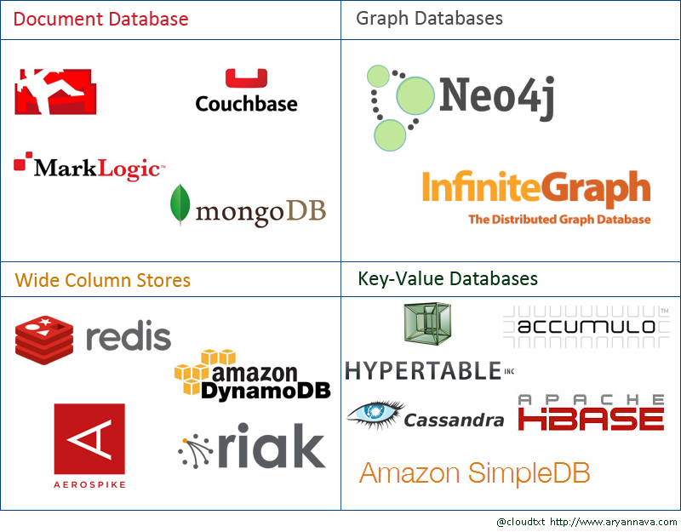
Evolution of Databases
Source:http://aryannava.com/category/nosql/

Slide 5
Relational vs. NoSQL
Relational databases
Well designed schemes
Well organized data structures
Row-based
NoSQL databases
Document based
<key, value> pair based
Graph based
Column-based

Slide 6


Distributed Databases
6
Notes:
6

Slide 7
Motivations I
Your single machine runs out of storage!
Easy scalability
Avoids single point of failure by distributing data among multiple machines.
We will not lose any data in case a machine fails.
We will not lose the ability to query the data in case a machine fails.
Machines which are performance bottlenecks will not affect the overall performance of the system.
7
Notes:
7

Slide 8
Motivations II
Reduce query time by “intelligently” distribute data among multiple nodes.
A query should look into a smaller subset of data.
In write operations the index should be updated for a smaller set of data.
Distribute workload on multiple nodes in case of simultaneous access.
Re-route requests to multiple machines (courtesy of replication).
Incorporate organizational structure.
Each group wants to host their own data!
8
Notes:
8

Slide 9
Challenges
Require new skills and knowledge for many database admins.
Relatively new era. Still lots of development is being made.
Issues with integrity and consistency of the database.
More issues on ensuring the security of the database cluster.
Require new database design techniques.
9
Notes:
9

Slide 10
Concepts
Replication: System maintains multiple identical copies of the data.
Increase latency on update.
Partitioning: The dataset is divided into multiple smaller datasets based on a pre-defined function.
Balancing the load on different chunks of data should be considered.
Consistency: any transaction must only affect data in allowed ways.
10
Notes:
10

Slide 11
Consistency
X : John’s balance
X: 1000$
X: 950$
X: 1020$
X: 1008$
11
Notes:
11

Slide 12
Types of Consistency
Strong consistency: Every client can observe one consistent stage.
Weak consistency: relaxing some constraints on the strong consistency to gain better performance and availability.
12
Notes:
12

Slide 13
CAP Theorem
A distributed computer system to simultaneously cannot provide all of these 3 guarantees at the same time:
Consistency
Availability
Partition tolerance
The system can continue its operation despite partitioning due to failures.
13
Notes:
13

Slide 14



Examples of
Distributed Databases
14
Notes:
14

Slide 15
MongoDB
Document-oriented database.
Store records in a json-like format.
Easy-to-use.
Supports replication and partitioning (sharding).
Support primary and secondary indexes.
Support aggregation queries through:
Javascript-basd MapReduce structure which can support arbitrary large data but it is slow.
C++ based aggregation framework which is limited in size but very fast.
15
Notes:
15

Slide 16
Apache Cassandra
Highly decentralized architecture.
Read/write throughput both scale linearly as the new machines are added.
Very fast write performance.
The admin can tune the consistency level based on the application.
Most popular option in the industry for massive and highly distributed datasets.
Easy integration with Hadoop, Hive, etc.
Limited support for geospatial operations.
16
Notes:
16

Slide 17
Data Model
Partitioning Key
Clustering Key
Row ID
Field 1 | Field 2
Field 1 | Field 2
Field 1 | Field 2
Other fields
Other fields
Other fields
Bus Station
Time | Bus Id
Time | Bus Id
Time | Bus Id
# of passenger
# of passenger
# of passenger
17
Notes:
17

Slide 18
Query Language: CQL
INSERT INTO BUSDATA (station, time, id, passengers) VALUES (100, 201504041000, 13222, 22);
SELECT * FROM BUSDATA WHERE station = 100 AND time >= 201510010000;
UPDATE BUSDATA SET passengers = passengers + 5 WHERE station = 100 AND time <= 201511010000 AND time >=201510010000;
18
Notes:
18

Slide 19
Redis
In memory key-value stores.
Supports limited operations but it is significantly faster for smaller datasets.
Supports replications.
Provide multiple methods to ensure persistency of the data.
Main supported data types:
Lists
Sets and Sorted Sets.
Hash Tables.
19
Notes:
19

Slide 20
Basic Commands
SET “13132” “John Smith”
GET “13132”
“John Smith”
ZADD “arrivals” 201410100105 “american airlines 3322”
ZRANGEBYSCORE “arrivals” 201410010000 201410052359
HSET “employees” “13132” “John Smith”
HGET “employees” “13132”
20
Notes:
20

Slide 21
Geospatial Commands
GEOADD Illinois -87.6847 41.8369 “Chicago”
GEOADD Illinois -88.2728 40.1150 “Champaign”
GEODIST Illinois Champaign Chicago mi
GEORADIUS Illinois -88.2000 40.3442 200 km WITHDIST
21
Notes:
21

Slide 22
Performance Comparison
Solving Big Data Challenges for Enterprise Application
Performance Management
Mainly from University of Toronto
VLDB 2012
Benchmark the databases with different workloads (read-heavy, write-heavy, mixed).
Benchmark the database with different metrics (latency (sec) and throughput (ops/sec).
22
Notes:
22

Slide 23
Performance Comparison
Cassandra is a good choice for applications with high insertion rate and applications which requires great scalability.
Redis performs significantly faster than other database systems in read-heavy loads, however it does not scale well. In addition it comes with a limitation on the size of data.
MongoDB works fine for smaller clusters, but shows significant performance drop as we move to larger clusters.
23
Notes:
23

Slide 24
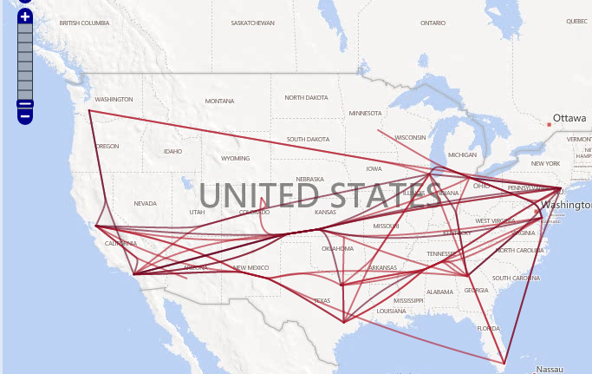
Case Study: MovePattern
An interactive framework for visualizing massive number of movements in multiple spatial resolutions.
Provide a concise multi-level view of collective movements using MapReduce-based algorithms.
Store the summarized graph in a 4-node MongoDB cluster to link with the visualization component.
24
Notes:
24

Slide 25
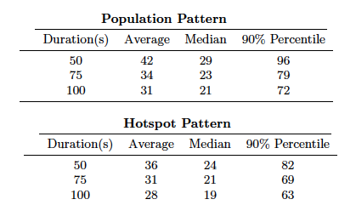
Case Study: MovePattern
25
Notes:
25

Slide 26
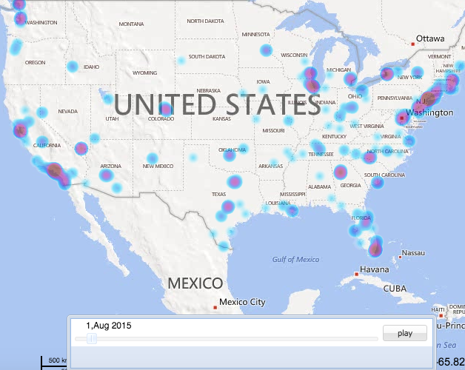
Case Study: GeoHashViz
An interactive framework to study spatiotemporal diffusion of ideas in virtual world using Hashtags.
The framework requires pre-calculating some metrics for hashtag diffusion in order to support fast querying capability from the user.
Store the result in a 4 node Apache Cassandra cluster.
26
Notes:
26

Slide 27
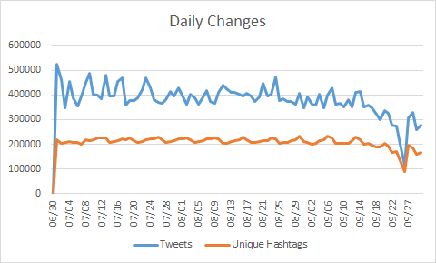
Case Study: GeoHashViz
27
Notes:
27

Slide 28
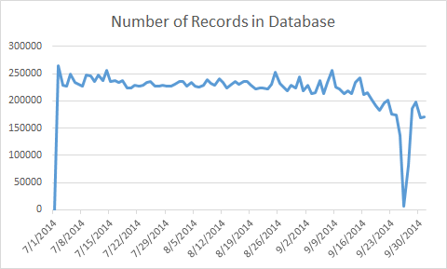
Case Study: GeoHashViz
28
Notes:
28

Slide 29
Case Study: Spatial Query Engine
Establish a generic and scalable query framework for geospatial big data on cyberinfrastructure.
Support query patterns in a scalable way.
Use Redis to store the indexing structure in memory and the actual data on Cassandra database.
Design for integrated spatiotemporal queires.
Arbitrary input and query shapes.
29
Notes:
29

Slide 30
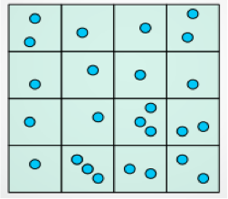
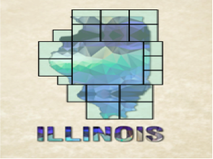
Case Study: Spatial Query Engine
Polygon Indexing
Point Indexing
30
Notes:
30

Slide 31
Experiments
2 weeks of geo-tagged tweets in US
Rectangular query shape
100 queries per level (point and 3 polygon levels)
Temporal length: one week
Maximum width/height in miles
Point: 2.0
Zipcodes: 16.0, County: 64.0, State: 256
31
Notes:
31
31

Slide 32
Result I
Database write and read -- local performance (ms)
Operation/Node | Average for Point data | Average for Polygon Data
Local Write Latency | 0.0445 | 0.984
Local Read Latency | 21.738 | 3.122
32
Notes:
32
32

Slide 33
Result II
End-to-end query performance(ms)
Query Type/Latency | Mean | Average | 90% Percentile
Polygon Level 0 | 82 | 85 | 160
Polygon Level 1 | 78 | 80 | 142
Polygon Level 2 | 158 | 190 | 322
Point | 75 | 121 | 200
33
Notes:
33
33

Slide 34
MongoDB
Managing MongoDB
Using MongoDB
Choose your favorite programing language to access the databases
Using command line interface:
mongo --host hostserver_name:port (default: 27017)/database_name
mongo –-host 141.142.168.54
show dbs
use <name> to create a new database

Slide 35
Geo-located Tweets query in Chicago
Getting started with MongoDB in OpenStack
Choose your programming language and setup appropriate drivers
List of commands and guidelines:
https://docs.mongodb.org/manual/core/crud-introduction/
Prepare geo-located Tweets as documents to MongoDB
MongoDB uses JSON objects to store the data
Convert your data structure to JSON
Covert geospatial objects to GeoJSON
They are essentially <key, value> pairs but with hierarchical structure

Slide 36
Geo-located Tweets query in Chicago
A GeoJSON object
{
"type": "Feature",
"geometry": {
"type": "Point",
"coordinates": [125.6, 10.1]
},
"properties": {
"name": "Dinagat Islands"
}
}
Geo-located tweets
Using Pig script to extract <User_id, latitude, longitude, timestamp, content>

Slide 37
Import Twitter Data into MongoDB
from pymongo import MongoClient
import datetime
import json
def main():
client = MongoClient('mongodb://141.142.168.54:27017')
db = client.ddbs
collection = db['chicago']
mFile = open("2014_12_25_chi.txt","rb")
for mLine in mFile:
# print mLine
[uid, lat, lng, tm, msg] = mLine.split("\t")
geoString = {'user_id': uid, 'time': tm, 'message': msg, 'loc': {'type' : 'Point', 'coordinates' : [lng, lat]}}
print geoString
db.chicago.insert(geoString)
if __name__ == '__main__':
main()

Slide 38
Geo-located Tweets query in Chicago
Create spatial index to speed up database querying
db.chicago.createIndex( { loc : "2dsphere" } )
Find the geo-located tweets within the search distances from a specified location
db.chicago.find({loc: {$nearSphere: {$geometry: {type : "Point",coordinates : [-87.639160, 41.878628]},$minDistance: 1000,$maxDistance: 5000}}})
Find the geo-located tweets within a specified region (polygon)
db.chicago.find({loc:{$geoWithin: { $geometry: {type : "Polygon", coordinates: [ [ [-87.639546, 41.878053], [87.639643, 41.879506], [-87.638602,41.879363], [-87.638270,41.878045], [-87.639546, 41.878053]]]}}}})

Slide 39
Geo-located Tweets query in Chicago
Sort the query result based on distance
db.chicago.find({loc: { $nearSphere: { $geometry: { type : "Point", coordinates : [-87.639160, 41.878628]}, $minDistance: 1000, $maxDistance: 5000}}}).sort({"loc":1})

Slide 40
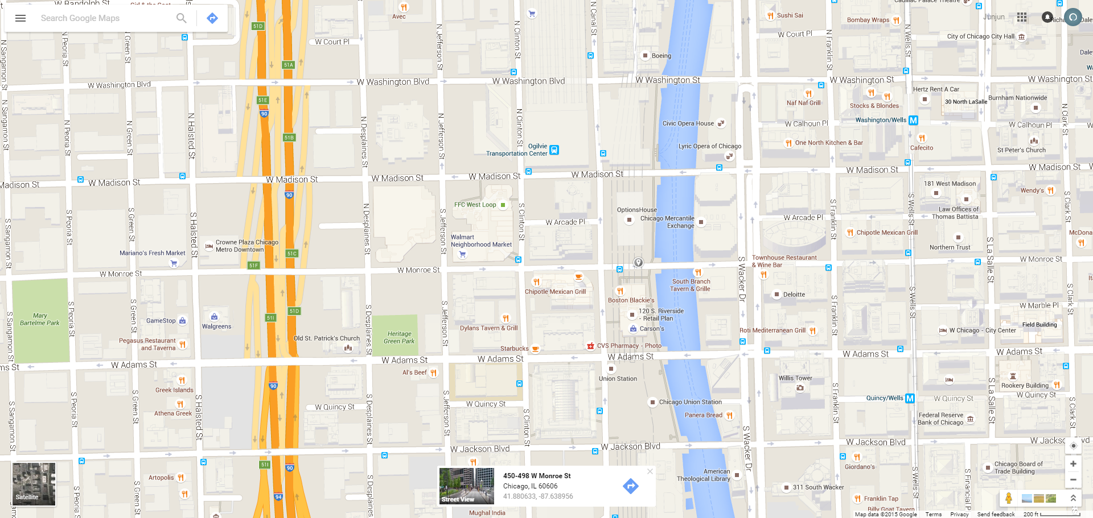
Pick up coordinates from Google Maps

