Slide 1
Big data analysis with R
Myeong-Hun Jeong
CyberGIS Center for Advanced Digital and Spatial Studies
National Center for Supercomputing Applications (NCSA)
University of Illinois at Urbana-Champaign
mhjeong@illinois.edu
March, 15, 2016

Slide 2
Contents
Labs:
Lab 1: Investigate resource pressures between serial and parallel approaches.
Lab 2: Parallel spatial analysis -- Parallel spatial autocorrelation analysis (Moran’s I)

Slide 3
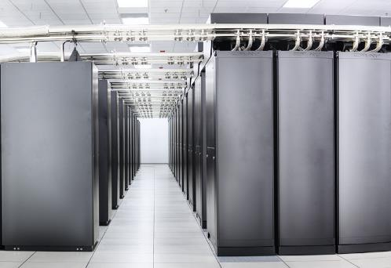


+
=

Slide 4
What to do if the computation is too big for a single desktop
Break big computation with multiple job submission
RHadoop is a collection of R packages that enables users to process and analyze big data with Hadoop.
Rmr2 and Rhdfs packages.
Implement code using parallel packages
Run R with a couple of parallel packages.

Slide 5
Lab 1: Running parallel R
Objective:
Learn how to run parallel R
Successful outcome:
Investigate resource pressures between serial and parallel approaches.
Before you begin:
Environmental variable setting
vi ./bashrc -- open bashrc file
module load R -- put this line and exit the file after saving.
Module load
module load binutils/2.25 openblas/0.2.14 R/3.2.1-openmpi geos
Install parallel R packages

Slide 6
Running parallel R
Perform the following steps:
Step 1: Install packages for this course.
Start R
$ R
Install packages for this course.
> install.packages(“snow”)
> install.packages(“Rmpi”)
> install.packages(“foreach”)
> install.packages(“doSNOW”)
> install.packages(“parallel”)
> install.packages(“boot”)
> install.packages(“maptools”)
> install.packages(“spdep”)
You select a CRAN mirror for installing packages (e.g., USA(IN)).
Or > install.packages(c("snow", "Rmpi", "foreach", "doSNOW", "parallel", "boot", "maptools", "spdep”))

Slide 7
Running parallel R
Step 2: Define a simple R function.
myProc <- function(size=10000000) {
#Load a large vector
vec <- rnorm(size)
#Now sleep on it
Sys.sleep(2)
#Now sum the vec values
total <- 0
for(v in vec) {
total <- total + v
}
}

Slide 8
Running parallel R
Step 3: To run myProc() 10 times using apply.
ptm <- proc.time()
#sapply converts results into a vector or array of appropriate size
result <- sapply(1:10, function(i) myProc())
proc.time() – ptm
=> user system elapsed
14.929 0.232 35.179

Slide 9
Running parallel R
Step 3: To run myProc() 10 times using a parallel package.
require(parallel)
ptm <- proc.time()
result <- mclapply(1:10, function(i) myProc(), mc.cores=10)
proc.time() – ptm
=> user system elapsed
0.012 0.025 4.616

Slide 10
Running parallel R
Step 4: To run myProc() 10 times using a SNOW package.
require(snow)
#Create a cluster object
hostnames <- rep('localhost', 10)
cluster <- makeSOCKcluster(hostnames)
#Assigns the values on the master of the variables named in list to variables of the same names in the global environments of each node.
clusterExport(cluster, list('myProc'))
ptm <- proc.time()
#Call function on the first cluster node with arguments seq[[1]] and ..., on the second node with seq[[2]] and ..., and so on. If the length of seq is greater than the number of nodes in the cluster then cluster nodes are recycled.
result <- clusterApply(cluster, 1:10, function(i) myProc())
proc.time() - ptm
=> user system elapsed
0.006 0.001 4.053
#To shut down the cluster
stopCluster(cluster)

Slide 11
Running parallel R
Step 5: To run myProc() 10 times using foreach + SNOW packages.
require(foreach)
require(doSNOW)
hostnames <- rep('localhost', 10)
cluster <- makeSOCKcluster(hostnames)
#register the SNOW parallel backend with the foreach package.
registerDoSNOW(cluster)
ptm <- proc.time()
#'c' is useful for concatenating the results into a vector.
result <- foreach(i=1:10, .combine=c) %dopar% {
myProc()
}
proc.time() - ptm
user system elapsed
0.023 0.010 4.983
stopCluster(cluster)

Slide 12
Running parallel R
Step 6: Bootstrap calculations.
Serial implementation.
random.data <- matrix(rnorm(1000000), ncol = 1000)
bmed <- function(d, n) median(d[n])
library(boot)
sapply(1:100, function(n) {sd(boot(random.data[, n], bmed, R = 10000)$t)})
=> user system elapsed
103.305 0.828 224.822
Parallel implementation
library(doSNOW)
cluster = makeCluster(10, type = "SOCK")
clusterExport(cluster, c("random.data", "bmed"))
results = foreach(n = 1:100, .combine = c) %dopar% {
library(boot); sd(boot(random.data[, n], bmed, R = 10000)$t)
}
stopCluster(cluster)
user system elapsed
0.340 0.069 21.037

Slide 13
Lab 2: Parallel spatial analysis
Objective:
Learn how to calculate parallel spatial autocorrelation (Moran’s I)
Location of files:
/gpfs_scratch/geog479/lab9
Successful outcome:
Your will calculate a spatial autocorrelation index, based on serial and parallel approaches.
Before you begin:
SSH into the ROGER system.
Make a data directory and copy shape files into the data directory
cp /gpfs_scratch/geog479/lab9/*.* dataset

Slide 14
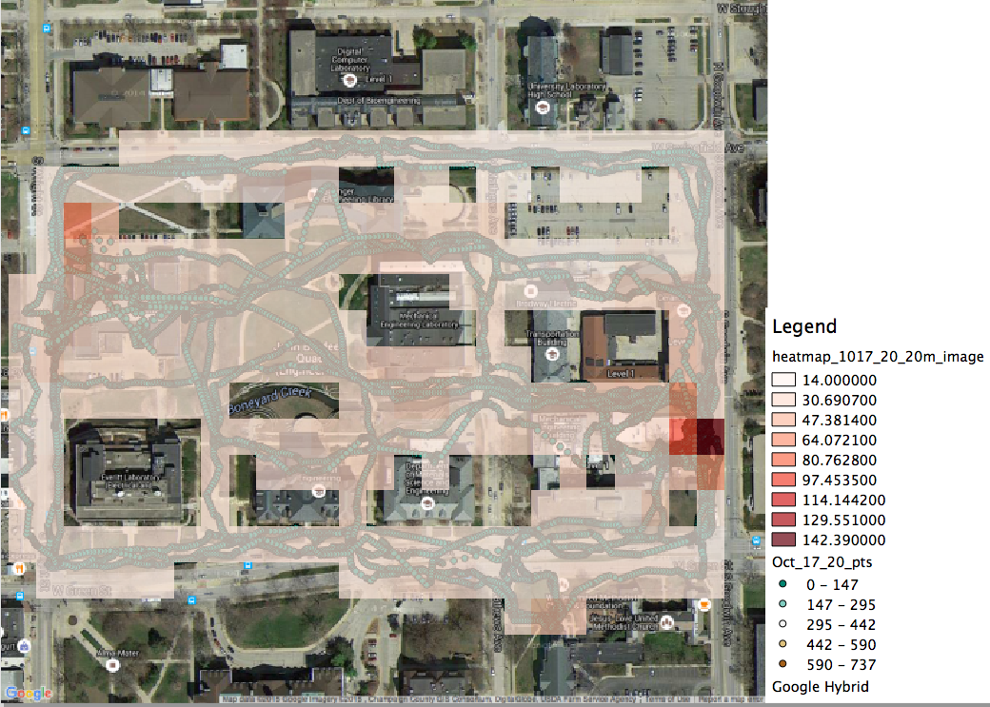
Lab 2: Radiation spatial autocorrelation
Radiation measurements on UIUC campus.
Acknowledgement of data use
Prof. Clair, the department of NPRE shares her group data for the CyberGIS workshop.
Notes:
Advantage
Do whatever you want with them
Get the best performance
Limitations
Need code development
In some case, the analysis workflow may need be changed.

Slide 15
Radiation spatial autocorrelation
Step 1: Moran’s I serial implementation
require(maptools)
require(spdep)
#an absolute filepath representing the current working directory of the R proces
getwd()
#set the working directory
setwd(”~/”)
#Get shapefile header information in the radiation data
getinfo.shape("dataset/Oct_17_20_proj.shp")
#Reads data from a points shapefile
radiation<-readShapePoints ("dataset/Oct_17_20_proj.shp")
#Retrieve spatial coordinates from a Spatial object
coords<-coordinates(radiation)
IDs<-row.names(as(radiation, "data.frame"))
#Neighbourhood contiguity by distance
radiation_nei<-dnearneigh(coords, d1=0, d2=20, row.names=IDs)
#Spatial weights for neighbours lists
radiation_nbq_wb<-nb2listw(radiation_nei, style="W")
#Moran's I test for spatial autocorrelation
moran.test(radiation$field_5, listw=radiation_nbq_wb)

Slide 16
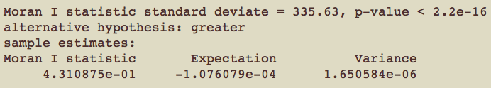
Radiation spatial autocorrelation
Step 1: Moran’s I serial implementation
#Moran's I test for spatial autocorrelation
moran.test(radiation$field_5, listw=radiation_nbq_wb)
Notes:
Advantage
Do whatever you want with them
Get the best performance
Limitations
Need code development
In some case, the analysis workflow may need be changed.

Slide 17
Radiation spatial autocorrelation
Step 2: Moran’s I parallel implementation
gamma <- radiation$field_5
listw <- radiation_nbq_wb nsim <- 999
require(foreach)
require(doSNOW)
n <- length(listw$neighbours)
S0 <- Szero(listw)
cluster = makeCluster(10, type = "SOCK")
registerDoSNOW(cluster)
clusterExport(cluster, c("gamma", "listw","n","S0"))
results = foreach(n = 1:nsim, .combine = c) %dopar% {
library(spdep); moran(sample(gamma), listw, n, S0,zero.policy=NULL)$I
}

Slide 18
Radiation spatial autocorrelation
Step 2: Parallel Moran’s I calculation
paMoran <- function(res, x, listw, nsim,zero.policy=NULL,alternative="greater") {
n <- length(listw$neighbours)
S0 <- Szero(listw)
res[nsim+1] <- moran(x, listw, n, S0, zero.policy)$I
rankres <- rank(res)
xrank <- rankres[length(res)]
diff <- nsim - xrank
diff <- ifelse(diff > 0, diff, 0)
if (alternative == "less")
pval <- punif((diff + 1)/(nsim + 1), lower.tail=FALSE)
else if (alternative == "greater")
pval <- punif((diff + 1)/(nsim + 1))
statistic <- res[nsim+1]
names(statistic) <- "statistic"
parameter <- xrank
names(parameter) <- "observed rank"
method <- "Parallel Monte-Carlo simulation of Moran's I"
lres <- list(statistic=statistic, parameter=parameter,
p.value=pval, alternative=alternative, method=method,res=res)
lres
}

Slide 19
Radiation spatial autocorrelation
Step 2: Parallel Moran’s I calculation
mtest <- paMoran(results,gamma,listw,nsim)
mtest$method => Parallel Monte-Carlo simulation of Moran's I
mtest$statistic => 0.43109
mtest$parameter => observed rank 1000
mtest$p.value => 0.001

