Slide 1
Interactive Visualization of Large-scale Movement Data using Apache Spark
Junjun Yin
CyberGIS Center for Advanced Digital and Spatial Studies
Department of Geography and Geographic Information Science
National Center for Supercomputing Applications (NCSA)
University of Illinois at Urbana-Champaign
April 5, 2016

Slide 2
Outline
Big Movement Data
Distributed computing environment in ROGER
Apache Spark
Big Data processing in Hadoop Distributed File System (HDFS)
Interactive data visualization with D3.js
Spark for data processing (Python) and D3 for visualization (JavaScript)

Slide 3
Outline – detailed
Introduction to Spark
What is Spark, why and when to use Spark
Comparisons between Spark and Hadoop
Spark basics
Visualization of density map of movement data
Density map generation for New York taxi GPS datasets
Implementation in Spark ( based on space-time query)
Visualization of movement flows from Twitter data
Workflow design
Data preparation
Mapping movement flows in real geographical space (e.g. using polygons in shapefile)
Summarizing the origin and destination networks
Interactive visualization using D3.js

Slide 4
Big Movement Data
Let us recap on the different types of big movement data we have encountered in the previous lectures
New York taxi records
Location Based Social Media data (in particular, Twitter data)
Challenges
e.g., large volume, messy, noisy
Can traditional GIS (geographical information system) work?
Notes:
Over 2 million tweets (2 GB) collected for North American per day
400 million for half a year
That is just 1% of all the tweets!
For New York taxi data, basically, Chris has to send several hard drives to the collect the data and it is only for one year already processed data

Slide 5
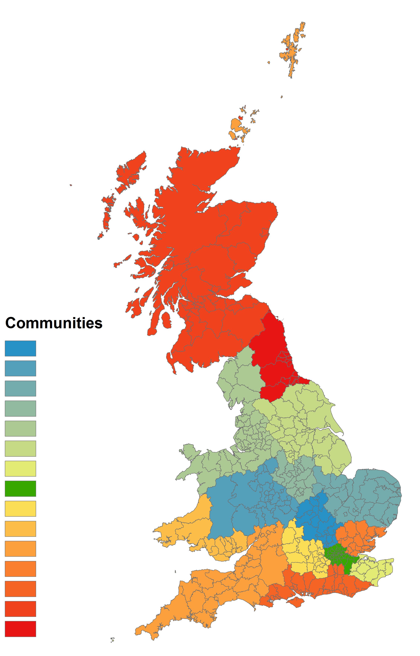
Visualization and knowledge discovery
Source: X Liu, L Gong, Y Gong, Y Liu - Journal of Transport Geography, 2015
Community structure of the Great Britain based on the movement of Twitter users

Slide 6
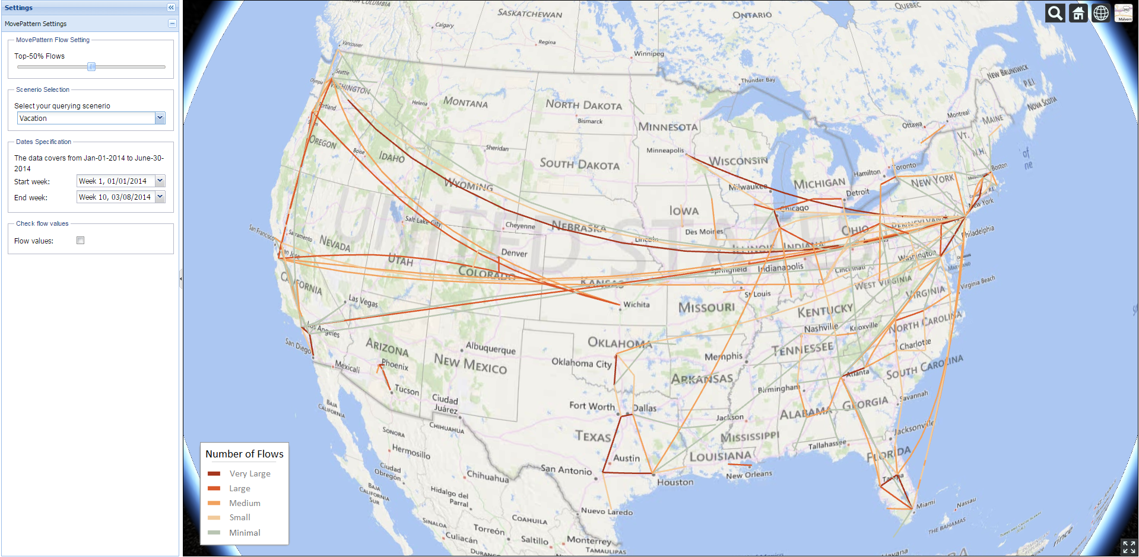
MovePattern
Key-word specified (scenario-based) Twitter user movement patterns
Adjustable (longer) time range selection
Utilizing MapReduce approach with Apache Hadoop for larger volume of data processing
3D virtual globe visualization

Slide 7
Distributed Computing with Spark
What is Spark
http://spark.apache.org/
An open-source cluster computing framework originally developed in the AMPLab at UC Berkeley
The fundamental programming abstraction is Resilient Distributed Datasets (RDD), which is a logical collection of data partitioned across machines.
Run programs up to 100x faster Hadoop MapReduce in memory, or 10x faster on disk.
Ease of Use
Write applications quickly in Java, Scala, Python, R.
Runs Everywhere
Spark runs on Hadoop, Mesos, standalone, or in the cloud. It can access diverse data sources including HDFS, Cassandra, HBase, and S3.
When to use Spark
When the operations involves iterations, especially machine learning and data mining algorithms
Repeatable/multiple queries on the same large dataset

Slide 8
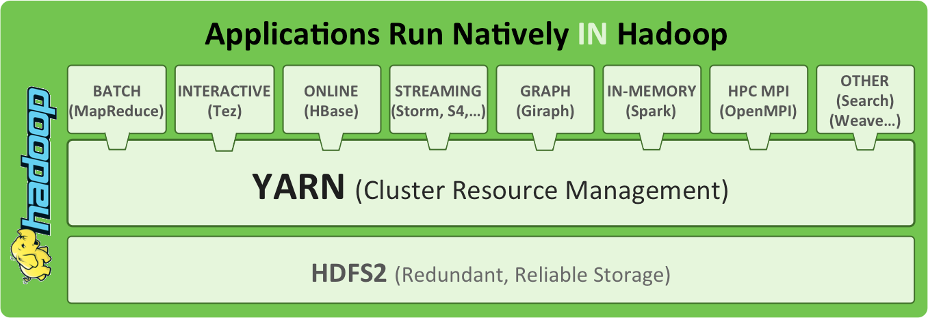
Taking advantage of the Hadoop Architecture
Source: http://radar.oreilly.com/2014/01/an-introduction-to-hadoop-2-0-understanding-the-new-data-operating-system.html
Notes:
Yahoo developed HDFS to compete with GFS (Google). Google developed MapReduce for their own system.
Yarn for resource management. Queue system.
Hbase – big table, column based database. OS version. SQL-like.
Hive for Hbase
Pig for raw data like loaded CSVs

Slide 9
Example in Spark
launch spark:
>> ssh cg-hm08
>> module load java
>> pyspark
text_file = sc.textFile("words.txt")
counts = text_file.flatMap(lambda line: line.split(",")).map(lambda word: (word, 1)).reduceByKey(lambda a, b: a + b)
#counts.saveAsTextFile("hdfs://...") (this saves to HDFS format, we will not use it this time)
results = counts.collect()
print results
type exit() to exit Spark shell

Slide 10
Basic Spark syntax
pyspark script.py
spark-submit script.py
spark-submit --master yarn-cluster --executor-memory 20G --num-executors 50 script.py
Important notes about spark-submit with YARN
Set the parameters within the code
import pyspark
from pyspark.context import SparkContext
from pyspark import SparkConf, SparkContext
from pyspark.storagelevel import StorageLevel
conf = (SparkConf().setMaster("yarn-client").setAppName("flow_generator").set("spark.executor.memory", "4g").set("spark.executor.instances", 50))
sc = SparkContext(conf = conf)
Run the script using spark-submit script.py

Slide 11

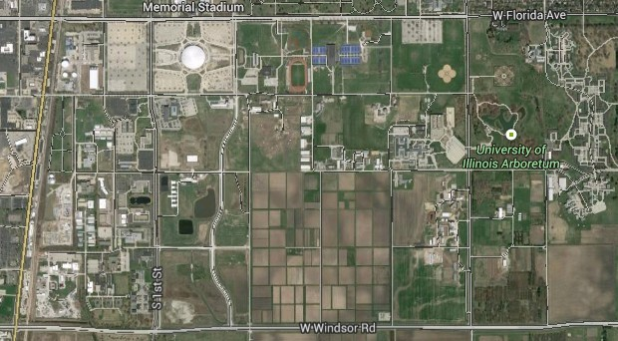

Visualizing Twitter user movements
Movement 1
Movement 2
Mapping units
11

Slide 12
Illustrations of mapping movements in different units
(a) Polygon based mapping units (ward level) (b) Grid based mapping units (10 km)

Slide 13
Determine point-in-polygon Spark with ESRI’s shapefile
To map Twitter user’s movement to a corresponding mapping unit, e.g. county, zip code area, state, etc., we need to perform “point-in-polygon” operation
Traditional spatial database provides such operation
For Spark, there is no spatial operation implemented nor does it recognize ESRI’s shapefile and GeoJSON format
The power of open source
For Python, there is Shapefile.py (https://github.com/GeospatialPython/pyshp)
Even Spark is open sourced
Let’s review how we did it with Hadoop and MapReduce
Notes:
Quad-Tree

Slide 14
Determine point-in-polygon
Review the script
How do we add files when submitting the job via YARN
How do we specify the parameters
How do we performs the searches to find the candidate polygon
How do we specify the input and output
How do we implement the filter() and map() functions
…
What’s next?
Now we know each point belong to a certain polygon, and we know the timestamp for which is the origin and which is the destination
The next is mapping movement flows

Slide 15
D3.js
A JavaScript library for manipulating documents based on data.
D3 provides visualization of data using HTML, SVG, and CSS.
D3 combines powerful visualization components and a data-driven approach to DOM manipulation.
Everything you want to know about D3.js, visit http://d3js.org/
Check out the demos on the website
For geographical visualization: http://datamaps.github.io/

Slide 16
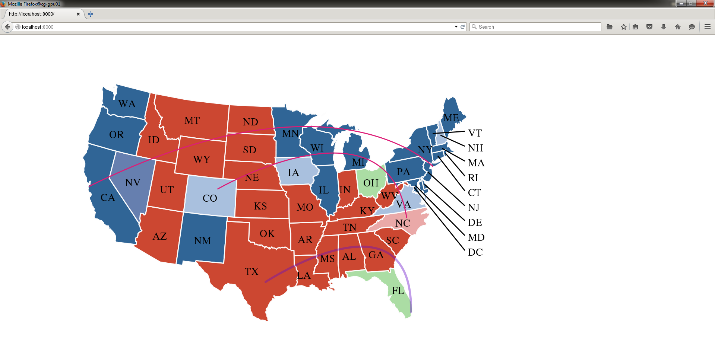
Demo: Map of USA

Slide 17
Create your own map
TopoJSON
https://github.com/mbostock/topojson
Usage:
topojson [options] -- [file …]
Input files can be one or more of:
.json GeoJSON or TopoJSON
.shp ESRI shapefile
.csv comma-separated values (CSV)
.tsv tab-separated values (TSV)

Slide 18
Generate Twitter user movement flows
For this workshop, let’s consider the state-level Twitter user movements
Suppose a user Twitter user tweeted at state A at time t1, and next moment, this user tweeted at state A at time t2, and next moment, at state B at time t3
Therefore, the flow from A to B is one
And imaging the collection of millions of Twitter users
A, B, count1
B, C, count2
…
M, N, countn

Slide 19
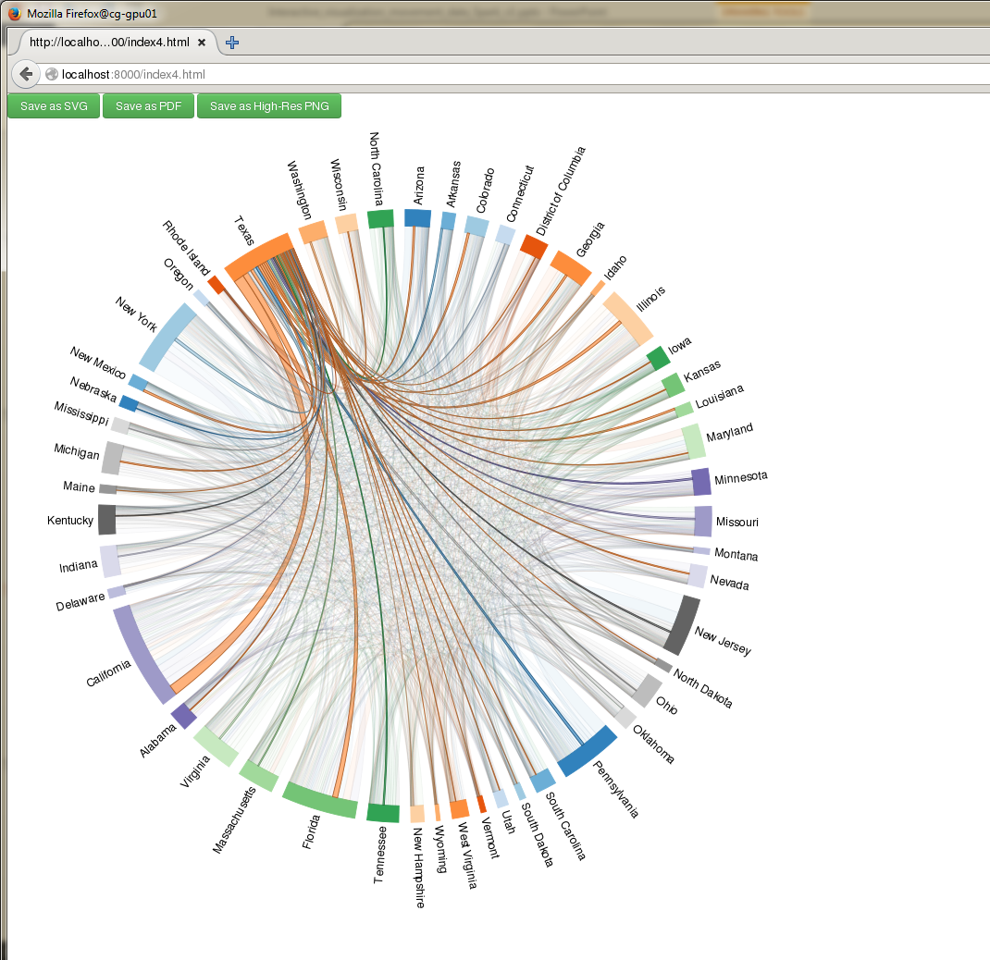
Chord diagram of Twitter user movement flows among states

Slide 20
Useful links
General usage
(Spark Tutorial) http://lintool.github.io/SparkTutorial/
Spatial Spark
(SpatialSpark) https://github.com/syoummer/SpatialSpark
(GeoSpark) http://geospark.datasyslab.org/

