Slide 1
Distributed Spatial Database
Dr. Junjun Yin
CyberGIS Center for Advanced Digital and Spatial Studies
Department of Geography and Geographic Information Science
National Center for Supercomputing Applications
University of Illinois at Urbana-Champaign, IL, 61801, USA
jyn@illinois.edu
February 9, 2016

Slide 2
Outline
What is “distributed databases”
File system vs. database
Relational database vs NoSQL database
Relational Database Management System (RDBMS)
Spatial Database Management System (SDBMS)
Non-relational database (NoSQL)
Big Data requirements
Variety and data structure
Velocity and concurrency
Data management, storage and query performance
Notes:
Name some of the popular spatial databases:
Oracle Spatial, MySQL, PostgreSQL+ PostGIS,

Slide 3
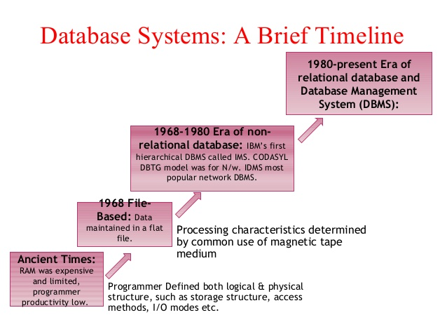
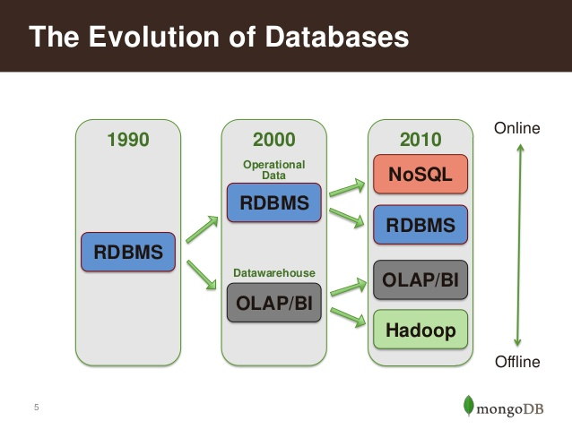
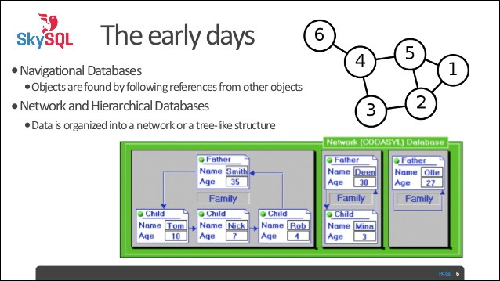
Evolution of Databases
Source:
http://www.slideshare.net/wlaforest/why-nosql-and-mongodb-for-big-data

Slide 4
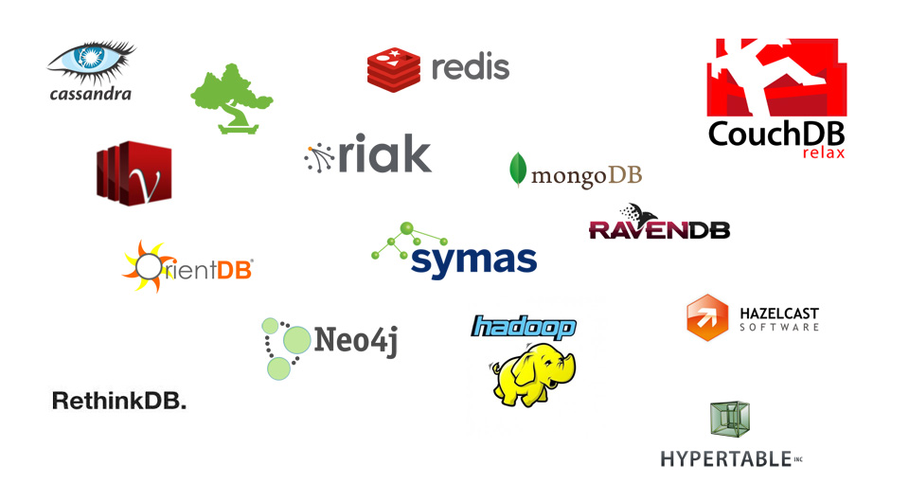
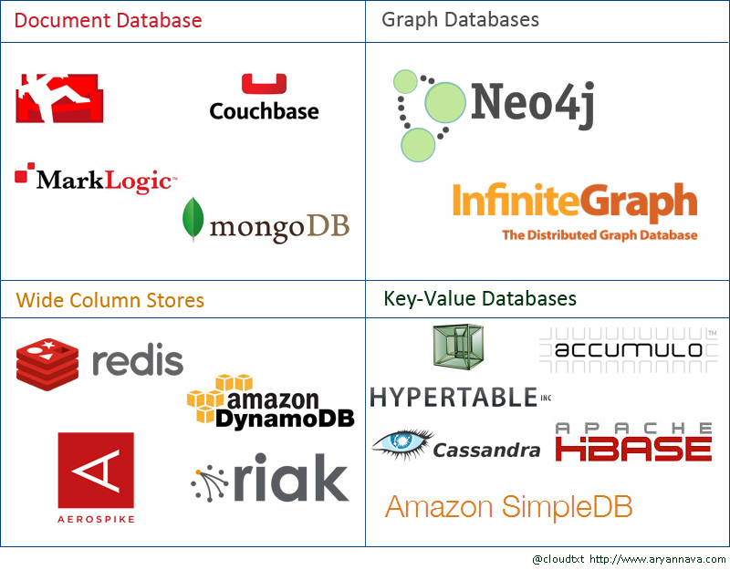
Evolution of Databases
Source:http://aryannava.com/category/nosql/
Notes:
Column-oriented organizations are more efficient when an aggregate needs to be computed over many rows but only for a notably smaller subset of all columns of data, because reading that smaller subset of data can be faster than reading all data.
Column-oriented organizations are more efficient when new values of a column are supplied for all rows at once, because that column data can be written efficiently and replace old column data without touching any other columns for the rows.
Row-oriented organizations are more efficient when many columns of a single row are required at the same time, and when row-size is relatively small, as the entire row can be retrieved with a single disk seek.
Row-oriented organizations are more efficient when writing a new row if all of the row data is supplied at the same time, as the entire row can be written with a single disk seek.

Slide 5
Document-oriented Database
{
"_id" : ObjectId("5660d0d92a5d502680eb616f"),
"loc" : {
"type" : "Point",
"coordinates" : [
-87.9609112,
42.1526175
]
},
"message" : "3 more!!!\n",
"user_id" : "232659889",
"time" : "Fri Jul 04 20:55:28 CDT 2014"
}
JSON (JavaScript Object Notation) based data format

Slide 6
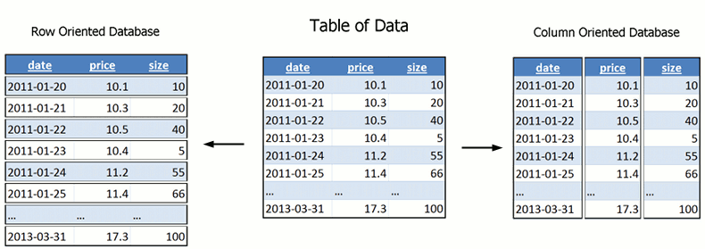
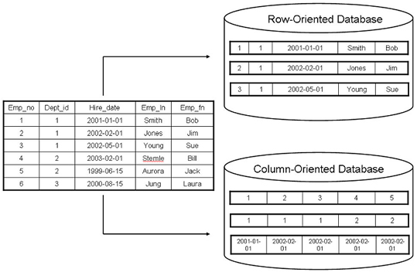
Column-oriented Database
Source: http://www.timestored.com/time-series-data/what-is-a-column-oriented-database
Notes:
What if some of the information are missing?

Slide 7
Relational vs. NoSQL
Relational databases
Well designed data schemes
Well organized data structures
Row-based
NoSQL databases
Document-oriented
Column-oriented
<key, value> pair-based
Graph-based

Slide 8
Spatial Database
Geometry
Point, polyline, polygon, and 3D geospatial objects
Attributes
Spatial indexing
R-tree (R*-tree), 3D R-tree
Quad-tree
Topological operations
Overlapping
Intersection
K-nearest neighbors
Within
…

Slide 9


Distributed Databases
9
Notes:
9

Slide 10
Why distributed database
Your single machine runs out of storage!
Easy scalability
Avoids single point of failure by distributing data among multiple machines.
Will not lose any data in case a machine fails.
Will not lose the ability to query the data in case a machine fails.
Machines that are performance bottlenecks will not affect the overall performance of the system.
10
Notes:
10

Slide 11
Why distributed database
Reduce query time by “intelligently” distribute data among multiple nodes.
A query should look into a smaller subset of data.
In write operations the index should be updated for a smaller set of data.
Distribute workload on multiple nodes in case of simultaneous access.
Re-route requests to multiple machines (courtesy of replication).
Incorporate organizational structure.
Each group wants to host their own data!
11
Notes:
11

Slide 12
Challenges
Require new skills and knowledge for many database admins.
Relatively new era. Still lots of development is being made.
Issues with integrity and consistency of the database.
More issues on ensuring the security of the database cluster.
Require new database design techniques.
12
Notes:
12

Slide 13
Concepts
Replication: System maintains multiple identical copies of the data.
Increase latency on update.
Partitioning: The dataset is divided into multiple smaller datasets based on a pre-defined function.
Balancing the load on different chunks of data should be considered.
Consistency: any transaction must only affect data in allowed ways.
13
Notes:
13

Slide 14
Consistency
X : John’s balance
X: 1000$
X: 950$
X: 1020$
X: 1008$
14
Notes:
14

Slide 15
Types of Consistency
Strong consistency: Every client can observe one consistent stage.
Weak consistency: relaxing some constraints on the strong consistency to gain better performance and availability.
15
Notes:
15

Slide 16
CAP Theorem
It is impossible for a distributed computer system to simultaneously provide all of these 3 guarantees:
Consistency
Availability
Partition tolerance
The system can continue its operation despite partitioning due to failures.
16
Notes:
16
Consistency: all nodes see the same data at the same time
Availability: guarantee every request receives a response whether it succeeded or failed
Partition tolerance: the system continues to operate despite arbitrary partitioning due to failures

Slide 17



Examples of NoSQL
Distributed Databases
17
Notes:
17

Slide 18
MongoDB
Document-oriented database.
Store records in a json-like format.
Easy-to-use.
Supports replication and partitioning (sharding).
Support primary and secondary indexes.
Support aggregation queries through:
Javascript-basd MapReduce structure which can support arbitrary large data but it is slow.
C++ based aggregation framework which is limited in size but very fast.
18
Notes:
18

Slide 19
Apache Cassandra
Highly decentralized architecture.
Read/write throughput both scale linearly as the new machines are added.
Very fast write performance.
The admin can tune the consistency level based on the application.
Most popular option in the industry for massive and highly distributed datasets.
Easy integration with Hadoop, Hive, etc.
Limited support for geospatial operations.
19
Notes:
19

Slide 20
Data Model
Partitioning Key
Clustering Key
Row ID
Field 1 | Field 2
Field 1 | Field 2
Field 1 | Field 2
Other fields
Other fields
Other fields
Bus Station
Time | Bus Id
Time | Bus Id
Time | Bus Id
# of passenger
# of passenger
# of passenger
20
Notes:
20

Slide 21
Query Language: CQL
INSERT INTO BUSDATA (station, time, id, passengers) VALUES (100, 201504041000, 13222, 22);
SELECT * FROM BUSDATA WHERE station = 100 AND time >= 201510010000;
UPDATE BUSDATA SET passengers = passengers + 5 WHERE station = 100 AND time <= 201511010000 AND time >=201510010000;
21
Notes:
21

Slide 22
Redis
In memory key-value stores.
Supports limited operations but it is significantly faster for smaller datasets.
Supports replications.
Provide multiple methods to ensure persistency of the data.
Main supported data types:
Lists
Sets and Sorted Sets.
Hash Tables.
22
Notes:
22

Slide 23
Basic Commands
SET “13132” “John Smith”
GET “13132”
“John Smith”
ZADD “arrivals” 201410100105 “american airlines 3322”
ZRANGEBYSCORE “arrivals” 201410010000 201410052359
HSET “employees” “13132” “John Smith”
HGET “employees” “13132”
23
Notes:
23

Slide 24
Geospatial Commands
GEOADD Illinois -87.6847 41.8369 “Chicago”
GEOADD Illinois -88.2728 40.1150 “Champaign”
GEODIST Illinois Champaign Chicago mi
GEORADIUS Illinois -88.2000 40.3442 200 km WITHDIST
Details: http://redis.io/commands/georadius
24
Notes:
24
retrieve geospatial items near a specified point and within a given amount of raidus

Slide 25
Performance Comparison
Solving Big Data Challenges for Enterprise Application
Performance Management
Mainly from University of Toronto
VLDB 2012
Benchmark the databases with different workloads (read-heavy, write-heavy, mixed).
Benchmark the database with different metrics (latency (sec) and throughput (ops/sec).
25
Notes:
25

Slide 26
Performance Comparison
Cassandra is a good choice for applications with high insertion rate and applications which requires great scalability.
Redis performs significantly faster than other database systems in read-heavy loads, however it does not scale well. In addition it comes with a limitation on the size of data.
MongoDB works fine for smaller clusters, but shows significant performance drop as we move to larger clusters.
26
Notes:
26

Slide 27
Case Study: Spatial Query Engine
Establish a generic and scalable query framework for geospatial big data on cyberinfrastructure.
Support query patterns in a scalable way.
Use Redis to store the indexing structure in memory and the actual data on Cassandra database.
Design for integrated spatiotemporal queires.
Arbitrary input and query shapes.
27
Notes:
27

Slide 28
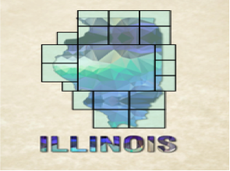
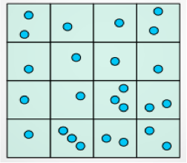
Case Study: Spatial Query Engine
Polygon Indexing
Point Indexing
28
Notes:
28

Slide 29
Experiments
2 weeks of geo-tagged tweets in US
Rectangular query shape
100 queries per level (point and 3 polygon levels)
Temporal length: one week
Maximum width/height in miles
Point: 2.0
Zipcodes: 16.0, County: 64.0, State: 256
29
Notes:
29
29

Slide 30
Result I
Database write and read -- local performance (ms)
Operation/Node | Average for Point data | Average for Polygon Data
Local Write Latency | 0.0445 | 0.984
Local Read Latency | 21.738 | 3.122
30
Notes:
30
30

Slide 31
Result II
End-to-end query performance(ms)
Query Type/Latency | Mean | Average | 90% Percentile
Polygon Level 0 | 82 | 85 | 160
Polygon Level 1 | 78 | 80 | 142
Polygon Level 2 | 158 | 190 | 322
Point | 75 | 121 | 200
31
Notes:
31
31

Slide 32
MongoDB in CyberGIS OpenStack
Managing MongoDB in OpenStack
Create a new instance(s) in OpenStack to host MongoDB server (clusters)
For this class, we have created a MongoDB instance
Use a GUI client to access MongoDB
Using MongoDB
Choose your favorite programing language to access the databases
Using command line interface:
mongo --host hostserver_name:port (default: 27017)/database_name
mongo –-host 141.142.168.54
show dbs
use <name> to create a new database

Slide 33
Geo-located Tweets query in Chicago
Getting started with MongoDB in OpenStack
Choose your programming language and setup appropriate drivers
List of commands and guidelines:
https://docs.mongodb.org/manual/core/crud-introduction/
Prepare geo-located Tweets as documents to MongoDB
MongoDB uses JSON objects to store the data
Convert your data structure to JSON
Covert geospatial objects to GeoJSON
They are essentially <key, value> pairs but with hierarchical structure

Slide 34
Geo-located Tweets query in Chicago
A GeoJSON object
{
"type": "Feature",
"geometry": {
"type": "Point",
"coordinates": [125.6, 10.1]
},
"properties": {
"name": "Dinagat Islands"
}
}
Geo-located tweets
Using Pig script to extract <User_id, latitude, longitude, timestamp, content>

Slide 35
Import Twitter Data into MongoDB
from pymongo import MongoClient
import datetime
import json
def main():
client = MongoClient('mongodb://141.142.168.54:27017')
db = client.ddbs
collection = db['chicago']
mFile = open("2014_12_25_chi.txt","rb")
for mLine in mFile:
# print mLine
[uid, lat, lng, tm, msg] = mLine.split("\t")
geoString = {'user_id': uid, 'time': tm, 'message': msg, 'loc': {'type' : 'Point', 'coordinates' : [lng, lat]}}
print geoString
db.chicago.insert(geoString)
if __name__ == '__main__':
main()

Slide 36
Geo-located Tweets query in Chicago
Create spatial index to speed up database querying
db.chicago.createIndex( { loc : "2dsphere" } )
Find the geo-located tweets within the search distances from a specified location
db.chicago.find({loc: {$nearSphere: {$geometry: {type : "Point",coordinates : [-87.639160, 41.878628]},$minDistance: 1000,$maxDistance: 5000}}})
Find the geo-located tweets within a specified region (polygon)
db.chicago.find({loc:{$geoWithin: { $geometry: {type : "Polygon", coordinates: [ [ [-87.639546, 41.878053], [87.639643, 41.879506], [-87.638602,41.879363], [-87.638270,41.878045], [-87.639546, 41.878053]]]}}}})

Slide 37
Geo-located Tweets query in Chicago
Sort the query result based on distance
db.chicago.find({loc: { $nearSphere: { $geometry: { type : "Point", coordinates : [-87.639160, 41.878628]}, $minDistance: 1000, $maxDistance: 5000}}}).sort({"loc":1})

Slide 38
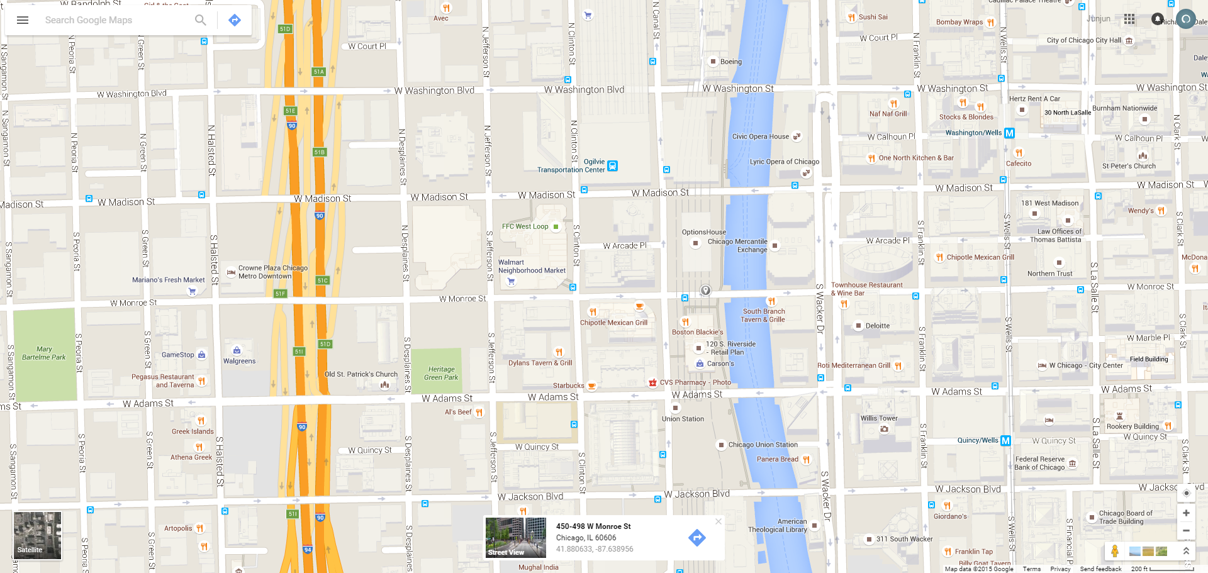
Pick up coordinates from Google Maps

