Slide 1
Taming Big Geospatial Data with Hadoop re-visit
Dr. Junjun Yin
CyberGIS Center for Advanced Digital and Spatial Studies
Department of Geography and Geographic Information Science
National Center for Supercomputing Applications (NCSA)
University of Illinois at Urbana-Champaign, IL, 61801
jyn@illinois.edu
February 23, 2016

Slide 2
Apache Pig
Notes:
Pig was created at Yahoo. To make it easier to analyze the data in your HDFS without the complexities of writing a traditional Mapreduce program.
Pig abstract away these complexities.
Internally it creates a sequence of MapReduce jobs,

Slide 3
Basic Hadoop Commands
Check Hadoop directory
hdfs dfs -ls [/user/netID/folder]
hdfs dfs -ls folder
Make a Hadoop directory
hdfs dfs -mkdir folder
Copy data into HDFS
hdfs dfs -copyFromLocal local_file [path_in_HDFS]
Copy data from HDFS to local directory
hdfs dfs -getmerge file_in_HDFS path_in_local_directory
Delete files from HDFS
hdfs dfs -rm -r file_in_HDFS

Slide 4
What is Pig?
Pig provides an engine for executing data flows in parallel on Hadoop¹.
A scripting platform for processing and analyzing large data sets
Apache Pig allows Apache Hadoop users to write complex MapReduce transformations using a simple scripting language called Pig Latin.
Pig Latin includes operators for many of the traditional data operations (join, sort, filter, etc.), as well as the ability for users to develop their own functions for reading, processing, and writing data.
How Pig differs from MapReduce?
It can do early error checking (did the user try to add a string field to an integer field?) and optimizations (can these two grouping operations be combined?).
Pig Latin cost less to write and maintain than Java code for MapReduce.
Multiple operators are provided.
1. Gates, A. (2011). Programming Pig. " O'Reilly Media, Inc.".
Notes:
I am a pig. I let you play with the data from HDFS cages. I speak Pig Latin.
It includes a language, Pig Latin, for expressing these data flows.
Pig uses a high-level, SQL-like programming language named Pig Latin.
Multiple operators, particularly join, are not provided and must instead be written by the user.

Slide 5
Apache Pig Philosophy
The Apache Pig Project published founding philosophy for pig developers¹.
Pigs Eat Anything
Pig can process any data, structured or unstructured.
Pigs Live Anywhere
Pig is not just for Hadoop. Pig can run on any parallel data processing framework.
Pigs Are Domestic Animals
Pig is designed to be easily controlled and modified by its users.
Pigs Fly
Pig processes data quickly.
1. http://pig.apache.org/philosophy.html
Notes:
Pig can process unstructured data without a schema.
Pig is intended to be a language for parallel data processing. First implemented on Hadoop
Pig provide user defined functions.

Slide 6
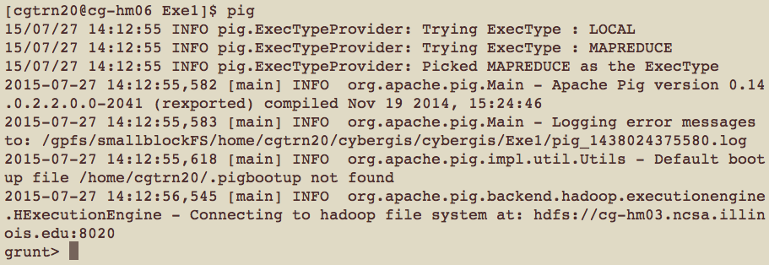
Pig Script and Grunt Shell
Pig Latin scripts can be executed by Pig script or Grunt shell
Pig script
Write a Pig Latin program in a text file and execute it using the pig command
Grunt shell
Grunt is Pig’s interactive shell. It enables users to enter Pig Latin interactively and provides a shell for users to interact with HDFS.
Notes:
To enter Grunt, invoke Pig with no script or command to run. Typing: pig

Slide 7
Pig’s Data Model
Pig’s data types are consisted of two categories:
Scalar types contain a single value
Complex types contain other types.
Scalar Types
Int, long, float, double, chararray (strings of Unicode characters), bytearray (a blob), boolean
Complex types
Map: Collection of key value pairs
[name#David,department#CyberGis,zip#61821]
Tuple: Ordered set of fields
(David,CyberGIS,61821) – Tuples are divided into fields.
Bag: Unordered collection of tuples
{(David,CyberGIS,61821), (Tom,Mathmatics,61820),
(Clair,Computer Science,61821) }
Notes:
Int: a 32-bit signed integer
Long: a 64-bit signed integer
Float: 32 bit floating-point number
Double:64 bit floating-point number

Slide 8
Pig Latin 1
Pig Latin is a dataflow language.
Each processing step results in a new data set, or relation.
input= LOAD ‘twitterdata.txt' USING PigStorage(',')
In input = LOAD ’ twitterdata.txt ', input is the name of the dataset in HDFS.
Case sensitive
Pig Latin cannot decide whether it is case-sensitive.
Keywords in Pig Latin are not case-sensitive (e.g., LOAD is identical to load)
Comments
SQL-style single-line comments (--) and Java-style multiline comments (/* */).
Pig Latin Reference Manual
http://pig.apache.org/docs/r0.7.0/piglatin_ref2.html

Slide 9
Pig Latin 2
LOAD
raw = LOAD 'cybergis/radiation.csv' USING PigStorage(',') AS (CapturedTime : chararray,Latitude:double,Longitude:double,Value:int,Unit:chararray);
Pig is very lenient in terms of schemas:
If you define a schema, then Pig will perform error-checking with it.
If you do not define a schema, Pig will make a best guess as to how the data should be treated
STORE
STORE result into 'heatmap_output';
The store command sends the output to a folder in HDFS.
DUMP
DUMP result;
The dump command directs the output of your script to your screen.
Notes:
Next, I would like to talk about frequently used operators.
Load/Store functions
Diagnostic operators
Dump is particularly useful during debugging and prototyping sessions.

Slide 10
Pig Latin 3
FILTER
step1 = FILTER step0 BY $4 MATCHES 'cpm’;
Use FILTER to select the rows you want or filter out the rows you do not want.
Select the rows by its fifth field (i.e., $4).
FOREACH…GENERATE
step4 = FOREACH step3 GENERATE $CapturedTime,$3,$4;
The FOREACH operator transforms your data into different data sets.
The FOREACH takes a set of expressions and applies them to every record in the data pipeline,
GROUP
step5_group = GROUP step5 BY (latkey,logkey);
The group statement collects together records with the same key.
LIMIT
L = LIMIT step5_group 10;
See only a limited number of results.
Notes:
Relational Operators

Slide 11
Preparing the data using Pig
ssh net_ID@roger-login.ncsa.Illinois.edu
ssh cg-hm08
cd ~/lecture6/pig
hdfs dfs -copyFromLocal tweets.txt [user/file_name]
The Pig script is located in:
cd ~/lecture6/pig
pig simple.pig

Slide 12
Pig script
raw = LOAD ‘input_file_name' USING PigStorage('\u0001') AS (tweetId,text:chararray,geo,source,isretweet,search_id,create_at,meta_data,to_user_id,language_code,user_id,profile_image_url,user_name,place_id,place_name,place_fullname,country,place_type,street_address,boundary,boundary_type,place_url);
clean = DISTINCT raw;
step0 = FILTER clean BY geo is not null AND geo != 'null' AND geo != '' AND isretweet == 'false' AND create_at is not null AND create_at != 'null' AND create_at != '';
step1 = FOREACH step0 GENERATE user_id, flatten(STRSPLIT(geo, ',')), REPLACE(REPLACE(create_at, 'CDT', '-05:00'), 'CST', '-06:00'), text;
-- $2 is longitude, $1 is latitude
step2 = FILTER step1 BY $2 > -167.276413 AND $2 < -56.347517 AND $1 > 5.499550 AND $1 < 82.296478;
step3 = FOREACH step2 GENERATE $0, $1, $2, $3;
STORE step3 INTO ‘output_filename' USING PigStorage(',');

Slide 13
Hadoop Streaming API
Notes:
Pig was created at Yahoo. To make it easier to analyze the data in your HDFS without the complexities of writing a traditional Mapreduce program.
Pig abstract away these complexities.
Internally it creates a sequence of MapReduce jobs,

Slide 14
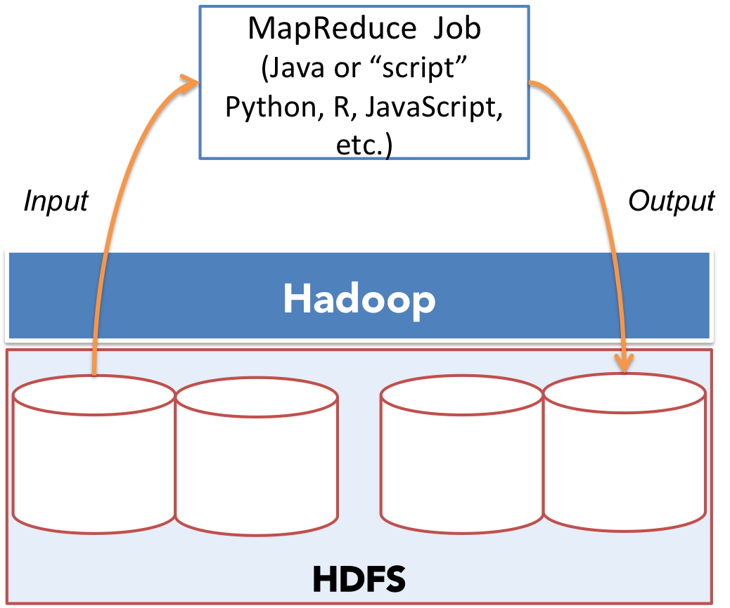
Delegation of Map and Reduce tasks

Slide 15
Example using Hadoop Streaming API
Summarize the frequency of words occurred in the constitution of United States of America
Code and data are stored in /gpfs_scratch/geog479/lecture6
Copy the folder to your home directory
cp -r /gpfs_scratch/geog479/lecture6 ~/
cd lecture6/word_count_hadoop_python
hdfs dfs –copyFromLocal const.txt

Slide 16
Mapper
#!/usr/bin/env python
import sys
### This is a great day (yes, a great day), but we are sitting inside doing coding.
for line in sys.stdin:
line = line.strip().replace('(','').replace(')','').replace(':','').replace('.','').replace(';','').replace(',','')
words = line.split()
#what does "word" look like
###remember, this is a mapper, the sole task is to prepare key and value pairs to reducer
for word in words:
print '%s,%s' % (word, 1)

Slide 17
Test the mapper
echo " This is a great day (yes, a great day), but we are sitting inside doing coding" | lecture6/word_count_hadoop_python/mapper.py
This,1
is,1
a,1
great,1
day,1
yes,1
of,1
course,1
but,1
we,1
are,1
sitting,1
inside,1
doing,1
coding,1

Slide 18
Reducer
For reducer, you can even choose other programing language other than Python
By default, reducer assumes they are operating on the same key
However, in Hadoop Streaming API, we have to determine whether the input to reducer belong to the same key.
Check out the reducer.py for details
Check out the reducer2.py for another implementation

Slide 19
Test the reducer
echo " This is a great day (yes, a great day), but we are sitting inside doing coding " | ~/lecture6/word_count_hadoop_python/mapper.py | ~/lecture6/word_count_hadoop_python/reducer.py
a,2
great,2
sitting,1
doing,1
inside,1
coding,1
we,1
but,1
This,1
are,1
yes,1
day,2
is,1

Slide 20
Run Hadoop Streaming Job
hadoop jar /usr/hdp/2.3.2.0-2602/hadoop-mapreduce/hadoop-streaming-2.7.1.2.3.2.0-2602.jar -file mapper.py -mapper mapper.py -file reducer.py -reducer reducer.py -input const.txt -output word_count.txt
or
hadoop jar /usr/hdp/2.3.2.0-2602/hadoop-mapreduce/hadoop-streaming-2.7.1.2.3.2.0-2602.jar -files word_count_hadoop_python -mapper “word_count_hadoop_python/mapper.py” -reducer “word_count_hadoop_python/reducer.py” -input const.txt -output word_count.txt

Slide 21
Quiz
How to check out the results?

Slide 22
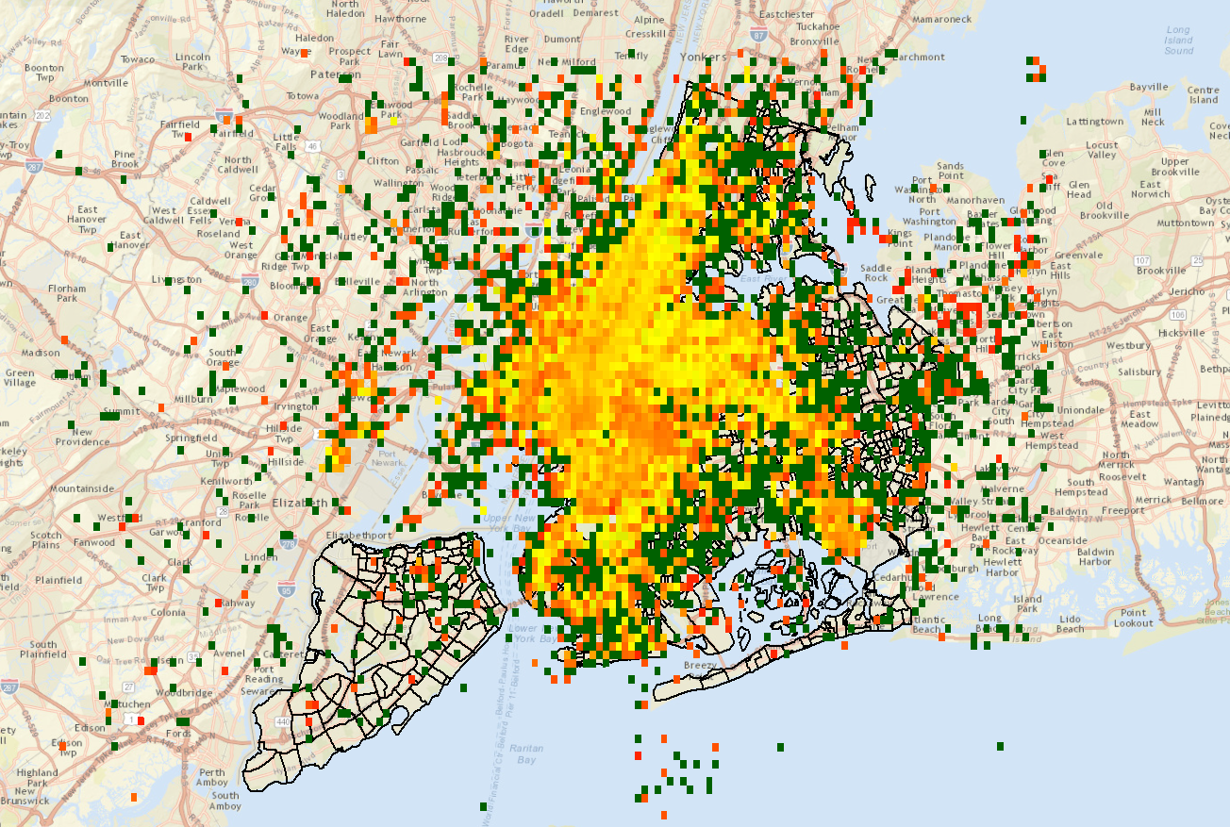
New York taxi pickup passenger density map

Slide 23
Taxi Data
January 2013 Taxi Trips from FOIA (Freedom of Information Act) request from Chris Whong
(http://www.andresmh.com/nyctaxitrips/)
Trip:
medallion, hack_license, vendor_id, rate_code, store_and_fwd_flag, pickup_datetime, dropoff_datetime, passenger_count, trip_time_in_secs, trip_distance, pickup_longitude, pickup_latitude, dropoff_longitude, dropoff_latitude Fare:
medallion, hack_license, vendor_id, pickup_datetime, payment_type, fare_amount,surcharge, mta_tax, tip_amount, tolls_amount, total_amount
Notes:
Explain code

Slide 24
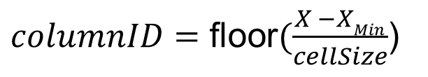
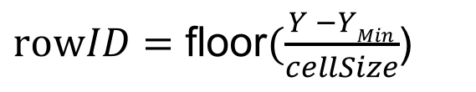
Find the cell number (index) that a point belongs to:
(X_{Min}, Y_{Max})
(xMax, Y_{Max})
[6,0]
[5,0]
[4,0]
[3,0]
[2,0] | [2,1] | [2,2]
[1,0] | [1,1] | [1,2]
[0,0] | [0,1] | [0,2] | [0,3] | [0,4] | [0,5]
$columnID=\text{floor}(\frac{X −XMin}{cellSize}$)
$rowID=\text{floor}(\frac{Y −YMin}{cellSize}$)
(X_{Min}, Y_{Min})
(X_{Max}, Y_{Min})

Slide 25
Implementation
First, let’s be aware that we are designing a MapReduce program
What should the Mapper do?
What is the key now?
And what is the value to the key?
What should the Reducer do?
If they belong to the same key, what would you do
Notes:
Explain code

