Slide 1
Big data analysis with R
Myeong-Hun Jeong
CyberGIS Center for Advanced Digital and Spatial Studies
National Center for Supercomputing Applications (NCSA)
University of Illinois at Urbana-Champaign
mhjeong@illinois.edu
March, 15, 2016

Slide 2
Contents
Unit 1: What is R?
Exercise 1: Setup working environment
Unit 2: Scaling up R computation
R and Hadoop
Parallel R
Labs:
Lab 1: Implementing a word count problem with RHadoop
Lab 2: Parallel spatial analysis -- Parallel spatial autocorrelation analysis (Moran’s I)

Slide 3
Unit 1: What is R?
“R is a free software environment for statistical computing and graphics. It compiles and runs on a wide variety of UNIX platforms, Windows and MacOS.”
https://www.r-project.org
Available from The Comprehensive R Archive Network
http://cran.r-project.org/mirrors.html
Origin and History
Initially written by Ross Ihaka and Robert Gentleman at Department of Statistics of University of Auckland, New Zealand during 1990s.
International project since 1997
Open source with GPL license
Free to anyone
In actively development

Slide 4
How to work with R
Downloading and installing R
Go to the R CRAN website (http://www.r-project.org/), and click on the download R link (http://cran.r-project.org/mirrors.html)
Downloading and installing Rstudio
To write an R script, one can use R Console, R commander, or any text editor (EMACS, VIM, or sublime)
However, the assistance of RStudio, an integrated development environment (IDE) for R, can make development a lot easier.
Access RStudio's official site by using the following URL: http://www.rstudio.com/products/RStudio/.

Slide 5
How to work with R
R as a calculator
> 4 + 1 - 2 #add and subtract
[1] 3
Assignments
> x <- 8 #The object (variable) x holds the value 8
> x
[1] 8
Executing functions
> print(x) #print() is a function. It prints its argument, x.
[1] 8
>ls() #lists the objects in memory
[1] “x”
>rm(x) #remove x from memory
>ls() #no objects in memory, therefore:
character(0)

Slide 6
How to work with R
Basic data structures
Vector: An ordered collection of data of the same type
> x <- 0: 5
>x
[1] 0 1 2 3 4
Matrix: A rectangular table of data of the same type
> mdat <- matrix(c(1,2,3, 11,12,13), nrow = 2, ncol = 3)
List: An ordered collection of data of arbitrary types.
>person = list(name=“Matt”, age=30, married=F)
>person$name
[1] “Matt”
Plots
> plot(x <- sort(rnorm(47)), type = "l", main = "plot(x, type = \"s\")")
Help
Help(plot)
Installing packages
> install.packages(Stats) #This package contains functions for statistical calculations and random number generation.

Slide 7
Unit 2: Scaling up R computation
R’s limitation to large-scale data analysis¹
It’s single-threaded
The R language has on explicit constructs for parallelism, such as threads. An out-of-the-box R install cannot take advantage of multiple CPUs.
It’s memory-bound
R requires that your entire dataset fit in memory (RAM). Four gigabytes of RAM will not hold eight gigabytes of data, no matter how much you smile when you ask.
Solution:
Spreading work across multiple CPUs overcomes R’s single-threaded nature.
Offloading work to multiple machines reaps the multi-process benefit and also addresses R’s memory barrier.
1. McCallum, Q. E. and Weston S. (2012). Parallel R. O’Reilly Media, Inc. 2011

Slide 8
Scaling up R computation
What to do if the computation is too big for a single desktop?
Using automatically offloading with multicore/GPU.
HiPLAR (High Performance Linear Algebra in R): use the latest multi-core and GPU libraries to give substantial speed-ups to existing linear algebra functions in R.
Advantage:
No code changes needed
User can run R solution as before without knowledge of the parallel execution.
Limitations:
Only support limited computational operations.
Break big computation with multiple job submission
Running R in non-interactive session
Rhadoop and SparkR packages
Advantage:
Utilize efficiency of other data intensive processing framework
Each job can use existing R code
Limitations:
A “data-parallel” solution that may not suitable for simulation based analysis

Slide 9
Scaling up R computation
What to do if the computation is too big for a single desktop?
Implement code using parallel packages.
Parallel packages: snow, parallel, or foreach
Advantage:
Do whatever you want with them
Get the best performance
Limitations:
Need code development
In some case, the analysis workflow may need be changed.

Slide 10
Exercise 1: R and Hadoop
Objective:
Preparing the RHadoop environment
Installing rmr2
Installing rhdfs
Operating HDFS with rhdfs

Slide 11
Preparing the RHadoop environment
RHadoop is a collection of R packages that enables users to process and analyze big data with Hadoop.
https://github.com/RevolutionAnalytics/RHadoop/wiki
In RHadoop, there are five main packages, which are:
rmr: This is an interface between R and Hadoop MapReduce, which calls the Hadoop streaming MapReduce API to perform MapReduce jobs across Hadoop clusters.
Rhdfs: This is an interface between R and HDFS, which calls the HDFS API to access the data stored in HDFS
Rhbase: You can use rhbase to read/write data and manipulate tables stored within HBase.
Plyrmr: This is a higher-level abstraction of MapReduce, which allows users to perform common data manipulation in a plyr-like syntax.
Ravro: This allows users to read avro files in R, or write avro files.

Slide 12
Installing rmr2
Install dependent packages before installing rmr2
Start R
> install.packages(c("codetools", "Rcpp", "RJSONIO", "bitops", "digest", "functional", "stringr", "plyr", "reshape2", "rJava", "caTools"))
>q()
Download rmr-3.3.1
$ wget --no-check-certificate https://github.com/RevolutionAnalytics/rmr2/releases/download/3.3.1/rmr2_3.3.1.tar.gz
Install rmr-3.3.1
$R CMD INSTALL rmr2_3.3.1.tar.gz
$R
>library(rmr2)
Set up bashrc
vi .bashrc
export R_LIBS=/home/user_name/R
Exit after saving the change

Slide 13
Installing rhdfs
Download rhdfs 1.0.8 from GitHub.Start
$ wget --no-check-certificate https://github.com/RevolutionAnalytics/rhdfs/blob/master/build/rhdfs_1.0.8.tar.gz?raw=true
Install rhdfs under the command-line mode:
$ HADOOP_CMD=/usr/bin/hadoop R CMD INSTALL rhdfs_1.0.8.tar.gz?raw=true
$R
> Sys.setenv(HADOOP_CMD="/usr/bin/hadoop")
> Sys.setenv(HADOOP_STREAMING="/usr/hdp/2.3.2.0-2602/hadoop-mapreduce/hadoop-streaming-2.7.1.2.3.2.0-2602.jar")
> library(rhdfs)
> hdfs.init()

Slide 14
Operating HDFS with rhdfs
Initialize the rhdfs package:
$R
> Sys.setenv(HADOOP_CMD="/usr/bin/hadoop")
> Sys.setenv(HADOOP_STREAMING="/usr/hdp/2.3.2.0-2602/hadoop-mapreduce/hadoop-streaming-2.7.1.2.3.2.0-2602.jar")
> library(rhdfs)
> hdfs.init()
Manipulating files stored on HDFS, as follows:
dfs.put: Copy a file from the local filesystem to HDFS:
>hdfs.put('word.txt', './')
hdfs.ls: Read the list of directory from HDFS:
> hdfs.ls('./')
hdfs.copy: Copy a file from one HDFS directory to another:
> hdfs.copy('word.txt', 'wordcnt.txt')
hdfs.move : Move a file from one HDFS directory to another:
> hdfs.move('wordcnt.txt', './data/wordcnt.txt')
hdfs.delete: Delete an HDFS directory from R:
> hdfs.delete('./data/')
hdfs.get: Download a file from HDFS to a local filesystem:
> hdfs.get(word.txt', '/home/user_name/word.txt’)

Slide 15
Exercise 2: Running R with parallel packages
Objective:
Run R with a couple of parallel packages.
Investigate resource pressures between serial and parallel approaches.

Slide 16
Serial version of R code
To run myProc() 10 times using apply
ptm <- proc.time()
#sapply converts results into a vector or array of appropriate size
result <- sapply(1:10, function(i) myProc())
proc.time() – ptm
=> user system elapsed
14.929 0.232 35.179
myProc function
#Define a simple R function
myProc <- function(size=10000000) {
#Load a large vector
vec <- rnorm(size)
#Now sleep on it
Sys.sleep(2)
#Now sum the vec values
return(sum(vec))
}

Slide 17
Running R with parallel packages
Parallel: mclapply
The parallel package provides several methods for parallelizing your work.
'mclapply' can only used for single-node parallelism.
require(parallel)
ptm <- proc.time()
result <- mclapply(1:10, function(i) myProc(), mc.cores=10)
proc.time() – ptm
=> user system elapsed
0.012 0.025 4.616

Slide 18
Running R with parallel packages
Snow
SNOW uses either MPI or socket based connections to achieve parallelism.
This means it can use cores on both the local and remote nodes.
require(snow)
#Create a cluster object
hostnames <- rep('localhost', 10)
cluster <- makeSOCKcluster(hostnames)
#Assigns the values on the master of the variables named in list to variables of the same names in the global environments of each node.
clusterExport(cluster, list('myProc'))
ptm <- proc.time()
#Call function on the first cluster node with arguments seq[[1]] and ..., on the second node with seq[[2]] and ..., and so on. If the length of seq is greater than the number of nodes in the cluster then cluster nodes are recycled.
result <- clusterApply(cluster, 1:10, function(i) myProc())
proc.time() - ptm
=> user system elapsed
0.006 0.001 4.053
#To shut down the cluster
stopCluster(cluster)

Slide 19
Running R with parallel packages
Snow: Load balancing with clusterApplyLB
clusterApplyLB is a load balancing version of clusterApply.
Instead scheduling tasks in a round-robin fashion, it sends new tasks to the cluster worker as they complete their previous task.
clusterApply() pushes tasks to the workers, while clusterApplyLB() lets the workers pull tasks as needed.
require(snow)
#Create a cluster object
hostnames <- rep('localhost', 4)
cluster <- makeSOCKcluster(hostnames)
#15 observations, mean = 15, sd = 15
sleeptime <- abs(rnorm(15,15,15))
#snow.time collects and returns timing information for cluster usage
tm <- snow.time(clusterApplyLB(cluster,sleeptime,Sys.sleep))
plot(tm)
stopCluster(cluster)

Slide 20
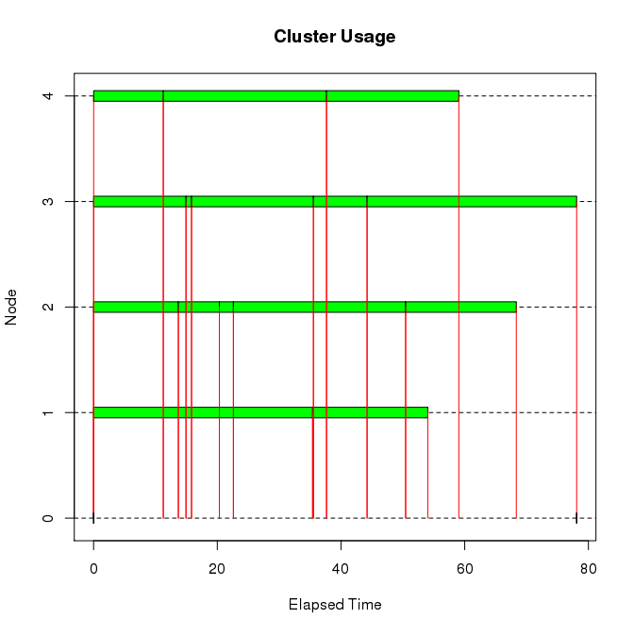
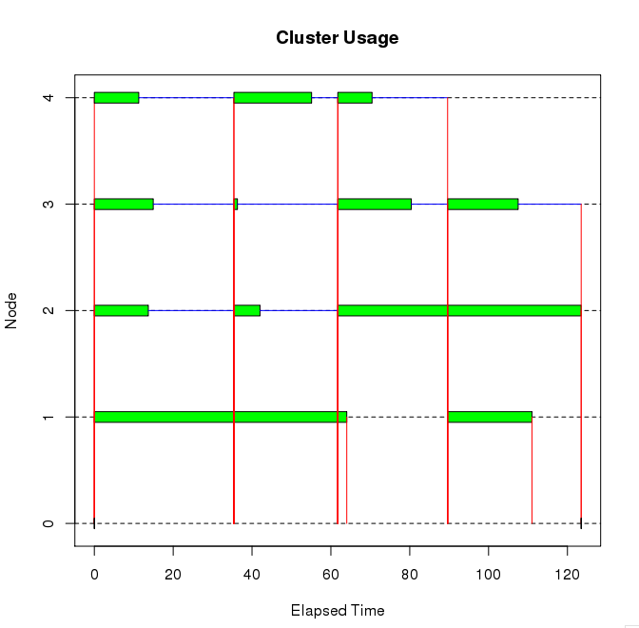
Running R with parallel packages
Snow: Load balancing with clusterApplyLB
clusterApplyLB() is much efficient than clusterApply() in this example: 78 seconds for clusterApplyLB(), and 120 seconds for clusterApply()
clusterApplyLB()
clusterApply()

Slide 21
Running R with parallel packages
foreach + snow
'foreach' is a package that makes parallelization easier.
'foreach' uses other parallel functions under the hood, but hides some of the complexity.
require(foreach)
require(doSNOW)
hostnames <- rep('localhost', 10)
cluster <- makeSOCKcluster(hostnames)
#register the SNOW parallel backend with the foreach package.
registerDoSNOW(cluster)
ptm <- proc.time()
#'c' is useful for concatenating the results into a vector.
result <- foreach(i=1:10, .combine=c) %dopar% {
myProc()
}
proc.time() - ptm
user system elapsed
0.023 0.010 4.983
stopCluster(cluster)

Slide 22
Running R with parallel packages
Executing snow programs on a cluster with Rmpi
require(Rmpi)
require(snow)
# Initialize SNOW using MPI communication.
cluster <- makeCluster(8, type="MPI")
# Compute row sums in parallel using all processes, then a grand sum at the end on the master process
parallelSum <- function(m, n)
{
A <- matrix(rnorm(m*n), nrow = m, ncol = n)
row.sums <- parApply(cluster, A, 1, sum)
print(sum(row.sums))
}
parallelSum(500, 500)
stopCluster(cluster)
mpi.exit()

Slide 23
Running R with parallel packages
foreach + snow for multi-nodes
Set up environmental setting (Before setting the environmental variable, you must quit R)
vim ~/.bashrc
Put the information to load module R and then save the file
module load R
Assign the number of nodes.
qsub -I -l nodes=2 #The -I option tells qsub you want to run an interactive job on the compute nodes.
Start R
require(foreach)
require(doSNOW)
#Get backend hostnames
nodelist <- Sys.getenv("PBS_NODEFILE")
hostnames <- scan(nodelist, what="", sep="\n")
#Set reps to match core count'
num.cores <- 10
hostnames <- rep(hostnames, each=num.cores)
hostnames
cluster <- makeSOCKcluster(hostnames)
registerDoSNOW(cluster)
ptm <- proc.time()
result <- foreach(i=1:100, .combine=c) %dopar% {
myProc()
}
proc.time() - ptm
stopCluster(cluster)

Slide 24
Running R with parallel packages
Bootstrap calculations.
Serial implementation.
random.data <- matrix(rnorm(1000000), ncol = 1000)
bmed <- function(d, n) median(d[n])
library(boot)
sapply(1:100, function(n) {sd(boot(random.data[, n], bmed, R = 10000)$t)})
=> user system elapsed
103.305 0.828 224.822
Parallel implementation
require(foreach)
require(doSNOW)
cluster = makeCluster(10, type = "SOCK")
clusterExport(cluster, c("random.data", "bmed"))
results = foreach(n = 1:100, .combine = c) %dopar% {
library(boot); sd(boot(random.data[, n], bmed, R = 10000)$t)
}
stopCluster(cluster)
user system elapsed
0.340 0.069 21.037

Slide 25
Lab: Parallel spatial analysis
A large and growing number of libraries for handling spatial data in R have been developed.
spdep package
A collection of functions to create spatial weights matrix objects from polygon contiguities, from point patterns by distance and tessellations, for summarizing these objects, and for permitting their use in spatial data analysis.
https://cran.r-project.org/web/packages/spdep/index.html
Spatial package
Functions for kriging and point pattern analysis.
https://cran.r-project.org/web/packages/spatial/index.html
GISTools package
Mapping and spatial data manipulation tools.
https://cran.r-project.org/web/packages/GISTools/index.html

Slide 26
Parallel spatial analysis
maptools package
Set of tools for manipulating and reading geographic data.
https://cran.r-project.org/web/packages/maptools/index.html
sp package
A package that provide classes and methods for spatial data;
https://cran.r-project.org/web/packages/sp/index.html
There are more available spatial packages. However, these packages are not available for parallel computations.
Notes:
Spatial autocorrelation is a descriptive statistic for spatially referenced attributed data.
Many statistical test and models are based on the assumption that each observation in a set of measurements is distributed independently of the others.
This common assumption is frequently untrue for spatial data.

Slide 27
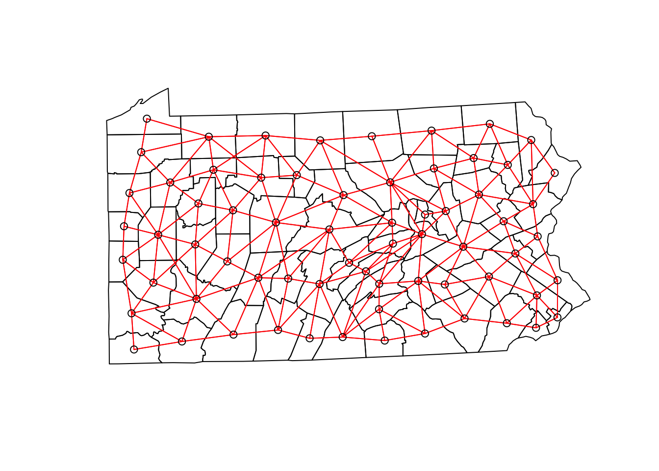
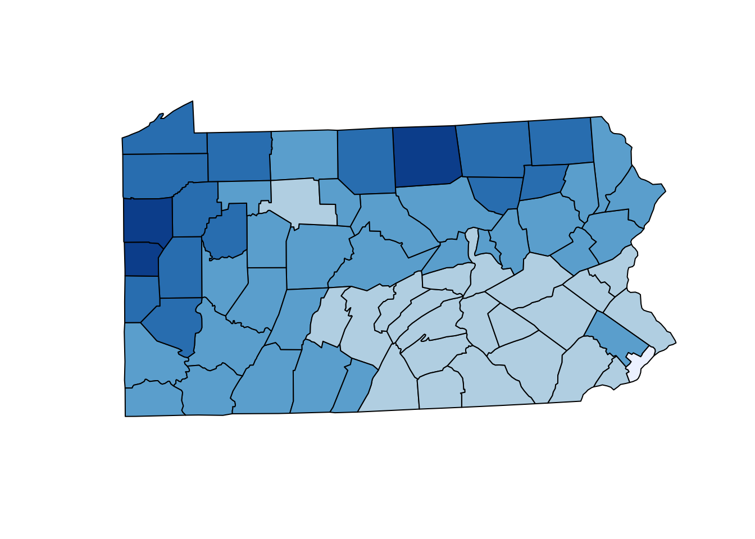
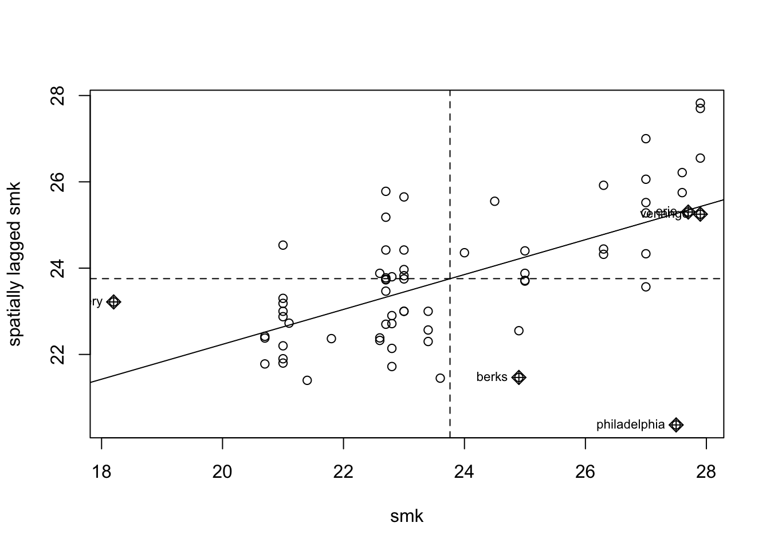
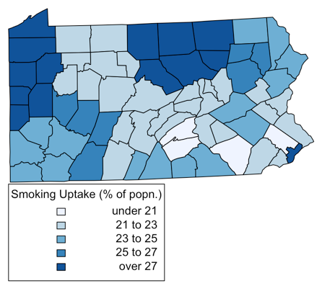
Example 3: Parallel spatial autocorrelation
Spatial autocorrelation
The extent to which points that are “close together” in space have similar values, on average (e.g., Is there a spatial pattern?).
Pennsylvania smoking rates
The figure shows smoking uptake based on the percentage of population
some degree of correlation between nearby observations.
Notes:
Spatial lagged means of smoking uptake rates (right figure)
The lagged mean is a weighted combination of values of the neighbors.
When nearby polygons tend to have similar Z_i values, there should be a linear trend in the plots.
If each Z_i is independent, the plots will show no pattern.

Slide 28
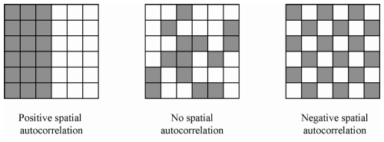
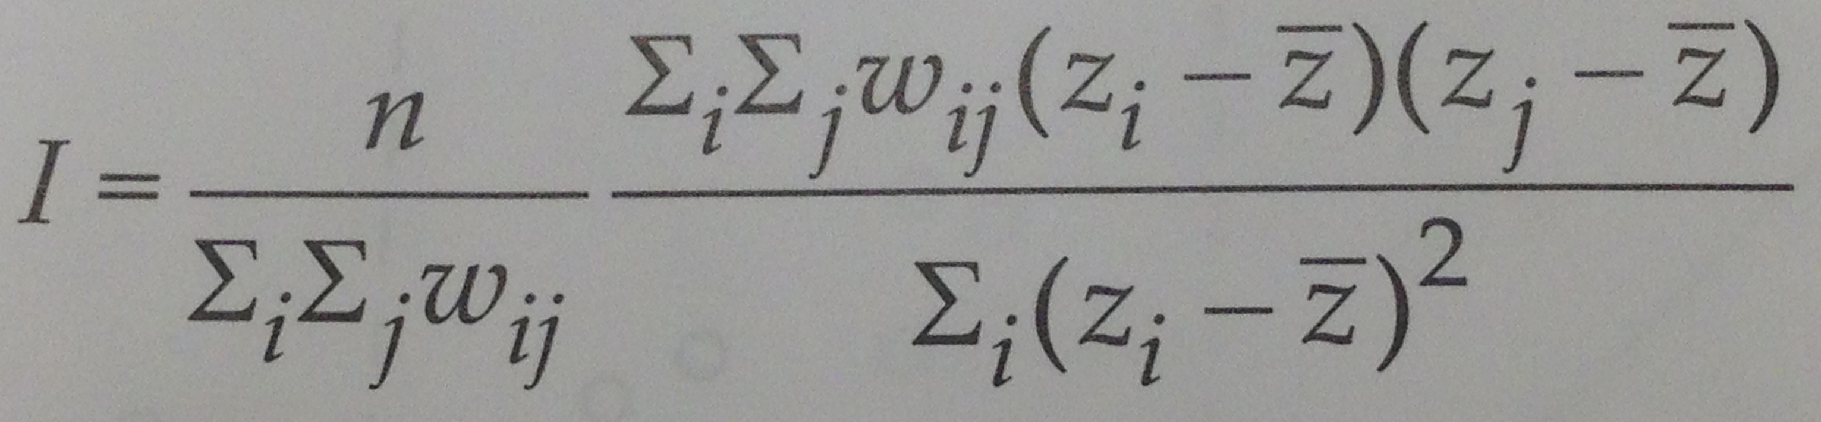
Example 3: Parallel spatial autocorrelation
Moran’s I is an index of autocorrelation¹.
Where w_ij is the (i,j)th element of a weights matrix W, specifying the degree of dependency between i and j.
n is the number of observations.
Z_{i} –\bar Z indicates deviations from mean.
Large values of I suggest that there is a stronger relationship between nearby z_{i} values. Furthermore, I may be negative in some circumstances – suggesting that there can be a degree of inverse correlation between nearby z_{i} values.
The range of Moran’s I is [-1, 1] – this interval can shrink or expands.
Anselin, L. (1995). Local indicators of spatial association-LISA. Geographical analysis, 27(2), 93-115.

Slide 29
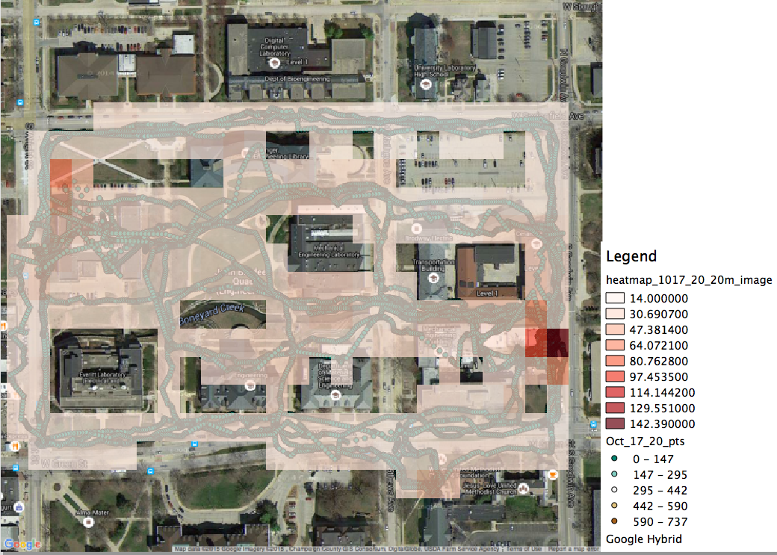
Example : Radiation spatial pattern
Radiation measurements on UIUC campus.
Acknowledgement of data use
Prof. Clair, the department of NPRE shares her group data for the CyberGIS workshop.
Notes:
Advantage
Do whatever you want with them
Get the best performance
Limitations
Need code development
In some case, the analysis workflow may need be changed.

