Slide 1

lanyard.
Remember everyone you meet.
SCAN TO CONNECT
ON THE DEMO
Yinjun Shao
UCL · CLAUDE BUILDERS CLUB HACKATHON

Slide 2
THE PROBLEM
Students meet constantly - and forget almost all of it.
1
2
3
The name
The context
The handles
A great conversation, then “sorry, remind me your name?” the next time you bump into them.
You can’t place where you met and what they do, which makes following up feel awkward.
Wasting time sharing your social handles with each other.
Typos in usernames
Follow requests left on read
The network is there in the room. The memory isn’t.
lanyard
02

Slide 3
WHAT IT IS
Lanyard is a living profile card students exchange with one scan or a 4-character code.
Living card
QR or 4-char code
Name, university, course & year, age, tagline, what people can come to you for, about, and every social link.
Show your code; they scan or type it. Both cards land in each other’s networks instantly.
The hello note
A photo together
A per-person note baked into the QR — “we met at the Claude Builders Hackathon” — so the context survives.
Snap a shared selfie the moment you meet; it’s attached to both cards as the visual memory.
lanyard
04

Slide 4
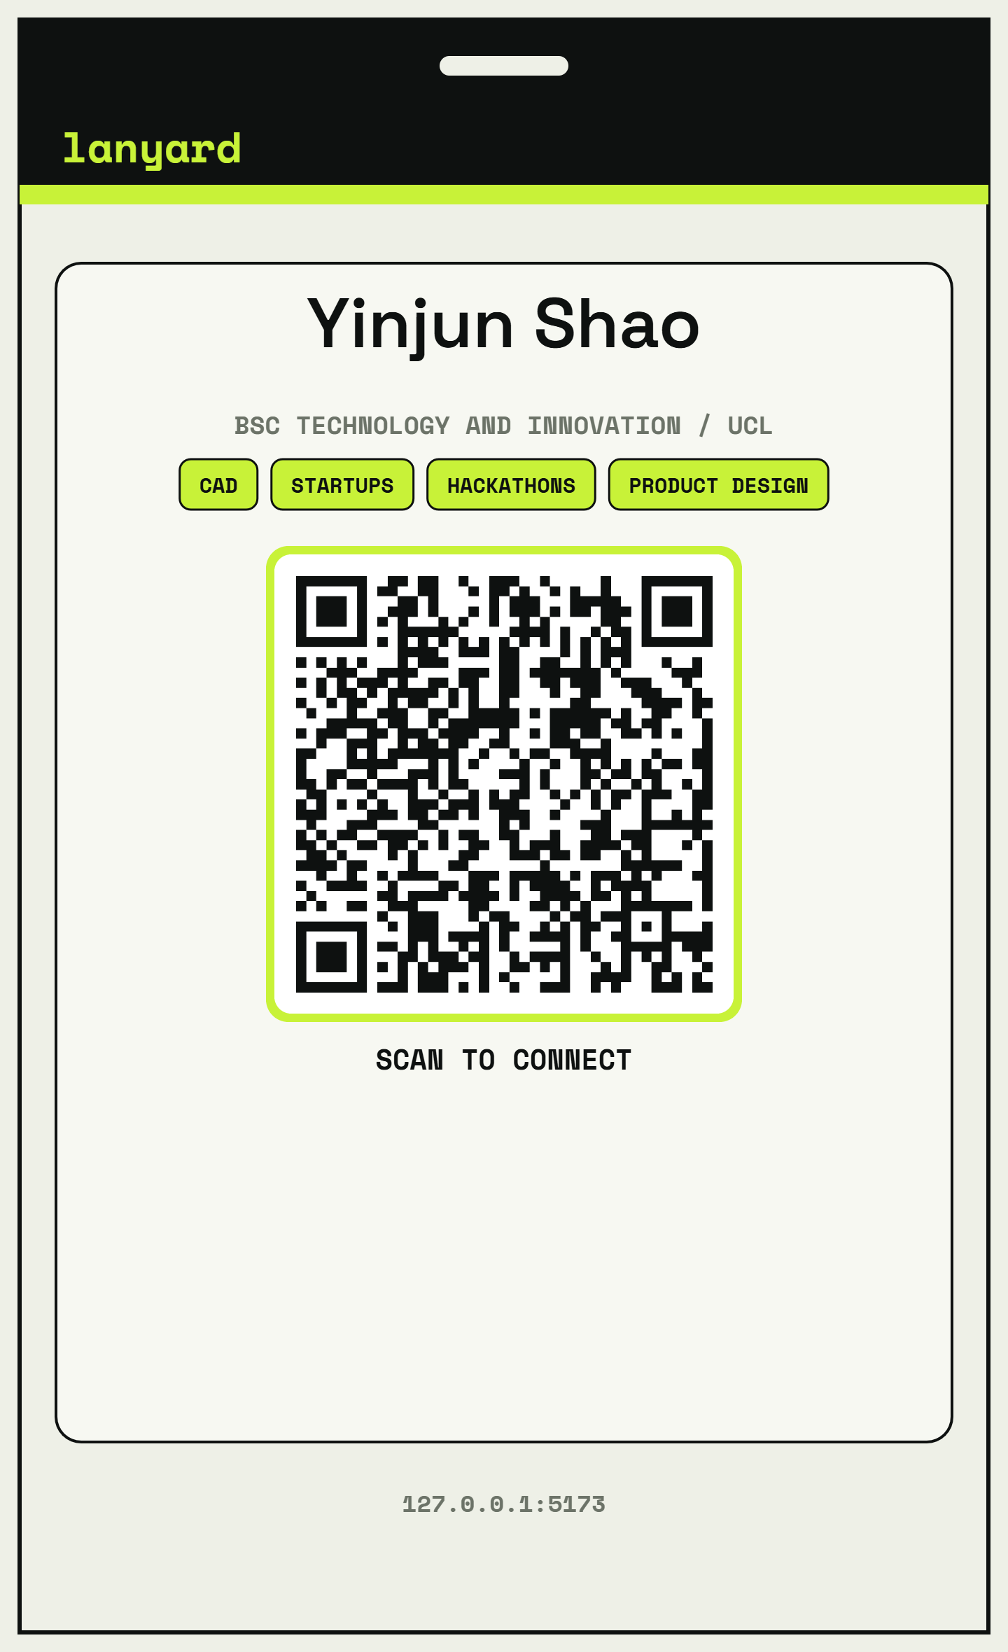
THE CARD
Everything a contact app should have — built for a student.
Name
What people can come to me for
University
About me
Course / degree
Hello note (per person)
Year of study
LinkedIn · GitHub · Portfolio · Instagram
Age
Email
One-line tagline
A photo together
lanyard
05

Slide 5
HOW IT WORKS
Four seconds. Both networks updated.
01
→
02
→
03
→
04
Show
Scan / type
Note + photo
Saved
Open your pass, the QR and 4-char code are right there.
They scan with their camera or enter the code in Swap.
The hello note rides in the QR; optionally snap a selfie.
Both cards, the note and the photo land in each other’s network.
Works over plain HTTPS - cellular, guest Wi-Fi, anywhere. No pairing friction.
lanyard
06

Slide 6
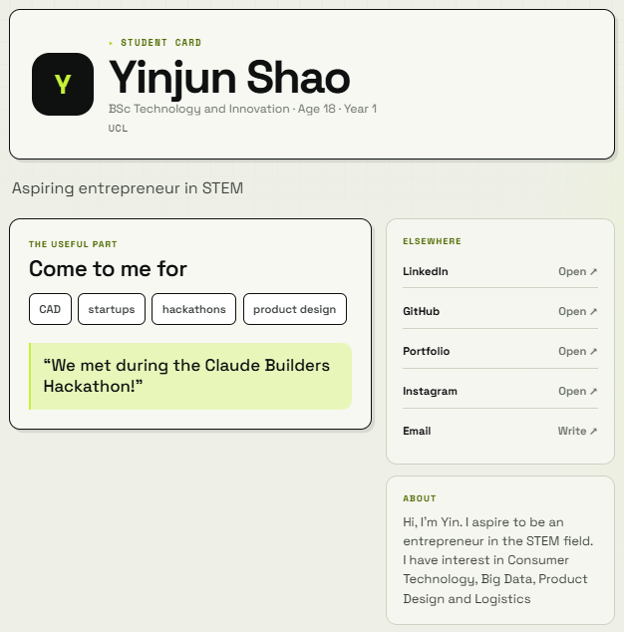
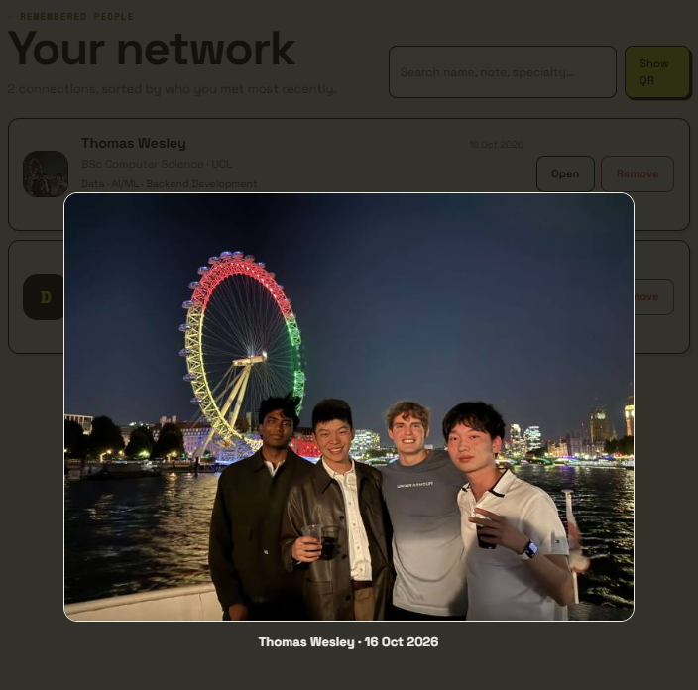
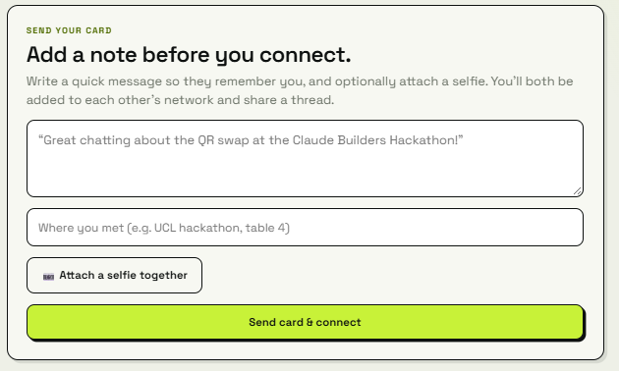
WHY IT STICKS
We don’t just store a link; we store the reason you’d message them.
The together photo
The hello note
Different for every person you show. Embedded in the QR itself, so a passive lock-screen code still carries where you met.
A shared JPEG attached to both connection cards, the fastest way to remember someone and helps you connect the face to the name.
lanyard
07

Slide 7
TECHNOLOGY USED
A real, deployed product - near-zero cost, no app to install.
1
4
STACK
VUE 3 + VITE
CLOUDFLARE WORKERS
scan to exchange a full card
characters to join without a camera
CLOUDFLARE KV
CLIENT-SIDE QR
WEBRTC-FREE HTTPS RELAY
CLAUDE FOLLOW-UPS
0
~2 s
Free tier comfortably covers a campus-scale demo: 100k KV reads / day.
apps to install — runs in the browser
to a reciprocal connection
lanyard
08

Slide 8
From “nice to meet you”
to actually meeting again.
lanyard turns every campus encounter into a card, a note and a face — so the people you meet become the network you keep.
SCAN TO TRY
TRY IT - SCAN OR ENTER THE CODE LIVE
lanyard

