Slide 1
R 語言套件 分享 - dplyr
Microsoft Student Partners 12th
Ian Hsu 徐英愷
2017 / 10 / 25

Slide 2
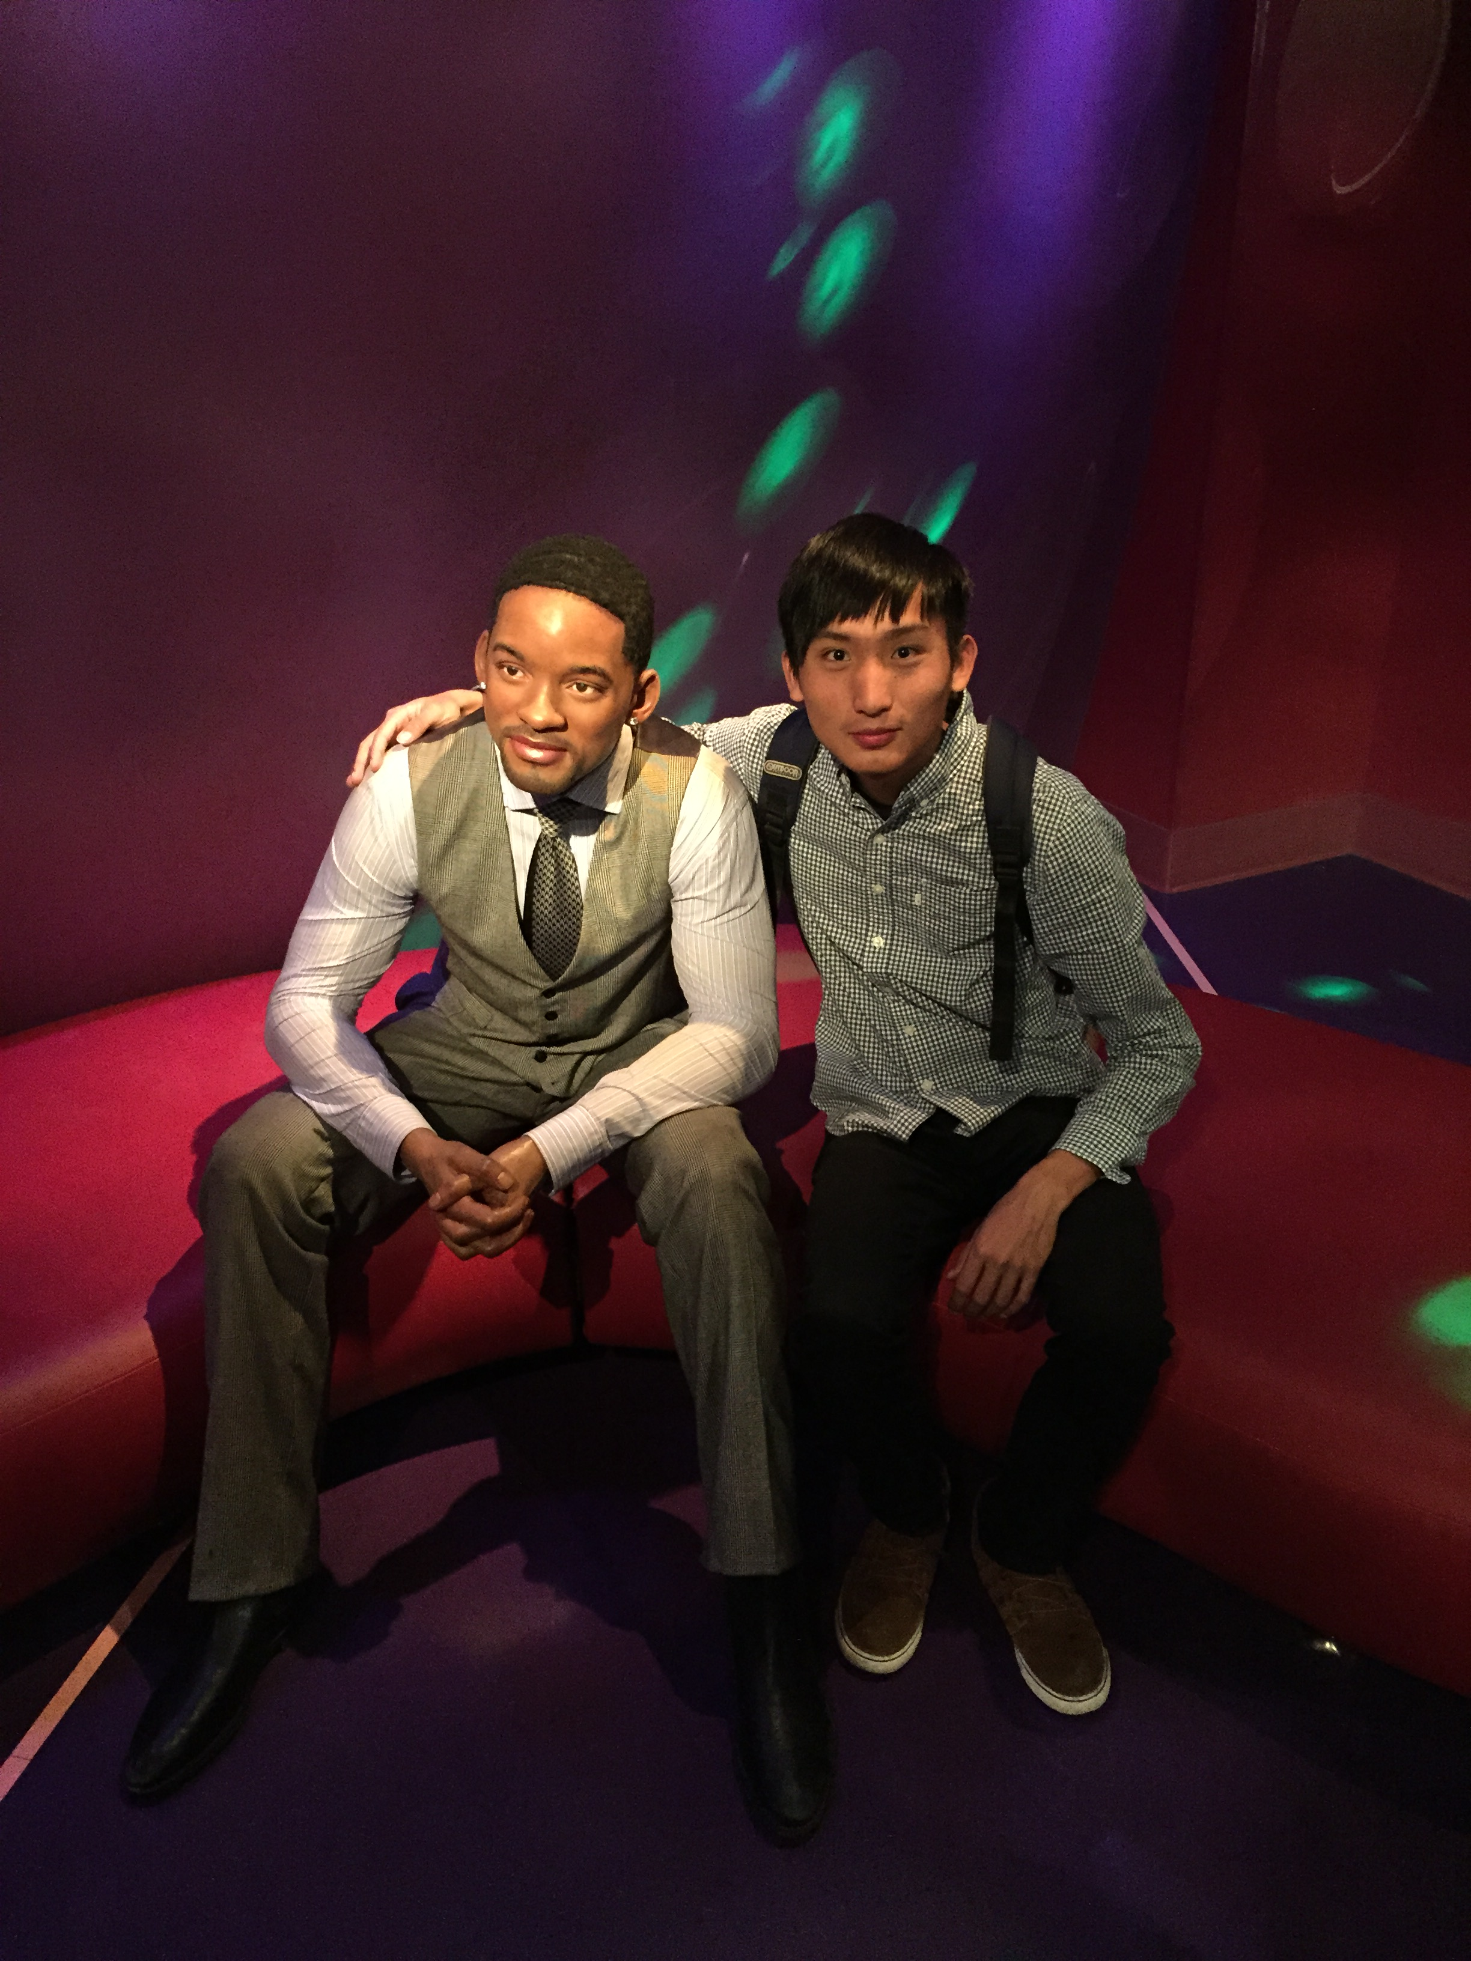
Self introduction
Ian Hsu 徐英愷
National Cheng Kung University
Department of Transportation and Communication Management Science
Credit Program of Big Data Analytics
Data Analysis Projects
Health Insurance Database in Taiwan
Database of Electronic Toll Collection on Freeway
Microsoft Student Partners 12th

Slide 3
Motivation of this share
Data preprocessing takes 50-80% of your time in data analysis.
Goal of Data Preprocessing
Make data suitable to use with a particular piece of software (i.e. R, Python)
Reveal important information
Extract variables to analyze

Slide 4
Introduction of R package dplyr
Author of R package dplyr: Hadley Wickham
Functions are easy to understand
Similar to SQL query
select, filter, mutate, arrange, group_by, summarise, ……
Build under c++
Compile faster with high efficiency
Support many database connection

Slide 5
Dataset used
Lahman Database (Baseball Data)
The Lahman database contains pitching, hitting, and fielding statistics for Major League Baseball from 1871 through 2016. It includes data from the two current leagues (American and National), the four other ”major” leagues (American Association, Union Association, Players League, and Federal League), and the National Association of 1871-1875.
Variables
Output: Salary of batters in 2016
Input: Information about batters and their teams in 2015

Slide 6
tbl_df
tbl_Salaries <- tbl_df(Salaries)
tbl_Salaries
Salaries
# A tibble: 26,428 x 5
yearID teamID lgID playerID salary
<int> <fctr> <fctr> <chr> <int>
1985 ATL NL barkele01 870000
1985 ATL NL bedrost01 550000
1985 ATL NL benedbr01 545000
1985 ATL NL campri01 633333
1985 ATL NL ceronri01 625000
1985 ATL NL chambch01 800000
1985 ATL NL dedmoje01 150000
1985 ATL NL forstte01 483333
1985 ATL NL garbege01 772000
1985 ATL NL harpete01 250000
# ... with 26,418 more rows
yearID teamID lgID playerID salary
1985 ATL NL barkele01 870000
1985 ATL NL bedrost01 550000
1985 ATL NL benedbr01 545000
1985 ATL NL campri01 633333
1985 ATL NL ceronri01 625000
1985 ATL NL chambch01 800000
1985 ATL NL dedmoje01 150000
1985 ATL NL forstte01 483333
1985 ATL NL garbege01 772000
1985 ATL NL harpete01 250000
…
…
[ reached getOption("max.print") -- omitted 26228 rows ]

Slide 7
select
select(tbl_Salaries, yearID, playerID, salary)
tbl_Salaries
# A tibble: 26,428 x 3
yearID playerID salary
<int> <chr> <int>
1985 barkele01 870000
1985 bedrost01 550000
1985 benedbr01 545000
1985 campri01 633333
1985 ceronri01 625000
1985 chambch01 800000
1985 dedmoje01 150000
1985 forstte01 483333
1985 garbege01 772000
1985 harpete01 250000
# ... with 26,418 more rows
# A tibble: 26,428 x 5
yearID teamID lgID playerID salary
<int> <fctr> <fctr> <chr> <int>
1985 ATL NL barkele01 870000
1985 ATL NL bedrost01 550000
1985 ATL NL benedbr01 545000
1985 ATL NL campri01 633333
1985 ATL NL ceronri01 625000
1985 ATL NL chambch01 800000
1985 ATL NL dedmoje01 150000
1985 ATL NL forstte01 483333
1985 ATL NL garbege01 772000
1985 ATL NL harpete01 250000
# ... with 26,418 more rows

Slide 8
filter
filter(tbl_Salaries, yearID == 2016)
tbl_Salaries
# A tibble: 853 x 5
yearID teamID lgID playerID salary
<int> <fctr> <fctr> <chr> <int>
2016 ARI NL ahmedni01 521600
2016 ARI NL barreja01 507500
2016 ARI NL brachsi01 509300
2016 ARI NL britoso01 508500
2016 ARI NL castiwe01 3700000
2016 ARI NL chafian01 519700
2016 ARI NL clippty01 6100000
2016 ARI NL corbipa01 2525000
2016 ARI NL delarru01 2350000
2016 ARI NL delgara01 1275000 # ... with 843 more rows
# A tibble: 26,428 x 5
yearID teamID lgID playerID salary
<int> <fctr> <fctr> <chr> <int>
1985 ATL NL barkele01 870000
1985 ATL NL bedrost01 550000
1985 ATL NL benedbr01 545000
1985 ATL NL campri01 633333
1985 ATL NL ceronri01 625000
1985 ATL NL chambch01 800000
1985 ATL NL dedmoje01 150000
1985 ATL NL forstte01 483333
1985 ATL NL garbege01 772000
1985 ATL NL harpete01 250000
# ... with 26,418 more rows

Slide 9
mutate
mutate(tbl_Salaries, salary = salary / 10000)
tbl_Salaries
# A tibble: 26,428 x 5
yearID teamID lgID playerID salary
<int> <fctr> <fctr> <chr> <dbl>
1985 ATL NL barkele01 87.0000
1985 ATL NL bedrost01 55.0000
1985 ATL NL benedbr01 54.5000
1985 ATL NL campri01 63.3333
1985 ATL NL ceronri01 62.5000
1985 ATL NL chambch01 80.0000
1985 ATL NL dedmoje01 15.0000
1985 ATL NL forstte01 48.3333
1985 ATL NL garbege01 77.2000
1985 ATL NL harpete01 25.0000
# ... with 26,418 more rows
# A tibble: 26,428 x 5
yearID teamID lgID playerID salary
<int> <fctr> <fctr> <chr> <int>
1985 ATL NL barkele01 870000
1985 ATL NL bedrost01 550000
1985 ATL NL benedbr01 545000
1985 ATL NL campri01 633333
1985 ATL NL ceronri01 625000
1985 ATL NL chambch01 800000
1985 ATL NL dedmoje01 150000
1985 ATL NL forstte01 483333
1985 ATL NL garbege01 772000
1985 ATL NL harpete01 250000
# ... with 26,418 more rows

Slide 10
arrange
arrange(tbl_Salaries, desc(salary))
tbl_Salaries
# A tibble: 26,428 x 5
yearID teamID lgID playerID salary
<int> <fctr> <fctr> <chr> <int>
2009 NYA AL rodrial01 33000000
2010 NYA AL rodrial01 33000000
2016 LAD NL kershcl01 33000000
2015 LAN NL kershcl01 32571000
2011 NYA AL rodrial01 32000000
2016 ARI NL greinza01 31799030
2012 NYA AL rodrial01 30000000
2016 BOS AL priceda01 30000000
2013 NYA AL rodrial01 29000000
2008 NYA AL rodrial01 28000000
# ... with 26,418 more rows
# A tibble: 26,428 x 5
yearID teamID lgID playerID salary
<int> <fctr> <fctr> <chr> <int>
1985 ATL NL barkele01 870000
1985 ATL NL bedrost01 550000
1985 ATL NL benedbr01 545000
1985 ATL NL campri01 633333
1985 ATL NL ceronri01 625000
1985 ATL NL chambch01 800000
1985 ATL NL dedmoje01 150000
1985 ATL NL forstte01 483333
1985 ATL NL garbege01 772000
1985 ATL NL harpete01 250000
# ... with 26,418 more rows

Slide 11
summarise
summarise(tbl_Salaries, m_salary = mean(salary), N = n())
tbl_Salaries
# A tibble: 1 x 2
m_salary N
<dbl> <int>
2085634 26428
# A tibble: 26,428 x 5
yearID teamID lgID playerID salary
<int> <fctr> <fctr> <chr> <int>
1985 ATL NL barkele01 870000
1985 ATL NL bedrost01 550000
1985 ATL NL benedbr01 545000
1985 ATL NL campri01 633333
1985 ATL NL ceronri01 625000
1985 ATL NL chambch01 800000
1985 ATL NL dedmoje01 150000
1985 ATL NL forstte01 483333
1985 ATL NL garbege01 772000
1985 ATL NL harpete01 250000
# ... with 26,418 more rows

Slide 12
group_by + summarise
summarise(group_by(tbl_Salaries, teamID), m_salary = mean(salary),
N = n())
tbl_Salaries
# A tibble: 46 x 3
teamID m_salary N
<fctr> <dbl> <int>
ANA 1895109.2 247
ARI 2521796.5 539
ATL 2211176.3 915
BAL 2028838.6 940
BOS 2968591.2 944
CAL 739073.2 368
CHA 2099929.1 863
CHC 5312678.2 29
CHN 2255379.7 876
CHW 4519946.7 25
# ... with 36 more rows
# A tibble: 26,428 x 5
yearID teamID lgID playerID salary
<int> <fctr> <fctr> <chr> <int>
1985 ATL NL barkele01 870000
1985 ATL NL bedrost01 550000
1985 ATL NL benedbr01 545000
1985 ATL NL campri01 633333
1985 ATL NL ceronri01 625000
1985 ATL NL chambch01 800000
1985 ATL NL dedmoje01 150000
1985 ATL NL forstte01 483333
1985 ATL NL garbege01 772000
1985 ATL NL harpete01 250000
# ... with 26,418 more rows

Slide 13
The pipe operator %>%
tbl_Salaries %>% select(yearID, playerID, salary)
tbl_Salaries
# A tibble: 26,428 x 3
yearID playerID salary
<int> <chr> <int>
1985 barkele01 870000
1985 bedrost01 550000
1985 benedbr01 545000
1985 campri01 633333
1985 ceronri01 625000
1985 chambch01 800000
1985 dedmoje01 150000
1985 forstte01 483333
1985 garbege01 772000
1985 harpete01 250000
# ... with 26,418 more rows
# A tibble: 26,428 x 5
yearID teamID lgID playerID salary
<int> <fctr> <fctr> <chr> <int>
1985 ATL NL barkele01 870000
1985 ATL NL bedrost01 550000
1985 ATL NL benedbr01 545000
1985 ATL NL campri01 633333
1985 ATL NL ceronri01 625000
1985 ATL NL chambch01 800000
1985 ATL NL dedmoje01 150000
1985 ATL NL forstte01 483333
1985 ATL NL garbege01 772000
1985 ATL NL harpete01 250000
# ... with 26,418 more rows

Slide 14
The pipe operator %>% (cont.)
tbl_Salaries %>%
filter(yearID == 2016) %>%
mutate(salary = salary / 10000) %>%
group_by(teamID) %>%
summarise(m_salary = mean(salary),
N = n()) %>%
arrange(desc(m_salary))
# A tibble: 30 x 3
teamID m_salary N
<fctr> <dbl> <int>
NYY 768.9579 29
SFG 689.0151 25
BOS 650.1578 29
LAD 632.2525 35
DET 628.6338 31
TEX 607.0301 29
BAL 558.1498 29
WSN 544.8179 26
CHC 531.2678 29
LAA 527.8897 26
# ... with 20 more rows

Slide 15
left_join, right_join, inner_join
Left Join
left_join(data_1, data_2, by = c("Variable 4", “Variable 5"))
Variable 1 | Variable 2 | Variable 3 | Variable 4 | Variable 5
Variable 4 | Variable 5 | Variable 6 | Variable 7 | Variable 8
A
A
B
NA NA NA
NA NA NA
NA NA NA
NA NA NA
C

Slide 16
left_join, right_join, inner_join (cont.)
Right Join
right_join(data_1, data_2, by = c("Variable 4", “Variable 5"))
Variable 1 | Variable 2 | Variable 3 | Variable 4 | Variable 5
Variable 4 | Variable 5 | Variable 6 | Variable 7 | Variable 8
A
A
NA NA NA
NA NA NA
NA NA NA
NA NA NA
B
C

Slide 17
left_join, right_join, inner_join (cont.)
Inner Join
inner_join(data_1, data_2, by = c("Variable 4", “Variable 5"))
Variable 1 | Variable 2 | Variable 3 | Variable 4 | Variable 5
Variable 4 | Variable 5 | Variable 6 | Variable 7 | Variable 8
A
A
B
C

Slide 18
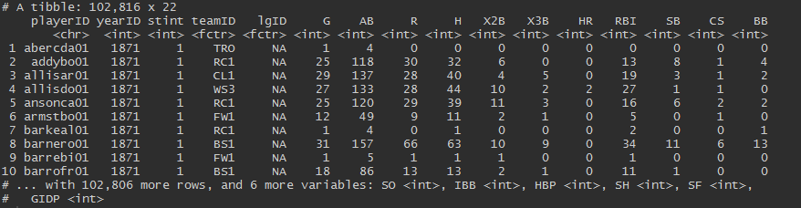
Dataset of Batting in Lahman
tbl_Batting <- tbl_df(Batting)
tbl_Batting

Slide 19
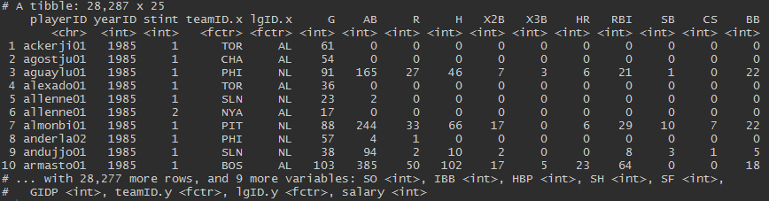
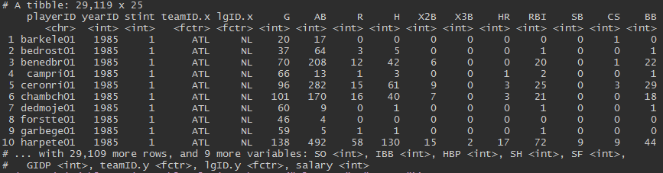
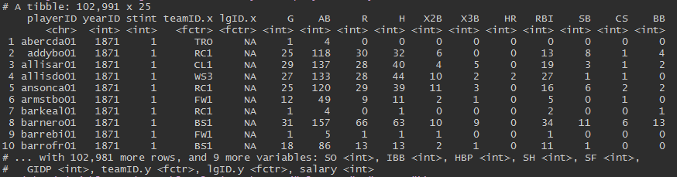
left_join, right_join, inner_join (cont.)
left_join(tbl_Batting, tbl_Salaries, by = c("playerID", "yearID"))
right_join(tbl_Batting, tbl_Salaries, by = c("playerID", "yearID"))
inner_join(tbl_Batting, tbl_Salaries, by = c("playerID", "yearID"))

Slide 20
Demo – dplyr in R
(Short Link: https://aka.ms/ianmspgit)

Slide 21
Demo - AML Studio
(Short Link: https://aka.ms/ianamlgallery)

Slide 22
Learn more
Manual of dplyr package - The R Project for Statistical Computing
https://cran.r-project.org/web/packages/dplyr/dplyr.pdf
Cheat sheet of dplyr package - Rstudio
https://www.rstudio.com/wp-content/uploads/2015/02/data-wrangling-cheatsheet.pdf
Introduction to Statistical Learning
http://www-bcf.usc.edu/~gareth/ISL/
Elements of Statistical Learning: data mining, inference, and prediction
https://web.stanford.edu/~hastie/ElemStatLearn/
Facebook Page: Microsoft Student Partners in Taiwan 微軟學生大使 – MSP
https://www.facebook.com/MSPTaiwan/

Slide 23
Q & A
(https://github.com/yinkaihsu/MSP-Lecture-R-Introduction)

Slide 24
Thank you for coming!

