Slide 1
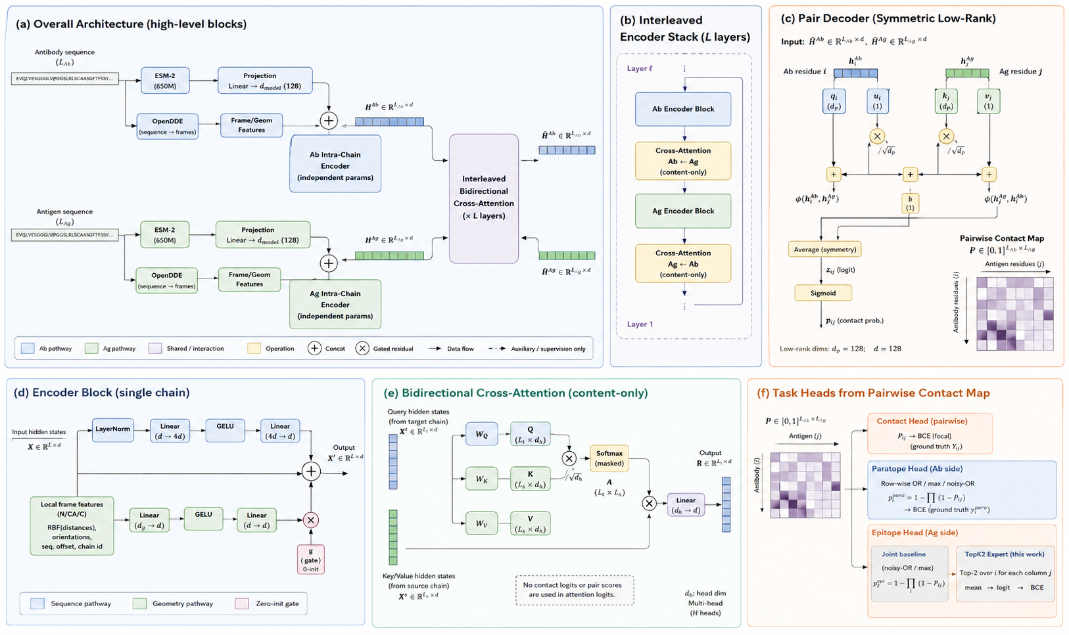

Slide 2
(a) Overall Architecture (high-level blocks)
(b) Interleaved
Encoder Stack (L layers)
(c) Pair Decoder (Symmetric Low-Rank)
Ĥ^Ab ∈ R^(L_ab × d)
Input: Ĥ^Ab ∈ R^(L_ab × d) Ĥ^Ag ∈ R^(L_ag × d)
Antibody sequence
(L_ab)
ESM-2
(650M)
Projection
Linear → d_model (128)
h_i^Ab
h_j^Ag
EVQLVESGGGLVQPGGSLR...
H^Ab ∈ R^(L_ab × d)
Layer ℓ
⋮
Ab residue i
Ag residue j
+
Ab Encoder Block
q_i
(d_p)
u_i
(1)
k_j
(d_p)
v_j
(1)
OpenDDE
(sequence → frames)
Frame/Geom
Features
Ab Intra-Chain
Encoder
(independent params)
Interleaved
Bidirectional
Cross-Attention
(× L layers)
×
Cross-Attention
Ab ← Ag
(content-only)
/√d_p
+
+
+
Ag Encoder Block
b
(1)
Antigen sequence
(L_ag)
φ(h_i^Ab, h_j^Ag)
φ(h_j^Ag, h_i^Ab)
MKTIILASYIFCLVFADY...
ESM-2
(650M)
Projection
Linear → d_model (128)
+
H^Ag ∈ R^(L_ag × d)
Cross-Attention
Ag ← Ab
(content-only)
Average (symmetry)
Pairwise Contact Map
P ∈ [0,1]^(L_ab × L_ag)
OpenDDE
(sequence → frames)
Frame/Geom
Features
Ĥ^Ag ∈ R^(L_ag × d)
Antigen residues (j)
Ag Intra-Chain
Encoder
(independent params)
⋮
z_ij (logit)
Antibody residues (i)
Sigmoid
Layer 1
p_ij (contact prob.)
Ab pathway
Ag pathway
Shared / interaction
Operation
+
Concat
×
Gated residual
Data flow
Auxiliary / supervision only
Low-rank dims: d_p = 128; d = 128
(d) Encoder Block (single chain)
(e) Bidirectional Cross-Attention (content-only)
(f) Task Heads from Pairwise Contact Map
LayerNorm
Linear
(d → 4d)
GELU
Linear
(4d → d)
Query hidden states
(from target chain)
X^t ∈ R^(L_t × d)
Output
R ∈ R^(L_t × d)
P ∈ [0,1]^(L_ab × L_ag)
Contact Head (pairwise)
P_ij → BCE (focal)
(ground truth Y_ij)
Input hidden states
X ∈ R^(L × d)
W_Q
Q
(L_t × d_h)
Antigen (j)
Output
X′ ∈ R^(L × d)
Softmax
(masked)
+
W_K
K
(L_s × d_h)
×
Antibody (i)
Paratope Head (Ab side)
Row-wise OR / max / noisy-OR
p_i^para = 1 − ∏(1 − P_ij)
→ BCE (ground truth y^para)
Local frame features
(N/CA/C)
RBF distances,
orientations,
seq. offset, chain id
/√d_h
Linear
(d_g → d)
GELU
Linear
(d → d)
×
A
(L_t × L_s)
Key/Value hidden states
(from source chain)
X^s ∈ R^(L_s × d)
W_V
V
(L_s × d_h)
×
g
(gate)
0-init
Linear
(d_h → d)
Epitope Head (Ag side)
No contact logits or pair scores
are used in attention logits.
d_h: head dim
Multi-head
(H heads)
Joint baseline
(noisy-OR / max)
p_j^epi = 1 − ∏(1 − P_ij)
TopK2 Expert (this work)
Top-2 over i for each column j
mean → logit → BCE
Sequence pathway
Geometry pathway
Zero-init gate
Notes:
Sources:
- Reference image supplied by the user in this conversation. Rebuilt as native PowerPoint shapes; the PNG was not used as a slide background.
- unflatten-ppt workflow reference: https://github.com/Feng-Y-28/unflatten-ppt (consulted for editable-PPT reconstruction principles: inspect, reconstruct with native objects, export/compare/iterate).

Slide 3
FrameContact: factorized intra-chain encoding, partner exchange, and routed heads
Symmetric Low-Rank Pair Decoder
φ(x,y) = q(x)ᵀk(y)/√dₚ + u(x) + v(y) + b
zᵢⱼ = ½[φ(hᵢᴬᵇ,hⱼᴬᵍ) + φ(hⱼᴬᵍ,hᵢᴬᵇ)]
pᵢⱼ = σ(zᵢⱼ), dₚ = 128
Antibody sequence $$(L_{ab})$$
PLM cache
ESM-2 650M
1280d → 128d
EVQLVESGGGLVQPGGSLR...
Interleaved
Partner
Exchange
Block
× 2
Predicted backbone
N / CA / C cache
Pair probabilities pᵣ
Antigen residues (j)
SEQUENCE-ONLY DEPLOYMENT INPUT
• PLM residue embeddings
• chain-internal predicted N/CA/C
• no cross-partner coordinates or true distances
• no contact labels as model input
Antigen sequence $$(L_{ag})$$
PLM cache
ESM-2 650M
1280d → 128d
$${\hat{H}}^{ab}∈R^{(L_{ab}d)}$$
Final Symmetric
Low-Rank
Pair Decoder
MKTIILASYIFCLVFADY...
Predicted backbone
N / CA / C cache
Antibody residues (i)
$${\hat{H}}^{ag}∈R^{(L_{ag}d)}$$
Interleaved Geometry-Aware Partner-Exchange Block ℓ ∈ {1, 2}
Seed-matched fixed router r ∈ {17, 29, 43}
contact + paratope ← Jᵣ | epitope ← Eᵣ
Factorized Intra-Chain Encoder
(two parameter-unshared copies run in parallel: Ab and Ag)
Stage Pair Decoder
Simultaneous Bidirectional
Partner Exchange
CONTACT · Jᵣ Pairwise output: Pᶜᵢⱼ = σ(zᴶᵢⱼ)
Dense Sequence Self-Attention
LN → QKV + RoPE → global MHA
residual → LN → SiLU FFN
H̃ᴬᵇ , H̃ᴬᵍ
Cross-Attention Ab ← Ag
content-only MHA + zero-init residual gate
Hˡ⁻¹
PLM
state
Zero-Gated
Fusion
H̃ = H_dense
+ tanh(g_geo)
·(H_local − H_in)
g_geo = 0 init
PARATOPE · Jᵣ direct Ab node logit + tanh(gₚ) · masked LMEⱼ(zᴶᵢⱼ) → sigmoid
Shared Symmetric
Low-Rank Pair Decoder
→ zᵢⱼ⁽ˡ⁾
Local Geometry-Biased Self-Attention
N/CA/C → frames; RBF + direction + rotation
QK/√dₕ + b_geo on same-chain spatial graph
residual → LN → SiLU FFN
Cross-Attention Ag ← Ab
content-only MHA + zero-init residual gate
stage logits are retained;
λ_contact = 0 in the frozen
content-only cross-attention
EPITOPE · Eᵣ for each Ag residue j: Top-2 valid σ(zᴱᵢⱼ) → mean → clip → logit
Hᴬᵇ,ˡ and Hᴬᵍ,ˡ
→ next block / final decoder
Notes:
[Sources]
- Local architecture authority: framecontact/src/interaction_first/framecontact.py
- Local geometry attention authority: framecontact/src/interaction_first/intra_chain_geometry.py
- Frozen task-routing authority: remote_tools/multitask_topk2_training_v1/source/src/interaction_first/framecontact.py
[/Sources]

