Slide 1
A Library to Manage Web Archive Files in Cloud Storage

Slide 2
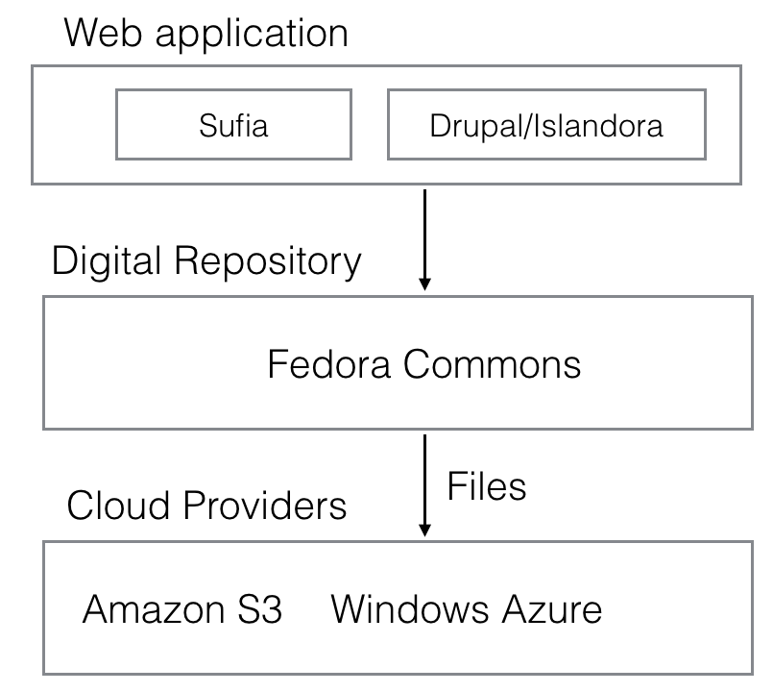
Project Description

Slide 3
fedora-cloud-tool
GitHub: https://github.com/yinlinchen/wadl

Slide 4
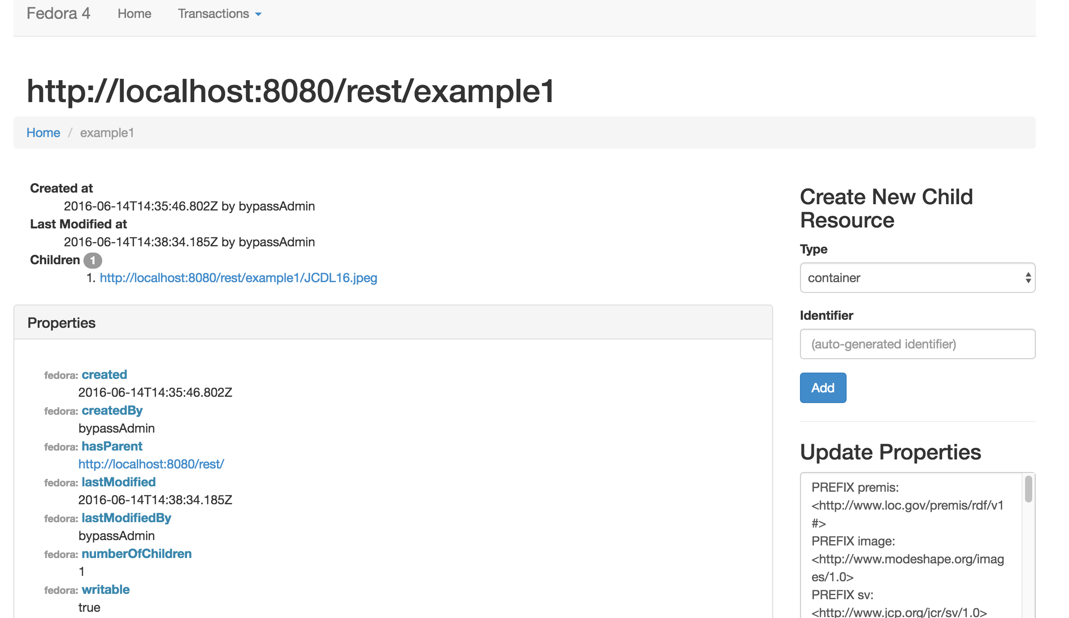

Slide 5
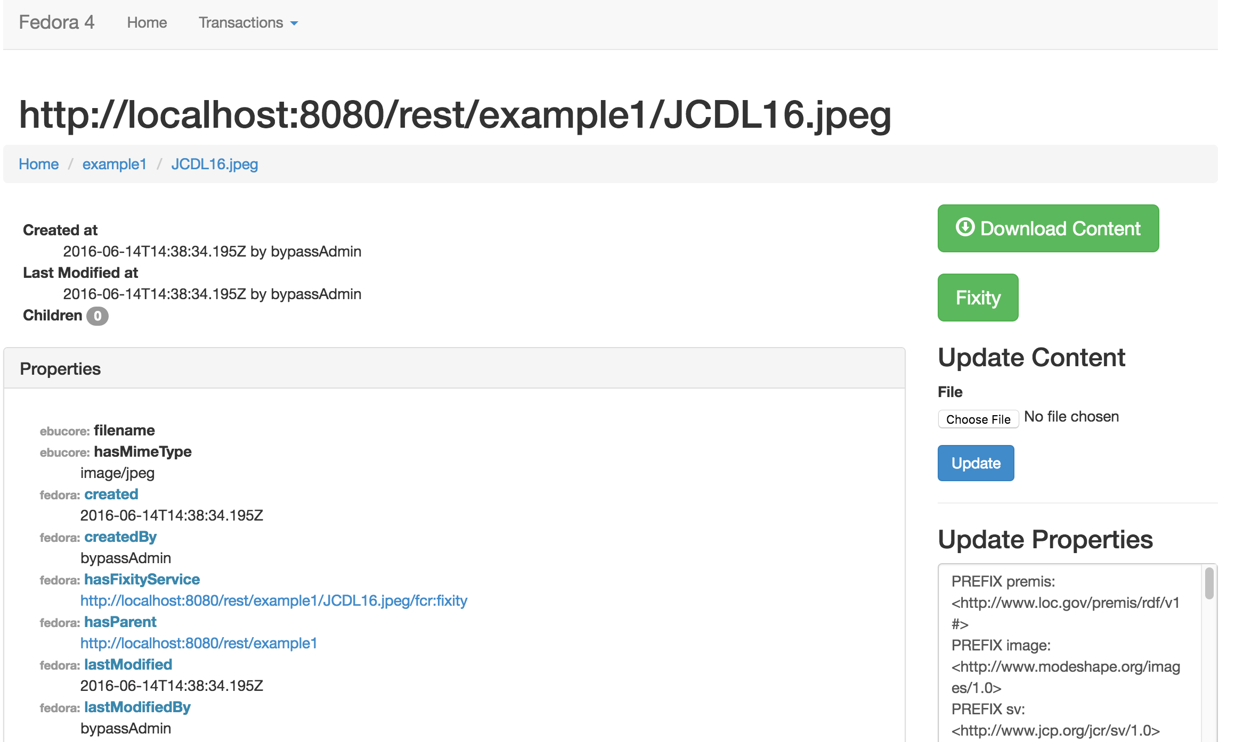

Slide 6
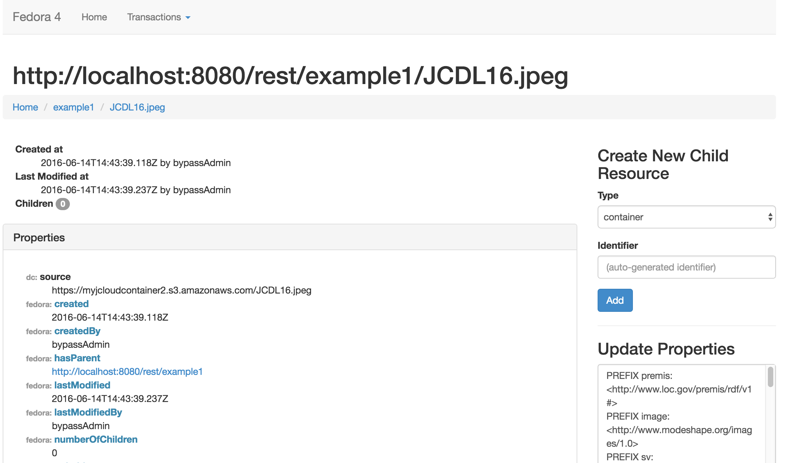
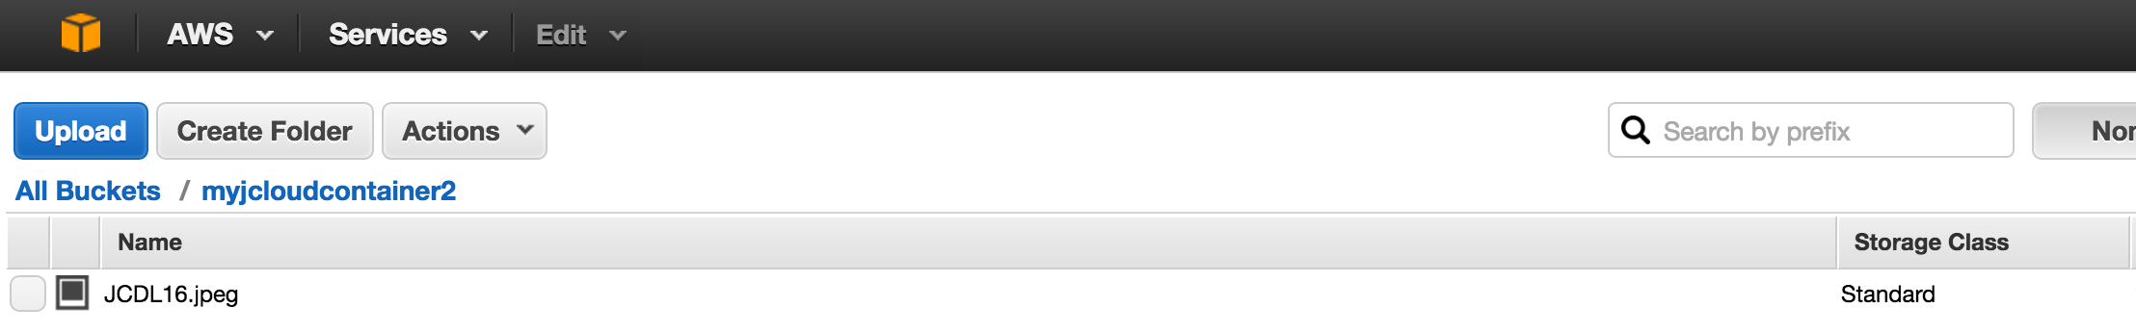

Slide 7
Thank You
SIGIR Student Travel Grant
Amazon AWS Research Grant
University Libraries, Virginia Tech
Computer Science, Virginia Tech

