Slide 1
A Library to Manage Web Archive Files in Cloud Storage
WADL 2016, 22 June 2016, Rutgers U., Newark, NJ
Yinlin Chen, Zhiwu Xie, and Edward A. Fox
Department of Computer Science, University Libraries
Virginia Tech, Blacksburg, VA 24061

Slide 2
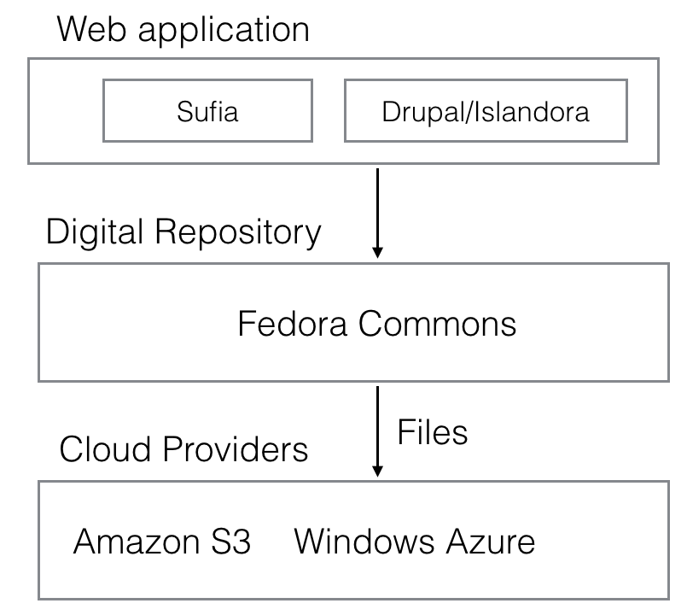
Introduction
Amazon S3
。。。。
Azure

Slide 3
Project Description
AWS – S3
AWS – S3
AWS – EC2
Fedora
fedora-cloud-tool
(Whole system)
FUSE
(Mount
filesystem)
(Individual
files)
Fedora
Fedora

Slide 4
fedora-cloud-tool
GitHub: https://github.com/yinlinchen/wadl
Source code: fedora-cloud-tool
$ cd fedora-cloud-tool
$ mvn clean install
Example: Move file: Fedora to S3; Restore from S3 to Fedora

Slide 5


Thank You
University Libraries, Virginia Tech
Computer Science, Virginia Tech
SIGIR Student Travel Grant
Amazon AWS Research Grant

Slide 6
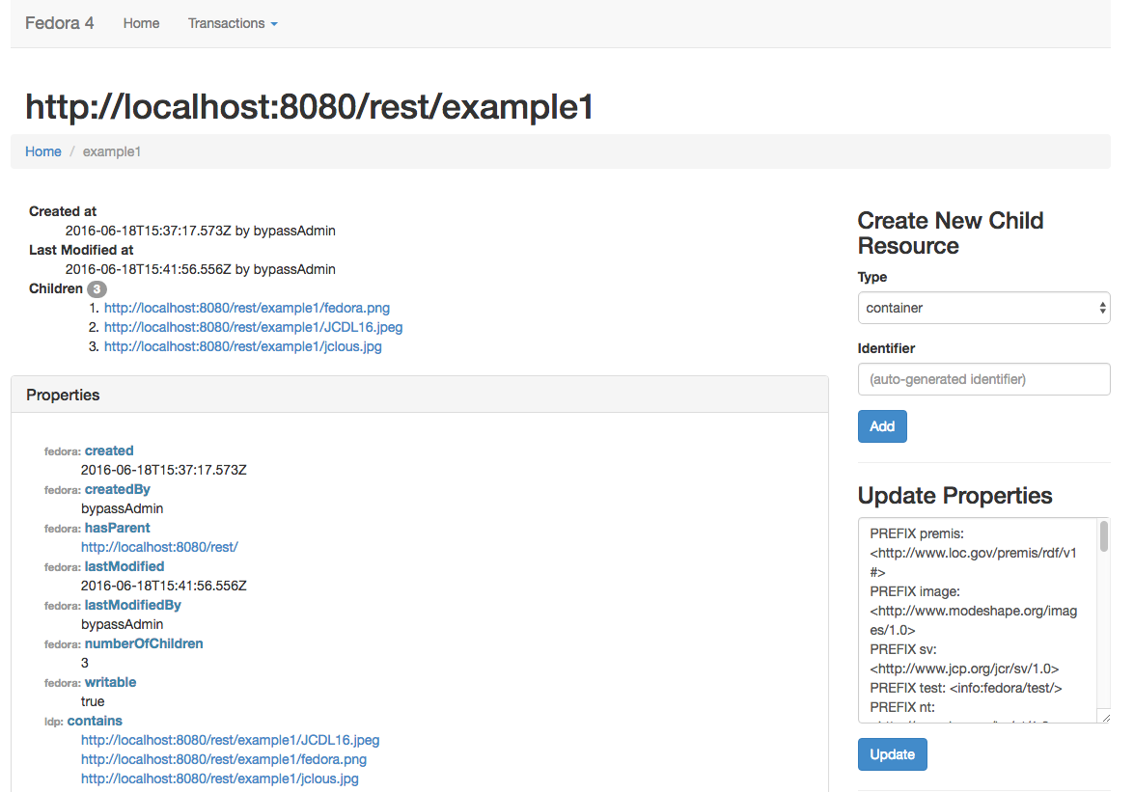

Slide 7
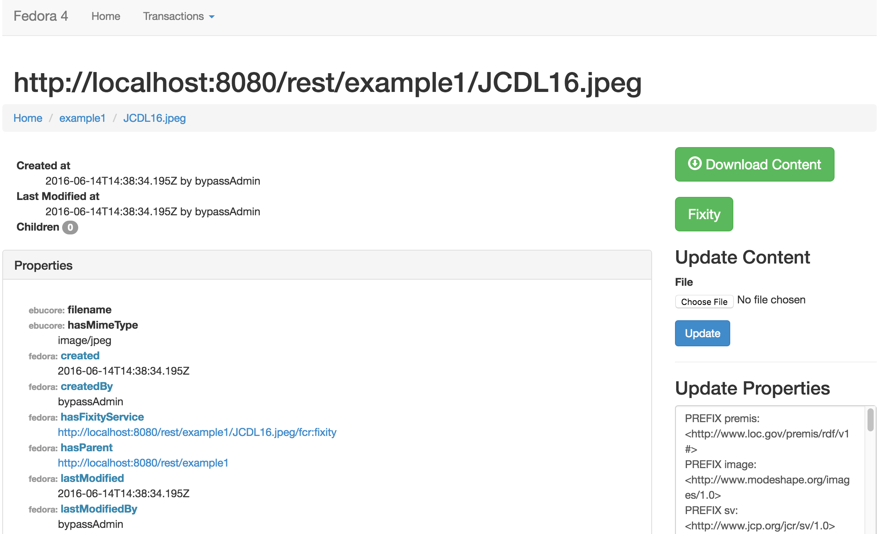

Slide 8
