Slide 1
Lipstick Recommender
Yinong Liang
05/09/2019

Slide 2
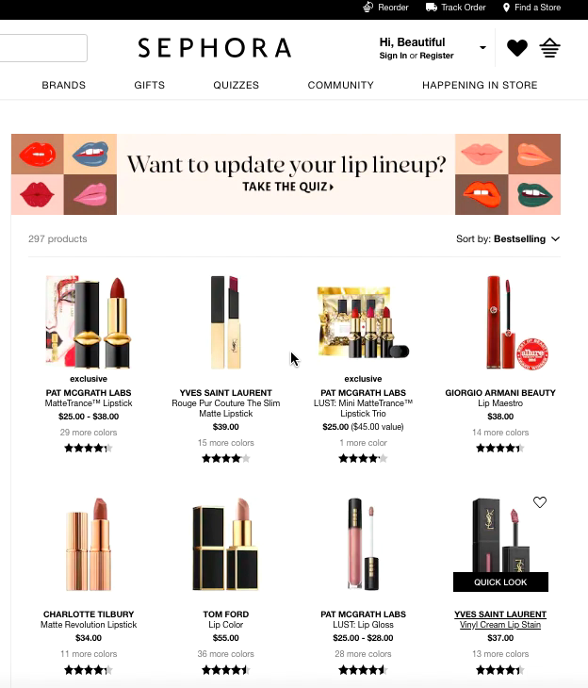
Problem:
When a customer considers buying lipsticks,
there are overwhelming numbers of beauty brands, products, and shades to choose from.
Notes:
For example, if I do a search in Sephora, which is one of the biggest beauty shopping websites, there are about 300 lipsticks and thousands of different shades I can pick.
The goal of the project is to help customers discover different lipstick products, and give them recommendations about new lipsticks they may like.

Slide 3
Limitations of current Sephora recommendation system
Based on previous shopping histories or product features
Not specific/customized
You don’t know what’s behind
Improvement
Another way to define customer similarity: demographics
Eye color
Hair color
Skin tone
Lipsticks
Popular shades of the lipsticks
Recommendations:
J1. Popular shades
2.Best features (long lasting/shiny…)
3. HSV values distributions
4. Recommendations of other products
Notes:
I collect all the lipsticks information, customer demographics, and costumer reviews on Sephora website, and used collaborative filtering to provide lipstick recommendations.

Slide 4
App
https://get-your-lipsticks.herokuapp.com/
On going work
Recommendation on lipstick shade
Alternative lipstick shade with lower price
J1. Popular shades
2.Best features (long lasting/shiny…)
3. HSV values distributions
4. Recommendations of other products

Slide 5
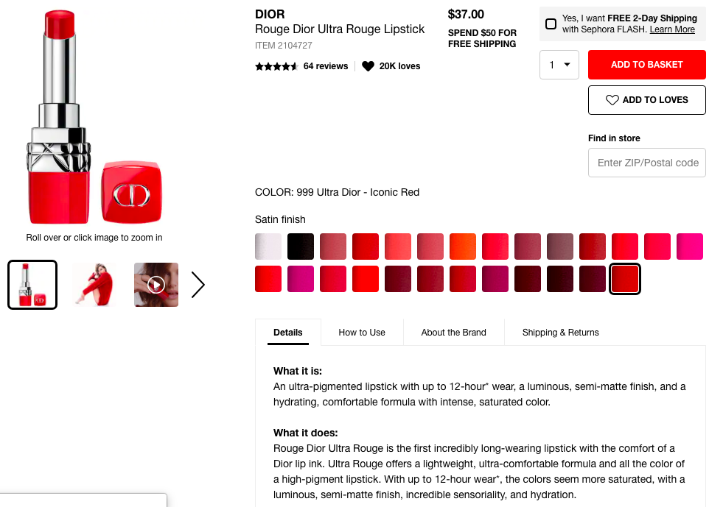
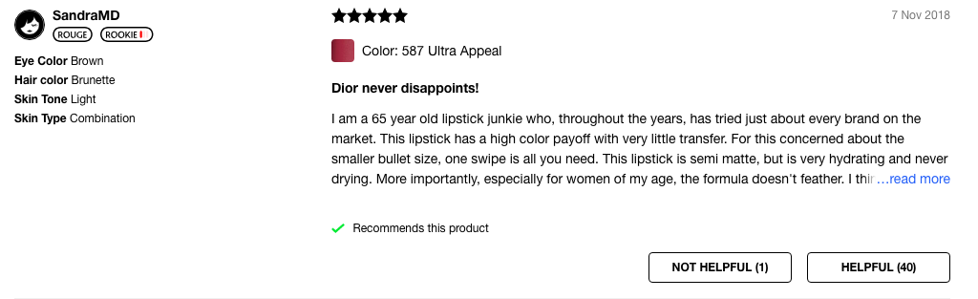
Demographics of reviewers

