Slide 1
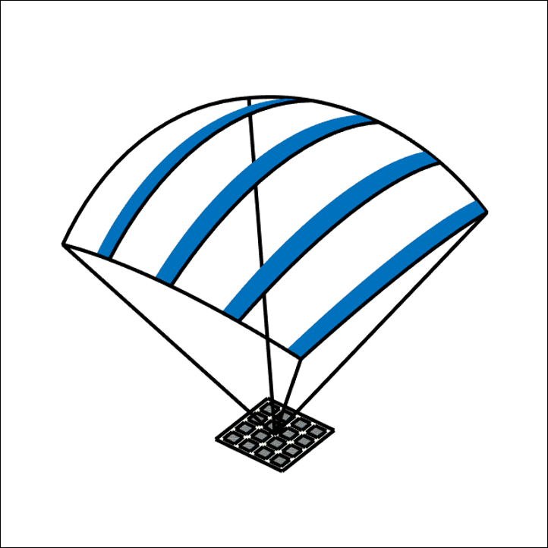
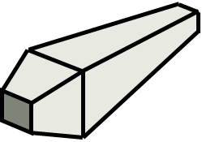
Volumetric Beamforming and Reconstruction
3D Beamformer
MPT: Multi-Plane Transmit beamforming
Tx fields

Slide 2
AI-assisted Image Reconstruction
Channel data
Image
Notes:
EN

Slide 3
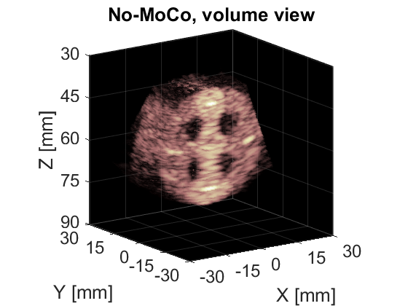

Motion Estimation and Compensation
Multi-mode Fused
Motion Estimation
(Pair-wise optical flow, Doppler, Speckle)
Notes:
EN

Slide 4
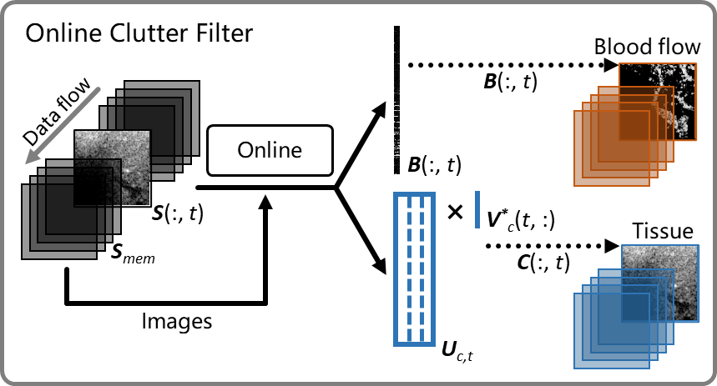
Online Clutter Filtering for Microvascular Imaging
Contrast-enhanced
Contrast-free
Notes:
EN

