Slide 1
Cs398 Project
Team Member:
Yin shuyu
Luo Yu Xuan
Notes:
Presentation - 20 points.
Course lecturer has limited time to evaluate your project so it is important for you to
- clearly specify the problem that you have worked and
- the parallel solution that your team has designed and implemented.
- Each team member should highlight the contribution that he/she has made.
- Each team will be given 15-20 min to present their results.
- In the presentation, the team is expected to give the high level description (e.g. the base and which part has been parallelized) and the significant details about the parallel solution.

Slide 2
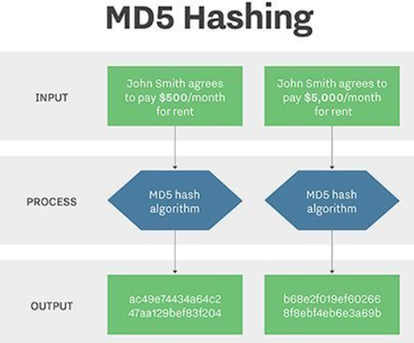
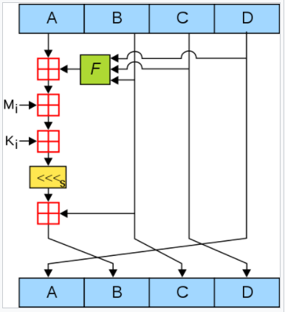
MD5 Password Recovery Background:
MD5 is a hashing function and not an encryption function. It is a one-way process and not reversible.
Password Recovery only can be done by the following methods:
Using a password dictionary
Hash the passwords in the dictionary list and compare with the User Hash
BruteForce method
Compute all possible combinations of password, hash them and compare with User Hash

Slide 3
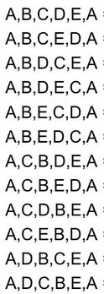
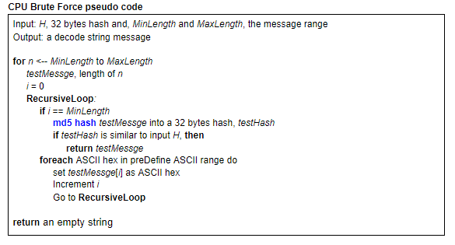
Brute Force Attack Solution :
CPU pseudo code

Slide 4
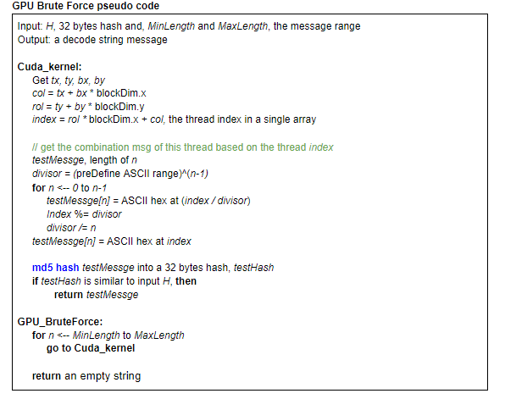
Brute Force Attack Solution :
GPU pseudo code

Slide 5
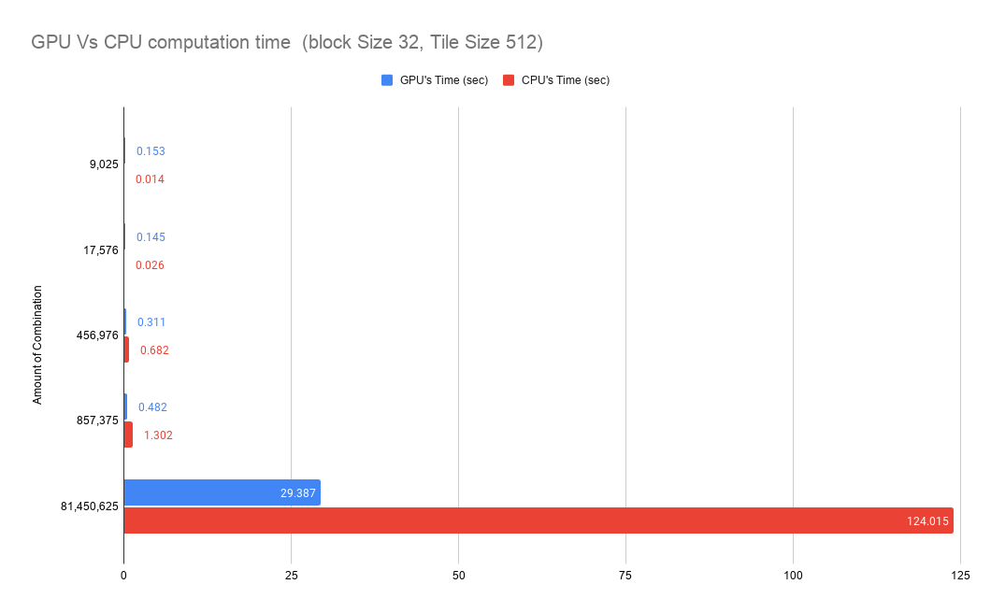

Slide 6
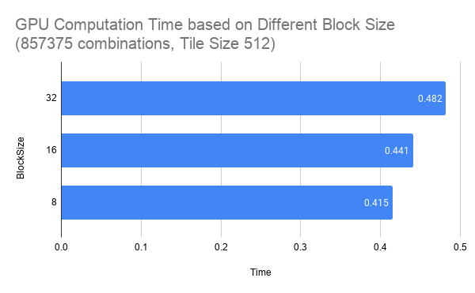
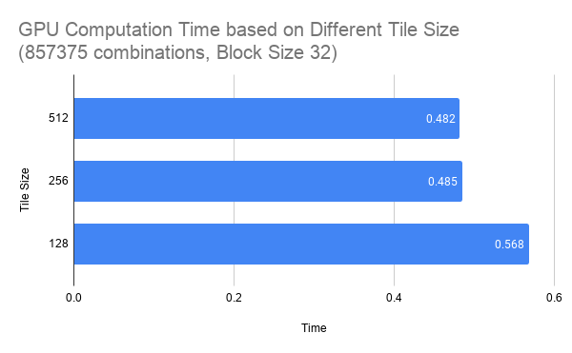

Slide 7
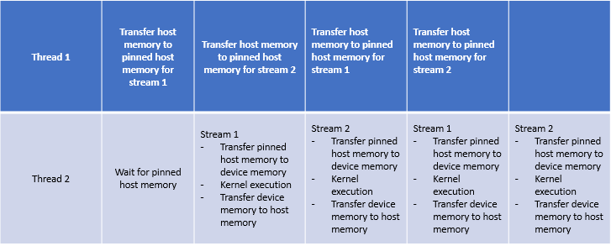
Dictionary Attack Solution :
Cuda Parallelism Model,
Task Parallelism, Pinned Host Memory
time
Notes:
The technologies used are Cuda parallelism model, task parallelism and pinned host memory.
The original sequential serial algorithm is not changed for the Cuda kernel.
In the cuda kernel, each thread hashes a password and compares with user input hash. If it is the same, result is found and a boolean is modified to true to inform the CPU to stop the multi-threading process.
For big dictionaries, where memory cannot be allocated all at once into the device, task parallelism is utilised.For task parallelism in the CPU, the tasks are split into 2 threads to enable cuda kernel for big dictionaries where Pinned host memory is tilised for fast transfer from host to device.
The diagram below shows how the task are delegated among the 2 threads.

Slide 8
Dictionary Attack Solution:
GPU Kernel Dictionary Pseudo code
Input: const char* __restrict__ hash, char * list, unsigned listSize, char* result, unsigned msgMaxLgth, bool * resultfound Output: result //password result For every thread in each block If thread is within listSize Get Password from list; Hash the password; If passwordhash is same as Userhash result= password; resultfound= true;

Slide 9
Dictionary Attack Solution:
Results Analysis
Total Messages | Block Size | Tile Size | Streams | Memory Allocation Time (sec) | Algorithm Execution Time (sec) | GPU's Total Latency (sec) | CPU's Total Latency (sec) | SpeedUp (%)
14,341,564 | 32 | 512 | 4 | 0.21999 | 0.81957 | 1.0396 | 21.594 | 20.77
14,341,564 | 32 | 512 | 3 | 0.15971 | 0.85852 | 1.0182 | 21.594 | 21.21
14,341,564 | 32 | 512 | 2 | 0.17392 | 0.80816 | 0.9821 | 21.594 | 21.99
14,341,564 | 32 | 512 | 1 | 0.15964 | 1.48197 | 1.6416 | 21.594 | 13.15

Slide 10
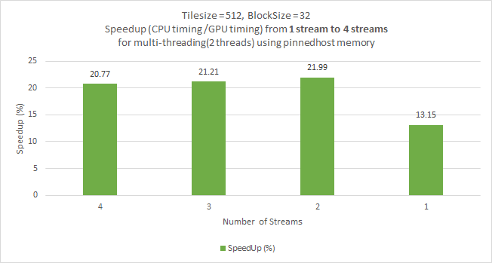
2 streams is the limit to gain speedup

Slide 11
Total Messages | Block Size | Streams | Tile Size | Memory Allocation Time (sec) | Algorithm Execution Time (sec) | GPU's Total Latency (sec) | CPU's Total Latency (sec) | SpeedUp (%)
14,341,564 | 32 | 2 | 512 | 0.17392 | 0.80816 | 0.9821 | 21.594 | 21.99
14,341,564 | 32 | 2 | 256 | 0.12686 | 0.86153 | 0.9884 | 21.594 | 21.85
14,341,564 | 32 | 2 | 128 | 0.11764 | 0.82469 | 0.9423 | 21.594 | 22.92

Slide 12
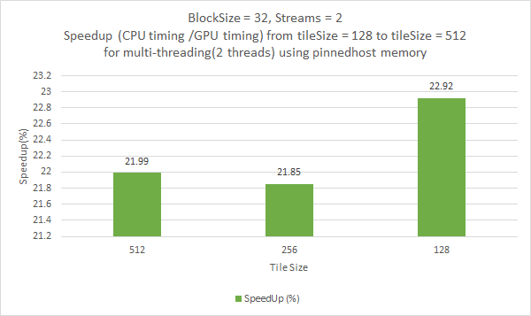

Slide 13
Reference:
Research On MD5 encoding & Cracking:
https://www.youtube.com/watch?v=53O9J2J5i14
http://cs.indstate.edu/~fsagar/doc/paper.pdf
https://crackstation.net/hashing-security.htm#attacks
Frameworks resources that we reference from:
https://github.com/CommanderBubble/MD5 (encoding)
https://github.com/Ex094/HashCrackerV.2 (Dictionary Decoding)
https://github.com/rossmacarthur/md5-brute-forcer (brute force Decoding)
Dictionary Resources:
https://www.kaggle.com/wjburns/common-password-list-rockyoutxt

Slide 14
Thank You!

