Slide 1
Knowledge-Aligned Counterfactual-Enhancement Diffusion Perception for Unsupervised Cross-Domain Visual Emotion Recognition
Wen Yin
24 March 2025
Notes:
Good afternoon everyone，my name is yin wen. I come from the Institute of Intelligent Computing. Today I am going to share about a paper of mine named that was recently accepted by Computer vision and pattern recognition 2025.

Slide 2
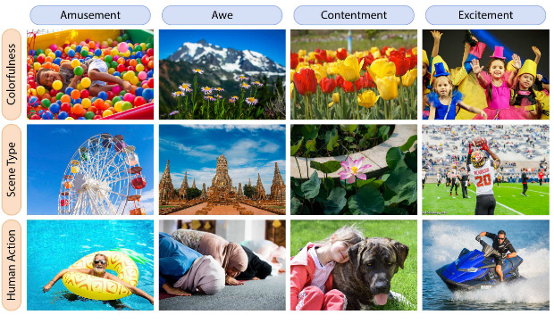
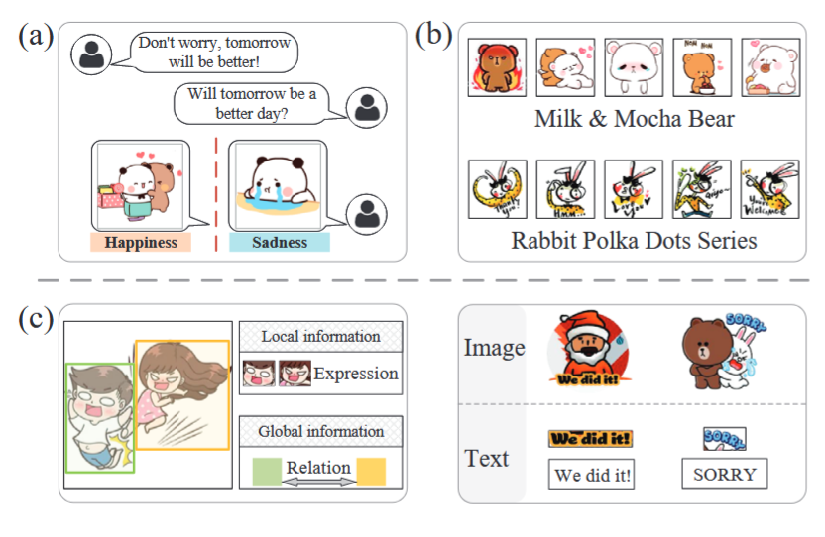
Background
Visual Emotion recognition(VER)
Real-world images：Emoset
Stickers（emoji）：SER30K
Art photos, Abstract images, etc.……
Notes:
First,i d like to talk about the background. Whats the visual emotion recognition? In short, It aims to recognize the emotion of images. There are many types of images on the internet. Generally, we can divide them into two main categories: real-world images and stickers namely emoji. besides, there are also art photos and abstract images.

Slide 3
Propose Task
New task:
Unsupervised Cross-Domain Visual Emotion Recognition
Can we design a single model which process data from multiple domains at the same time?
Real-world
Domain
Stickers
Domain
Real-world
Domain
Stickers
Domain
Model 1
Model 2
Single
Model
Notes:
So can we…. In other words ,look at this page, in previous works, model 1 is trained for real-world domain and the other model 2 is trained for stickers domain. naturally, can we use a single model to process two kinds of images? So we proposed a new task called unsupervised……VER

Slide 4
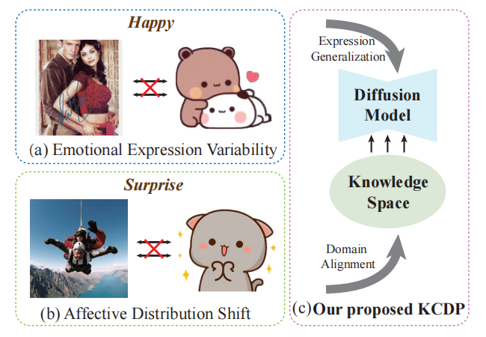
Motivation
Knowledge-aligned Counterfactual
enhancement Diffusion Perception (KCDP)
Notes:
After that, There are two differences between two domains: A and Ba. To address this, we use a diffusion model to achieve expression generalization. This helps us tackle the first challenge. For the second challenge, we align the emotional distribution in the knowledge space, which bridges the domain gap between different domains.
Finaly we proposed a method named KCDP.

Slide 5
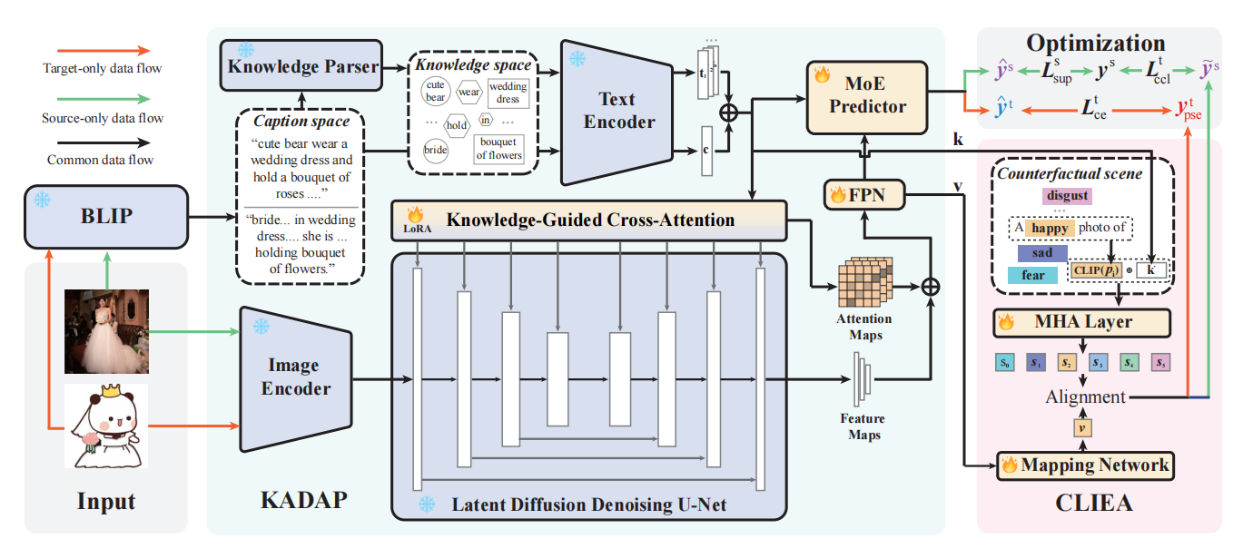
Method
Knowledge-aligned Counterfactual enhancement Diffusion Perception (KCDP)
Knowledge-Alignment Diffusion Affective Perception
Counterfactual-Enhanced Language- Image Emotional Alignment
Notes:
Now, let’s look at the architecture of our method.on left part, No matter which domain the image comes from, we first use BLIP to generate its caption and integrate it into knowledge triplets. Then, we use a knowledge-guided diffusion model to perceive the emotion in the image. Finally, we apply MoE (Mixture of Experts) to predict the emotion. On right part, we construct a counterfactual scene to achieve an alignment between the knowledge representation and the visual representation. This further reduces the domain gap.

Slide 6
Thanks
Email:631021497@qq.com
Notes:
Ok that’s all thank you.

