Slide 1
Book2
File created on: 2021-12-15 5:04:32 PM

Slide 2
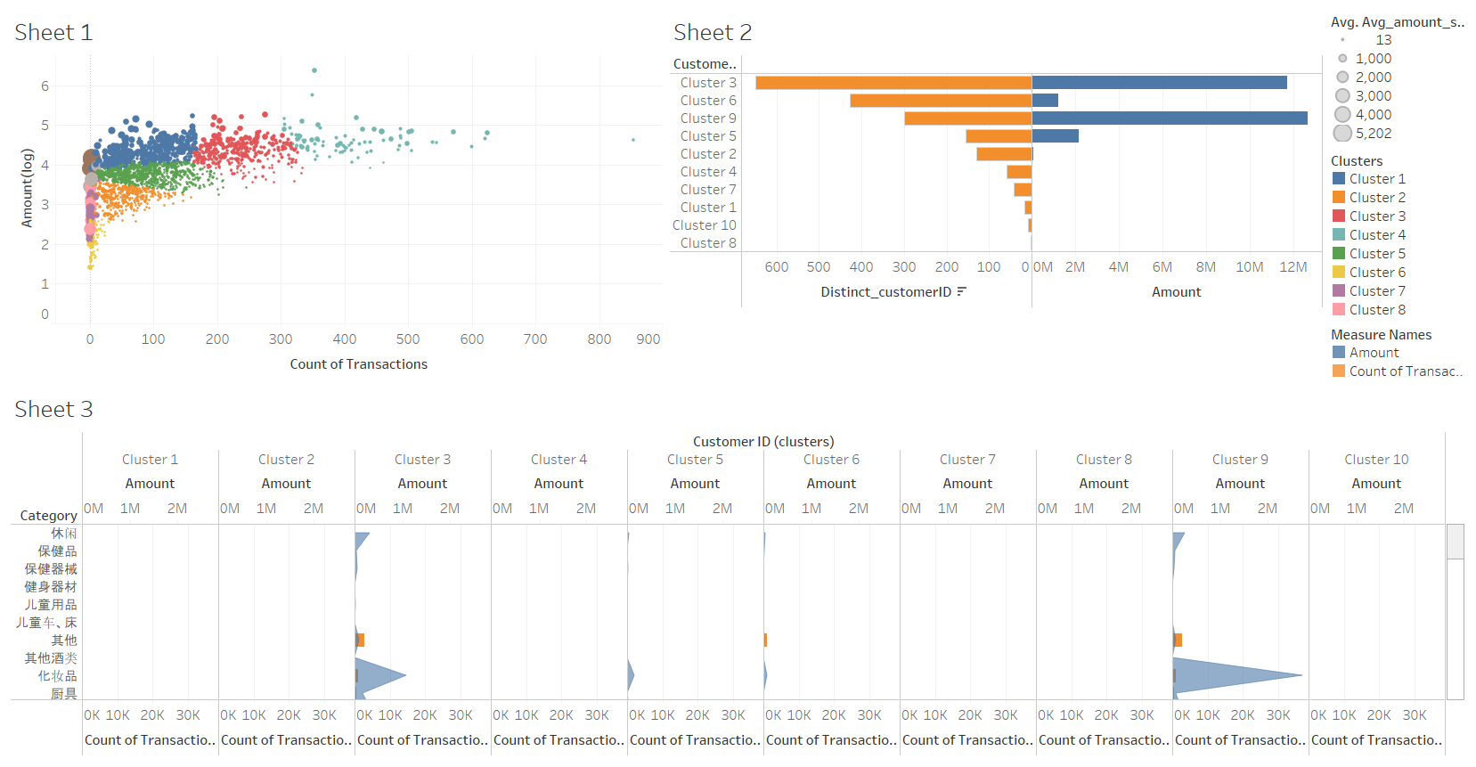

Slide 3
