Slide 1

America’s untapped OPPORTUNITY

Slide 2
The job/student gap in computer science
Computer Science Students
(high school)
Computer Science Jobs
All other math and science
All other math and science
Sources: College Board, Bureau of Labor Statistics

Slide 3
Fewer computer science majors than 2003
Why the decline in college? Because 17% fewer high schools teach CS
Sources: National Science Foundation, ACM

Slide 4
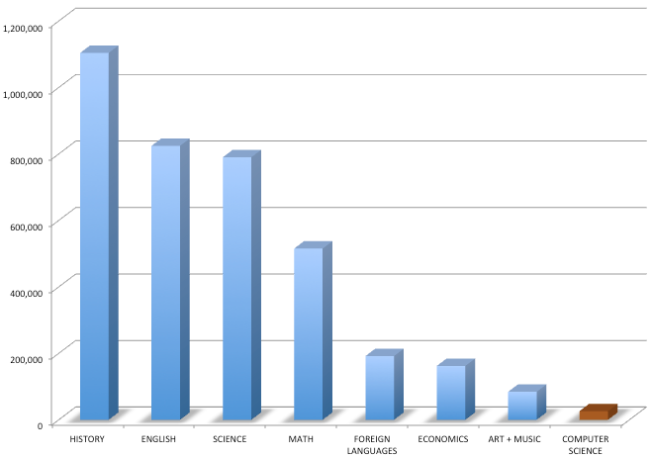
2012 High School A.P. Enrollment
Exposure to CS leads to the best-paying jobs in the world.
But it’s only available in 5% of high schools
Only 15% of these are women, and only 8% are students of color!
Source: College Board

Slide 5
1,000,000 more jobs than students by 2020
$500 billion opportunity
1,000,000 unfilled programming jobs*
400,000 computer science graduates
* Each software job supports 4.3 new neighborhood jobs!
Sources: BLS, NSF, Bay Area Council Economic Institute

Slide 6

a foundational skill, not just vocational
67% of software jobs are outside the tech industry – in banking, retail, government, entertainment, etc
China requires CS to graduate. UK, Australia are next
We need ALL our children prepared for the 21st century
“Knowledge of computer programming is as important as knowledge of anatomy when it comes to medical research or clinical care” Larry Corey,
President, Fred Hutchinson Cancer Research Center

Slide 7
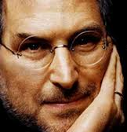
Everybody in this country should learn how to program a computer…
…because it teaches you how to think.
Steve Jobs

Slide 8
Appendix data
Studying CS in HS = more likely to study in college
Students who study AP CS in high school are twice as likely to take a class in college, and 6 times more likely to major in it in college. (Source: College Board)
One study showed that students who study intro CS in high school are twice as likely to major in it in college. (Source: Springfield, PA)
State policy can increase enrollment / representation
In the states where CS courses can satisfy existing math/science graduation requirements, enrollment per AP CS class is 50% higher than the other states. In these states, representation by African Americans and Hispanics in AP CS is 37% higher than in the other states (Source: College Board)

Slide 9
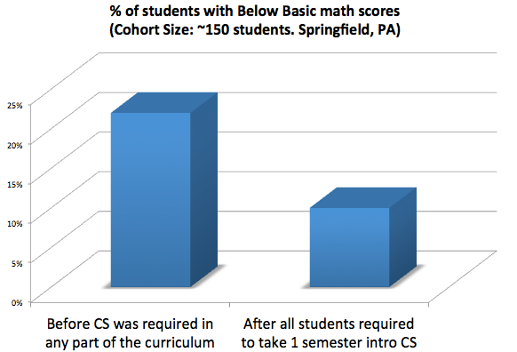
Appendix Data
CS helps students with math
Students exposed to Intro CS early on perform better at math. (Source: longitudinal study of students in Springfield PA, before/after CS was required of all students)

