Slide 1
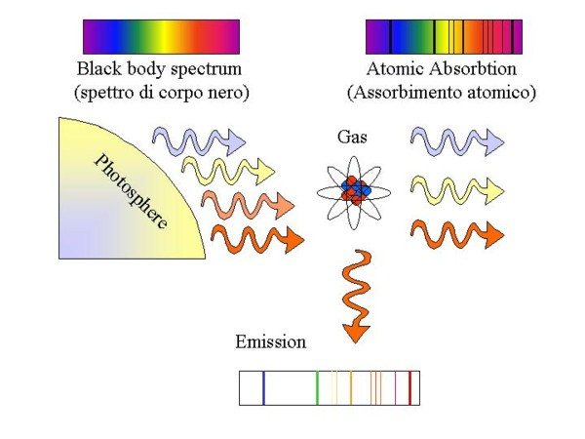
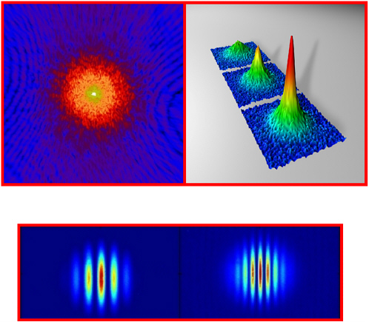
CHAPTER 2
PHOTONS AND ATOMS
Fundamentals of Optoelectronics

Slide 2
Outlines
THE PHOTON
  Photon Energy, Photon Position, Photon Momentum
  Photon Polarization, Photon Interference, Photon Time
  Photon Streams (Mean Photon Flux)
ATOMS, MOLECULES, AND SOLIDS
  A. Energy Levels
  B. Occupation of Energy Levels in Thermal Equilibrium
INTERACTIONS OF PHOTONS WITH ATOMS
  A. Interaction of Single-Mode Light with an Atom
  B. Spontaneous Emission
  C. Stimulated Emission and Absorption
  D. Line Broadening
Fundamentals of Optoelectronics

Slide 3
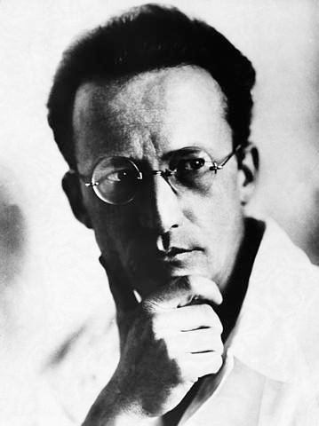
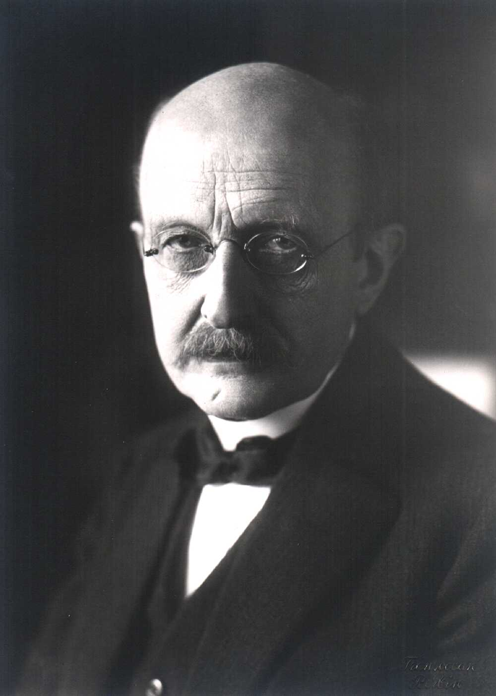
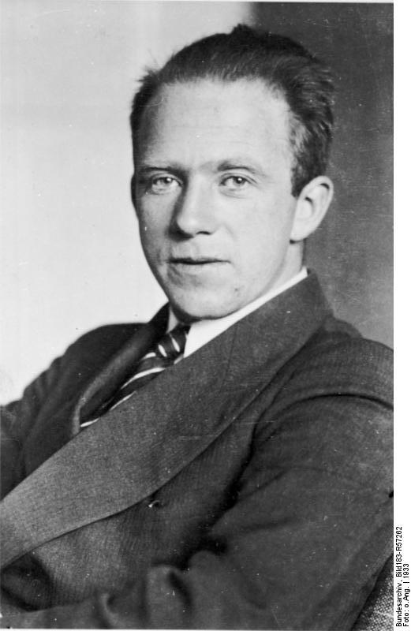
The Photon
Erwin Schrodinger
Max Plank
Werner Heisenberg
Fundamentals of Optoelectronics

Slide 4
Quantum electromagnetic theory is known as quantum electrodynamics (QED).
Quantum electrodynamics is more general than classical electrodynamics and it is today accepted as a theory that is useful for explaining virtually all known optical phenomena. For optical phenomena, this theory is also referred to as quantum optics.
it is possible to derive many of the quantum-mechanical properties of light and its interaction with matter by supplementing electromagnetic optics with a few simple relationships drawn from QED that represent the corpuscularity, localization, and fluctuations of electromagnetic fields and energy. This set of rules, which we call photon optics, permits us to deal with optical phenomena that are beyond the reach of classical theory, while retain classical optics as a limiting case.
Fundamentals of Optoelectronics

Slide 5
The relation among the optical theories
Quantum optics
Electromagnetic optics
Wave optics
Rays optics
Fundamentals of Optoelectronics

Slide 6
The Photon
Light consists of particles called photons.
zero rest mass m₀=0
electromagnetic energy
momentum.
intrinsic angular momentum (or spin)--- its polarization properties.
travels at the speed of light (in vacuum c₀)
Fundamentals of Optoelectronics

Slide 7
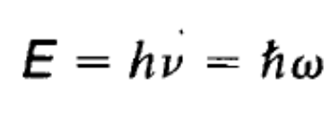
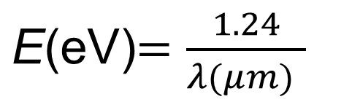

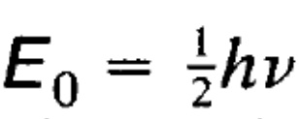

Photon energy
Where h=6.63 ×10⁻³⁴ Js --- Planck constant and ħ=h/2π
For a resonator, A mode containing zero photons nevertheless carries an energy
called the zero-point energy. In most experiments the zero-point energy is not directly observable. The presence of the zero-point energy can, however, be manifested in subtle ways when matter is exposed to static fields. It plays a crucial role in the process of spontaneous emission from an atom,
When it carries n photons, therefore, the mode has total energy
Fundamentals of Optoelectronics

Slide 8
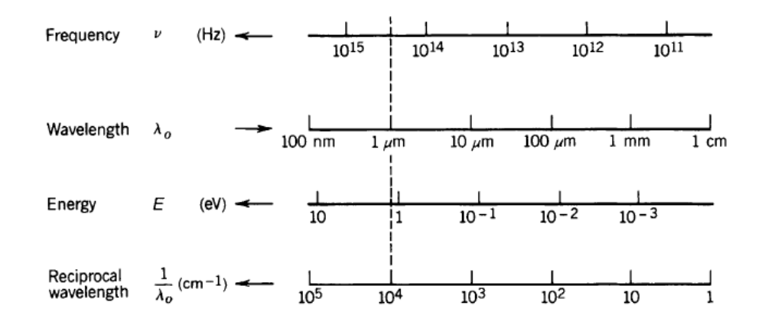
Relation energy, wavelength frequency and wavenumber
Fundamentals of Optoelectronics

Slide 9
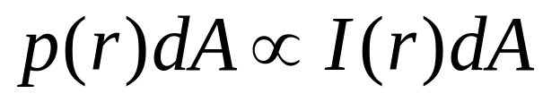
Photon Position
The photon is more likely to be found at those locations where the intensity is high.
The probability p(r)dA of observing a photon at a point r within an incremental area dA, at any time, is proportional to the local optical intensity I(r)∝اU(r)ا ², i.e.
Fundamentals of Optoelectronics

Slide 10
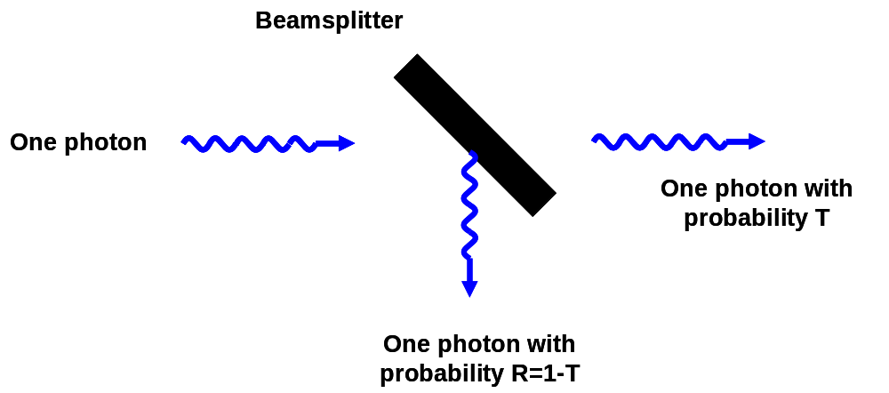
Transmission of a Single Photon Through a Beamsplitter
The probability for a photon is transmitted is equal to the transmittance T. The probability that it is reflected is 1 - T. Because, transmittance is a squire of normalization of light intensity.
From a probability point of view, the problem is identical to that of flipping a coin.
Fundamentals of Optoelectronics

Slide 11
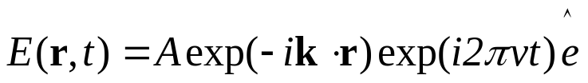

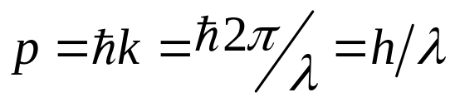
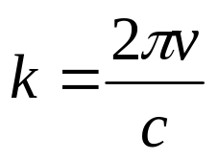


Photon Momentum
The momentum of a photon is related to the wavevector of its associated wave function
A photon in a mode describes by a plane wave as
Has a momentum vector
And the amplitude of the mommentum is
Fundamentals of Optoelectronics

Slide 12
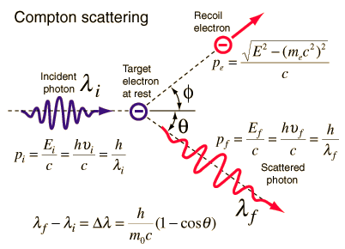
Compton scattering
Conservation energy
Conservation momentum
Fundamentals of Optoelectronics

Slide 13
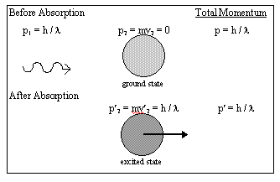
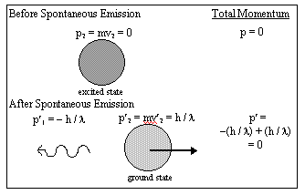
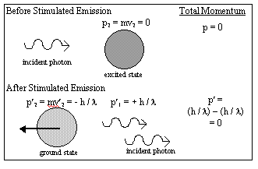
Conservation momentum
Fundamentals of Optoelectronics

Slide 14



Photon momentum and Energy
The momentum of a photon is given by:
where p is momentum, h is Planck's constant, λ is wavelength, m is mass, and c is speed of light in vacuum. This expression shows the wave–particle duality.
is the mass-energy relationship where E is the energy. Then
Fundamentals of Optoelectronics

Slide 15
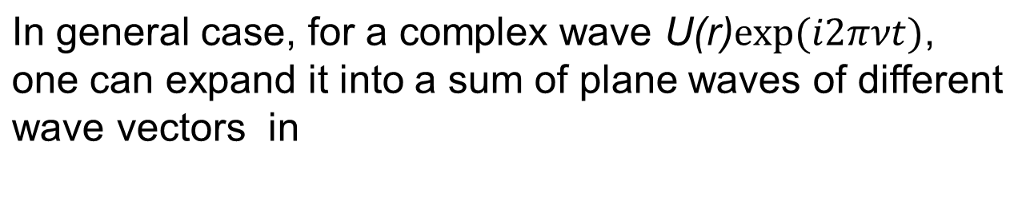
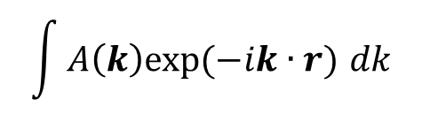
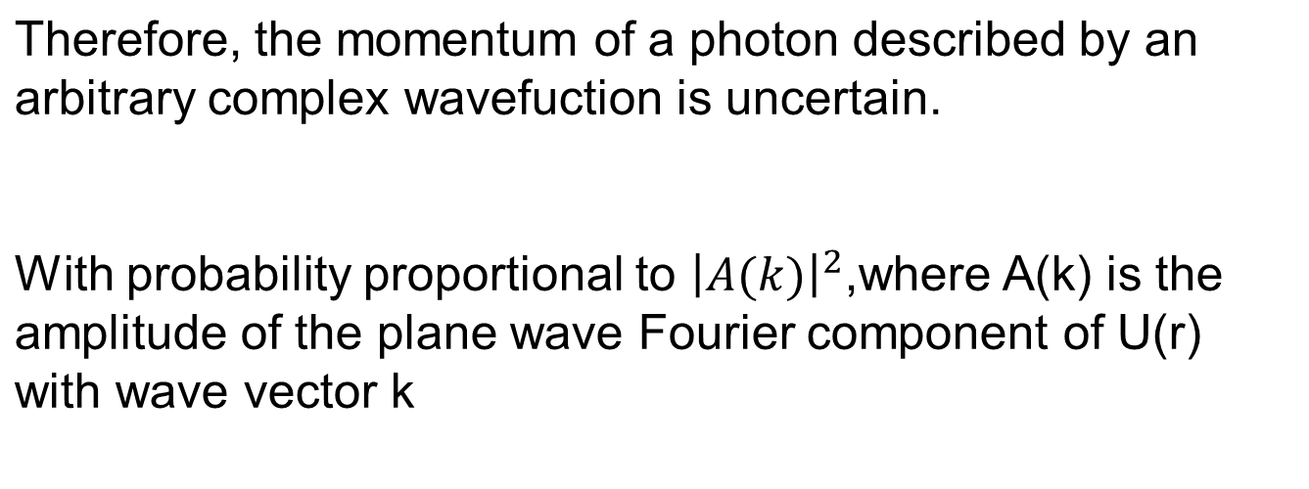

Momentum of a localized wave
Fundamentals of Optoelectronics

Slide 16



Radiation Pressure (or Photon Pressure)
Because momentum is conserved, its association with a photon means that the emitting atom experiences a recoil of magnitude hv/c. Furthermore, the momentum associated with a photon can be transferred to objects of finite mass, giving rise to a force and causing mechanical motion.
θ
The momentum change in unite time unite surface is
Photon pressure
Fundamentals of Optoelectronics

Slide 17
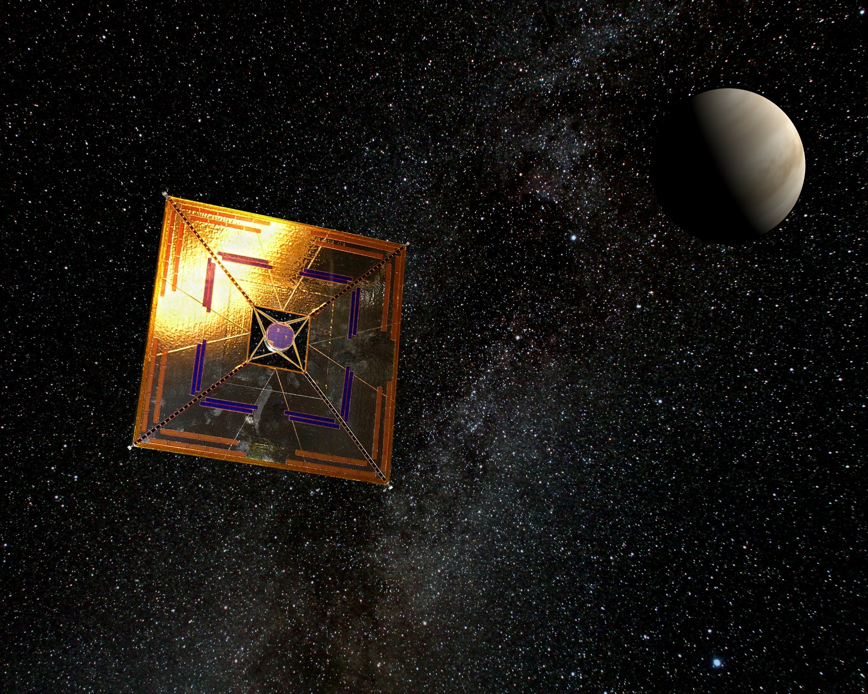
Solar sail
Fundamentals of Optoelectronics

Slide 18
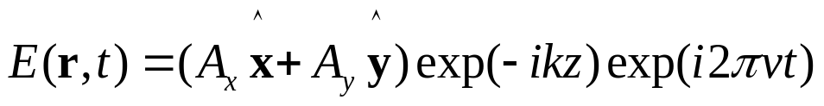
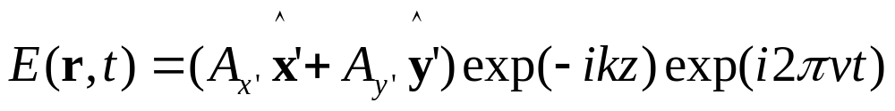
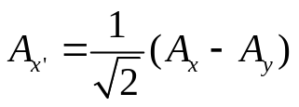
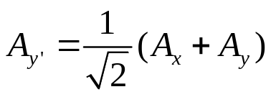
Photon Polarization
Light in a resonator, is characterized as a sum of modes of different frequencies, directions, and polarizations.
The polarization of a photon is one kind of its mode.
Linear polarized light
If we represent it in the coordinate system x’, y’ , which makes a 45” angle rotation with the initial coordinate system. Thus we can equally well view the field in photons polarized along the x’ and y’ directions,
where
Fundamentals of Optoelectronics

Slide 19
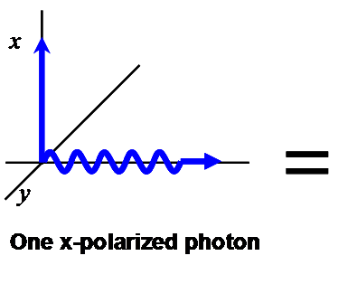
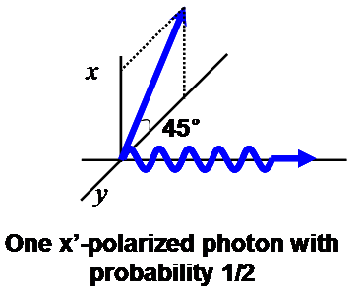
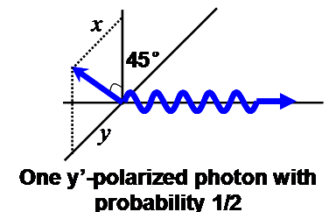

If we know that the x-polarized mode is occupied by a photon, and the y –polarized mode is empty.
what can be said about the possibility of finding a photon polarized along the x’, y’
The probabilities of finding a photon with x, y, x’, or y’ polarization are proportional to the intensities IA_{x}I², IA_{y}I², IA_{x}’I², and IA_{y}’I² respectively.
For example lA_{x}I² = 1, IA_{y}I² = 0, so that IA_{x}’ I² = IA_{y}’I² = 1/2
Fundamentals of Optoelectronics

Slide 20
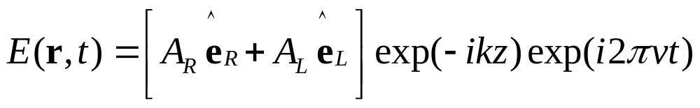
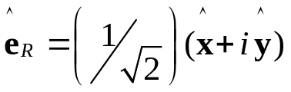
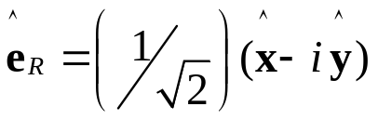
Circularly Polarized Photons
A modal expansion in terms of two circularly polarized plane-wave modes, one
right-handed and one left-handed, can be used,
where
These modes carry right-handed and left-handed circularly polarized photons.
the probabilities of finding a photon with these polarizations are proportional to the intensities IA_{R}I² and IA_{L}I².
when a circularly polarized photon is passed through a linear polarizer, the probability of detecting it, is 1/2.
Fundamentals of Optoelectronics

Slide 21

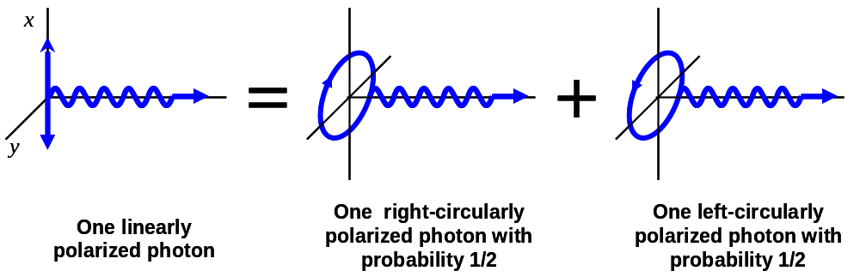
Photon spin
Photons possess intrinsic angular momentum (spin).
The magnitude of the photon spin
Right-handed (left-handed) circularly polarized photons have their spin vector parallel (antiparallel) to their momentum vector.
Linearly polarized photons have an equal probability of exhibiting parallel and antiparallel spin.
Photons can transfer linear momentum to an object,
circularly polarized photons can exert a torque on an object.
Fundamentals of Optoelectronics

Slide 22
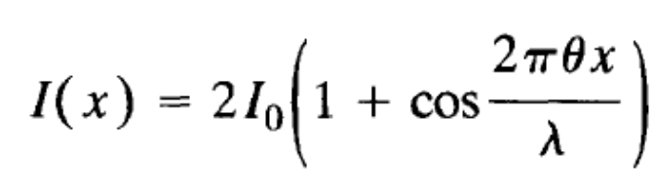
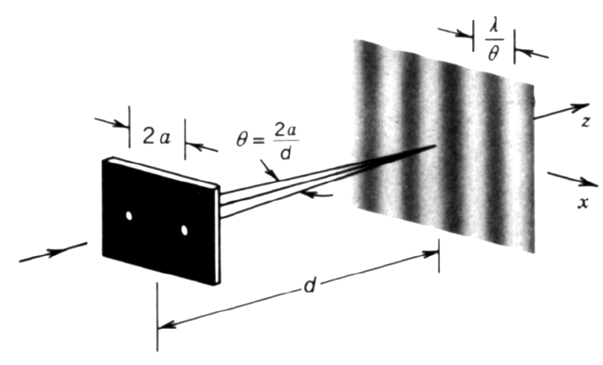
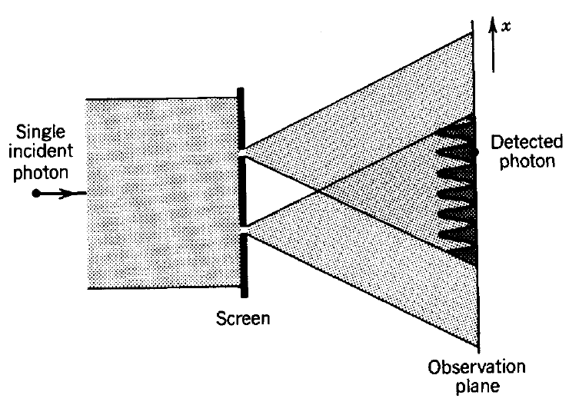
Photon Interference
The intensity at the observation plane is calculated using electromagnetic (wave) optics and the result is converted to a probability density function that specifies the random position of the detected photon.
The interference arises from phase differences in the two paths.
Fundamentals of Optoelectronics

Slide 23
Photon Time
A photon in a monochromatic mode is equally likely to be detected at any time.
A general expansion may be made in terms of polychromatic modes (time-localized wavepackets).
The probability of detecting the photon described by the complex wavefunction U(r, t), at any position, in the incremental time interval between t and t + dt, is proportional to I(r, t )dt ∝IU(r, t )I²dt, photon time localization:
Fundamentals of Optoelectronics

Slide 24


Heisenberg's uncertainty principle
The position of the electron can be determined to within the resolving power of the microscope, which is given by a formula from classical optics：
Where θ is the aperture angle of the microscope
since the photon is scattered anywhere within the aperture, the uncertainty of momentum transferred equals
So we have the product
Fundamentals of Optoelectronics

Slide 25
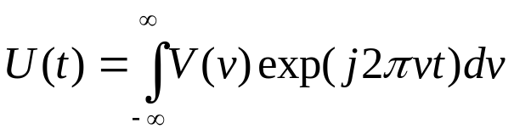


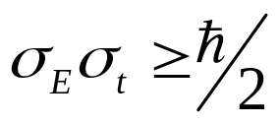
Time-Energy Uncertainty
The frequency uncertainty is readily determined by Fourier expanding U(t) in terms of its harmonic components,
The width σ_{v} of lV(v)l² represents the spectral width. If σ_{t} is the rms width of the function lU(t)l² (i.e., the power-rms width), then σ_{v} and σ_{t} must satisfy the duration-bandwidth reciprocity relation:
The energy of the photon hv then cannot be specified to an accuracy better than
σ_{E} = hσ_{v}. It follows that the energy uncertainty of a photon, and the time during which
it may be detected, must satisfy
Time-energy uncertainty relation.
Fundamentals of Optoelectronics

Slide 26
A monochromatic photon (σ_{v}0) has an eternal duration within which it can be observed (σ_{t}∞). or (σ_{ρ}∞）
In contrast, a photon associated with an optical wavepacket is localized in time and is therefore polychromatic with a corresponding energy uncertainty.
Fundamentals of Optoelectronics

Slide 27
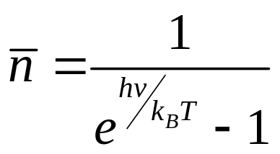
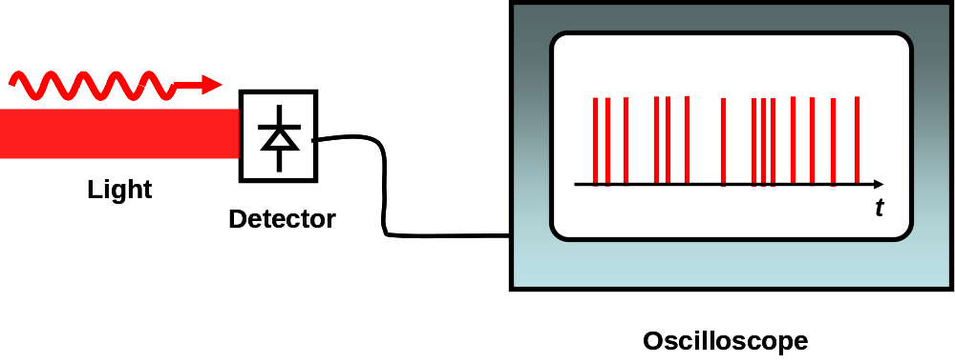
PHOTON STREAMS
The probability distribution obeyed by the photon number is governed by the quantum state of the mode, which is determined by the nature of the light source. Real photon streams often contain numerous propagating modes, each carrying a random number of photons.
The probability of detecting a photon in the incremental time interval between t and t + dt is proportional to the
optical power P(t) at the time t.
Fundamentals of Optoelectronics

Slide 28
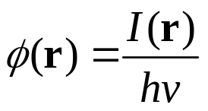
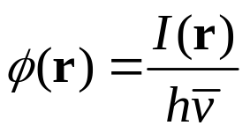
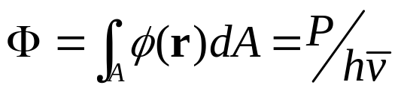
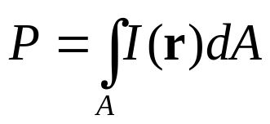
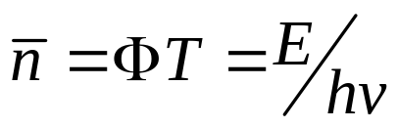
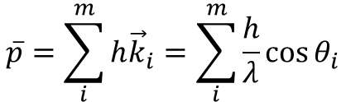
Mean Photon Flux
Mean Photon-Flux Density
Mean Photon Flux
Mean Number of Photons
Mean Photon momentum
Fundamentals of Optoelectronics

Slide 29
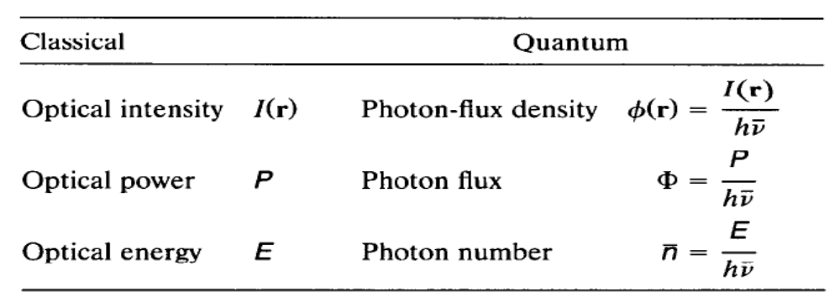
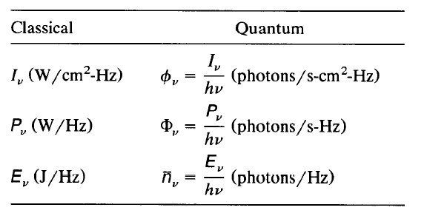
Fundamentals of Optoelectronics

Slide 30
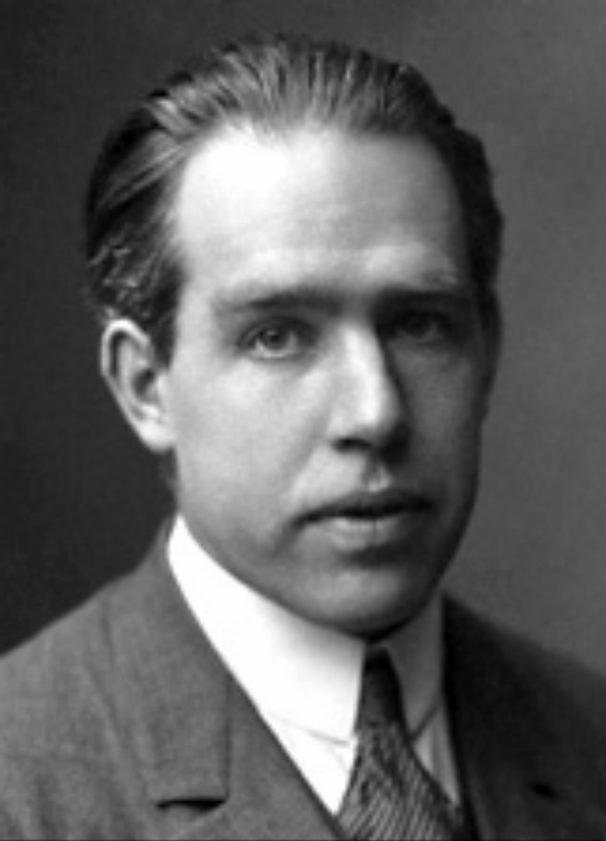
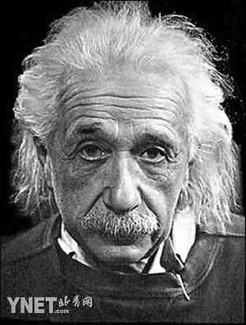
Niels Bohr
Nobel prize 1922
Albert Einstein
Nobel prize 1921
Fundamentals of Optoelectronics

Slide 31
Thermal light:
Light emitted from atoms, molecules, and solids, under conditions of thermal equilibrium and in the absence of other external energy sources.
Luminescence light:
Photon emission is induced by the presence of other external sources of energy, such as an external source of light, an electron current or a chemical reaction. The excited atoms can then emit non-thermal light.
Fundamentals of Optoelectronics

Slide 32


2. ATOMS, MOLECULES AND SOLIDS
The behavior of a single nonrelativistic particle of mass m (e.g., an electron), with a potential energy V(r, t), is governed by a complex wavefunction ψ(r, t) satisfying the Schrtidinger equation
If we simply to determine the allowed energy levels E of the particle in the absence of time-varying interactions, the wavefunction ψ(r, t) may be expressed as: Ψ(r, t) = ϕ(r) exp[ i(E/h)t], where ϕ(r) satisfies the time independent Schriidinger equation
Fundamentals of Optoelectronics

Slide 33

Energy Levels of materials
Vibrational and Rotational Energy Levels of Molecules
ev
N2
Vibrations of a Diatomic Molecule (ex. N2,CO,HCl etc.)
0.4
The molecular vibrations take on the set of allowed energy levels appropriate for the quantum-mechanical harmonic oscillator
Energy
0.3
q=1
0.2
0.1
where
0
q=0
Typical values of ħω lie between 0.05 and 0.5 eV, which corresponds to the photon in the infrared region
Fundamentals of Optoelectronics

Slide 34

Rotations of a Diatomic Molecule.
The rotations of a diatomic molecule about its axes are similar to those of a rigid rotor with moment of inertia I. The rotational energy is quantized to the values
ev
N2
0.4
Energy
0.3
q=1
Typical rotational energy levels are separated by values in the range 0.001 to 0.01 eV, so that the energy differences correspond to photons in the far infrared region
0.2
0.1
0
q=0
Fundamentals of Optoelectronics

Slide 35

Vibrations of the CO₂ Molecule
three kinds independent vibrations :
asymmetric stretching (AS)
symmetric stretching (SS)
bending (B).
Each of these vibrational modes behaves like a harmonic oscillator. But the frequencies ω_{q1} ω_{q2} ω_{q3} are different.
ev
CO2
050
0.4
200
040
001
0.3
9.6um
030
10.6um
100
0.2
020
010
0.1
000
0
Asymmetric stretch
Symmetric stretch
Bending
Fundamentals of Optoelectronics

Slide 36


Electron Energy Levels of Atoms and Molecules
Isolated atom has a potential energy that derives from the Coulomb law of attraction between the proton and the electron
Isolate atom
where m_{r} is the reduced mass of the atom, e is the electron charge, and Z is the number of protons in the nucleus (Z = 1 for hydrogen).
Fundamentals of Optoelectronics

Slide 37
ev
ev
He
Ne
21
1s2s 1S0
2p55s
3.39um
2p54p
21
20
1s2s 3S1
2p54s
20
Energy
632.8nm
19
19
18
2p53p
18
17
2p53s
17
16
16
Odd parity
Even parity
Some energy levels of He and Ne atoms. The Ne transitions marked by arrows correspond to photons of wavelengths 3.39 μm and 632.8 nm, as indicated. These transitions are used in He-Ne lasers
Fundamentals of Optoelectronics

Slide 38

Dye Molecules.
Organic dye molecules are large and complex. They may undergo electronic, vibrational, and rotational transitions so that they typically have many energy levels.
Levels exist in both singlet (S) and triplet (T) states.
Singlet states have an excited electron whose spin is antiparallel to the spin of the remainder of the dye molecule;
triplet states have parallel spins.
Fundamentals of Optoelectronics

Slide 39

EIectron Energy Levels in Solids
The energy levels of three generic solids with different electrical properties (metal, semiconductor, insulator) are shown in the figure
Vacuum level
Conduction band
Eg
Eg
3p
Valence band
3s
Energy
2p
2s
1s
Isolated atom
Metal
Semi-conductor
Insulator
Fundamentals of Optoelectronics

Slide 40

Ruby
Ruby is an insulator. It is alumina (also known as sapphire, Al₂O₃) in which a small fraction of the Al³⁺ ions are replaced by Cr³⁺ ions.
The green and violet absorption bands (indicated by the group-theory notations 4F₂ and 4F₁,
respectively) give the material its characteristic pink color.
Fundamentals of Optoelectronics

Slide 41


Semiconductors.
Semiconductors have closely spaced allowed electron energy levels that take the form of bands
Fundamentals of Optoelectronics

Slide 42


Quantum Wells and Superlattices （量子井与超晶格）
Crystal-growth techniques, such as molecular-beam epitaxy and vapor-phase epitaxy, can be used to grow materials with specially designed band structures. In semiconductor quantum-well structures, the energy bandgap is engineered to vary with position in a specified manner, leading to materials with unique electronic and optical properties.
Quantized energies in a single-crystal AlGaAs/GaAs multiquantum-well structure. The well widths can be arbitrary (as shown) or periodic.
Fundamentals of Optoelectronics

Slide 43


B. Occupation of Energy Levels in Thermal Equilibrium
Boltzmann Distribution
In thermal equilibrium at temperature T (the atoms motion reaches a steady state that is invariant to time), the probability P(E_{m}) that an arbitrary atom is in energy level E_{m} is given by the Boltzmann distribution
where N_{m} is the number of atoms occupying energy level E_{m}, and the population ratio is, on the average, is
where k_{B} is the Boltzmann constant
Fundamentals of Optoelectronics

Slide 44
E_{m}
E_{m}
E₃
E₃
E₂
E₂
E₁
E₁
P(E_{m})
Energy levels
Occupation
Fundamentals of Optoelectronics

Slide 45
At T = 0 K, all atoms are in the lowest energy level (ground state).
T increases， the populations of the higher energy levels increase.
Under equilibrium conditions, the population of a given energy level is always greater than that of a higher-lying level.
Population inversion ：A higher energy level has a greater population than a lower energy level， the basis for laser action
Fundamentals of Optoelectronics

Slide 46

There are several different quantum states which can correspond to the same energy (e.g., different states of angular momentum).
To account for these degeneracies, we have
The degeneracy parameters g₂ and g₁ represent the number of states corresponding to the energy levels E₂ and E₁, respectively.
Fundamentals of Optoelectronics

Slide 47
Fermi-Dirac Distribution
Pauli exclusion principle:
Each state can be occupied by at most one electron.
One state is either occupied or empty, the number of electrons N_{m} in state m is either 0 or 1.
Electrons in a semiconductor obey a different occupation law. Since the atoms are located in close proximity to each other, the material must be treated as a single system within which the electrons are shared. So that very large number of energy levels exist and forming the band.
Fundamentals of Optoelectronics

Slide 48



Fermi-Dirac distribution
The probability that energy level E is occupied is given by the Fermi-Dirac distribution
where E_{f} is a constant called the Fermi energy. This distribution has a maximum value of unity, which indicates that the energy level E is definitely occupied. f(E) decreases monotonically as E increases, assuming the value 1/2 at E = E_{f}.
when E >> Ef , f(E) behaves like the Boltzmann distribution:
Fundamentals of Optoelectronics

Slide 49
3. Interactions of photons with atoms
Semi-classical view of atom excitations
e
Ze
Atom in ground state
e
Ze
Atom in excited state
Fundamentals of Optoelectronics

Slide 50

Spontaneous Emission自发辐射
Spontaneous emission: a photon is generated into the mode of frequency ν by an atomic transition from energy level 2 to level 1.
The photon energy: hν=Ε2−Ε1
hν
Probability Density (rate) of Spontaneous Emission into a Single Prescribed Mode is
The function σ(v) is a narrow function of ν centered about the atomic resonance frequency v₀; it is known as the transition cross section.
“probability density” signifies that the probability of an emission taking place in an incremental time interval
Unit is s⁻¹
May be bigger than 1
Fundamentals of Optoelectronics

Slide 51


Decay of the number of the excited atoms
The number of atoms in the excited state will be decreases Spontaneously as the time passes
N(t)
N(0)
1/P_{sp}
t
Spontaneous emission into a single mode causes the number of excited atoms to decrease exponentially with time constant 1/p_{sp}
Fundamentals of Optoelectronics

Slide 52


Absorption
If the atom is initially in the lower energy level, the radiation mode contains a photon, the photon may be absorbed, thereby raising the atom to the upper energy level. The process is called absorption.
The probability density for the absorption
if there are n photons in the mode, the probability density that the atom absorbs one photon is n times greater
hν
Fundamentals of Optoelectronics

Slide 53
Stimulated Emission
if the atom is in the upper energy level and the mode contains a photon, the atom may be stimulated to emit another photon into the same mode. The presence of a photon in a mode of specified frequency, direction of propagation, and polarization stimulates the emission of a duplicate (“clone”) photon with precisely the same characteristics as the original photon
Energy
Super-excited state
excited state
hν
hν
hν
ground state
Fundamentals of Optoelectronics

Slide 54


Stimulated Emission
the probability density p_{st} that this process occurs in a cavity of volume V is governed by the same transition cross section,
As in the case of absorption, if the mode originally carries n photons, probability density that the atom is stimulated to emit an additional photon is
Fundamentals of Optoelectronics

Slide 55
After the emission, the radiation mode carries n + 1 photons.
Since P_{st} = P_{ab},
we use the notation W_{i} for the probability density of both stimulated emission and absorption.
The photon emission is due to spontaneous emission and stimulated emission, the total probability density of the atom emitting a photon into the mode is :
P_{sp} + P_{st} =(n + 1)(c/V)σ(v)
from a quantum electrodynamic point of view, spontaneous emission may be regarded as stimulated emission induced by the zero-point fluctuations of the mode.
Because the zero-point energy is inaccessible for absorption, P_{ab} is proportional to n rather than to (n + 1).
Fundamentals of Optoelectronics

Slide 56
Conservation momentum
Fundamentals of Optoelectronics

Slide 57

Consider a single atom in the beam of a laser. Let the beam propagate in the positive x direction.
The total change in the x component of momentum of the atom given absorption, spontaneous emission, and stimulated emission can be obtained using the expression:
where n, j, and k represent integers such that n = j + k and represents a random angle between 0 and 2.
Fundamentals of Optoelectronics

Slide 58


Because the momentum of spontaneous emission is:
In case of the rate of spontaneous emission is much greater than the rate of stimulated emission，
and the stimulated emission term is negligible since j >> k，
then, After numerous absorptions, though:
Fundamentals of Optoelectronics

Slide 59



The Lineshape Function
The transition cross section σ(v) specifies the character of the interaction of the atom with the radiation. Its area
which has units of cm²Hz, is called the transition strength or oscillator strength, and represents the strength of the interaction.
Lineshape function is defined as
g(v) = σ(v)/S
The transition cross section σ(v) is normalized by the transition strength, with units of Hz⁻¹ , and has the same profile as σ(v)
there are
and
Fundamentals of Optoelectronics

Slide 60


The width of the function g(v) is known as the transition linewidth. The linewidth Δv is defined as the full width of the function g(v) at half its maximum value (FWHM).
The function σ(v) is characterized by its height σ₀, width Δv, area S, and profile g(v)
Fundamentals of Optoelectronics

Slide 61


Lineshape function g(v)
Lineshape is caused by the lifetime effect of the atom at the excited states.
The transition of the atom form excited state to low states create lifetime, and the lifetime τ of an energy level is related to the time uncertainty of the occupation of that level.
  if we assume the amplitude decay of an oscillation electron can be expressed as, an exponentially decaying harmonic function of time:
  x(t) ~ e ^{-t/2τ} e^{2iπv0t}
  the Fourier transform of this amplitude, which has an energy that decays as e^{-t/τ} (with time constant τ), is proportional to:
x(v) ~ 1/[1 + i4π(v – v₀)τ]
  The self radiation is proportional to the amplitude square P(v) ~ { x(v)²}
so that the lineshape function g(v) is
Fundamentals of Optoelectronics

Slide 62




B. Spontaneous Emission
Total Spontaneous Emission into All Modes
Let’s remember that the density of modes for a three-dimensional cavity is
The probability density of spontaneous emission into a single prescribed mode must be weighted by the modal density.
so that we have:
We define a time constant t_{sp} known as the spontaneous lifetime of the 2→1 transition, such that: 1/t_{sp} = P_{sp} =M(v₀)cS. Thus
Fundamentals of Optoelectronics

Slide 63

Probability Density of Spontaneous Emission of One Photon into Any Mode
it is important to note, is independent of the cavity volume V.
We can therefore express S as
the transition strength is determined from an experimental measurement of the spontaneous lifetime t_{sp}.
Typical values of t_{sp} are = 10⁻⁸ s for atomic transitions
Fundamentals of Optoelectronics

Slide 64



Relation Between the Transition Cross Section and the Spontaneous Lifetime
the transition cross section is related to the spontaneous lifetime and the lineshape function
the transition cross section at the central frequency v₀ is
because
so that the peak transition cross section σ(v₀) is inversely proportional to the linewidth Δv for a given t_{sp}.
Fundamentals of Optoelectronics

Slide 65



C. Stimulated Emission and Absorption
Transitions Induced by Monochromatic Light
A monochromatic light of frequency v, intensity I, and mean photon-flux density (photons/cm²-s): interact with an atom having a resonance frequency v₀
a volume in the form of a cylinder of area A and height c (the speed of light), the cylinder has a volume V=cA. The photon flux across the cylinder base is n=φA (photons per second), or
because
We have
φσ(v) is the photon flux “captured” by the atom for the purpose of absorption or stimulated emission.
Fundamentals of Optoelectronics

Slide 66


Transitions in the Presence of Broadband Light
An atom in a cavity of volume V illuminated by the multimode polychromatic light of spectral energy density ρ(v) (energy per unit bandwidth per unit volume) that is broadband in comparison with the atomic linewidth. The average number of photons in the v to v+dv band is ~ρ(v)Vdv/ħv, each with a probability density (c/V)σ(v) of initiating an atomic transition, so that
Because then
where λ = c/v₀ is the wavelength (in the medium) at the central frequency v_{o}
Fundamentals of Optoelectronics

Slide 67


Defining the mean number of photons per mode,
We have
The interpretation of ñ follows from the ratio:
W_{i}/P_{sp}=ρ(v_{o})/hv_{o}M(v_{o}).
The probability density W_{i} is a factor of ñ greater than that for spontaneous emission since each of the modes contains an average of ñ photons.
Fundamentals of Optoelectronics

Slide 68





Einstein Coefficients
Einstein had proposed two coefficient A and B to describe the photon and atom interaction
The Einstein’s A and B coefficients have relations as:
Using the above relation, we can have another form of A and B, as
Fundamentals of Optoelectronics

Slide 69
Fundamentals of Optoelectronics

Slide 70
In quantum mechanics, the energy of an electron in an atom or molecule have discrete values. Namely En and Em. The transition between these levels can be in there ways called respectively absorption, spontaneous emission and stimulated emission.
Absorption is simply the excitation of electron to upper level. You may think it as an electromagnetic wave (photon) providing an electron harmonic oscillation with its altering fields. In fact this is obvious from our previous model on harmonic oscillation of dipoles.
We also said before that this oscillation comes to an end after some time this is analogous to what we call spontaneous emission, after some time which is called relaxation time–analogous to radiative lifetime- our electron returns to its original state.
Fundamentals of Optoelectronics

Slide 71
Stimulated emission, simply an extra photon comes and kicks a photon which is already at higher energy level and makes it emit a photon corresponding to energy of transition. In fact it is explained by Einstein as elastic collision because we observe no energy change of incoming photon only its momentum changes to opposite direction.
All of these transitions are quantum mechanical and instantaneous, they do not occur gradually as in classical world and the only way to make instantaneous things meaningful for classical world is to work statistically.
Fundamentals of Optoelectronics

Slide 72
D. Lineshape Broadening
Lineshape g(v) ------ Lifetime broadening
Lifetime broadening is, in essence, a Fourier transform effect. The lifetime τ of an energy level is related to the time uncertainty of the occupation of that level.
  if we assume the amplitude decay of an oscillation electron can be expressed as, an exponentially decaying harmonic function of time:
  x(t) ~ e ^{-t/2τ} e^{2iπv0t}
  the Fourier transform of this amplitude, which has an energy that decays as e^{-t/τ} (with time constant τ), is proportional to:
x(v) ~ 1/[1 + i4π(v – v₀)τ]
  The self radiation is proportional to the amplitude square P(v) ~ { x(v)²}
so that the lineshape function g(v) is
Δv = 1/2πτ
Fundamentals of Optoelectronics

Slide 73




Lorentzian lineshape function
where
The full width at half-maximum (FWHM) of the square magnitude of this Lorentzian function of frequency is
Δv = 1/2πτ.
This spectral uncertainty corresponds to an energy uncertainty :
ΔE = hΔV = h/2πτ.
Fundamentals of Optoelectronics

Slide 74

2τ
t
Each of the photons emitted from the transition represents a wavepacket of central frequency v₀ (the transition resonance frequency), with an exponentially decaying envelope of decay time 2τ (i.e., with energy decay time equal to the transition lifetime τ),
g(υ)
Wavepacket emissions at random times from a lifetime broadened atomic system with transition lifetime τ. The light emitted has a Lorentzian power spectral density of width △v=1/2πτ
△υ
0
υ0
υ
Fundamentals of Optoelectronics

Slide 75



Life-time broadening
For 2 level system, we have
Because: ΔE = hΔV
So that:
called the lifetime-broadening linewidth
Fundamentals of Optoelectronics

Slide 76





from
because
So that we have
The largest transition cross section occurs under ideal conditions when the decay is entirely radiative so that τ₂ = t_{sp} and 1/τ₁=0 (which is the case when level 1 is the ground state from which no decay is possible). Then Δv= 1/2πt_{sp} therefore we have
Fundamentals of Optoelectronics

Slide 77

Collision Broadening
Inelastic collisions, energy is exchanged, result in atomic transitions between energy levels. This contribution to the decay rates affects the lifetimes of all levels involved and hence the linewidth of the radiated field, as indicated above.
Elastic collisions, on the other hand, do not involve energy exchange. Rather, they cause random phase shifts of the wavefunction associated with the energy level, which in turn results in a random phase shift of the radiated field at each collision time.
A sinewave interrupted at the rate fcol by random phase jumps has a Lorentzian spectrum of width △ν=fcol/π
Fundamentals of Optoelectronics

Slide 78

Collisions, they cause random phase shifts of the wavefunction associated with the energy level, which in turn results in a random phase shift of the radiated field at each collision time.
Collisions between atoms provide a source of such line broadening, exhibits spectral broadening.
The spectrum turns out to be Lorentzian, with width:
Δv = f_{col} /π,
where f_{col} is the collision rate (mean number of collisions per second).
Adding the linewidths arising from lifetime and collision broadening therefore results in an overall Lorentzian lineshape of linewidth
Fundamentals of Optoelectronics

Slide 79
There are two kinds of line shape broadening
homogeneous broadening
inhomogeneous broadening
Homogeneous broadening
Homogeneous broadening: All of the atoms are assumed to be identical and to have identical lineshape functions.
Lifetime broadening and collision broadening are forms of homogeneous broadening that are exhibited by the atoms of a medium.
Fundamentals of Optoelectronics

Slide 80

Inhomogeneous Broadening
In many situations, the different atoms’ constituting a medium have different lineshape functions or different center frequencies. In this case we can define an average lineshape function
υ0
υ
The average lineshape function of an inhomogeneously broadened collection of atoms
Fundamentals of Optoelectronics

Slide 81

Inhomogeneous Broadening
Doppler effect
In the case of Doppler broadening, the velocity v therefore plays the role
2
3
4
1
Direction
of observation
One inhomogeneous broadening mechanism is Doppler broadening. As a result of the Doppler effect, an atom moving with velocity v along a given direction exhibits a spectrum that is shifted by the frequency ±(v/c)v₀, where v₀ is its central frequency,
Fundamentals of Optoelectronics

Slide 82






P(v)
0
0
υ0
υ
Velocity v
The velocity distribution and average lineshape function of a Doppler-broadened atomic system.
M: atom mass, T is temperature
Fundamentals of Optoelectronics

Slide 83





The component of velocity v of atoms of a gas have a Gaussian probability density function
where
M is the atomic mass
if
then
where
The full-width half-maximum (FWHM) Doppler linewidth
the maximum value of the transition cross section for the Gaussian lineshape is
Fundamentals of Optoelectronics

Slide 84







4. Thermal light
Light emitted from atoms, molecules, and solids, under conditions of thermal equilibrium and in the absence of other external energy sources.
Thermal Equilibrium Between Photons and Atoms
N₂
Rate equation
hv
N₁
In steady state
we have
where ñ is the average number of photons per mode.
Fundamentals of Optoelectronics

Slide 85


the atoms are in thermal equilibrium, their populations obey the Boltzmann distribution,
with
We have: The average number of photons in a mode of frequency ν
Fundamentals of Optoelectronics

Slide 86


Black-body Radiation
The average energy Ē of a radiation mode is simply hv, so that
The spectral energy density (energy per unit bandwidth per unit cavity volume) gives rise to a ρ(v) = M(v)E, that is : Multiplying this expression for the average energy per mode E, by the modal density M(v) = 8πv²/c³, i.e.
Fundamentals of Optoelectronics

Slide 87




kT
0
v
Semilogarithmic plot of the average energy E of an electromagnetic mode in thermal equilibrium at temperature T as a function of the mode frequency ν. At T=300K, KBT/h = 6.25THz, which corrsponds to a wavelength of 48um.
Fundamentals of Optoelectronics

Slide 88

2.4 LUMINESCENCE LIGHT
An applied external source of energy may cause an atomic or molecular system to undergo transitions to higher energy levels. In the course of decaying to a lower energy, the system may subsequently emit optical radiation.
Such “nonthermal” radiators are generally called luminescent radiators and the radiation process is called luminescence.
Luminescent radiators are classified according to the source of excitation energy
Fundamentals of Optoelectronics

Slide 89
Cathodoluminescence is caused by accelerated electrons that collide with the atoms of a target. An example is the cathode ray tube where electrons deliver their energy to a phosphor. The term betaluminescence is used when the fast electrons are the product of nuclear beta decay rather than an electron gun, as in the cathode-ray tube.
Photoluminescence is caused by energetic optical photons. An example is the glow emitted by some crystals after irradiation by ultraviolet light. The term radioluminescence is applied when the energy source is x-ray or gamma-ray photons, or other ionizating radiation. Indeed, such high-energy radiation is often detected by the use of luminescent (scintillation) materials such as NaI, special plastics, or PbCO, in conjunction with optical detectors.
Chemiluminescence provides energy through a chemical reaction. An example is the glow of phosphorus as it oxidizes in air. Bioluminescence, which characterizes the light given off by living organisms (e.g., fireflies and glowworms), provides another example of chemiluminescence.
Electroluminescence results from energy provided by an applied electric field. An important example is injection electroluminescence, which occurs when electric current is injected into a forward-biased semiconductor junction diode. As injected electrons drop from the conduction band to the valence band, they emit photons. An example is the light-emitting diode (LED).
Sonoluminescence is caused by energy acquired from a sound wave. The light emitted by water under irradiation by a strong ultrasonic beam is an example.
Fundamentals of Optoelectronics

Slide 90
Exercises
如果工作物质的某一跃迁波长为100nm，自发辐射跃迁几率A₁₀等于10⁶/s，问： 该跃迁的受激辐射爱因斯坦系数B10是多少？为了使受激跃迁几率比自发跃迁几率大3倍，腔内单色光能量密度应该为多少？
如果受激辐射爱因斯坦系数B₁₀=10¹⁹m³s⁻³W⁻¹，试求：波长为：6mm，600nm，60nm的各色的光的自发辐射跃迁几率A₁₀与自发辐射寿命
某一分子的能级E4到三个较低能级E1，E2，E3的自发辐射跃迁几率分别是：A₄₃=5*10⁷s-1，A₄₂=1*10⁷s-1，A₄₁=3*10⁷s-1，试求该分子的E4能级的自发辐射寿命τ_{s4}。如果τ₄=τ_{s4}，τ₁=5*10⁻⁷s，τ₂=6*10⁻⁷s，τ3=1*10⁻⁷s，对E4连续激发并达到稳态时，求能级上的粒子数密度比，n1/n4,n2/n4,n3/n4并指出在哪两个能级之间实现了粒子数反转。
作业： p.114-116 1, 3, 4, 6, 8, 11, 13, 15
Fundamentals of Optoelectronics

