Slide 1
Prediction of the Hamiltonian using equivariant neural networks(ENN)
Current Research Overview
Last update: 11/24/2024

Slide 2
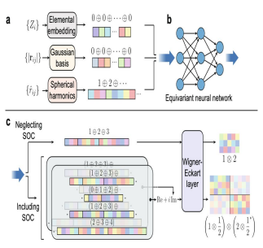
Background
1. The Hamiltonian in density functional theory (DFT) encompasses all electronic structure properties of the material, allowing predictions about the material.
2. Equivariant neural networks are used to address symmetry design issues related to the O3 group.
Benefit
Geometric symmetry is inherent to equivariant neural networks, eliminating the need for additional processing constraints (e.g., data augmentation) on the input data.

Slide 3
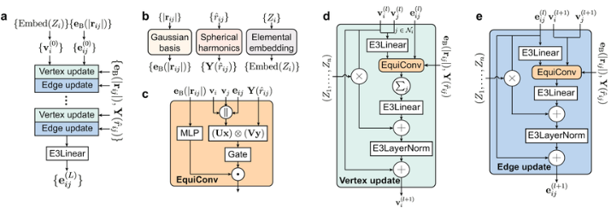
Logic and Current Work
Logic:
Mapping geometric graph structures to higher-order vectors.
Here, the geometric graph structure refers to converting information about the crystal cell structure of different
materials into input, such as element embedding, angular, and radial features.
The higher-order vector we seek is the Hamiltonian, which is a second-order tensor.
The mapping process is done by the model: DeepHe3.

Slide 4
MEERL-H Model Structure
We have developed a new model based on Deephe3, we currently call it: Meerl-H model. In our model there exists two parts, main model and auxiliary model.
Main model:
Based on the DeepHe3 architecture, responsible for predicting the Hamiltonian matrix.
Auxiliary Model:
Also based on DeepHe3, focused on estimating uncertainty of the main model’s predictions.
Uses Evidential Learning to quantify Epistemic and Aleatoric Uncertainty, providing feedback to enhance the reliability of predictions.
Dynamic Weight Adjustment:
Adjusts task weights during training based on uncertainty feedback. Prioritizes optimization of critical matrix elements.

Slide 5
MEERL-H Model Principles
1. Input Material Data:
Geometric structure and basis set information are encoded as high-dimensional geometric features.
2. Hamiltonian Matrix Prediction:
The main model predicts values for all matrix elements, forming a complete Hamiltonian matrix.
3. Reliability Assessment:
The auxiliary model evaluates the uncertainty of predictions, generating quantitative reliability scores.
4. Dynamic Optimization:
Adjusts main model’s optimization direction based on uncertainty feedback.
Allocates more resources to uncertain regions and reduces focus on reliable areas.
5. Final Output:
Outputs an optimized Hamiltonian matrix and quantified uncertainty for reliable results.

Slide 6
Current Work and Future Work
My current work:
Reproduce DeepHe3 on the SACADA dataset.
Future Work:
Verify the potential of equivariant neural networks in robotic optimization problems.
Milestone:
Plan to submit findings to Nature Machine Intelligence.

