Slide 1
Multi-SALP Robots System
Research Project Overview
Last update: 11/24 2024

Slide 2
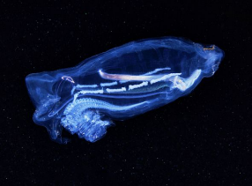
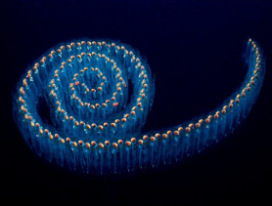
Back Ground
According to Professor Kelly's research at the University of Oregon, salps exist in two forms: individual salps and salp chains. However, in natural environments, salps predominantly exist as salp chains. Their research suggests that as more units join, the salp chain becomes faster and more efficient.
Our goal is to use a salp-inspired robot to verify this biological hypothesis

Slide 3
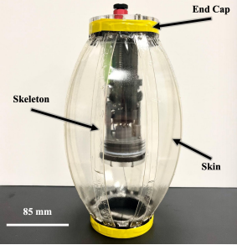
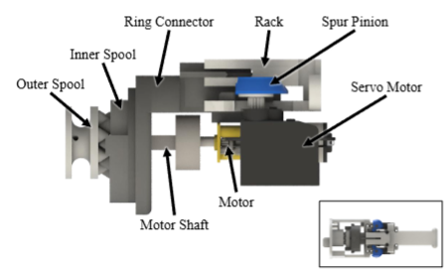
Our robot
Robot Body Design
- Structure: The robot body (Fig. 2 (a)) includes a skeleton, skin, and two end caps.
- Skeleton: Made of eight 240 mm × 15 mm PETG beams (1.27 mm thick), laser-cut and attached to end caps via rotatable hinges.
- Hinges: Allow flexible beam bending, restricted by a 1.59 mm acrylic stop ring (27.6 degree to 90-degree range).
- Resting Shape: Ellipsoidal, with beams slightly bent outward.
- Functionality: The structure naturally expands in volume when compressed in length.

Slide 4
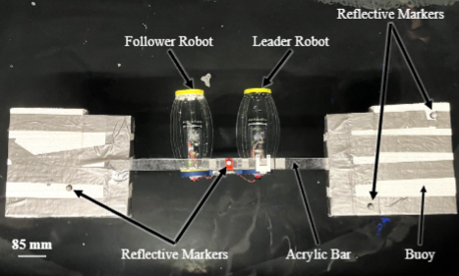
Method
We designed a rigid connecting rod to link two robots together in a salp-inspired manner and simulated the salp linkage mechanism. We tested the speed and efficiency of the two connected robots under different contraction conditions compared to a single robot.

Slide 5
My Contribution
My Contribution:
1. Based on the Origami Robot, the improvement of the design of the propulsion system, design of
the auxiliary swimming system, design of the rigid connection system.
2. Establishment of the communication system.
3. Computer vision and calibration code of GoPro camera.
4. Code construction of the Motion Capture system.
5. Experiment setting up
6. Data processing and analysis
Mile Stone:
Submitted to RoboSoft 2025 conference, more details will be updated after the paper is published.

