Slide 1
Outline
an overview of the project and its objectives,
a discussion of the architectural and timing design
New hardware architecture diagram
experiences and issues in implementation (the difficult parts)
Deciding on algorithms
Fixed point accuracy and precision
FPGA resources
Driver data movement
a summary including lessons learned

Slide 2
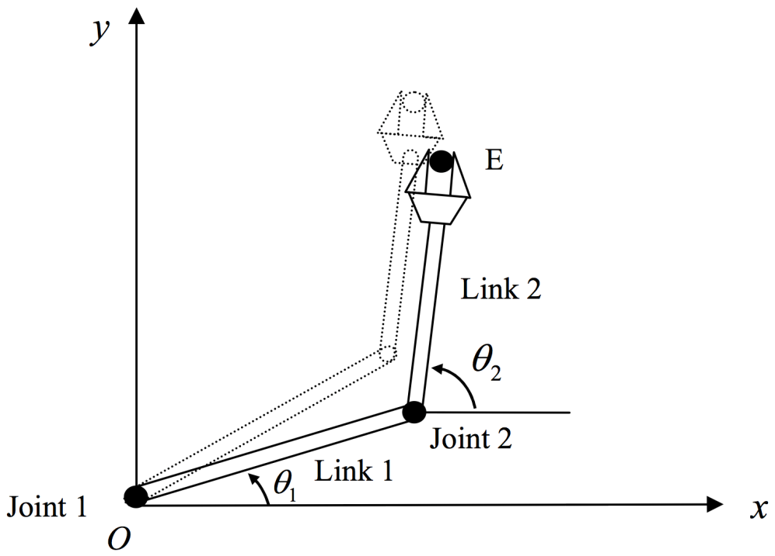
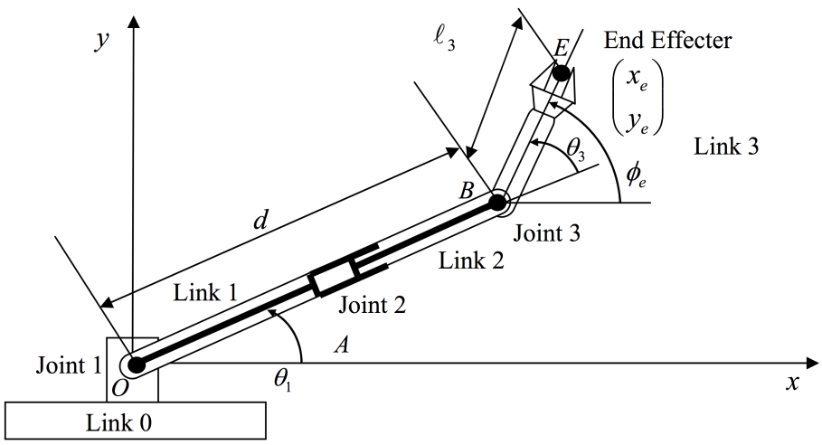
A Core Robot Algorithm: Inverse Kinematics
Setting a robot’s joints so end effector reaches a target
Input: current robot geometry
Output: required joint increments
Computationally intensive problem all limbed robots must solve
Beyond controlling single arms and legs, many larger problems rely on inverse kinematics
redundant manipulators
multiple end effectors
inverse dynamics

Slide 3
A Digital Accelerator for Inverse Kinematics
Inverse kinematics not well suited for normal digital architectures
Entirely floating point array, matrix operations
40% of cycles in inverting matrices
15% of cycles in sine, cosine operations
We solve IK via damped least squares
Dedicated sine, cosine function generators
Parallel, fixed-point functional units
Solves IK problem in 100μs: compare against 10ms for general algorithm on CPU

Slide 4
Architecture and Timing Design
Architectural Choices
Pipelining sine/cosine and array multiply
Parallelized matrix multiply and matrix inversion
Fixed point representations throughout system
Timing Choices
Single array of multipliers shared amongst modules
Aggregate individual enable and done signals into global state machine

Slide 5
Experiences and Issues
Deciding on the algorithm to use
Determining what implementation would fit on
the board
Convincing ourselves the algorithm works
Extensively tested the core hardware, but not the
top-level interface (until yesterday)

Slide 6
Lessons Learned
Test the whole stack earlier
Plan before trying to implement
Use timing diagrams and area estimates before touching hardware
Leave no ambiguity in the design

