Slide 1
Outline
an overview of the project and its objectives,
a discussion of the architectural and timing design
New hardware architecture diagram
experiences and issues in implementation (the difficult parts)
Deciding on algorithms
Fixed point accuracy and precision
FPGA resources
Driver data movement
a summary including lessons learned

Slide 2
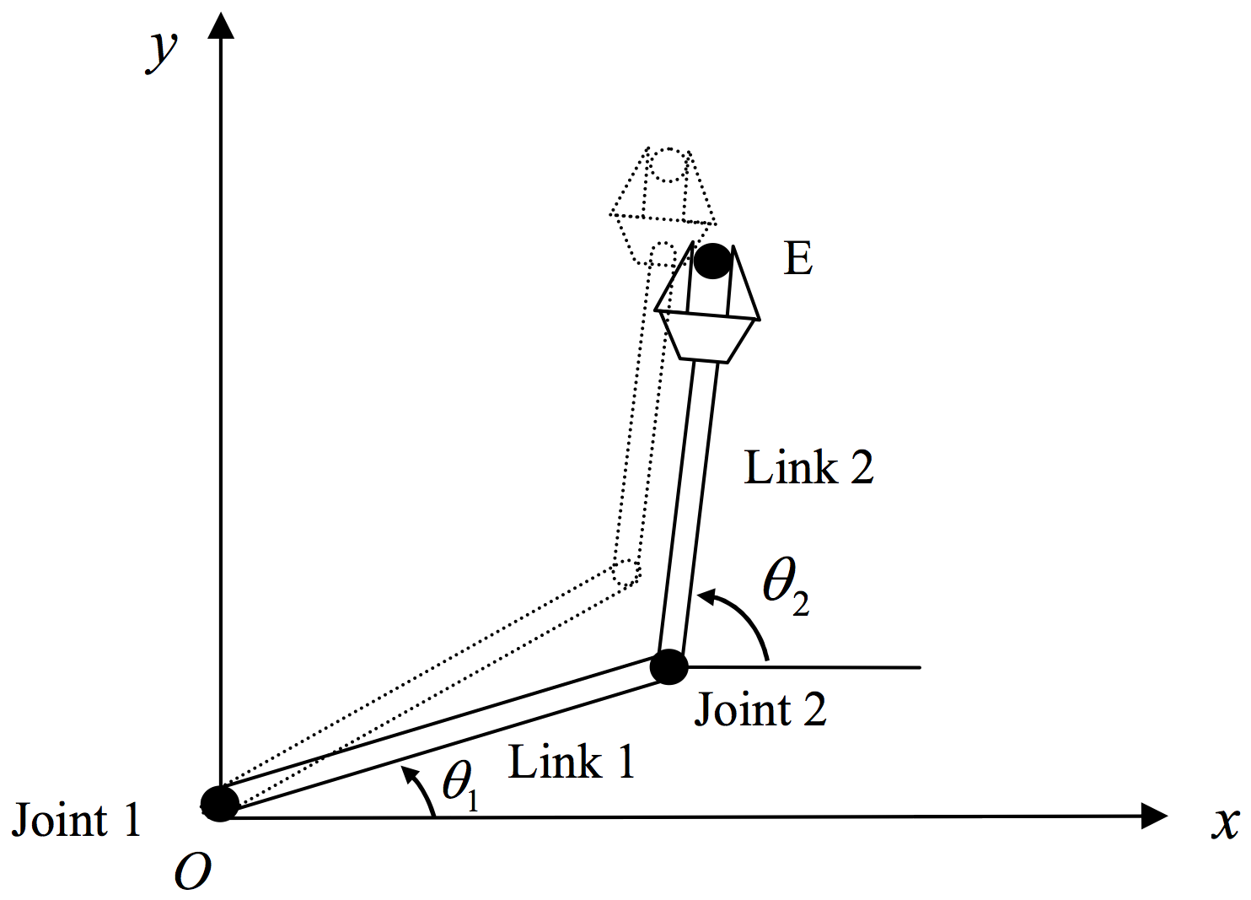
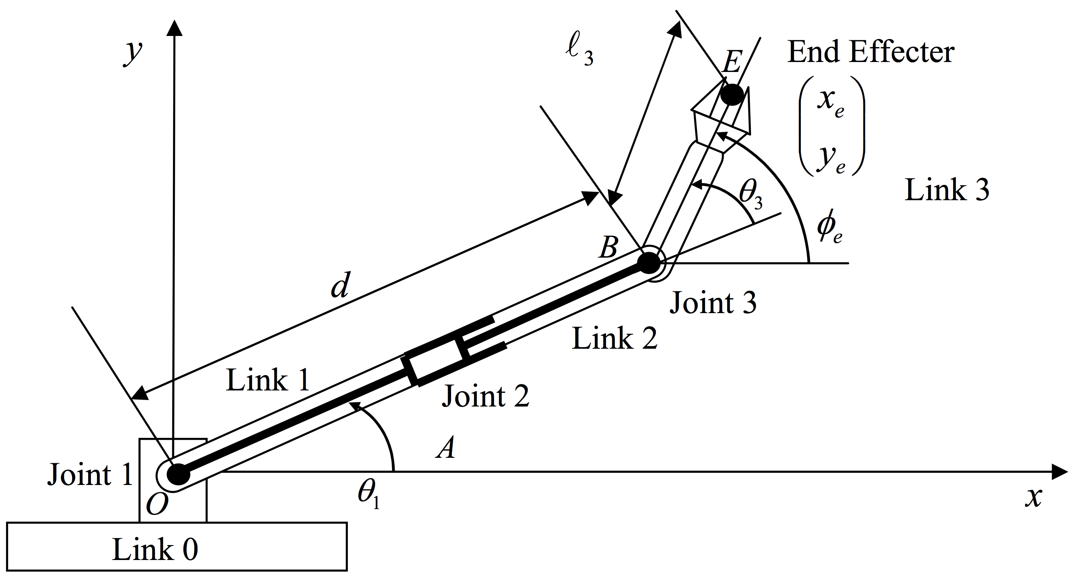
A Core Robot Algorithm: Inverse Kinematics
How to control a robot’s joints to achieve desired pose
Input: current robot geometry
Output: required joint increments
Computationally intensive problem all limbed robots must solve
Beyond controlling single arms and legs, many larger problems rely on inverse kinematics
redundant manipulators
multiple end effectors
inverse dynamics

Slide 3
A Digital Accelerator for Inverse Kinematics
Inverse kinematics not well suited for normal digital architectures
Entirely floating point array, matrix operations
40% of cycles in inverting matrices
15% of cycles in sine, cosine operations
We’ve created an accelerator to solve IK via damped least squares
Dedicated sine, cosine function generators
Parallel, fixed-point functional units
Solves IK problem in 4μs: compare against 10ms for general algorithm on CPU

Slide 4
Resource Minimization
Want all of computations done on FPGA
Problems of size vs. accuracy
Floating point arithmetic is expensive and instead used fixed point
Bit width of fixed point numbers greatly influenced the accuracy
Own implementation of sin and cos functions
Wanted design to be configurable
Still can configure for different robots
No longer supports translational joints
Sharing resources
Timing diagram showed what operations were done when allowing us to find where resources can be shared
Instead of each component having its own multipliers had a shared multiplier for whole design

Slide 5
Fixed Point
Varying number of bits
Always 16 bits for fraction part
1/2^16 smallest increment between numbers
Average 16 signed bits for integer part
Fixed point numbers use integer arithmetic
Smaller design than floating point megafunctions
Loss of precision during certain operations
Multiplications result in a number twice as large as original numbers being multiplied. Need to truncate
Division results in number half as large unless shifted before which can save precision
Square root results in number half as large and cannot be fixed by shifting
Software converts from floating point to fixed point so FGPA only sees fixed point

Slide 6
Algorithm Heuristics
Multiple steps had possible algorithms
Inverse kinetic algorithm
Matrix inverse algorithm
Sin and cos algorithms
Best algorithms for software might not be best for hardware
Can it be parallized?
How many operations are needed?
How big will the implementation be?
Accurate in fixed point?
Need to be able to understand the algorithm to implement it
Algorithms were found in research papers and described abstractly
Need to test thoroughly to ensure algorithm was implemented correctly

Slide 7
Lianne's Lessons Learned
Plan before trying to implement
Need to use timing diagram to understand which steps have to happen in what order to maximize resource sharing and parallelism

