Slide 1

Milestone 1
By:
Gideon Yip
Oh Qi Qi
Isaac Ibrahim

Slide 2

First Visualisation

Slide 3
First Visualisation: Background
The foreign interest bump chart is an analysis tool based on the Singapore’s Property Market trends.
The objective of the analysis is to share insights on some of the key driving factors of the Singapore’s Property Market such as the number of foreign buyers.
It presents the ranking of foreign buyers who bought Singapore non-landed private homes from 2017 to 2020.

Slide 4
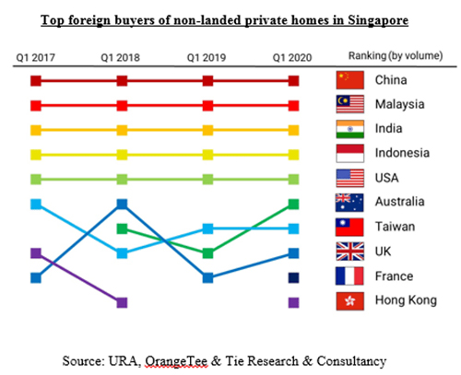
Bump Chart: Breakdown
The Bump Chart is a time-series visualization technique for exploring changes in quantitative data.
Changes in measured data such as ranking, position, and performance are visualised, allowing meaningful analysis of how each categorical variable performs against the same measure.
Colours are used as an identity channel for each item (Country)
A change in rank is indicated when a line overlaps another line.

Slide 5
Bump Chart: Breakdown
Year, Rank
Ordinal
Quantitative
Country
Nominal/Categorical
Qualitative

Slide 6
Bump Chart: Breakdown
X axis
Represents the timeline of the data
Y axis
Represents the rank of the various countries with the top being 1 and the bottom being 10
Different countries use different colours to represent their place on the chart

Slide 7
Problems - Expressiveness
The chart does not include a data scale to easily identify the rank of each country.
When the rank of a country drops below 10, the entire line simply disappears
When Hong Kong dropped below 10, no other country replaced it. Who was the 10th country in 2019?

Slide 8
Problems - Expressiveness
Legend on the right side of the chart does not match the colour of the lines
By using the flags of countries as the legend, it does not reflect the colour of the actual line
This makes is hard for users to look at the bottom 5 lines and know what country it belongs to (Discriminability)

Slide 9
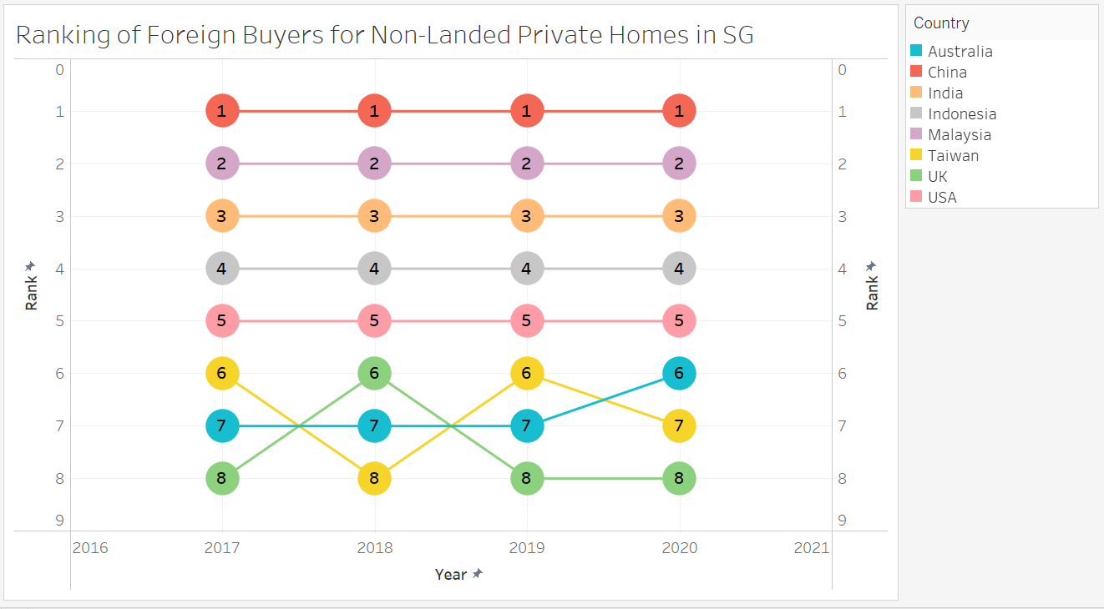
Proposed Graph: Improved Bump Chart

Slide 10

Second Visualisation

Slide 11
Second Visualisation: Background
MOAT Analysis is a decision-making tool to compare Condo projects based on objective factors.
The objective of the analysis is to find out how likely a property is to retain its value and appreciate over time.
The 10 factors identified contribute to the defenses of property value over time.
The scoring system ranks each component on its own, and then aggregates them for an overall score for the property.
The higher the MOAT score, the more likely the value is defensible in the future.

Slide 12
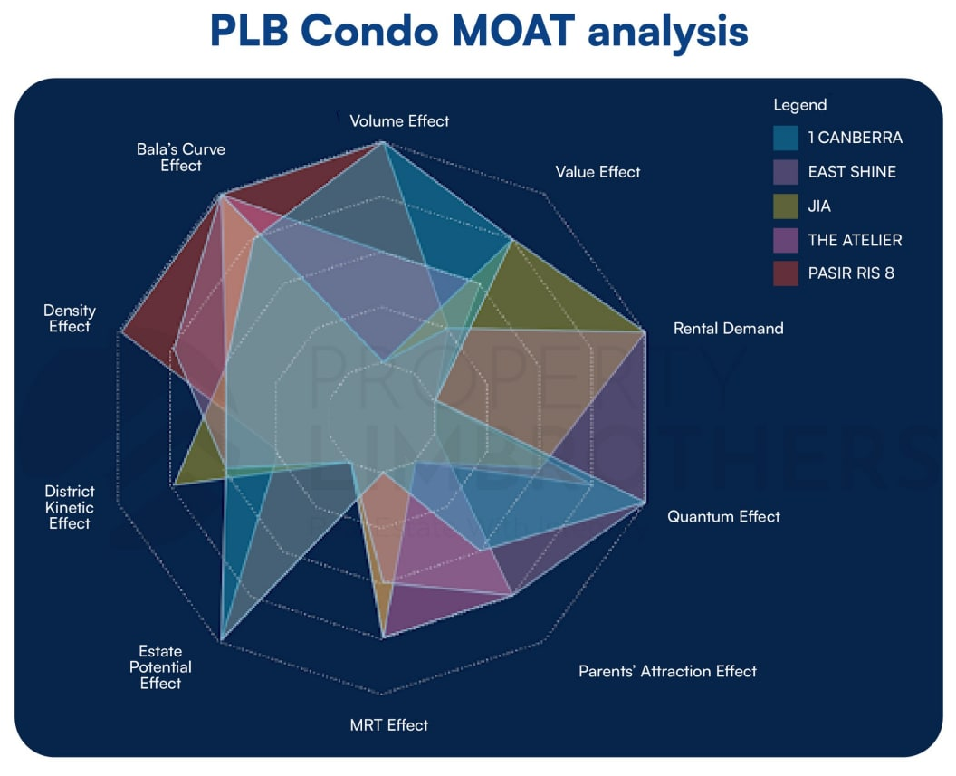
Radar Graph: Breakdown
The radar graph is a data visualisation technique that uses a two-dimensional chart to express categorical data (condos) and their attributes values (10 factors scores)
Colours are used as an identity channel for each item (condos) and is reflected in the legend
Plotting of the quantitative data (10 factors scores) along each axis and then connecting the resulting points will then form the area shape
Each area overlay on top of another, allowing for a centralised presentation for comparisons

Slide 13
Radar Graph : Breakdown
Condo Units
Nominal/Categorical
Qualitative
10 Factors Scores ( Scores)
Ratio
Quantitative

Slide 14
Radar Graph : Breakdown
Angular (X) axis
Represents the various categories of the data
Radial (Y) axis
Represents the value away from the center of the radar chart.
The further the line is from the center of the chart, the larger value it has

Slide 15
Problems – Wrong Idiom
The chart is trying to show comparisons between factors and condos has a higher MOAT score.
The designer picked a radar graph to present the data which is not really the best choice to represent the comparison.
A better design would be picking a visualization better suited for showing comparison between the condos

Slide 16
Problems - Expressiveness
Lacking data scales to provide meaningful insights.
The radar chart oversimplifies values and lacks important data scales to define each property’s measuring scale and the values of the effects.

Slide 17
Problems - Expressiveness
The separability between multivariate data is not distinct
As the radar graph overlays quantitative variables, colours which was used to identify each condo can create a sense of crowdedness and confusion
As the radar graph is static, it lacks interactions hence resulting in limited saliency or discriminability

Slide 18
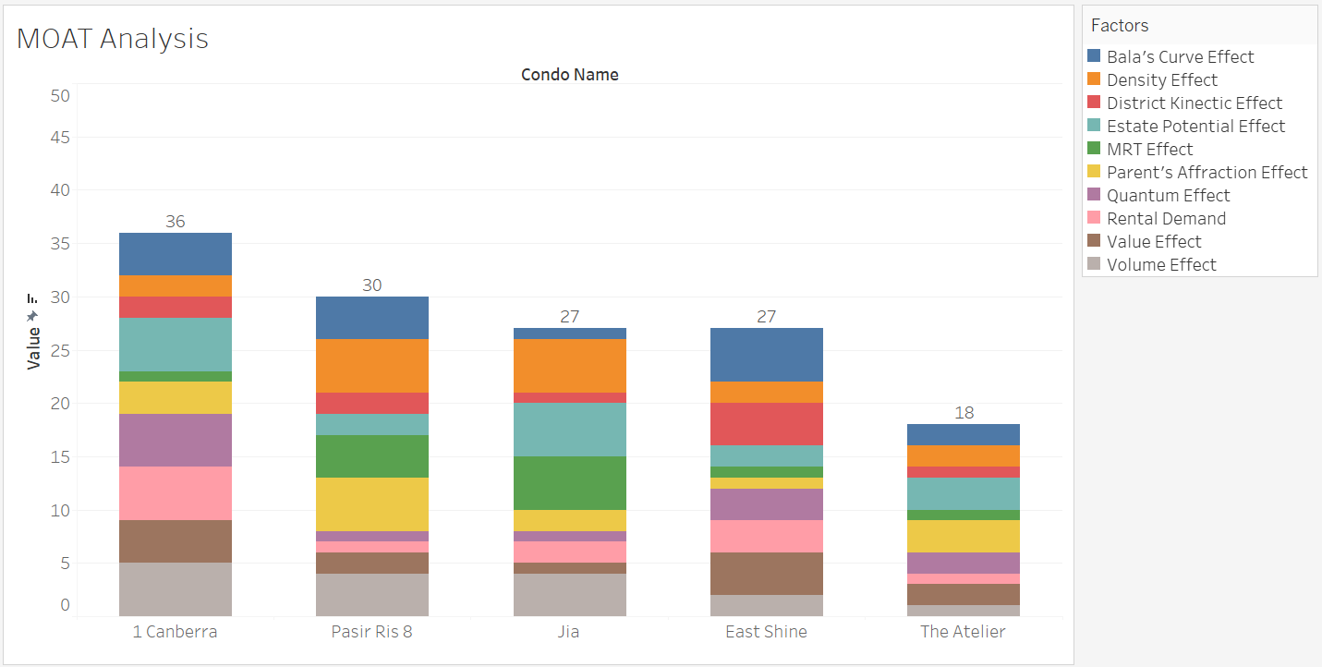
Proposed Graph: Stacked Bar Chart

Slide 19

Q&A

