Slide 1

Automatic Melody Generator
- Musier -
2018.4.25 Pre-final Presentation
Team#:
Zhang Ruoqing 115010096
Li Kengjie 115010177
Ye Shuqian 115010269
Mo Fan 115010204
Wang Junce 115010231

Slide 2

Pale words.
Let’s enjoy the music demo.
Outline
Goal & SE Cycle Life
01
Individual Contribution
02
Demonstration
03
Problem&Solutions
04
Next 2 Weeks Plan
05

Slide 3
01
Goal &
SE Cycle Life

Slide 4
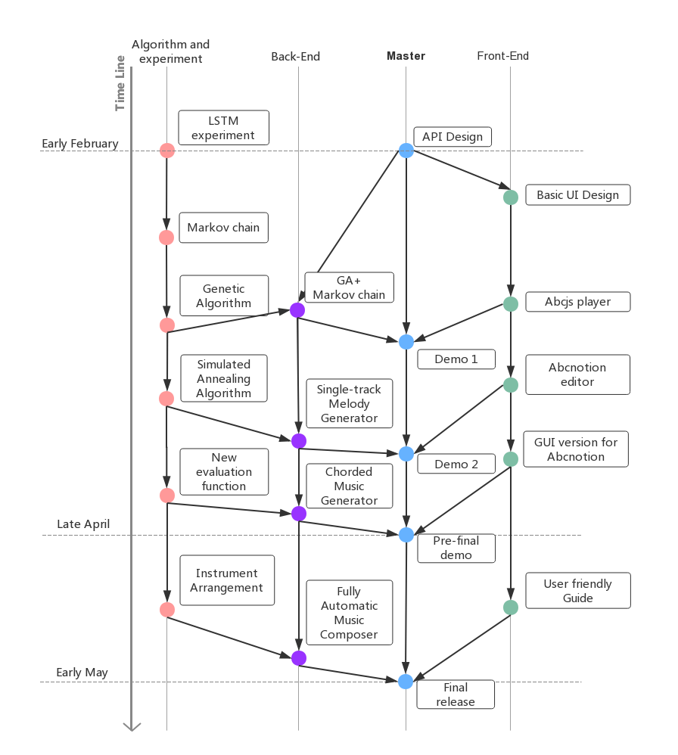
01. Goal & SE Cycle Life
Goal:
Create a fully automatic melody generator on website platform.
Put focus on how to improve the user experience.
Parallel Timeline:
Algorithm and experiment
Backend development
Master program
Frontend development

Slide 5
02
Individual
Contribution

Slide 6
02. Individual Contribution
Li Kengjie:
Main Front-end Development
Documentation
Mo Fan:
Main Back-end Development
Algorithm Design
Wang Junce:
Back-end Development
Api Design
Ye Shuqian:
Back-end Development
Product Manager
Documentation
Zhang Ruoqing:
Front-end Design & Development
Documentation

Slide 7
03
Front-end
Demostration

Slide 8
04
Problems &
Solutions

Slide 9
04. Problems & Solutions
01
P: Different Music Representation Standard
S: Use abc notion standard as interface.
02
P: For the property of genetic algorithm model, last bar ends in established note is not guaranteed.
S: A Pre-defined Gene with Established Ending
03
P: from Single Track to Multiple Tracks
S: A pre-defined dictionary is referenced to generate chord.
04
P: Blocking wait in GUI
S: Asynchronous requests

Slide 10
05
Next 2 Weeks
Plan

Slide 11
05. Next 2 Weeks Plan
Chord & Arrangement
Change the chord generator to a dynamic programming algorithm. Let the program compose not only melody but also instrument arrangement. A novel algorithm must be applied on it. If possible, add velocity performance to output a wav file.
User Guide & Art Style Redesign
Creat a user-friendly guide for abcnotion. Either the document page or the interactive guide is accepted.
Redesign the art style and adjust the layout. The version demonstrated is not recommended.

Slide 12
Q & A
Thanks all for listening!

